Slide 1
An animated tectonic reconstruction of southwestern North America since 36 Ma
McQuarrie and Wernicke, 2006
Goal: present tectonic reconstructions and animations of deformation across the North America-Pacific plate boundary since 36 Ma
Methods:
Synthesized kinematic data (amount, timing, and direction) along three main transects though the northern, central, and southern parts of the Basin and Range province
Combined transects and plate boundary constraints from the San Andreas fault and other areas west of the Basin and Range
Extension and strike-slip deformation was sequentially restored from 0-18 Ma and from 18-36 Ma using an ArcGIS script.

Slide 2
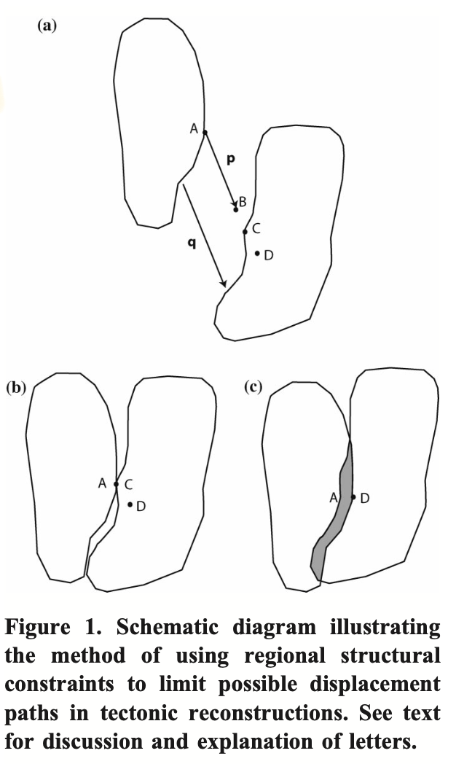
Methods and Context
Used offsets of structure markers (fig. 1) and a strain-compatible kinematic model.
Constructed an animation at 2 m.y. (0–18 Ma) and 6 m.y. (18–36 Ma) intervals.
Unstrained blocks are the large labeled areas on Fig. 1
Small labels are strained areas

Slide 3
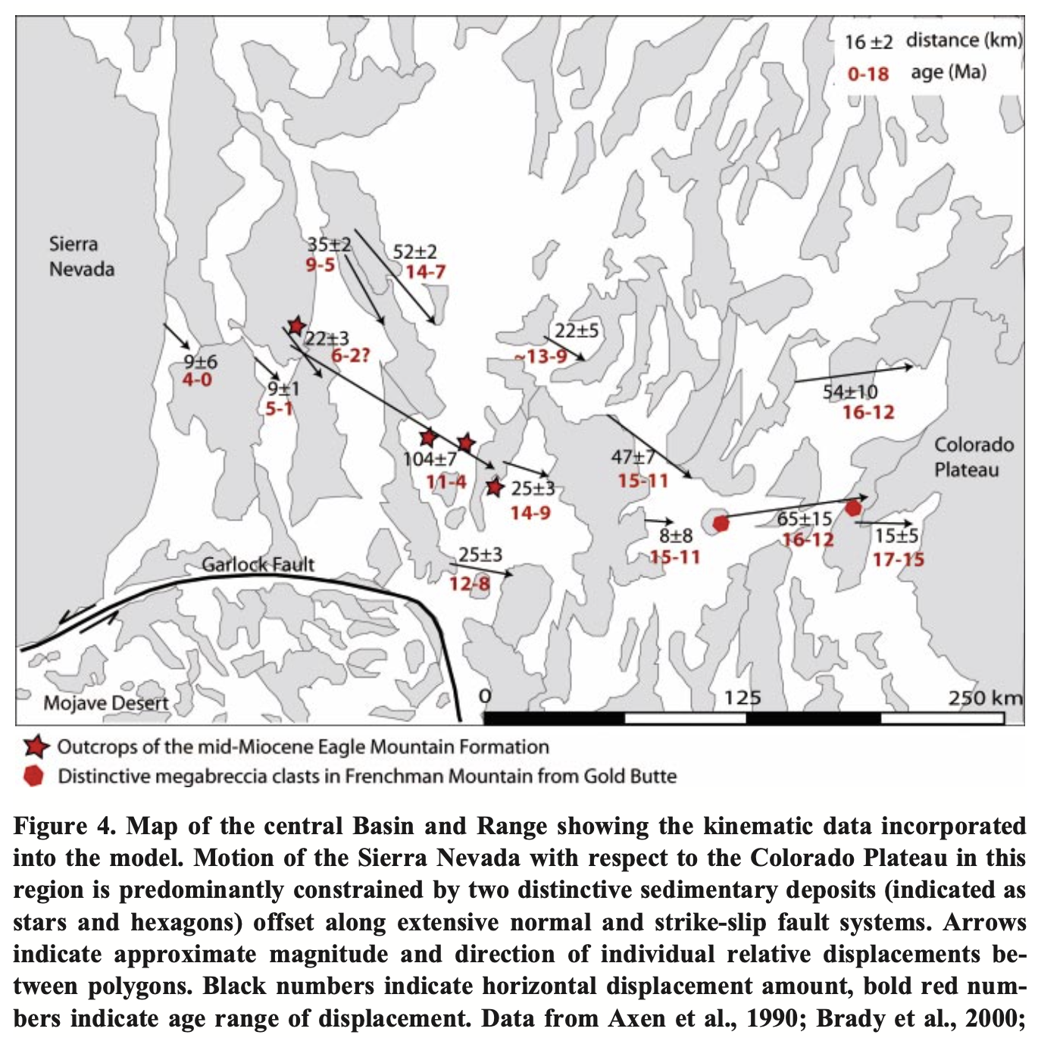
Central Basin and Range
Modeled motion of the Sierra Nevada with respect to the Colorado Plateau
Used two distinct sedimentary deposits along normal and strike-slip systems
Sum of all displacements is 235 km +/- 20 km

Slide 4
Animation of Western North America
combines 13 paleogeographic maps
polygon shape represents the modern bedrock/alluvium contact, fault-bounded crustal blocks or the physiographic boundaries of large, intact crustal blocks.
Yellow – areas of no data
Orange (ranges) – inactive faulting
Red – Orange ranges turn red during times of active faulting
White space
increases – extension
decreases - compression
Thick blue line – location of the eastern edge of the Pacific Plate

Slide 6
Key Ideas
235 km +/- 20 km of extension in the northern and central Basin and Range
boundary-parallel shear (in contrast to earlier extension) jumped into the continent at ca. 10–12 Ma and migrated westward with time.
The magnitude of slip on the eastern California shear zone appears to be 100 km +/- 10 km

