Slide 1
Thermal evolution of the Sierra Nevada batholith, California, and implications for strain localization
1
Elisabeth S. Nadin, Jason Saleeby, and Martin Wong
Presented by Alex Holmwood

Slide 2
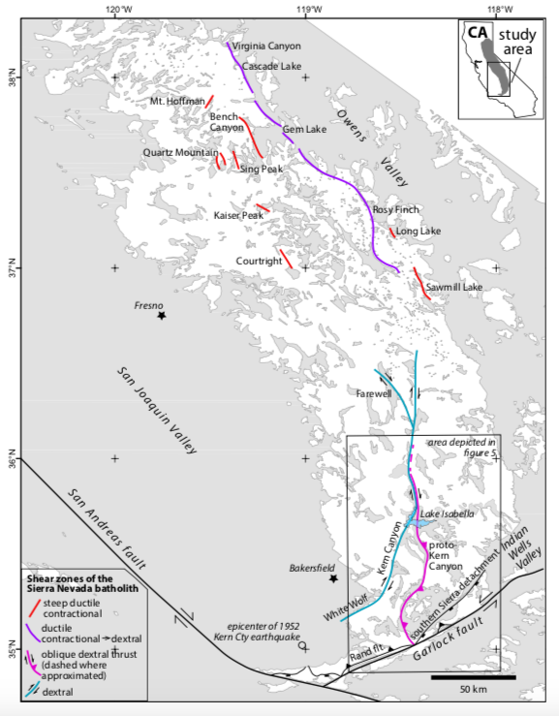
2
Continental arcs preserve complex deformation histories
Central and southern Sierra Nevada:
Cretaceous
Intra-arc deformation in 14 ductile and ductile-brittle shear zones
Southernmost part of batholith has not been studied in enough detail

Slide 3
3
This study:
Seek to constrain timing and deformation in southern part of batholith
Compare conditions to those known for shear zones in central part of batholith

Slide 4
4
Methods:
Compiling ⁴⁰Ar/³⁹Ar and U/Pb ages
Collected new radiometric ages
Plagioclase-hornblende, two-plagioclase, and Ti-in-quartz thermometry

Slide 5
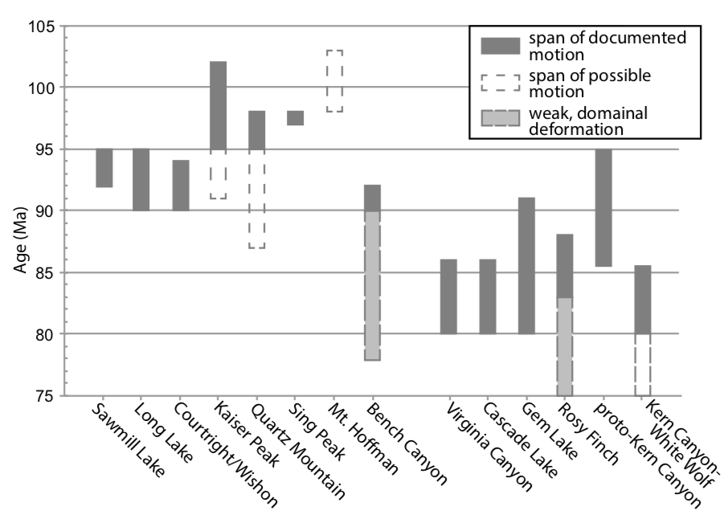
5

Slide 6
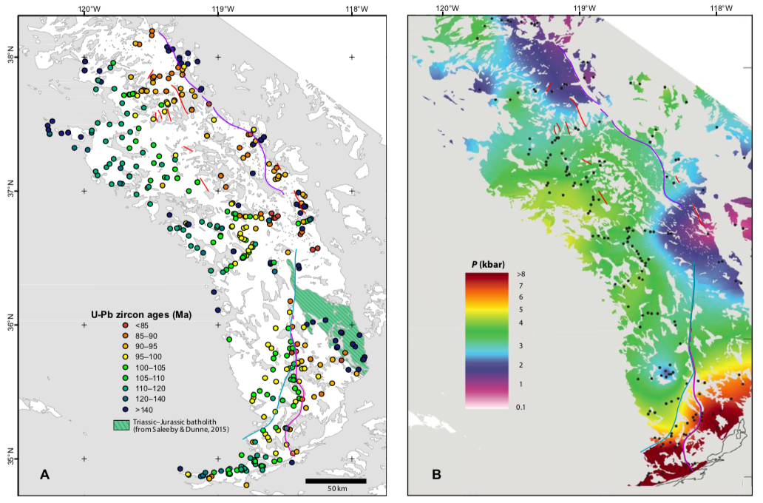
6
U-Pb

Slide 7
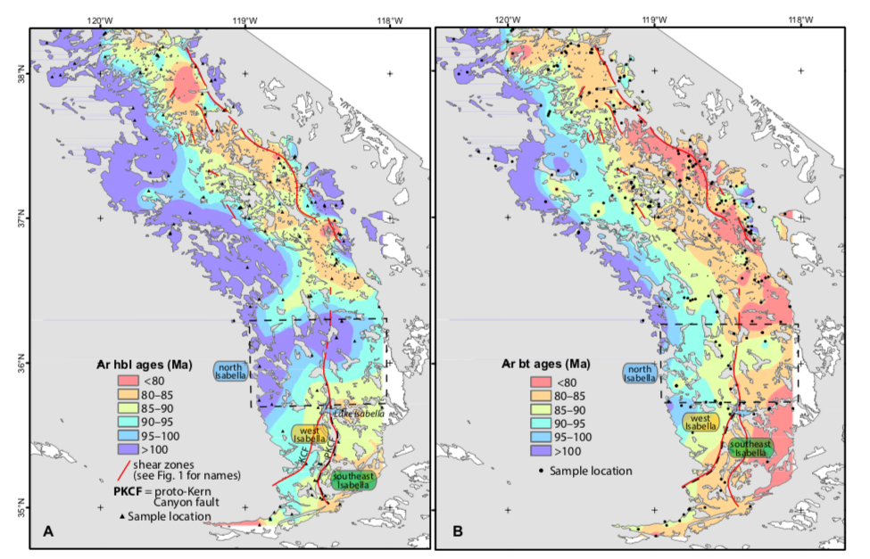
7
K-Ar &
Ar-Ar
K-Ar &
Ar-Ar

Slide 8
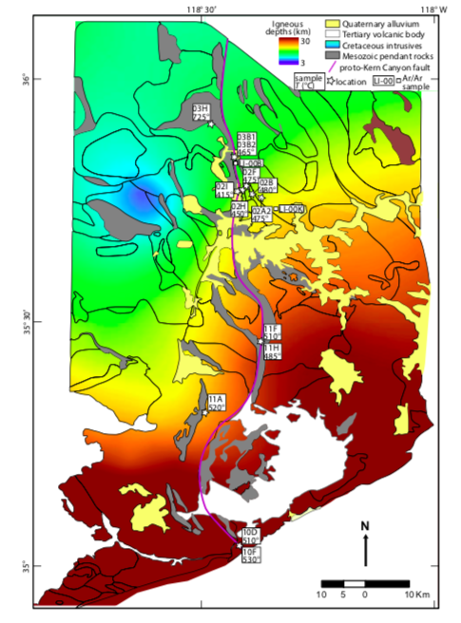
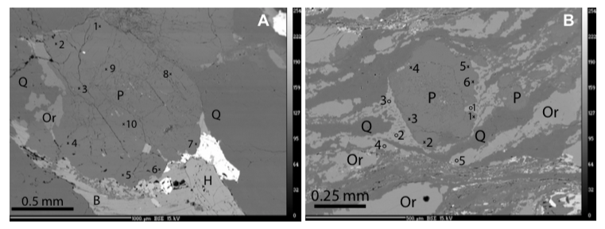
8
Thermometry
Central proto-Kern Canyon Fault:
Pluton crystallization: ~725ºC
Deformation initiation: 450–600ºC
Shearing in ductile regime ceased ~450ºC (TitaniQ)
Southern proto-Kern Canyon fault:
Higher TitaniQ deformation temperatures:
485–530ºC
Ductile deformation ended earlier in southern PKC; “locking in” record of higher temp deformation

Slide 9
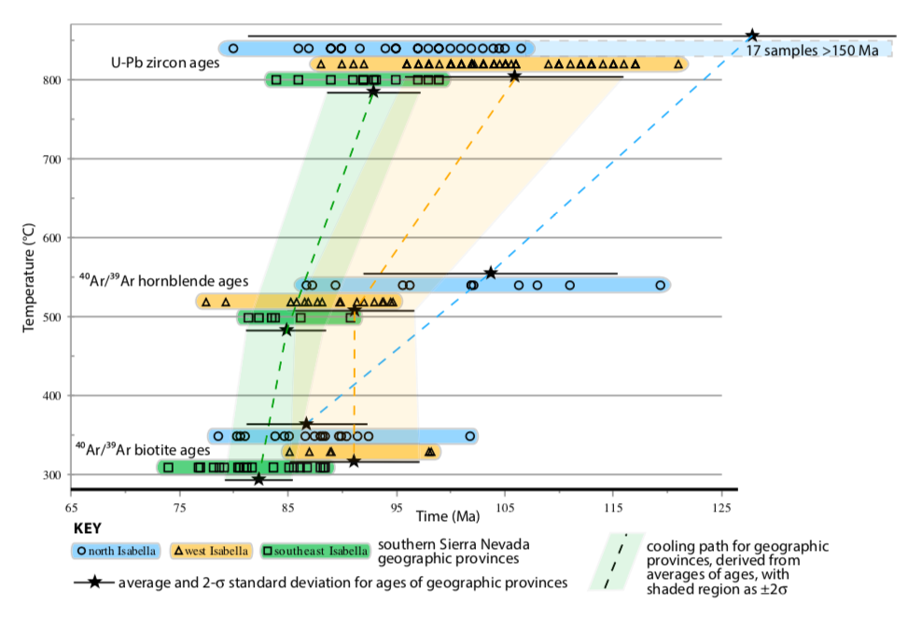
9
Cooling history of southern Sierra Nevada Batholith

Slide 10
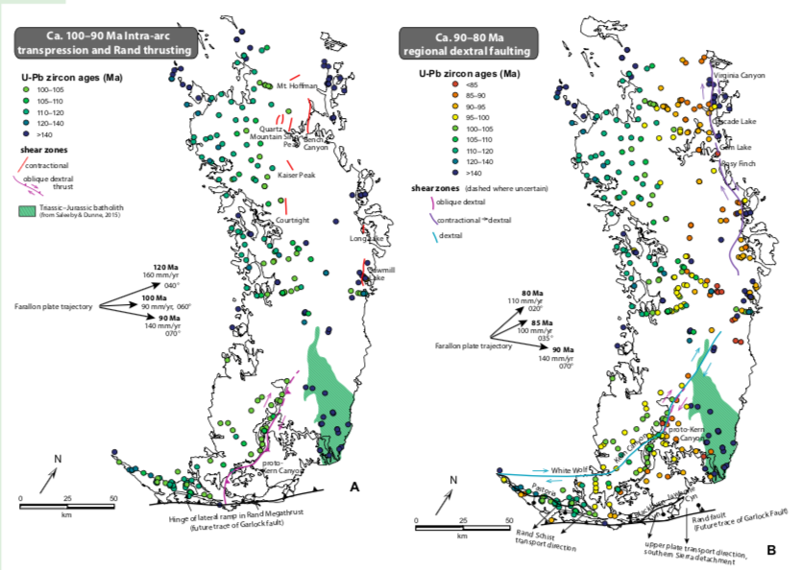
10

Slide 11
11
Sharp thermal gradient between southern and central SNB
Prevented southward migration of Sierra Crest shear zone
Proto-Kern Canyon Fault (PKC): due to local effects of oceanic plateau subduction
PKC: whole-crust penetrating lateral ramp
Kern Canyon-White Wolf fault system: large-magnitude extension

