Slide 1
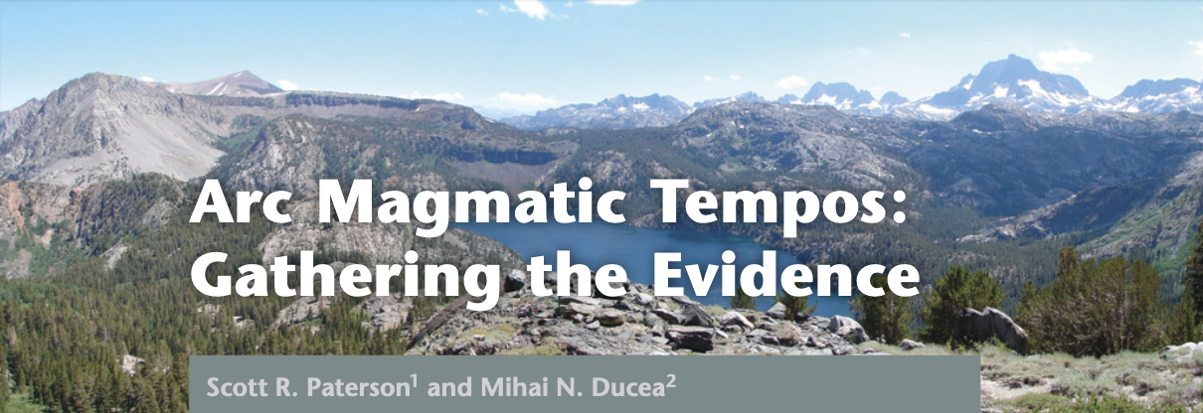
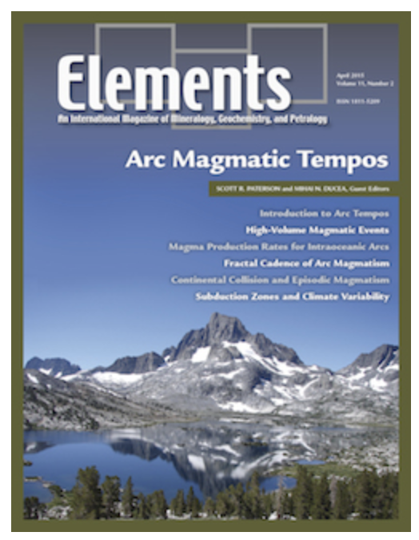
Paterson, S. R. and M. N. Ducea ,2015, Arc Magmatic Tempos: Gathering the Evidence, ELEMENTS, Vol. 11,pp. 91–98

Slide 2
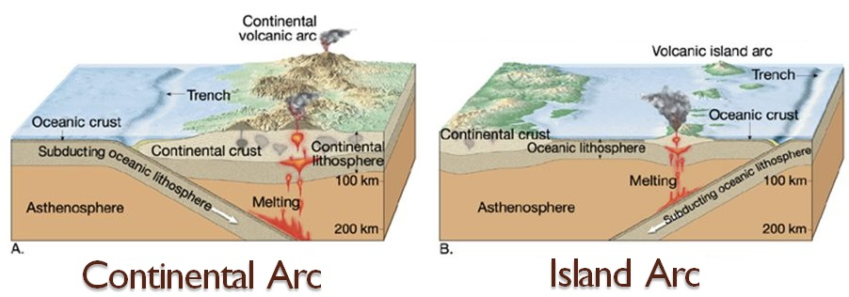
Introduction
Goal: explore the characteristics, potential causes, and implications of episodic magmatism in arcs
Development of Magmatic Arcs are episodic
First documented through a large regional geochronologic database
Now through increased dates using U-Pb zircon dating
Episodic magmatism may occur from external forcing
Plate reconfigurations, changes in mantle flow
Or, from internal cyclic processes
Feedback from tectonic or magmatic processes

Slide 3
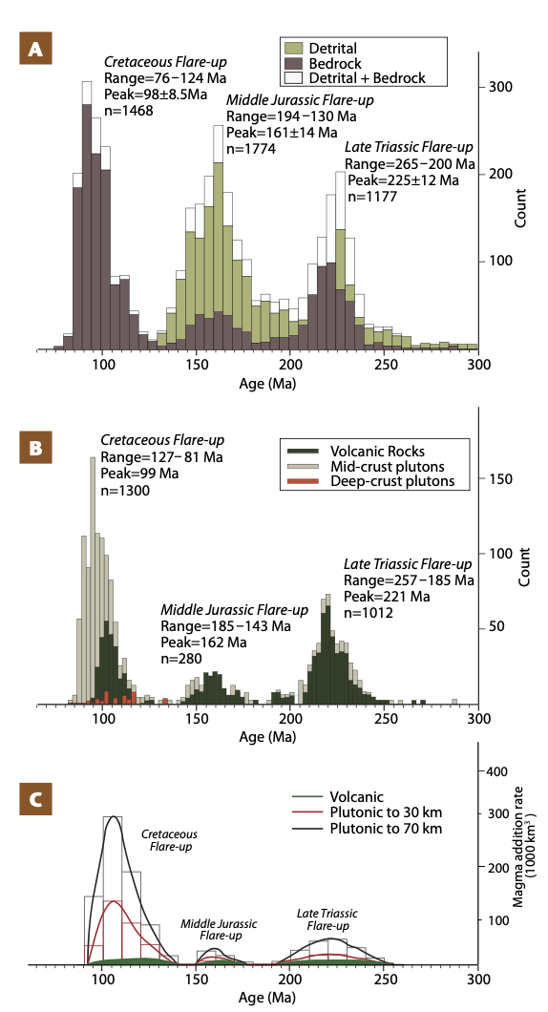
MAR(s): Magma addition rate(s)
Periods of MAR flare-ups and lulls
Timing comes in wave-like patterns
Examine the temporal spacing of these patterns
Detrital zircons from erosion of magmatic arcs give information about timing of high and low MAR
U-Pb dating, 400+ crystal ages
Compared to continental plutonic ages
Application to the central Sierra Nevada arc:
Flare-ups during the Cretaceous
Larger plutonic footprints indicating 100-1000 times more magma

Slide 4
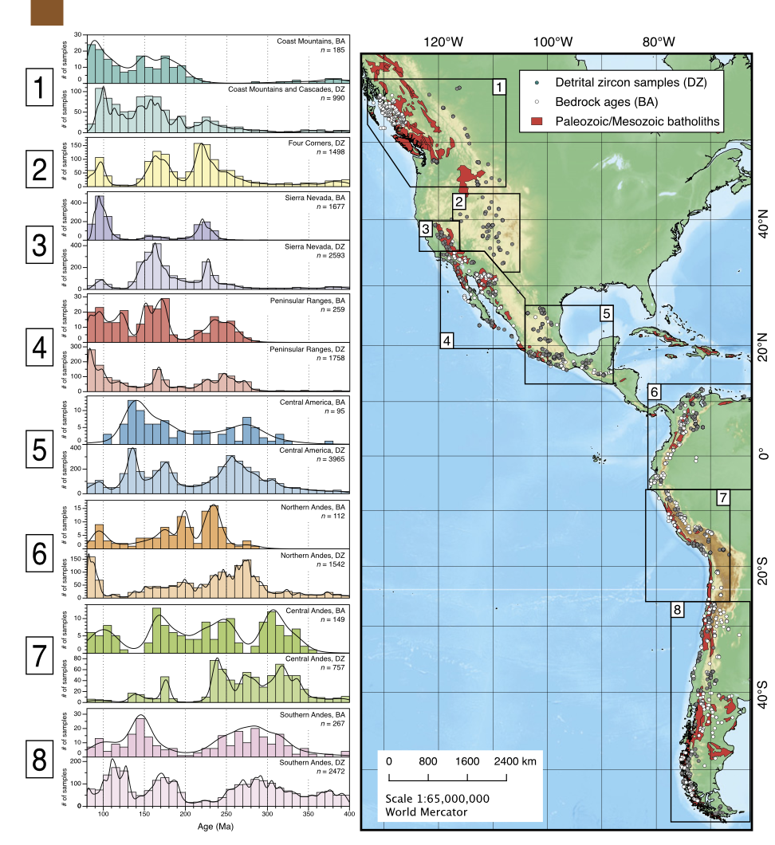
To determine MARs, temporal data sets must:
Compare to geologic maps of igneous rocks
Apply retrodeformation
Determine predeformation area
Estimate vertical thickness and volumes of units
Calculate value of volume of magma added per time period
Most arcs reflect gradual changes in MAR, chemistry, and tectonism

Slide 5
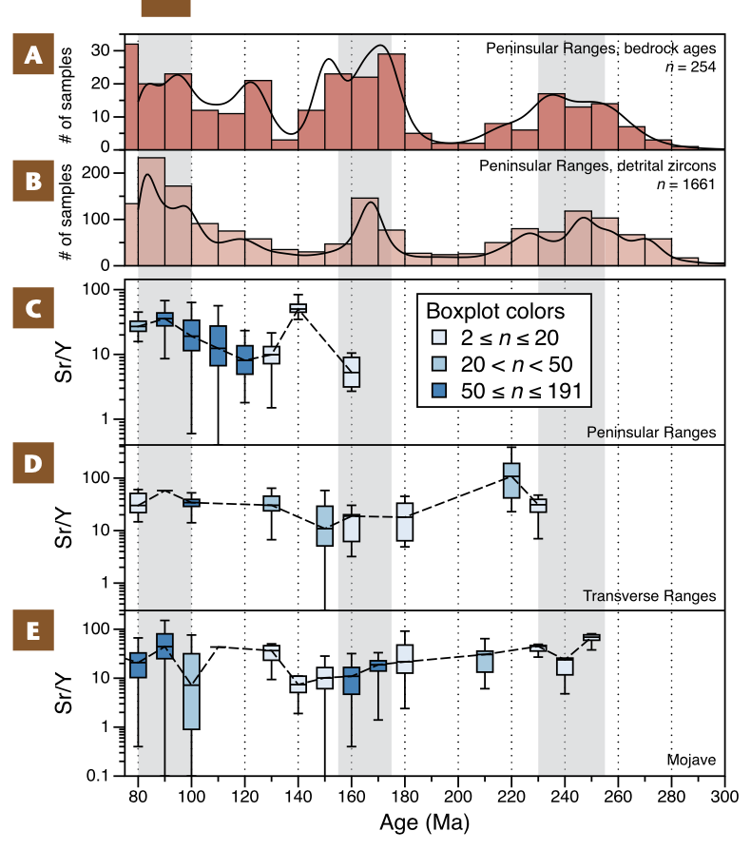
MARs and Chemistry
Isotopes and distinct trace element chemistry change with large MARs flare ups
High Sr/Y and La/Yb ratios
Events took place in thicker crust
MAR events begin with the spreading of radiogenic isotope ratios
Greater source coming from the upper plate’s lithosphere
Changes in chemical composition are also temporal
Peninsular Ranges, Southern California

Slide 6
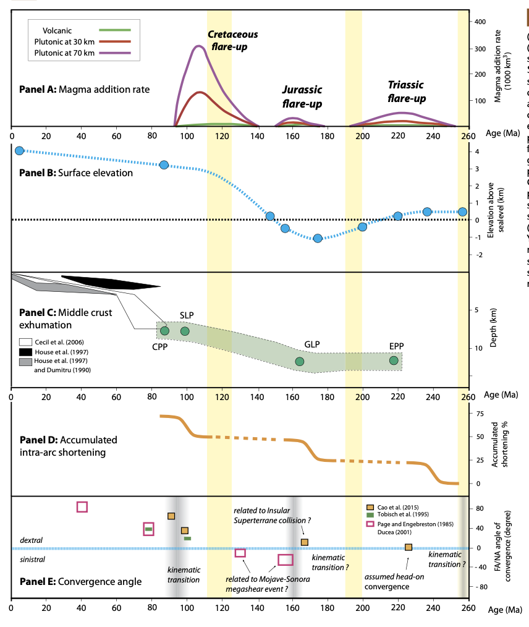
Models for Arc Tempos
Further explore mantle-lithosphere interactions
Want to find what else drives episodic magmatism in arcs
Ducea and Barton (2007) and DeCelles et al. (2009, 2015)
Linked tectonic processes, sedimentary erosion, and magmatic processes
All models suggest any change in configuration can result in increased melting and possibly a flare-up

Slide 7
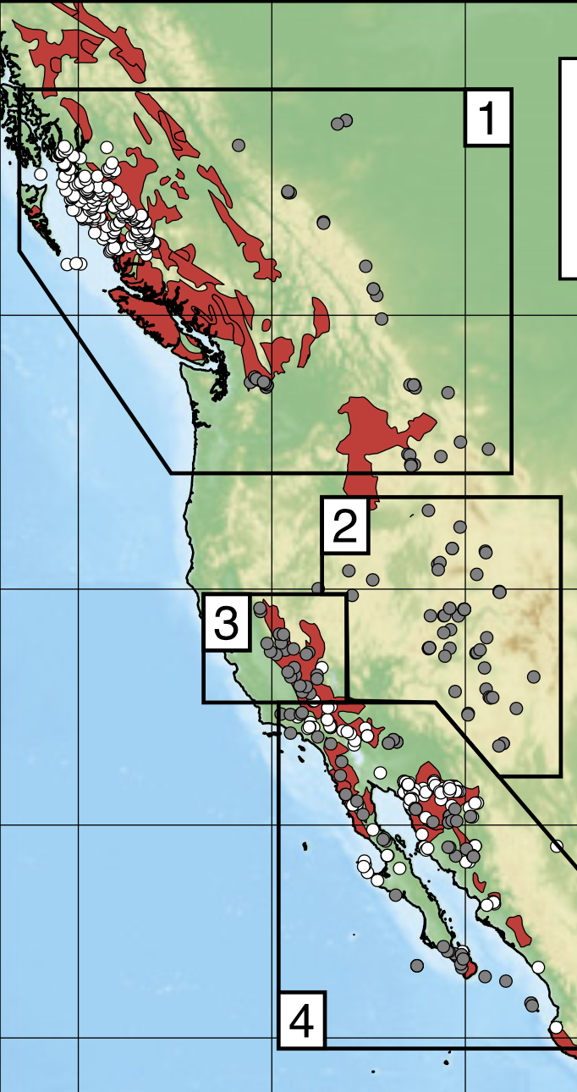
Summary
Magmatic arcs are episodic
MAR data sets are used to explore the temporal histories of arcs
Require large geochronologic data sets to determine
MAR episodes are driven by external forcing or internal cyclic processes
We are still unsure which
MAR processes for the Sierra Nevada arc show 100-1000x more magma is added during a flare up

