Slide 1
Space-time patterns and tectonic controls of Tertiary extension and magmatism in the Great Basin of western United States
Gary J. Axen, Wanda J. Taylor, and John M. Bartley, 1993
Focus: Relationship between the initiation of extension and major crustal magmatism
Main points:
Existence of two late Paleogene extensional belts
Calderas prefer to form in previously extended crust
Effusive volcanism is favored in unextended or actively extending areas
Methods:
review of available geologic data
good exposure and well-understood miogeoclinal stratigraphy
regionally extensive Tertiary ash flow tuffs

Slide 2
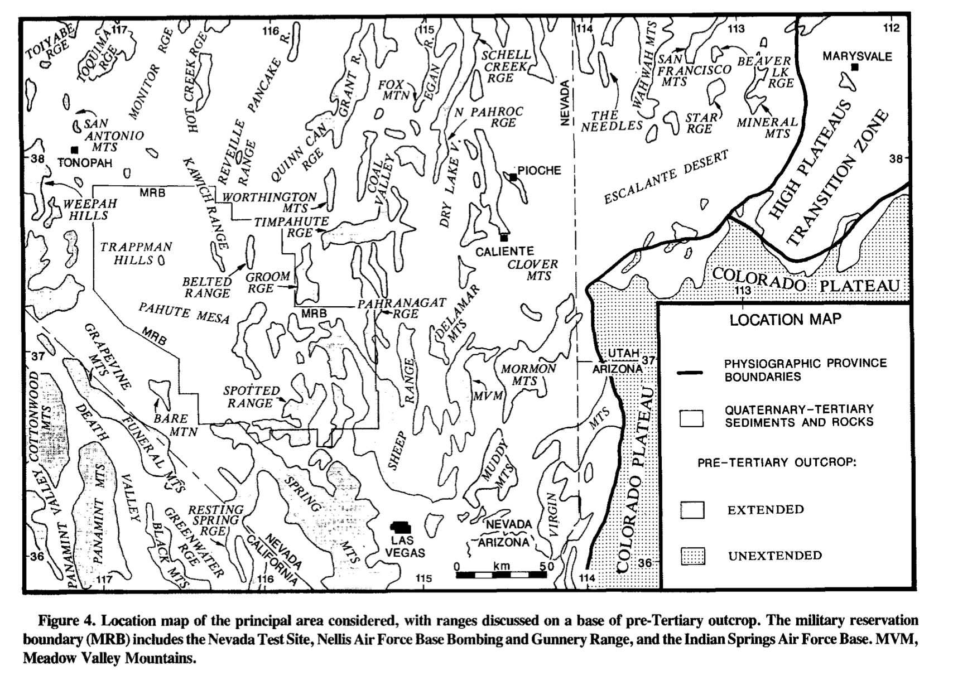
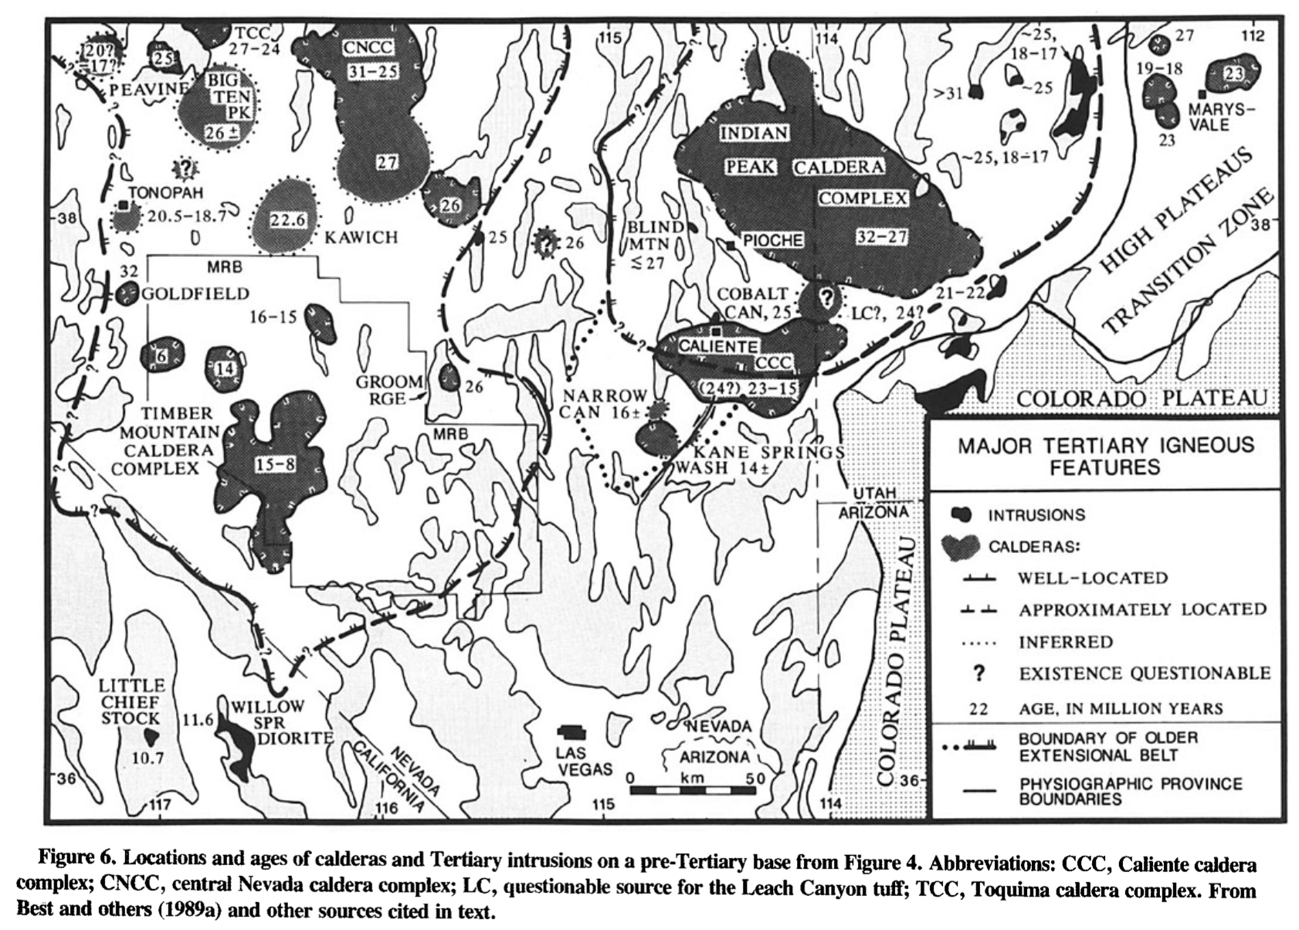
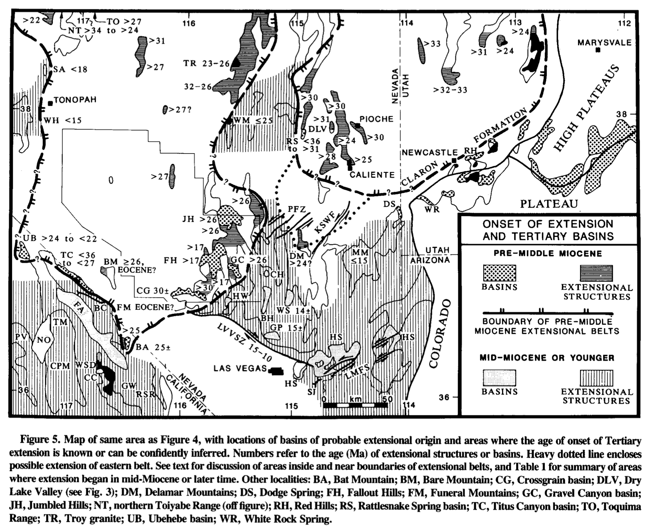

Slide 3
Extension and Magmatism
Calderas in the southern Great Basin formed within previously extended belts
The Caliente Caldera Complex formed along the boundary between unextended crust to the south and extended crust to the north

Slide 4
Discussion
age of extension vs location of metamorphic core complexes
solid lines – well established ages, dashed lines – permissible ages
shaded areas - extension episodes
solid circles – locations of metamorphic core complexes, open circles – highly extended areas

Slide 5
Key Points
widespread pre-middle Miocene extension defines two north trending extensional belts
Extension began around 30-32 Ma in the north and after 15 Ma in the south
Tertiary effusive volcanism began in the north and swept southward ending with voluminous ignimbrite eruptions
extension was post-volcanic in the north and pre-volcanic in the south
caldera formation may be controlled by the distribution of upper crustal extension

