Slide 1
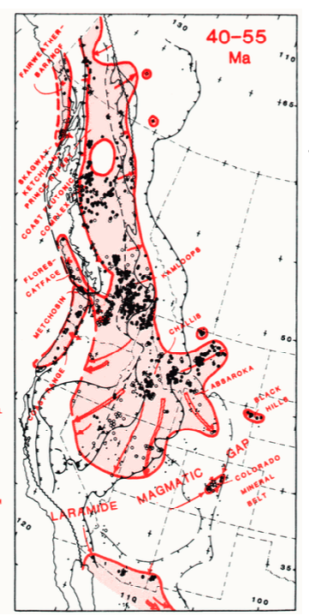
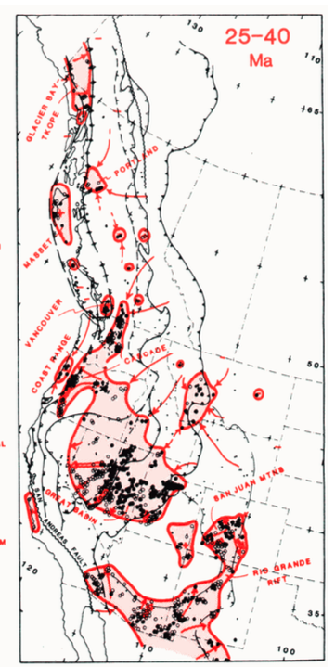
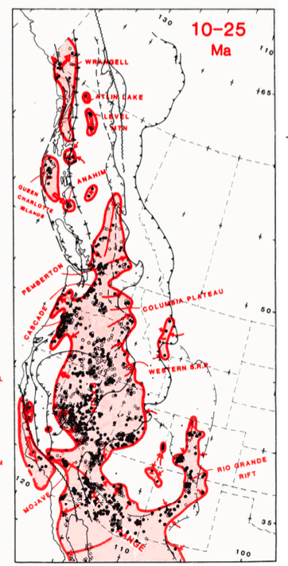
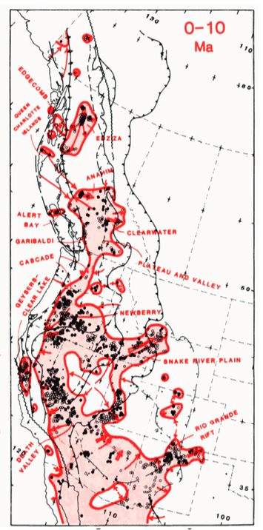
Attempt at synopsis....
Armstrong and Ward 1991 – focus on correlation of post 55Ma volcanism and core complexes

Slide 2
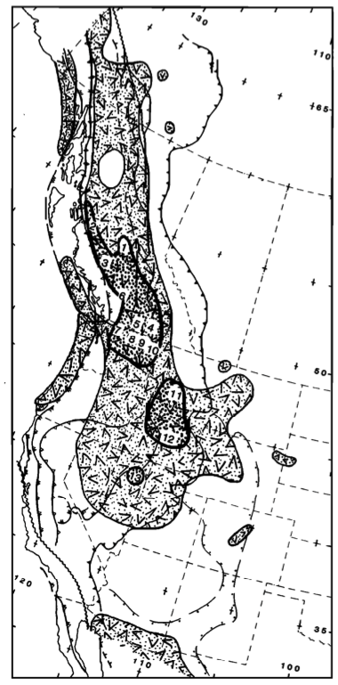
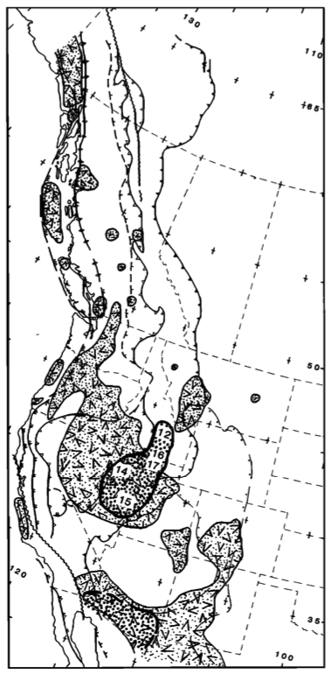
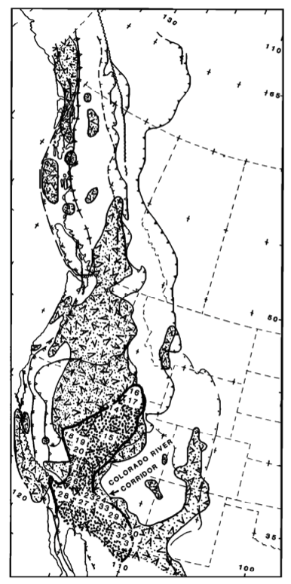
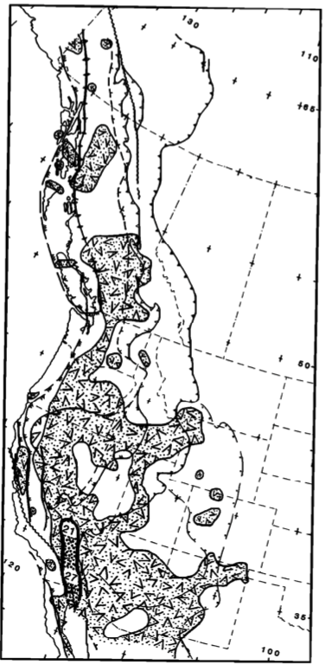
40-55 Ma 25-40 Ma 10-25 Ma 0-10 Ma
16: 15-34 Ma
17: 20-50 Ma
14: 23-45 Ma
15: 24-36 Ma
18: 17Ma
19: 15 Ma
20: 11 Ma
28: <24 Ma
29: 24-20 Ma
27: <6 Ma
33: 17-25 Ma
5: 47-60 Ma
4: 59-72 Ma
8: <65 Ma
3: 56-47 Ma
8: 48-65 Ma
11: 44-57 Ma
12: 33-68 Ma
12: 33-68 Ma
16: 15-34 Ma
17: 20-50 Ma
14: 23-45 Ma
15: 24-36 Ma
21: 5-12 Ma
27: <6 ma
Times ductile metamorphism in core complexes

Slide 3
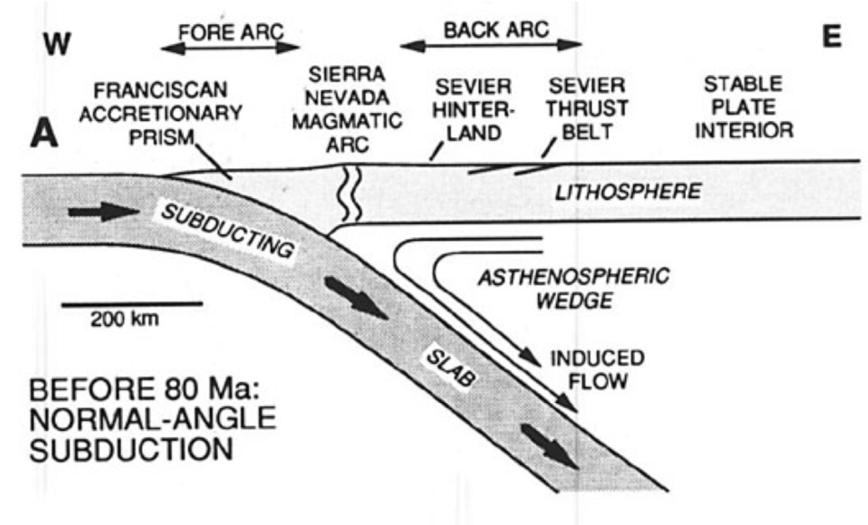
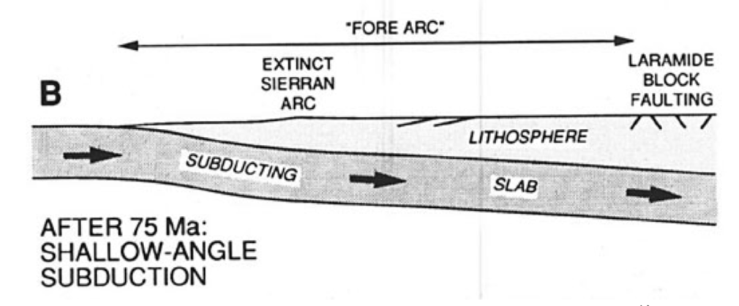
Attempt at synopsis....

Slide 4
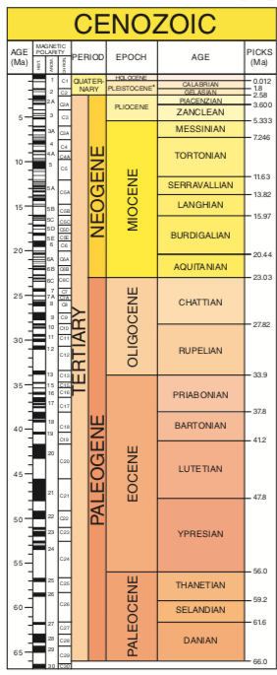
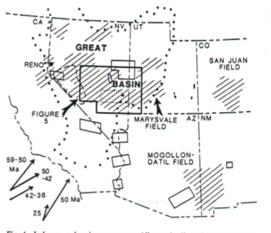
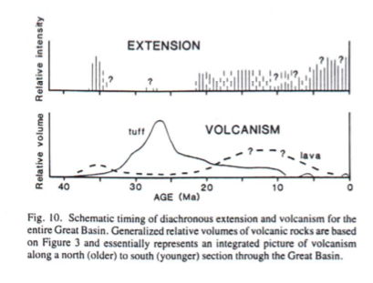
Best 91 – focus on Oligocene- ignimbrite flare up and extension recorded in those volcanics..
Tertiary extension interrupted during late Oligocene-early Miocene by period of ‘tectonic quiescence’ but voluminous volcanism
Older episode of extension in early Oligocene most localized in eastern Nevada

Slide 5
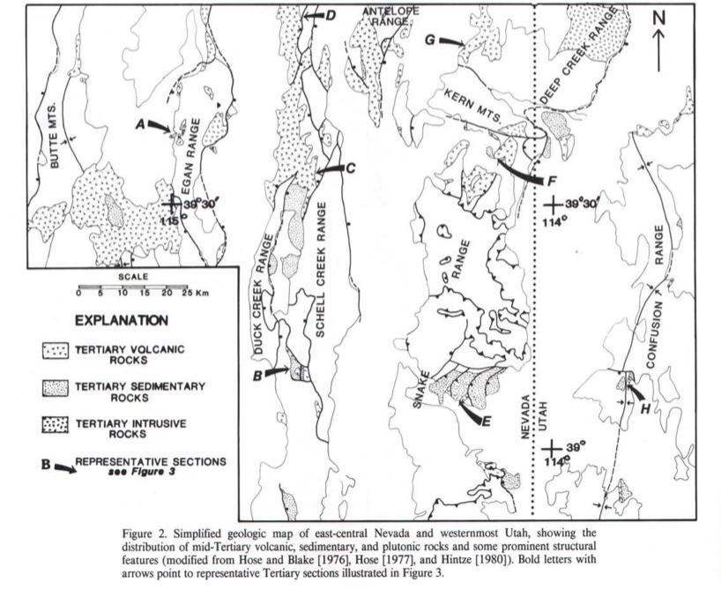
Gans 1989 – Synextensional Magmatism
Focus on East Central Nevada – Western Utah
Large volumes of magma erupted 33-39 Ma
Asserts correlation to metamorphic core development (e.g. Snake Range 36-24 Ma)

Slide 6
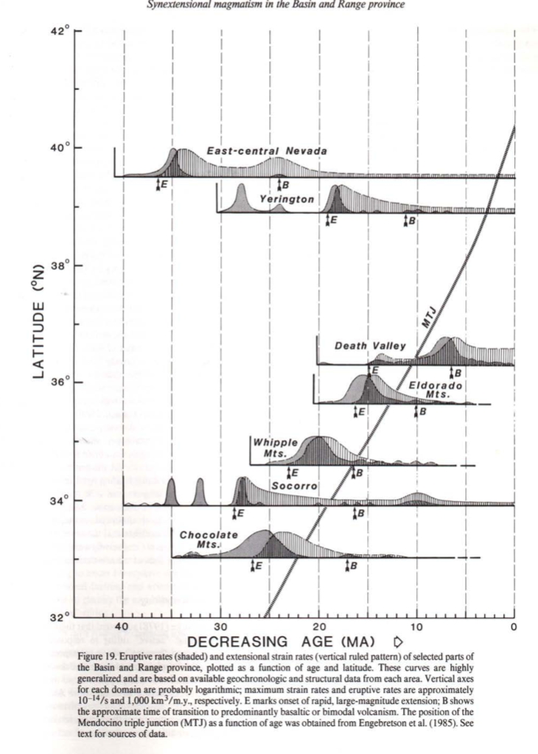
Notes similar correlations elsewhere – and apparent migration of volcanism and extension
And attempt to correlate to passing of Mendocino triple junction – interesting idea but...
Not perfect

Slide 7
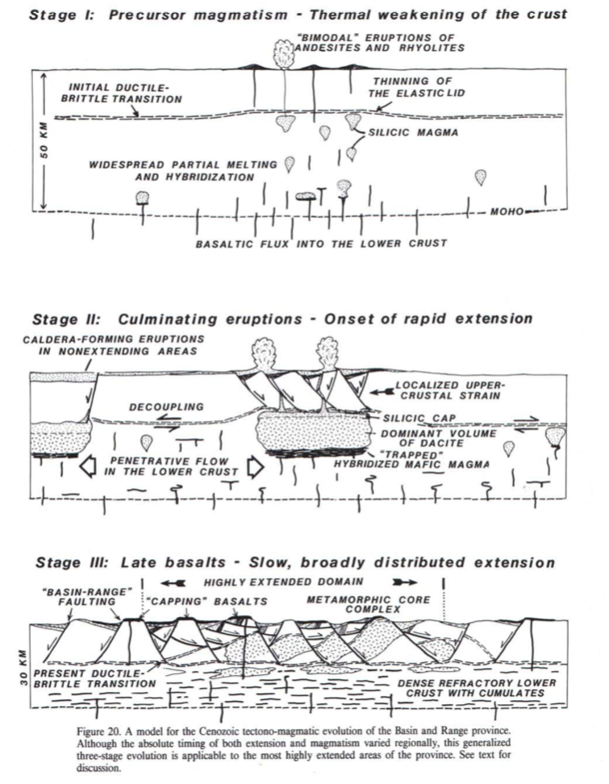
Then puts up a general model to explain correlation....

Slide 8
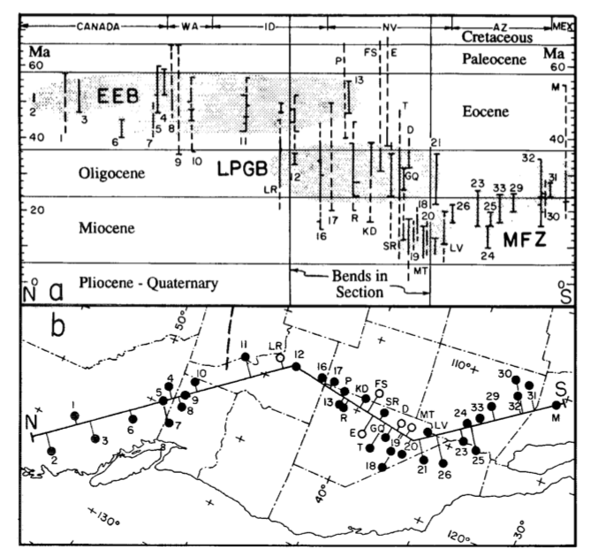
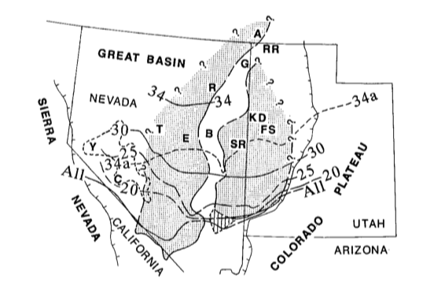
Then comes Axen 1993
Southward migration of Oligocene Calderas (solid lines) in relation to Paleogene-early Miocene ‘extensional belts (shaded)
Age of Extension versus location of metamorphic core complexes

