Slide 1
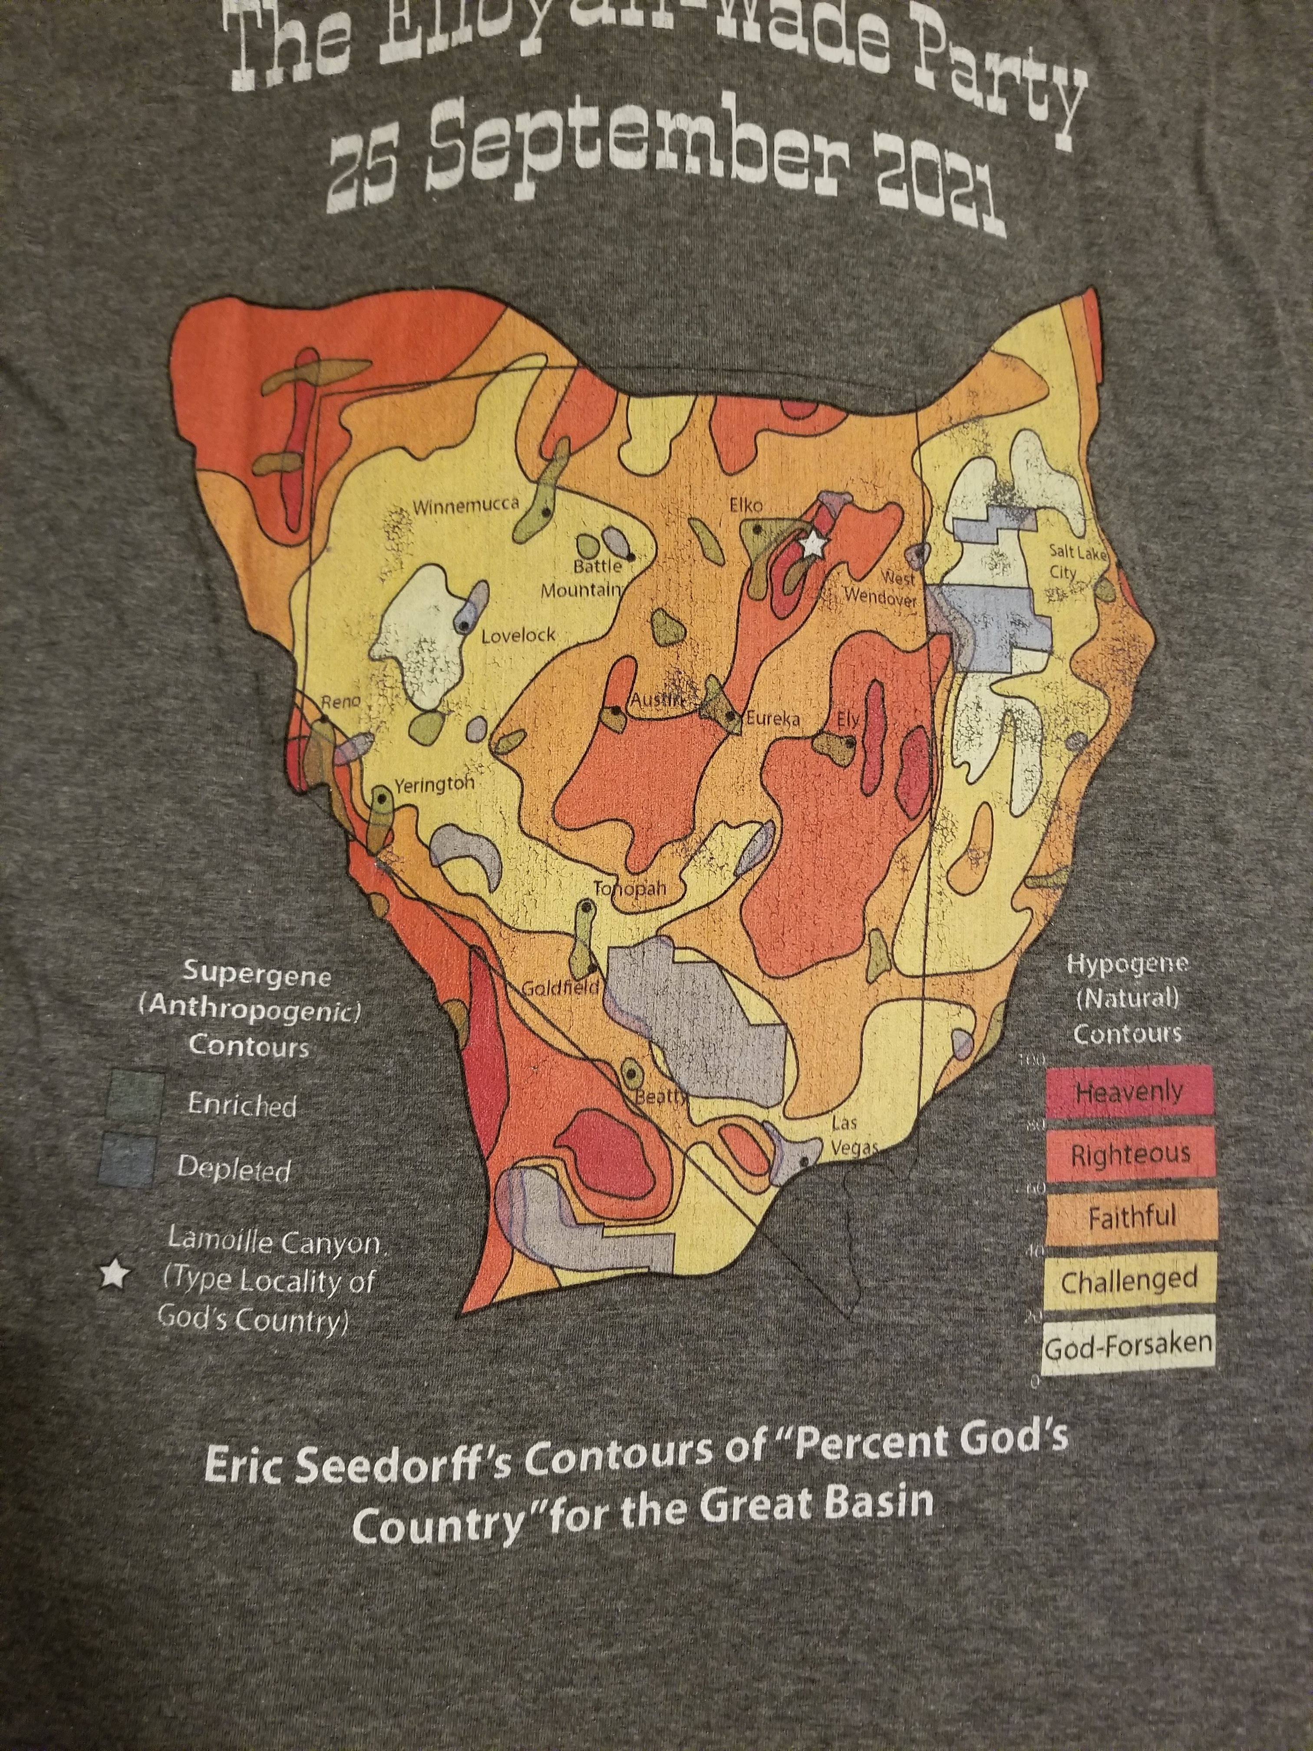
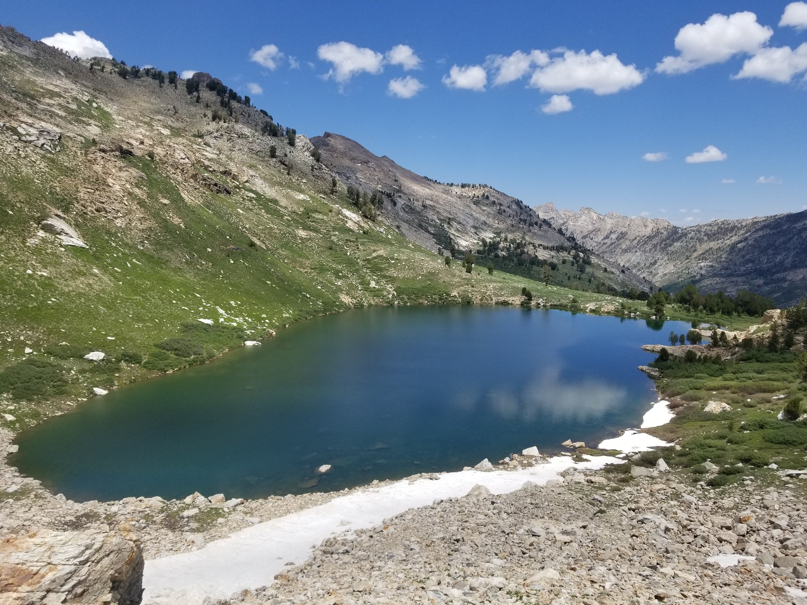
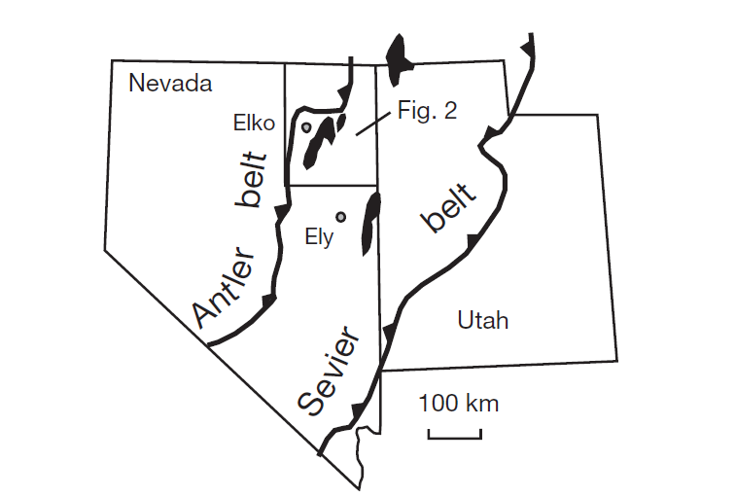
2003
Atticus Proctor, October 2021
Key Question: What can deep crustal rocks in the Ruby-East Humboldt metamorphic core complex (MCC) tell us about the setting in which Carlin Type Gold Deposits (CTGD) were deposited in?

Slide 2
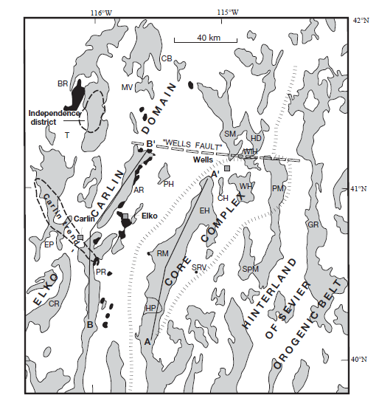
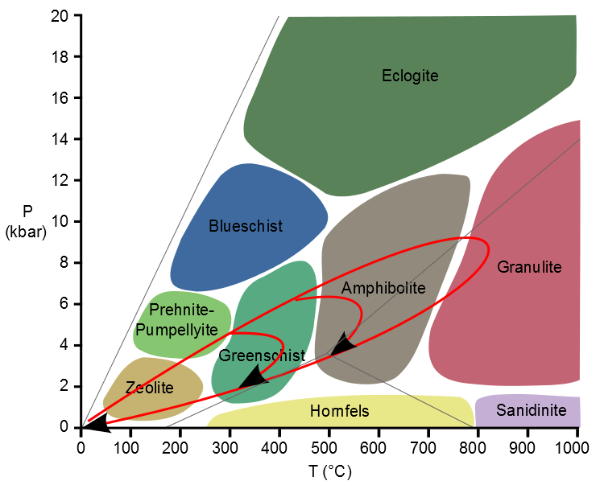
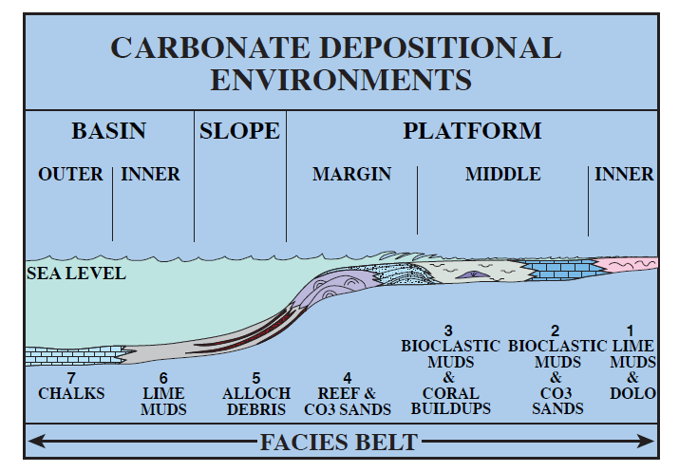
Pre-Eocene Tectonic framework
Three domains
Southeastern Hinterland of Sevier Orogenic belt
10-13km section of miogeoclinal, continental shelf sequence of Neoproterozoic siliciclastic strata, Paleozoic and Mesozoic marine strata capped by Jurassic eolian sandstone
Ruby-East Humboldt MCC
Composed of metamorphosed equivalents of rocks from the miogeocline and rocks from the Proterozoic and Archean
Greenschist and amphibolite facies metamorphism in Ruby-East Humboldt core complex
Elko-Carlin- deep water siliciclastic rocks moved from the west and are thrust over miogeoclinal rocks
Intruded by numerous Jurassic and Cretaceous intrusive units
Grey shaded rocks are pre-Tertiary
From Cook and Corboy, 2004

Slide 3
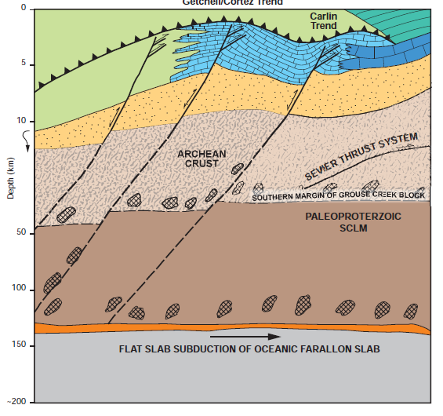
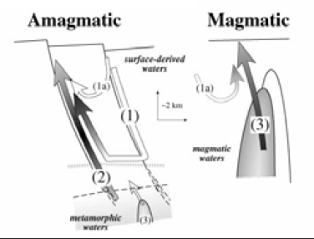
Pre-Eocene Tectonic framework
From Muntean, 2018
Grey shaded rocks are pre-Tertiary
From Seedorff and Barton, 2004

Slide 4
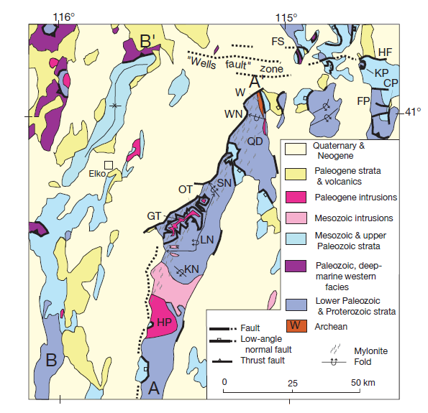
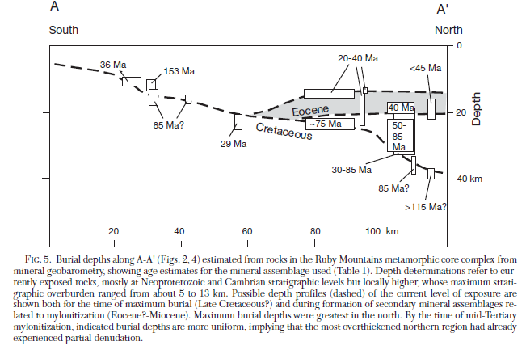
Position of Ruby-East Humboldt (REH) rocks in the Eocene (Presently exposed in the MCC)
Maximum burial depths were in the northern part of the MCC
Up to 9 kbars of pressure= >30km depth
Exhumation of the REH MCC took place in stages: up to 10km of unroofing in the first stage (1/3 of total)
Exhumation could have occurred by middle Eocene time
Second episode of exhumation peaked in the Miocene

Slide 5
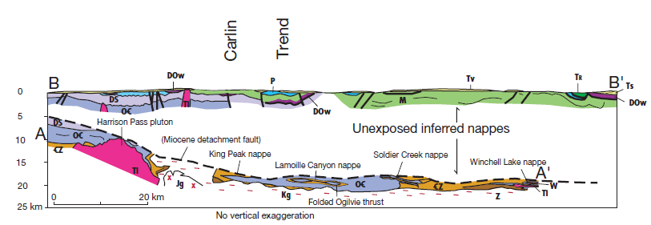
Stacked Eocene Crustal Section
Mesozoic nappes and tectonic wedges are believed to have been between the deep crust and upper crust.
This helps explain structural thick section that lacks significant topographic surface relief
Extensional klippen that structurally overlie the REH MCC rocks have been moved westward as MCC rocks have been exhumed
Interpreted the upper crustal rock remains mostly upright into the present

Slide 6
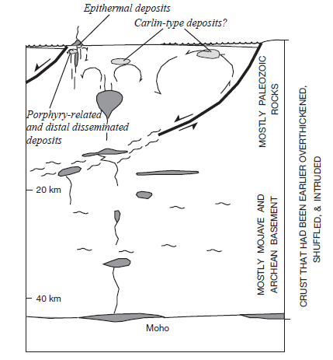
Eocene Landscape
Sedimentary and volcanic rocks were deposited in broad alluvial plains and lake basins.
Extension following the Sevier orogeny formed basins for the Cretaceous to Eocene lakebeds found in eastern Nevada
Eocene calc-alkalic volcanic flows and tuffs are interbedded with lacustrine strata
These eruptions mark a migration of arc-like magmatism that some link to the genesis of CTGDs
Eocene to early Oligocene extension is scattered in northeastern Nevada.
Paleogene extension was east-west to northwest-southeast
Deep Eocene Processes
“Stable isotope data show that mantle-derived fluids isotopically homogenized the deepest exposed metasedimentary rocks during magmatism, and exchange with meteoric water affected rocks down to the levels of mylonitic rocks close to detachment faults”
Grey shaded rocks are pre-Tertiary

Slide 7
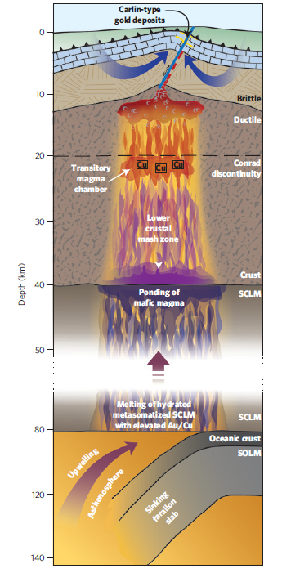
Correlating crustal structures to Carlin-style mineralization
Mesozoic granites produced Ag-bearing skarns, but these lack gold, ruling out they could not be the roots to CTGDs
No major Cenozoic structure can be identified as controlling mineralization along the Carlin trend
Trend may follow a structure in Paleozoic host rock strata
Late Eocene magmatism derived from the middle crust cold have provide deep-seated magmatic or metamorphic fluids for mineralization
Eocene lakes could have provided fluid for hydrothermal circulation
None of the rocks in the cross section below have been documented as a source for CTGD metals
Upper-crust CTGD mineralization does not root in a simple structure or rock body in the middle crust

Slide 8
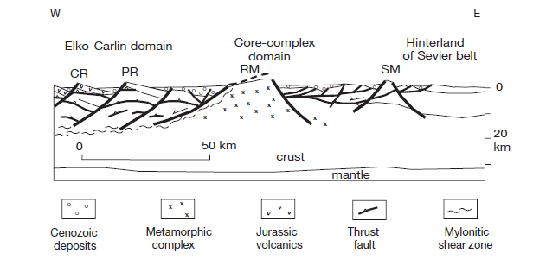
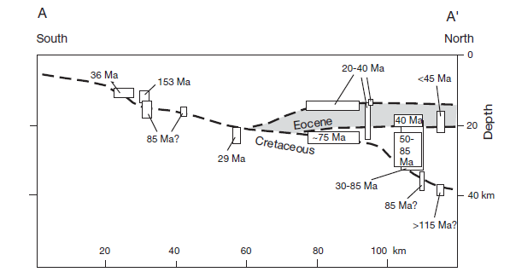
Key Great Basin Development Points
Rocks in the REH MCC were buried shallowest in the southern part of the present-day range and deepest in the north
Greenschist to amphibolite facies metamorphism: 9kbars, >30km burial depth
Exhumation of these rocks took place in multiple stages, and it is interpreted they were at ~20km depth in the Eocene
The Eocene eastern Nevada landscape consisted of alluvial plains, lake basins, and volcanism.
Evidence for scattered Eocene to early Oligocene extensional faulting in east-west to northwest-southeast directions.

