Slide 1
Segmentation of the Laramide Slab – evidence from the southern Sierra Nevada region
1
Jason Saleeby, 2003
Presented by Alex Holmwood

Slide 2
Brief overview
2
Laramide orogeny: Late Cretaceous – Early Paleogene
Authors argue for segmentation of subducting Laramide slab
Shallow segmentation + subduction = plate margin AND intracontinental deformation

Slide 3
Background
3
Prevailing idea: Laramide orogeny related to flattening of subducting slab
Hypothesis: two segments of subducting slab; one shallow and one deep
Shallow segment correlated with plate margin and intracontinental deformation

Slide 4
Significance
4
Laramide associated with end of Cretaceous Sierra Nevada magmatism
Also associated with deformation, denudation, westward breachment of ~500 km batholith segment
Resulted in oblique crustal section

Slide 5
Methods
5
Petrology + geochemistry: SNB xenoliths
Cross section drafting: oblique crustal section
Seismic data

Slide 6
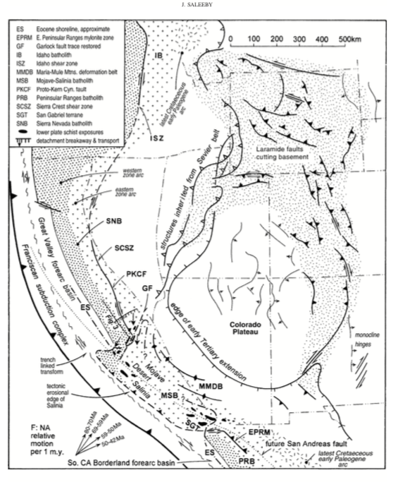
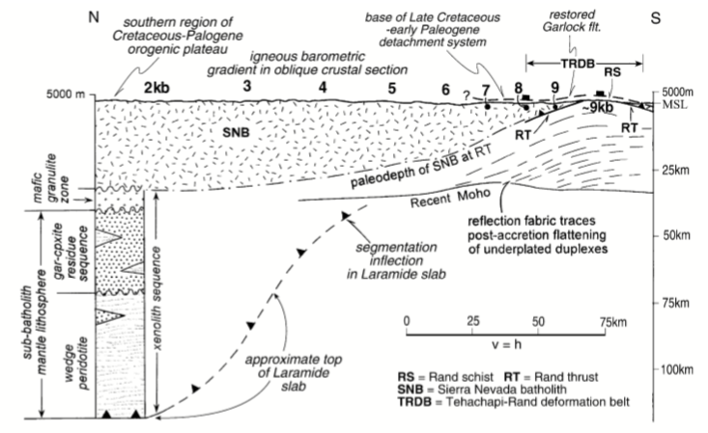
6
Inflection of Laramide slab:
Two distinct sub-batholithic domains
Inflection forms a ”ramp” in subducting slab
Shallow segment in south
Deep segment in north

Slide 7
7
Shallow segment
Thrusted (underplated) schists
Late Cretaceous emplacement (cooling ages)
Almost complete termination of batholith magmatism
*only small plutons with Rand Schist isotopic signatures
Rapid denudation

Slide 8
Deformation
8
Garlock fault trace: approximate location of ramp/inflection in slab
Trajectory of shallow segment correlates with orientation of Laramide thrusts
Mechanisms of intracontinental deformation:
End loading
Basal traction
Shallow slab trajectory
Mylonite zone: interpreted southernmost extent of shallow slab

Slide 9
9
Schematic cross sections (no section line on map)
Extensional collapse due to steepening of slab (Cretaceous–Paleogene)

