Slide 1
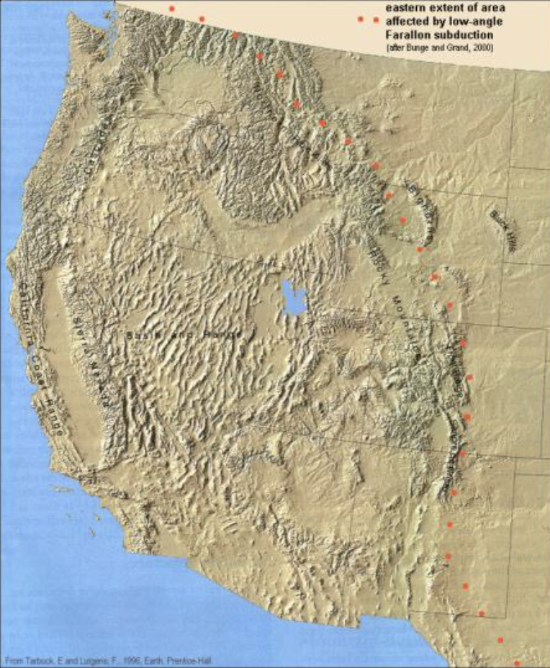
The Laramide Orogeny: What Were the Driving Forces?
English, J. M. and Johnston, S. T., 2004, The Laramide Orogeny: What were the Driving Forces? International Geology Review, 46, 833-838.

Slide 2
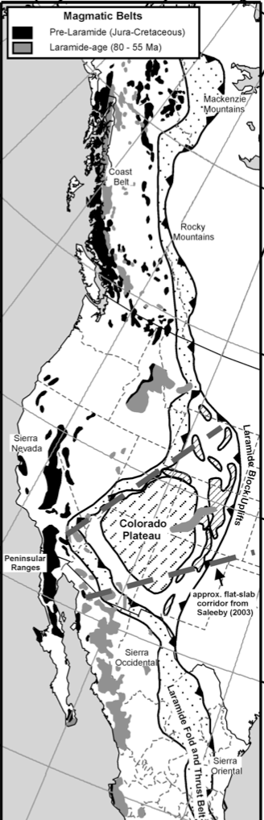
Purpose: demonstrate that the processes responsible for orogeny remain hard to interpret
The Laramide orogeny caused:
- the Laramide block in the U.S. to uplift
- the formation of the Rocky Mountain fold-and-thrust belt in Canada and the U.S.
- Sierra Madre Oriental fold-and-thrust belt in east central Mexico
- Deformation belt developed 700-1500 km inboard of the convergent margin
Four different models for deformation:
Retroarc thrusting
“Orogenic floating” tectonics
Flat-slab subduction
Cordilleran transpressional collision
Notes:
rise to the Laramide block uplifts in the United States, as well as the Rocky Mountain fold-and- thrust belt in Canada and the United States, and the Sierra Madre Oriental fold-and-thrust belt in east- central Mexico
deformation belt is thought to have developed 700–1500 km inboard of the nearest con- vergent margin

Slide 3
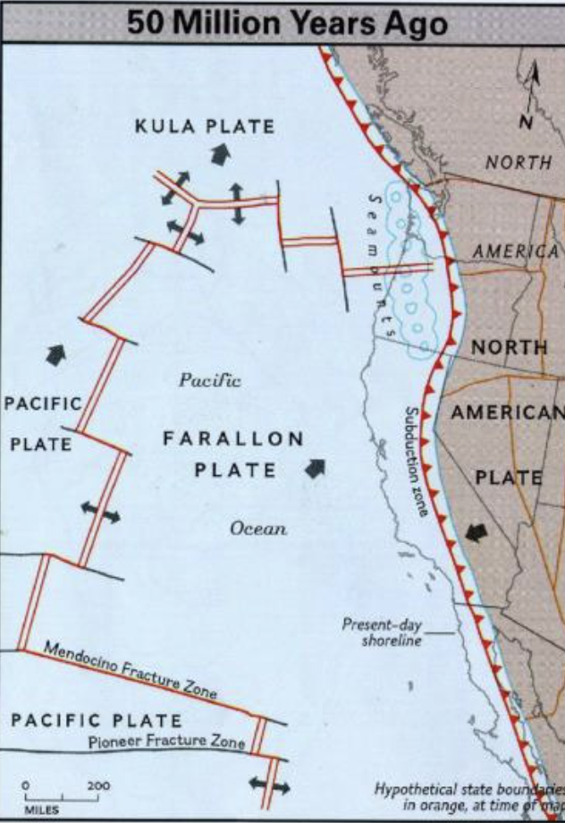
Retroarc Thrusting:
Thrust faulting occurs opposite to subduction at the plate boundary
Caused backthrusting of Cordillera onto continental interior
Due to regional compressive stresses
Westward moving North American plate collides with the oceanic slab
Model requires that stress from plate collisions was transmitted across the region without causing internal deformation
- needs a strong block, despite old faults present
- model does not describe how shortening was accommodated in the mantle lithosphere
Notes:
Does not account for how shortening was accommodated for in the lithosphere
he zone of backthrusting represents a locus of continuing relative motion between the Cordillera and the continental interior; its location may be controlled by inherited weak- nesses in the lithosphere

Slide 4
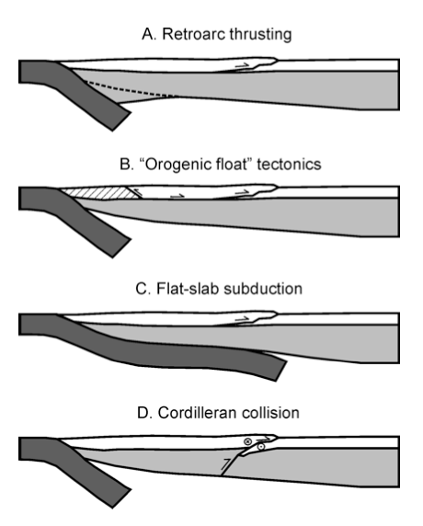
“Orogenic Float” tectonics
Portion of the crust ‘floats’ on top of the underlying lithosphere
Detaches due to an underlying deep-crustal basal detachment system
Used to relate formation of mountains in Canada to a collision of a block in Alaska
No known accretion events that correlate with the Laramide orogeny
No driving force to drive compression and cause detachment
Model ruled out

Slide 5
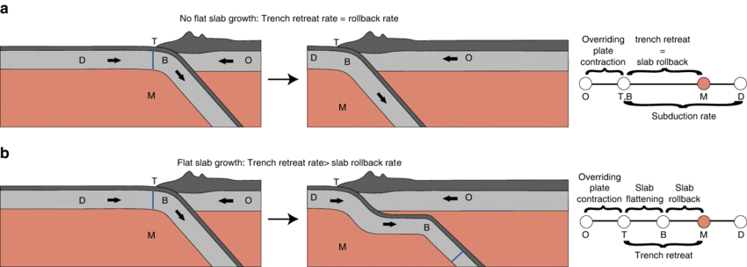
Flat-slab Subduction
The oceanic slab subducting along the west stays intact with the upper plate 700 km along the trench
Occurred due to the subduction of the Farallon plate or of the oceanic plateau
Deformation occurs as the slab steepens and descends on into the mantle
Evidence from basement-cored uplifts in Wyoming, Colorado, and New Mexico
Model refuted due to 300 km magmatic arc within the trench in Canada and Mexico

Slide 6
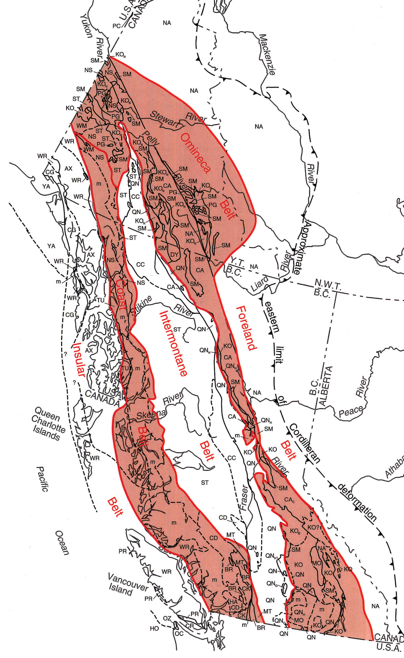
Cordilleran Collision
Based off paleomagnetic studies of Cretaceous layered sedimentary and volcanic rocks
Timing constrained movement between 85 and 55 Ma
Laramide may have occurred in response to a dextral transpressional collision between a north migrating continent and a stable North America
Rocky Mountain belt may have been produced by offscraping of sediments
Does not match with foreland basin formation
Missing Late cretaceous magmatic belt

Slide 7
Conclusions
- None of the proposed mechanisms for the Laramide Orogenesis can explain the entire situation
Three main questions remain:
- Does the paleomagnetic data correctly indicate a northward translation and how large was that translation?
- What was the relationship between northward translation, dextral transpression, and fold-and- thrust belt formation?
- Why did the Laramide strain zone form so far inboard of the inferred plate boundary?
Notes:
Farallon plate moving to the northeast
Collision with the north American plate
Floats near the crust to Colorado

