Slide 1
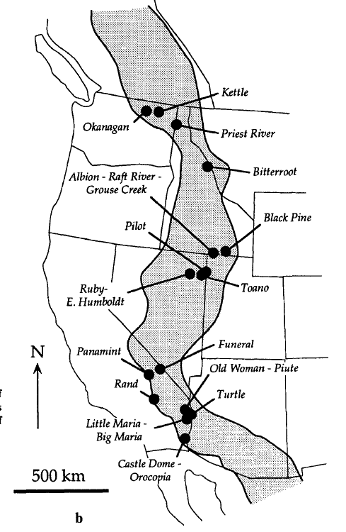
1992
Atticus Proctor, November 2021
Key Points
Cretaceous extension took place in the North American Cordillera during the development of the Sevier foreland fold and thrust belt.
Gravitational collapse led to extension in the Sevier fold and thrust belt
Mid-crustal decoupling of an intraplate allochthon moved westward, leading to extension
Map of metamorphic core complexes within the Sevier Internal Zone →

Slide 2
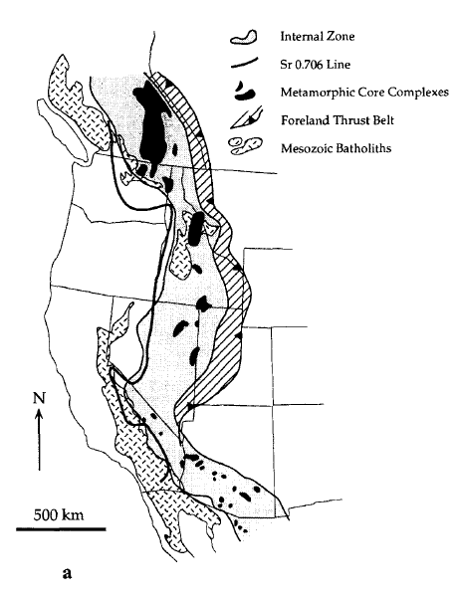
Geologic Setting
Sevier Orogeny, spanned the Cretaceous (160-50 Ma)
“Internal Zone” consists of:
Metamorphic core complexes
Mesozoic-Paleogene plutons
Bounding features are complex due to complex structural geology
Little to no surface expression of Sevier-age extension
Evidence for Cretaceous Extension
16 metamorphic core complexes in the Internal Zone show evidence of Cretaceous extension.

Slide 3
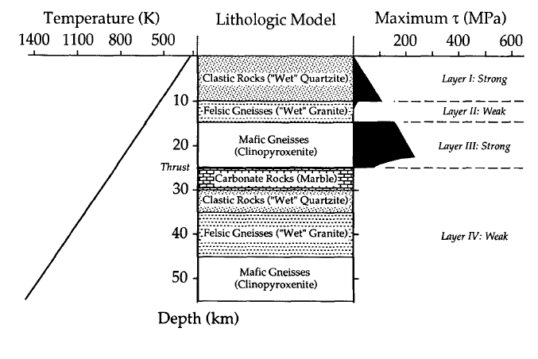
Rheological Conditions for Basement-Involved Shortening
Key consideration to the model: Shorten the basement to get mid-crustal extension!
Analogous structures and geophysical data show the crust was thickened in the basement rocks, not by upper crust fold and thrust belts
Basement thickening allows for thrusting at depth that places high-strength rocks at intermediate depths

Slide 4
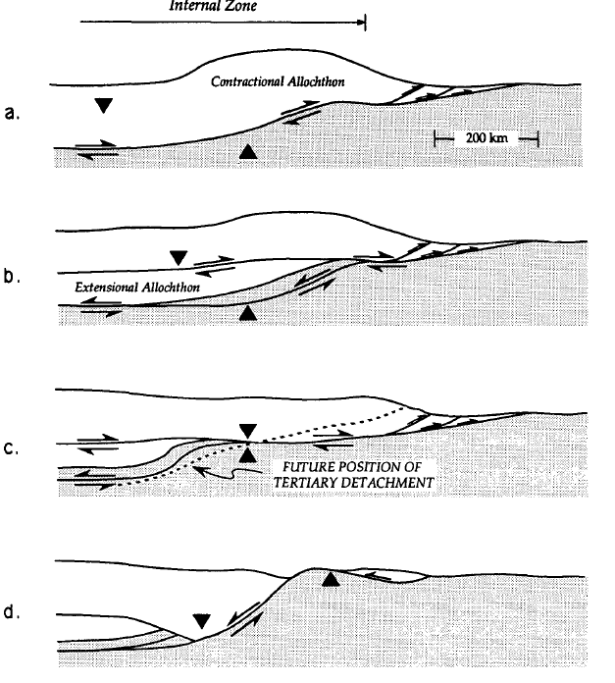
Model for Cretaceous Extension
W
E
J-K time
Mid-Crustal Extensional Allochthon is created by gravitational collapse due to eastward verging thrusting and crustal thickening
New detachment surfaces form in response to gravitational collapse
Extensional allochthon moves west relative to the east verging upper and lower crust
Mid-crustal extension is contemporaneous with upper-crustal shortening
This model allows for extension without surface-breaking normal faults
Tertiary normal faulting finishes exhuming metamorphic core complexes to the present-day surface
K time
K time
Tertiary time

Slide 5
Important points pertaining to the evolution of the Great Basin
During the Sevier orogeny the dominant movement was convergent, but there was also some extension
This Sevier/Cretaceous extension partially exhumed many of the metamorphic core complexes that stretch from southern Canada to Arizona in the present-day
W
E

