Slide 1
LATE JURASSIC TO EOCENE EVOLUTION OF THE CORDILLERAN THRUST BELT AND FORELAND BASIN SYSTEM, WESTERN U.S.A.
Regional Patterns of Orogenesis
DeCelles, P.G., 2004, Late Jurassic to Eocene evolution of the Cordilleran Thrust Belt and Foreland Basin System, western U.S.A., American Journal of Science, 304, 105-168

Slide 2
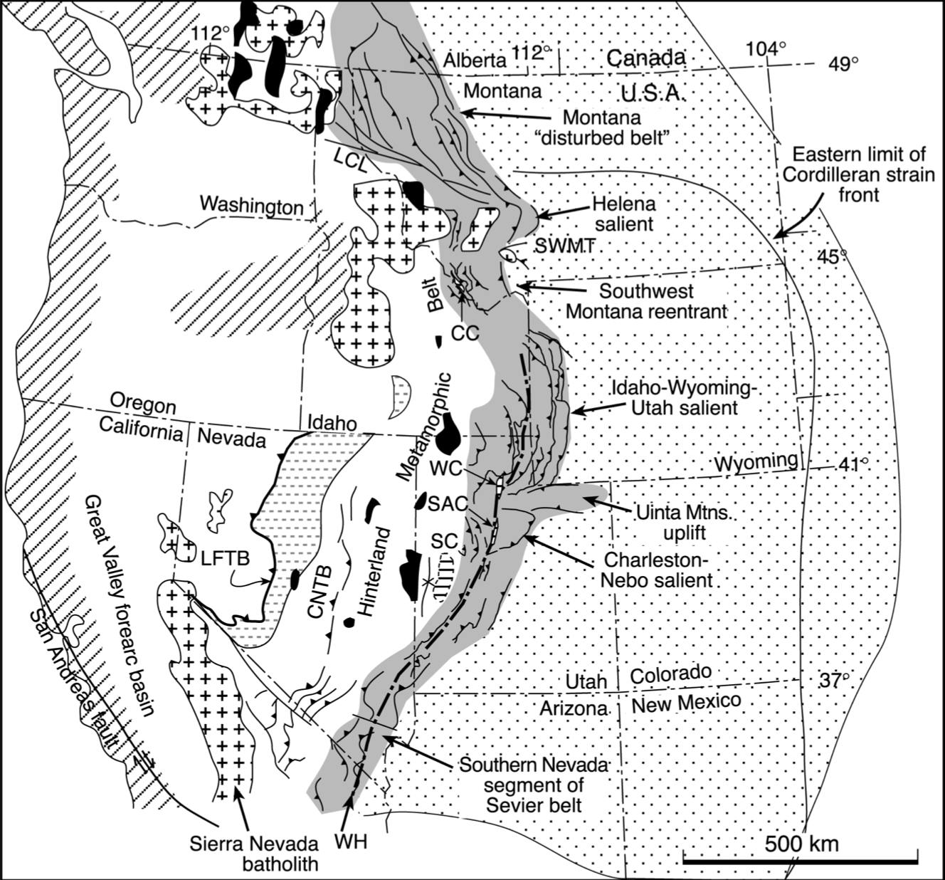
Large-scale temporal and spatial patterns of events associated with the Cordilleran thrust belt
Kinematic, metamorphic, igneous, and sedimentary events
Thrust faulting propagated to the east
Influenced by Precambrian stratigraphic geometry, embayments, and promontories
Promontories located in southwestern Montana and southeastern California
Opposite ends of the Sevier belt
Initial thrusts of the frontal Sevier belt began ~60 m.y. behind the earliest movements of the Luning-Fencemaker thrust

Slide 3
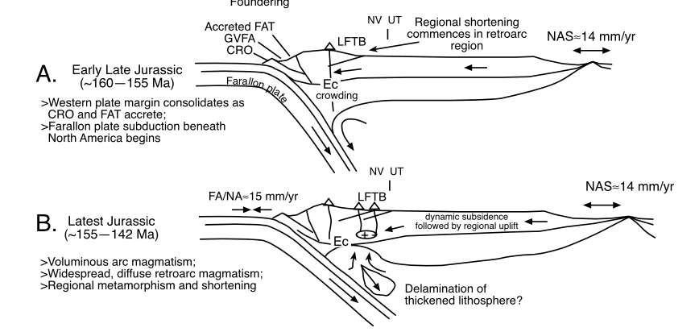
Character of deformation
Deformation varied depending on the rocks involved
Triassic:
Fine grained Triassic strata of the Luning-Fencemaker thrust belt
Closely spaced faults
Rocks have penetrative cleavage
Formed in low grade metamorphic conditions
Mid-crustal shear zones incorporated crystalline basement rock into Eastern Nevada and Western Utah
Located near the transition of Proterozoic and Paleozoic strata

Slide 4
During Early Cretaceous:
Thrusts spread significantly
Internal strain was reduced
Faults broke eastward over regional flats
Flats are Pre-Cambrian-Paleozoic ”Megathrust sheets”
Precambrian quartzites and Paleozoic carbonates
Late Cretaceous:
Between 80 to 75 Ma.
The basal thrust, or shear zone, or the orogenic wedge propagated into the foreland crystalline basement
Causing Laramide uplifts and basins to form

Slide 5
Total Shortening
Shortening estimated to be < 100 km in the South to 350 + km in the east by central Utah
Estimates have a high margin of error
Estimates are likely minimum values
Does not include significant amount of internal strain
Shortening on the western thrust systems are not well known
Because shortening is occurring in upper crustal rocks then an equal amount of lower crust and lithosphere must also have been subducted westward beneath the Cordilleran arc

Slide 6
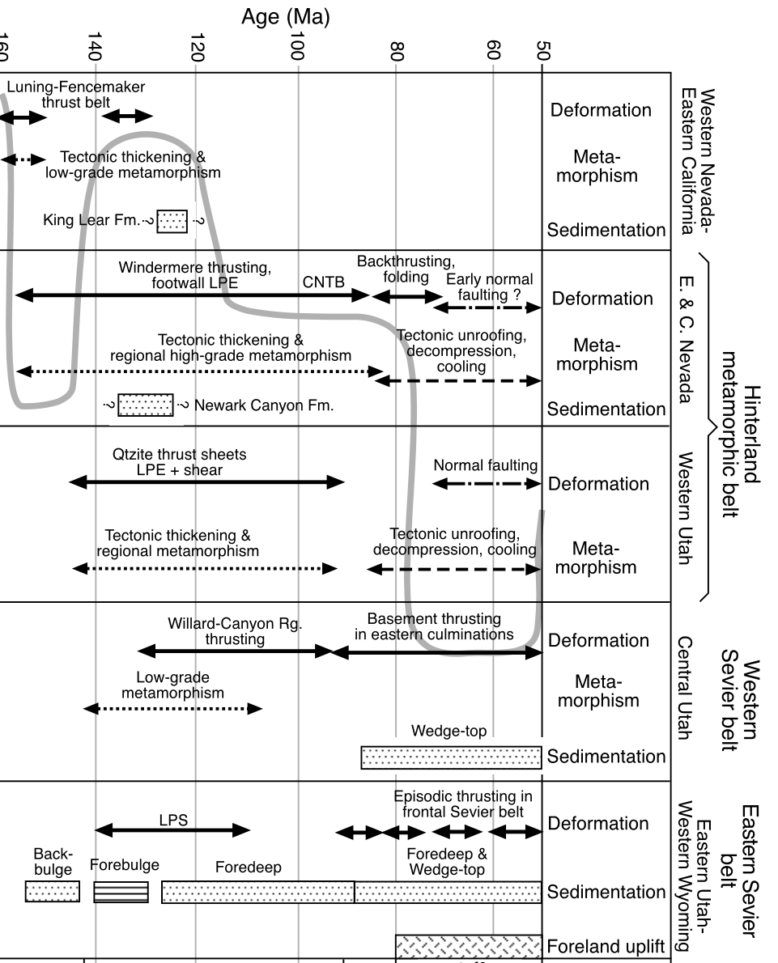
Because shortening is occurring in upper crustal rocks then an equivalent amount of lower crust and lithosphere must also have been subducted westward beneath the Cordilleran arc
- Then, the interior portion of the Cordilleran thrust was the location of the thickest crust
Evidence:
Metamorphic rocks in Nevada indicate mid-crustal rocks were buried 10-25 km deeper than their original stratigraphic depths
Luning-Fenemaker Thrust belt to the west and megathrust sheets to the east are lower grade greenschist facies
Rocks at the Sevier belt were unmetamorphosed

Slide 7
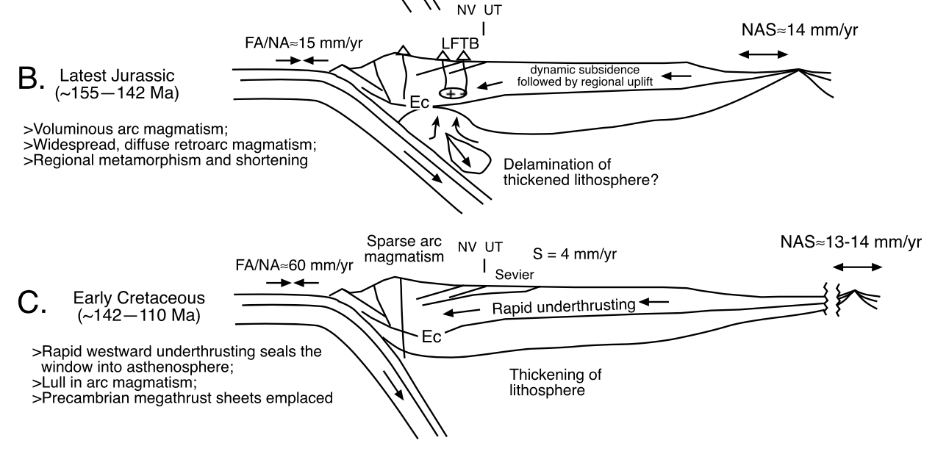
Magmatic Activity
Two major episodes:
Late Jurassic
Crustal melts were caused by the addition of heat to the mantle from
Mafic intrusions in the lower crust
Asthenospheric upwelling
Late Cretaceous to Early Tertiary
Related to a decrease in the angle of subduction of the Farallon plate and the onset of the Laramide crustal shortening

Slide 8
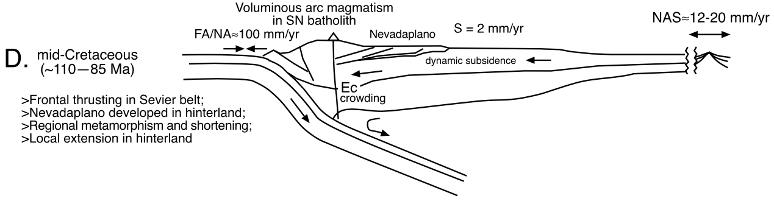
Paleogeography
In the Late Cretaceous:
Late Cordilleran was characterized by a low relief hinterland and a frontal thrust belt
Crustal thickness was 50-60 km in Utah
Based on shortening estimates in the thrust belt
And metamorphic mineral assemblages in the hinterland
Paleoelevation in Nevada was > 3km forming the ”Nevadaplano”
From paleobotanical estimates
The western Sevier belt has high regional elevations of 3-4 km

Slide 9
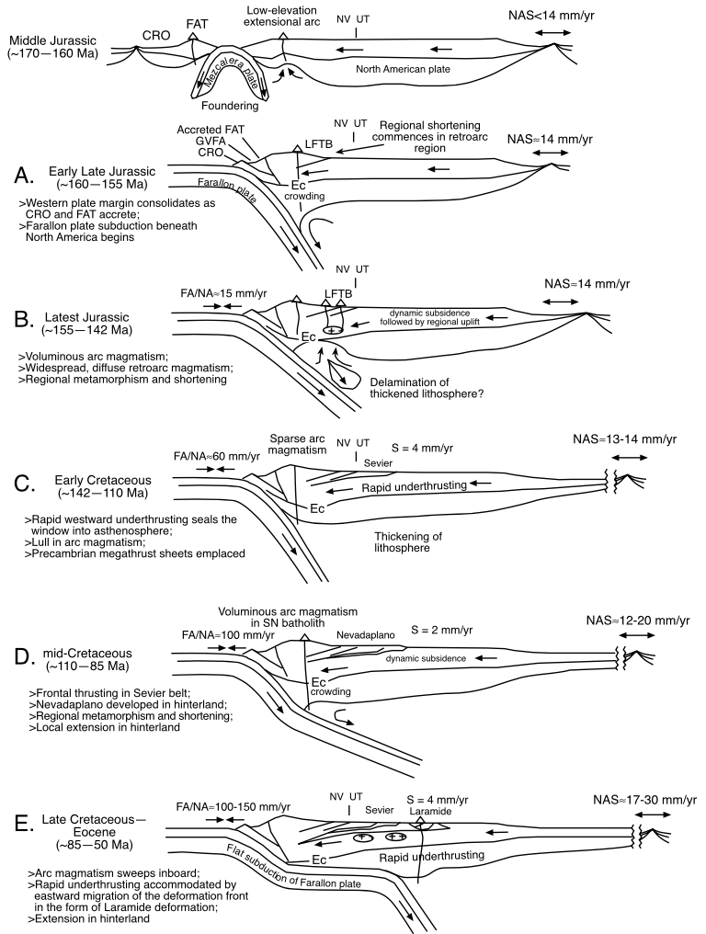
Summary
Large-scale temporal and spatial patterns of events associated with the Cordilleran thrust belt
Thrust faulting propagated to the east
Characterized by episodes of shortening, magmatism, uplift, and varying forms of deformation

