Slide 1
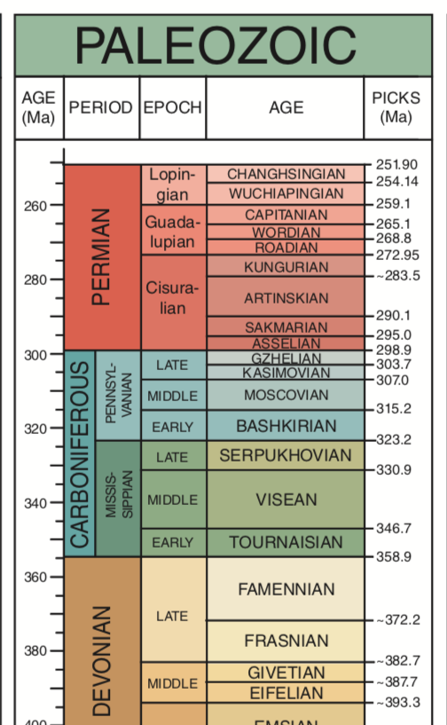
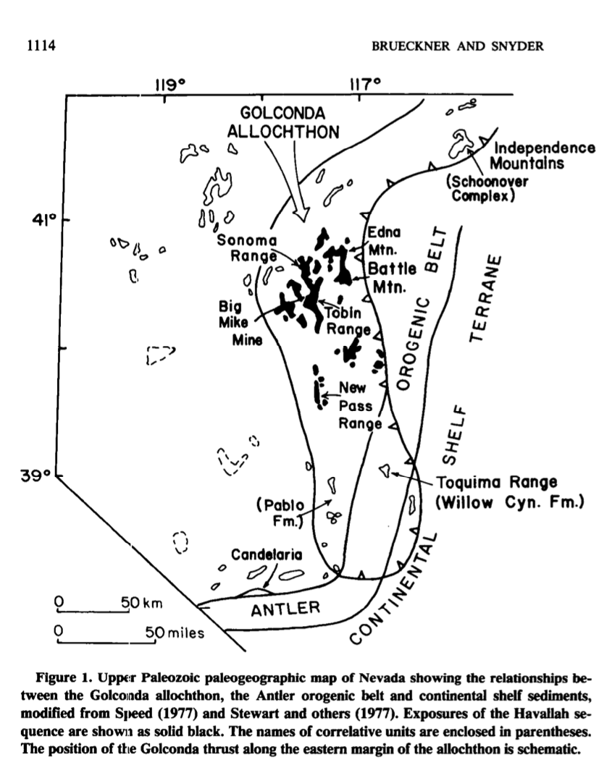
Havallah Sequence
Dominated by radiolarian chert, argillites, lesser amoounts silicicclastic, calcarenitic, and volcaniclastic turbidites. Cherts generally rest on tholeitic basalts – some altered by hydrothermal systems.
Latest Devonian to Permian
Underlain by east verging thrust – the Golconda thrust

Slide 2
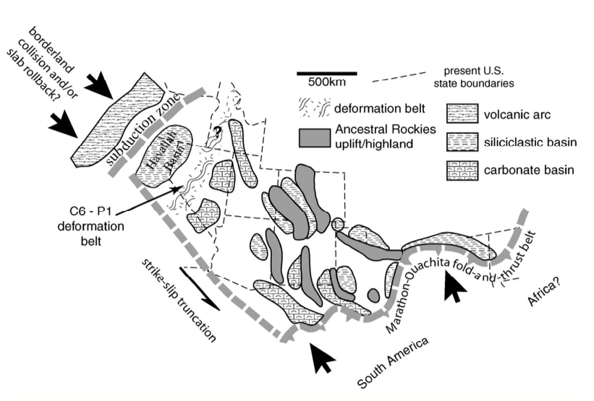
Older and contemporaneous
Orogenic belts of the Craton
Deeper distal slope and basin sediments along
Continental margin
Carbonates rocks of Paleozoic Continental shelf

Slide 3
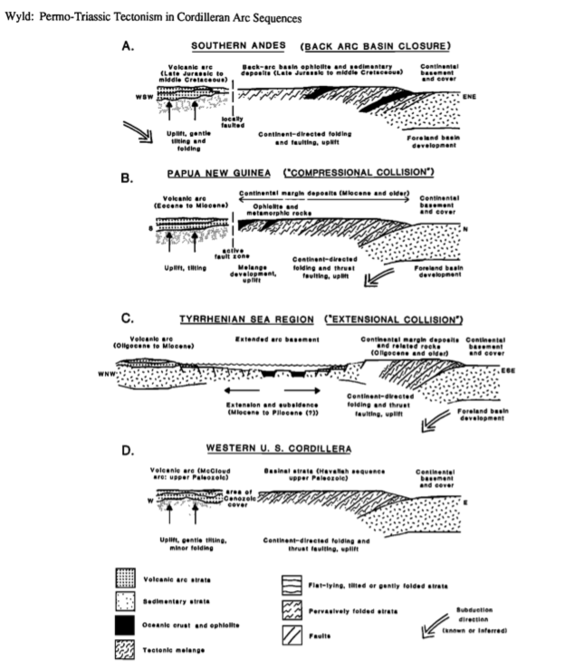
Plate tectonics is at heart of efforts to explain the emplacement of the Havallah sequence and associated volcanics along the Golconda thrust.
For this, investigators go to what may be modern analogs.
There is more than one analog that might explain the sequence
These may even involve different directions of underthrusting…

Slide 4
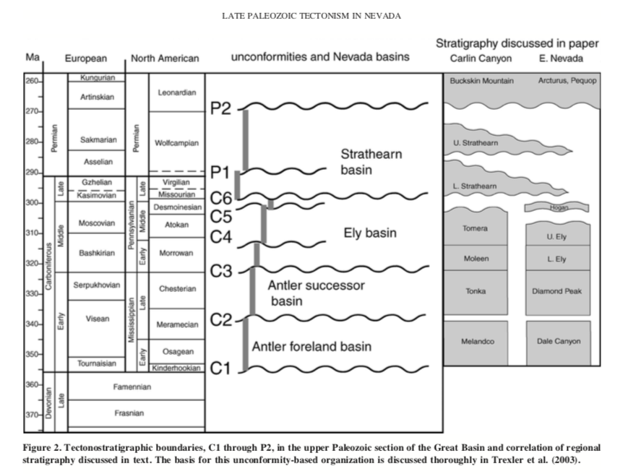
Trexler et al document additonal unconformities to suggest the defoermation history is likely a bit more complicated than the simple twofold model of Sonoma (and Antelope) orogenies

