Slide 1
Widespread effect of middle Mississippian deformation in the Great Basin of western North America
1
Trexler et al., 2003

Slide 2
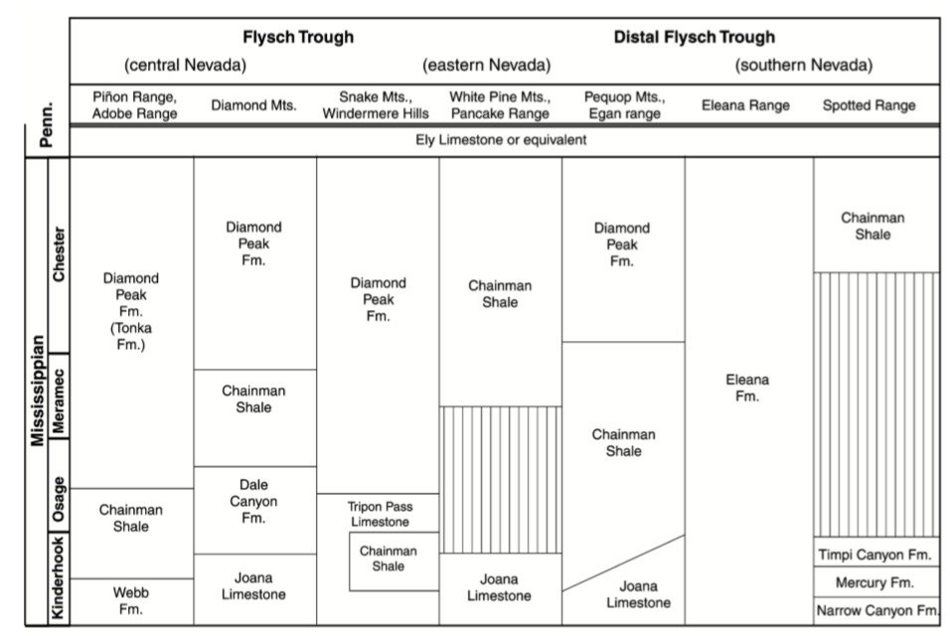
2

Slide 3
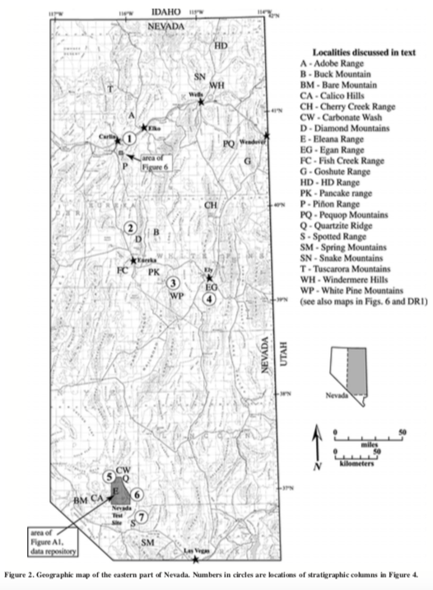
3
Mississippian stratigraphy in Nevada: background
Foreland basin that filled progradationally in response to Antler orogeny
Angular unconformity within Mississippian section first recognized in Diamond Mountains
Locally truncates tectonically deformed rocks
This unconformity is one of a number of regional unconformities from middle Mississippian through Permian time

Slide 4
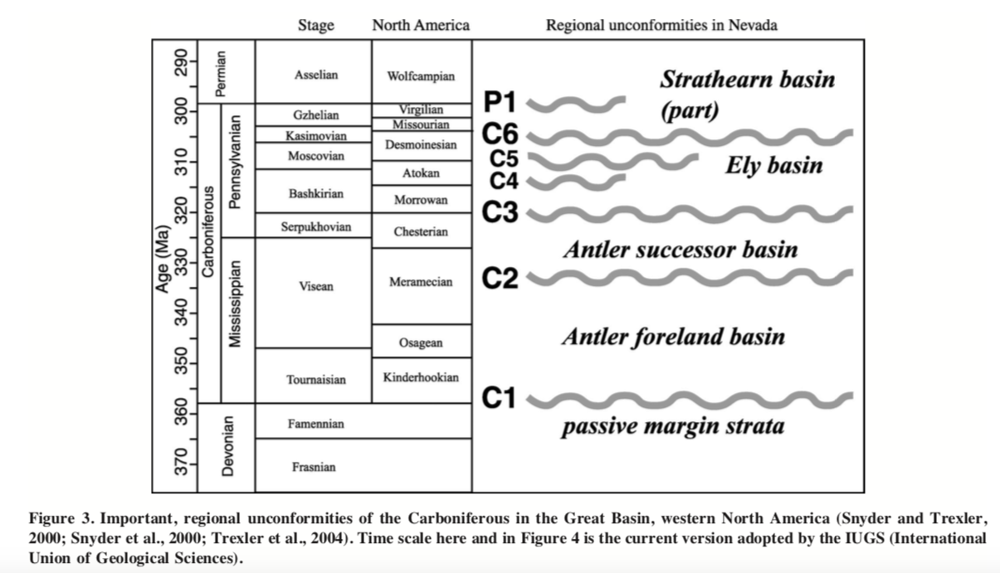
4
Sub-C2 stratigraphy summary:
Kinderhookian through Meramecian age strata
Siliciclastic sedimentary rocks, deposition attributable to filling of Antler foredeep
Poor fossil preservation
Bulk of siliciclastic sediments did not start to arrive in central Nevada foredeep until Osagean time
Distribution of foreland strata was influenced both by irregular paleogeography of collision margin and by flexural effects of eastward-directed collapse of continental borderland

Slide 5
5
Super-C2 stratigraphy summary:
Strata that overlie C2 boundary record systematic variations in depositional environment
Nonmarine siliciclastic deltaic rocks (western Nevada)
Shallow-marine carbonates, conglomerates, litharenites, and lagoonal shales (central Nevada)
Shelf and lagoonal carbonaceous shales and quartzites (eastern Nevada)
Southern Nevada –> C2 boundary is a conformable contact between siliciclastic and carbonate-clast turbidites

Slide 6
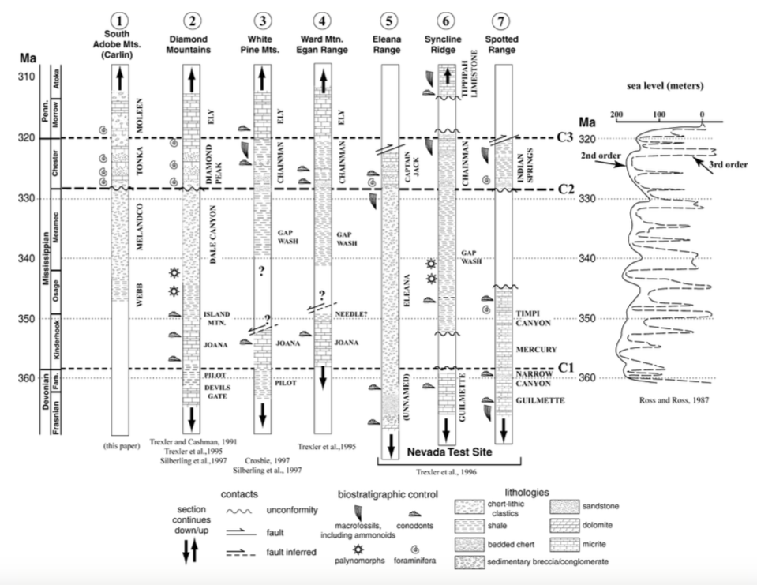
6

Slide 7
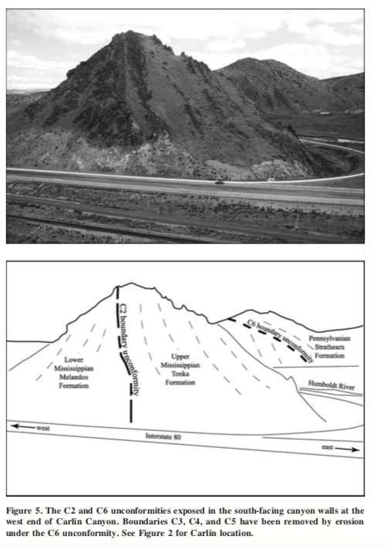
7

Slide 8
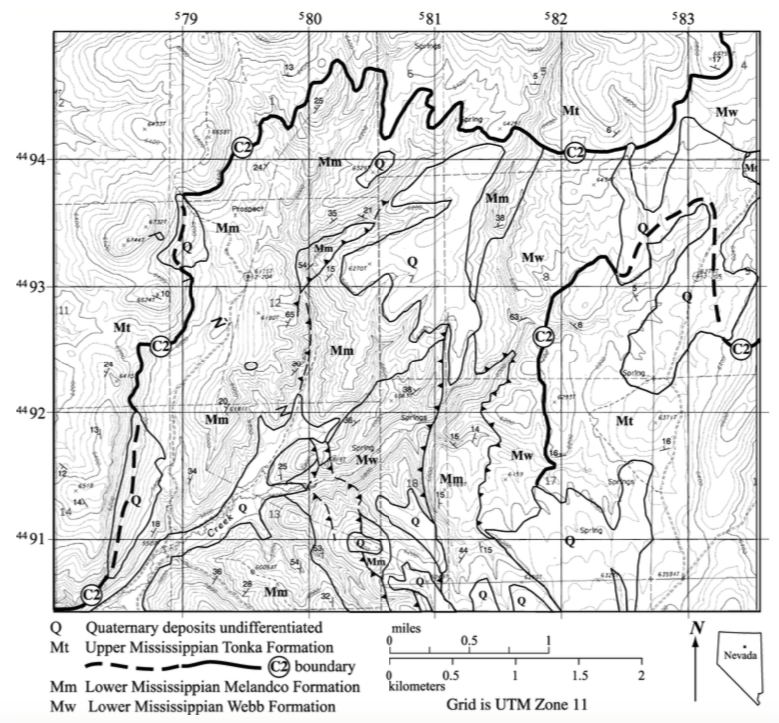
8

Slide 9
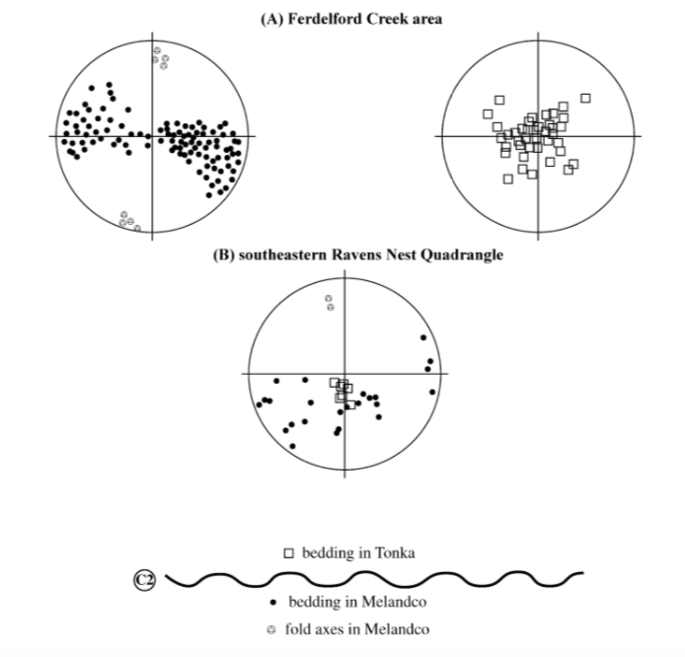
9

