Slide 1
Geophysical and Isotopic Constraints on Crustal Structure Related to Mineral Trends in North-Central Nevada and Implications for Tectonic History
Grauch, Rodriguez, and Wooden, 2003
Goals:
Review isotopic and geophysical data, discuss elements of crustal structure
build a composite picture of the crust
compare results to mineral trends and tectonic features of successively younger events
it was previously thought that blocks of Precambrian crust had been obliterated by later extension and magmatism and that geophysical data in the Basin and Range province was the result Cenozoic events – seeking to overturn this notion
Methods:
Sr and Pb isotope data, gravitational and magnetic data

Slide 2
Tectonic Setting
Late Proterozoic
inception of the North American Cordillera during the breakup of the super-continent Rodinia
Development of a west-facing passive margin at the edge of Precambrian continental crust
Location of edge commonly inferred from the 0.706 line
Pb and Sr isotope ratios suggest that the rifted margin is more complex and covers a wider area
Continental margin modification begins
Late Devonian to Early Mississippian Antler orogeny
eugeoclinal siliciclastic rocks of the Roberts Mountains allochthon were thrust eastward over miogeoclinal rocks of the continental shelf
Late Permian to Early Triassic: the Sonoma orogeny - placed eugeoclinal rocks of the Golconda allochthon over the RM allochthon
Early to middle Tertiary tectonism: southward sweep of generally east-west belts of magmatism from 43 to 21 Ma
Middle to late Tertiary tectonism: regional uplift, formation of the Northern Nevada rift and Basin and Range style faulting

Slide 3
Isotopic Boundaries
Granitoid magmas commonly retain the properties of material from the base of the crust
Isotopic compositions of granitoids of different ages can give a picture of the lower and middle crust through time
The 38.8 and 39 isopleths also broadly define the continental edge
West and north of the 0.706 isopleth is composed dominantly of oceanic crust. The eastern province, east of the Carlin trend, represents Precambrian continental crust and the central province is transitional or thinned crust that formed during development of the passive margin

Slide 4
Gravitational Boundaries
HGM of gravity data is used to locate density boundaries associated with gravity gradients
Density contrasts commonly occur where different types of crust are juxtaposed
The area along the BME trend represents a density boundary
Figure 4d. Map constructed from the gravity data to display ridges where major density boundaries are inferred in the crust. The mapped values are the magnitude of the horizontal gradient of Bouguer gravity of (d) but continued upward by 10 km instead of 5 km to better represent the locations of regional gradients of (c). High horizontal-gradient magnitude values imply either shallow boundaries, boundaries with large density contrast, or both. Density boundaries can represent major fault zones, lithologic contacts (such as the edges of batholiths), or structural relief on the lower crust or mantle.

Slide 5
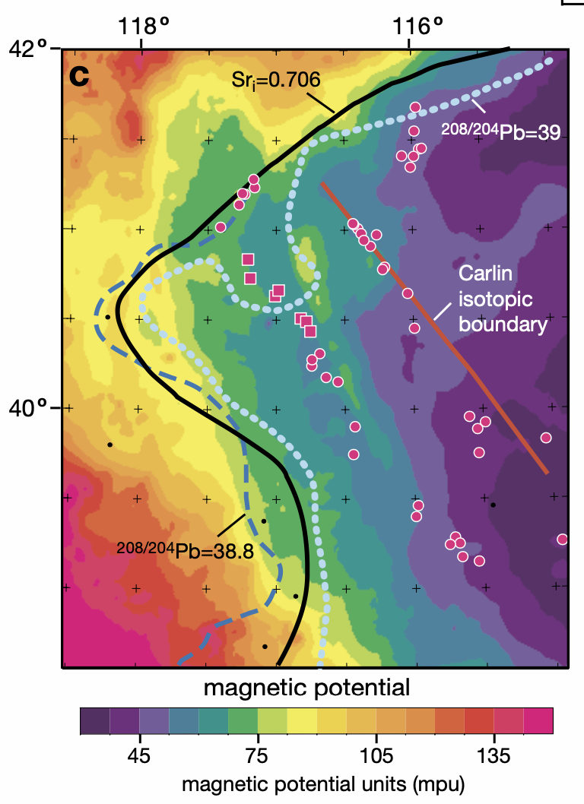
Magnetic Boundaries
Structural Boundary
general increase in magnetic potential values from northeast to southwest
expression of the Northern Nevada rift
correlates with the transitions in lower to middle crustal composition inferred from the isotopic data
low magnetic potential values – magnetite-poor Precambrian basement rocks
moderate to high magnetic potential values - expression of the more magnetic crust in the western province
“The magnetic boundary is an expression of a steep increment in the gradual increase of magnetic potential values from east to west. The coincidence of the density and magnetic boundaries, their linearity, and their location near the isopleths of Sr and Pb iso- tope ratios and limit of the area of low magnetic potential values suggest that this is a structural boundary related to the margin of the Precambrian crust.”
Figure 5c. Magnetic potential data computed as a vertical integral of the aeromagnetic data that enhances the broadest features of the data corresponding with major crustal features. The units (mpu) are arbitrary. Black, blue, and light blue lines are the isopleths of Sr initial = 0.706 and 208Pb/204Pb = 38.8 and 39, respectively, from Figure 2. Lack of correlation between lows on this map and the thermal features of Figure 5b, combined with the good correspondence between the Sr and Pb isopleths and the limits of the region of areas of low values, imply that the low values are primarily produced by magnetite-poor basement rocks rather than elevated temperatures

Slide 6
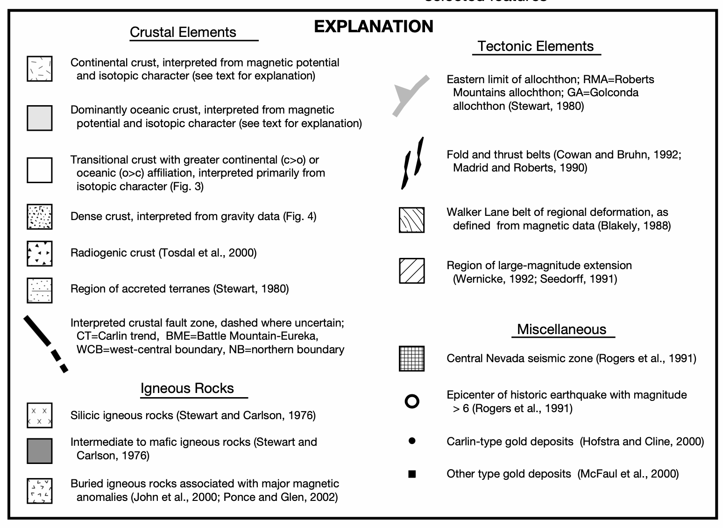
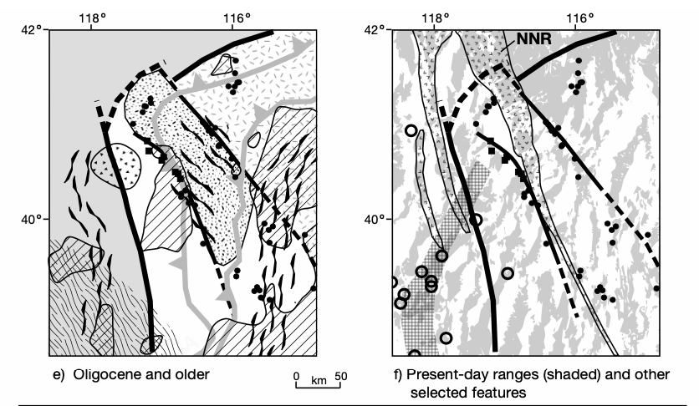
Notes:
8a: Basic crustal structure established after Rodinia rifted apart and a passive margin was established at the western edge of the continent
8b: Antler foreland basin develops, large pile of low-density sedimentary rock may obscure the gravitational signature of the Carlin boundary
8c: Intense folding and faulting in the antler foreland basin, large scale shearing initiated in the Walker lane belt
8d: voluminous magmatism in a curved belt SW of the BME gave rise to lower gravity values in this area. Magmatism concentrated in N part of area
8e: concentrated domains of large magnitude extension. This deformation could have obliterated the physical signature of older structures and lithologic contacts in the upper crust, such as the Carlin boundary. During this time, regional hydrothermal fluid flow deposited metals along the mineral trends and in other isolated deposits

Slide 7
Conclusion
Fault zones were developed during Precambrian rifting of Rodinia, or during later continental margin modification – these fault zones have had a profound influence on many subsequent tectonic events
During extensional events, the fault zones guided rifting, magmatism, and fluid flow
During compressional events, discontinuities at the fault zones may have acted as buttresses that controlled allochthon emplacement or folding, or the faults may have reactivated as thrust or strike-slip faults.
“Geophysical signatures of the crustal fault zones reflect the final products of millions of years of reactivation and/or influence of the fault zones throughout the Phanerozoic.”

