Slide 1
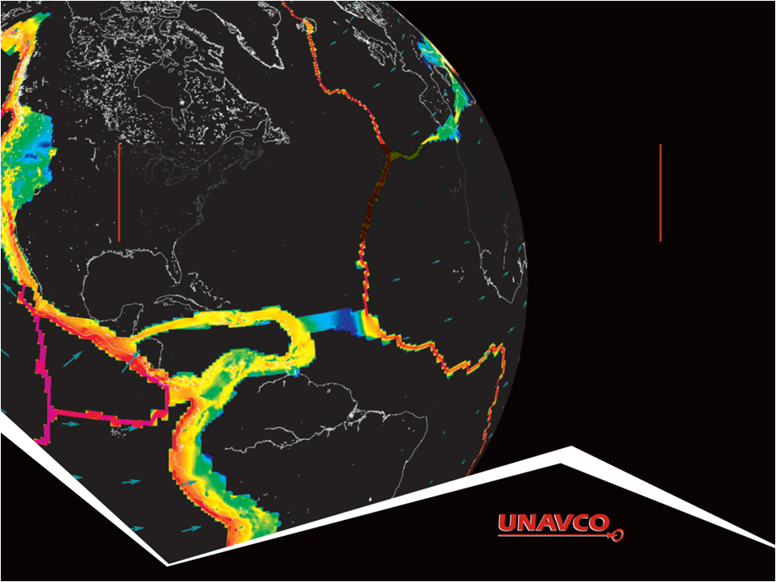
Using velocities from a triangle of GPS sites to investigate crustal strain Vince Cronin (Baylor University) Revisions by Beth Pratt-Sitaula (UNAVCO)
Version Mar 2013
1
Notes:
This slideshow provides a generic example of how the velocities at three sites can be used to determine the different components of infinitesimal strain that are occurring in the region between the sites.
Questions or comments please contact Vince_Cronin@baylor.edu or ece@unavco.org

Slide 2
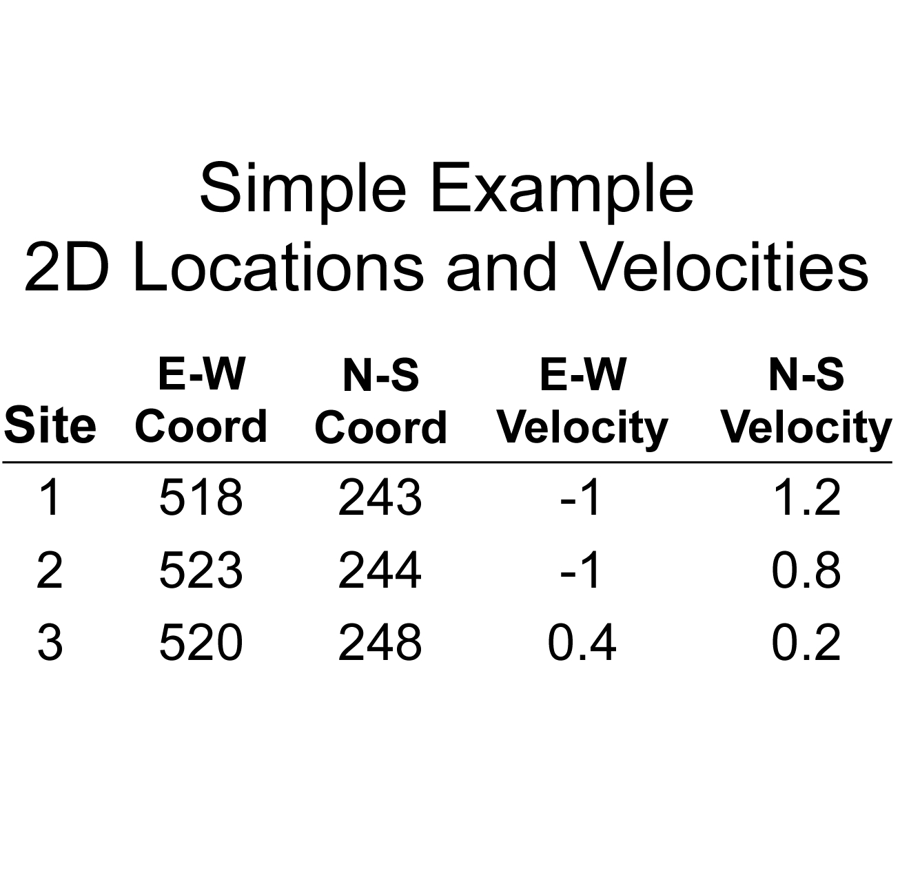
Graphical visualization of
crustal strain defined by GPS velocities
2
Notes:
We are only considering horizontal motion in this problem, for the sake of computational simplicity. The E-W and N-S map coordinates given in this table are analogous to Universal Transverse Mercator coordinates. We chose to use simple numbers to make it easier to visualize the graphing of these numbers and velocities. The sign convention for the velocity components is that east and north velocities are positive numbers, and west and south velocities are negative numbers. For example, site 1 is moving west and north, while site 3 is moving east and north.
All of these velocities are expressed relative to a common frame of reference. For example, GPS station velocities within the Plate Boundary Observatory are presented relative to the Stable North American Reference Frame (SNARF), defined by a set of GPS stations located on the North American craton well east of the Rocky Mountains that have negligible motion relative to each other.

Slide 3
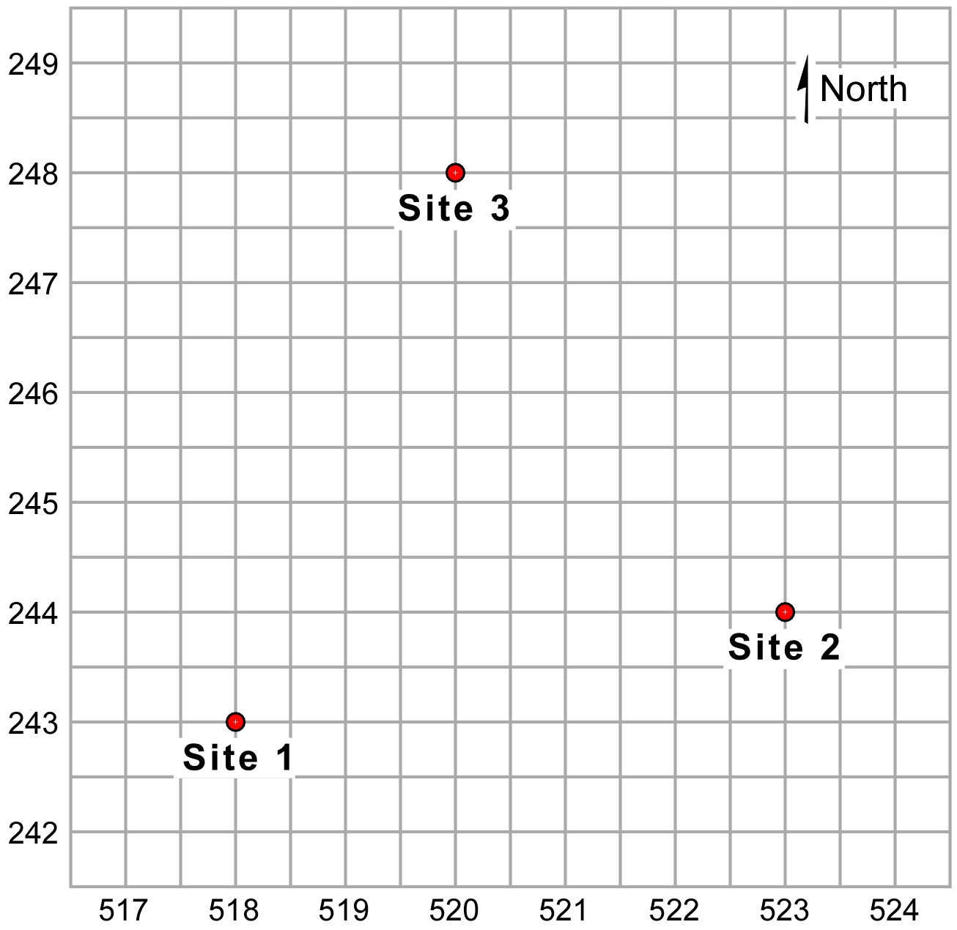
Graphical visualization of
crustal strain defined by GPS velocities
Locate three non-colinear GPS sites
3
Notes:
When choosing your GPS sites, an ideal triangle between the sites should be relatively equilateral with no apex angles less than ~30 degrees.

Slide 4
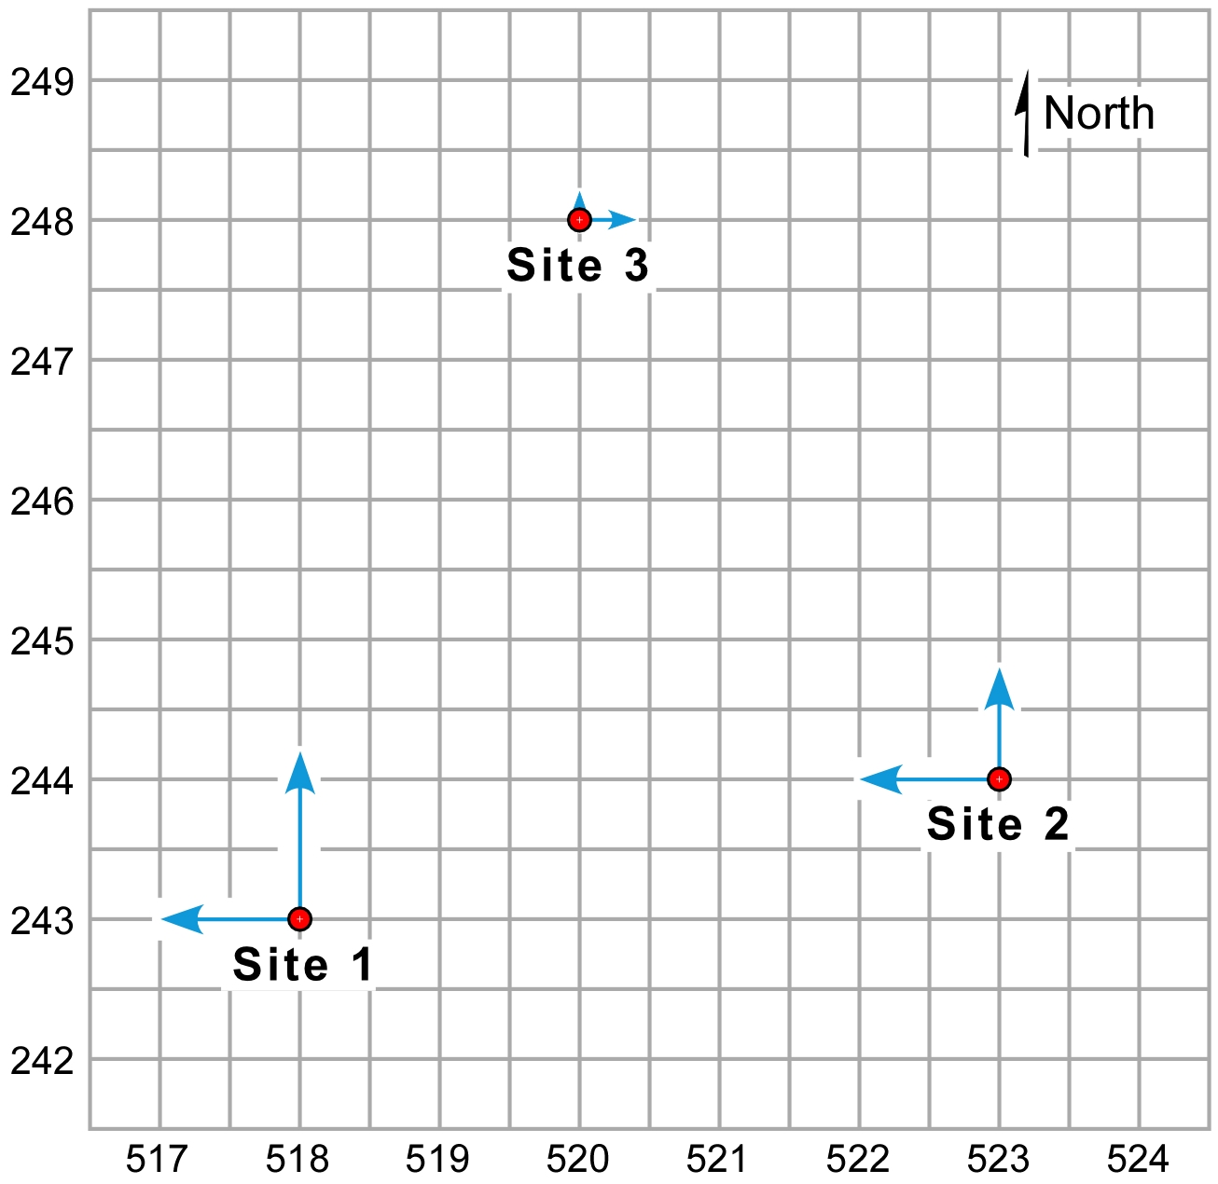
Graphical visualization of
crustal strain defined by GPS velocities
E-W and N-S components of sites’ velocities
4
Notes:
The instantaneous motion of each site is initially given as a N-S velocity vector and an E-W velocity vector, shown as blue arrows. PLEASE NOTE that the velocities used in this example are several orders of magnitude faster than the velocities of actual GPS stations, which are generally tens of kilometers apart. We employ the far greater velocities in this presentation for the same reason we employ vertical exaggeration in a cross section or hillshade map image: to accentuate the features we are discussing.

Slide 5
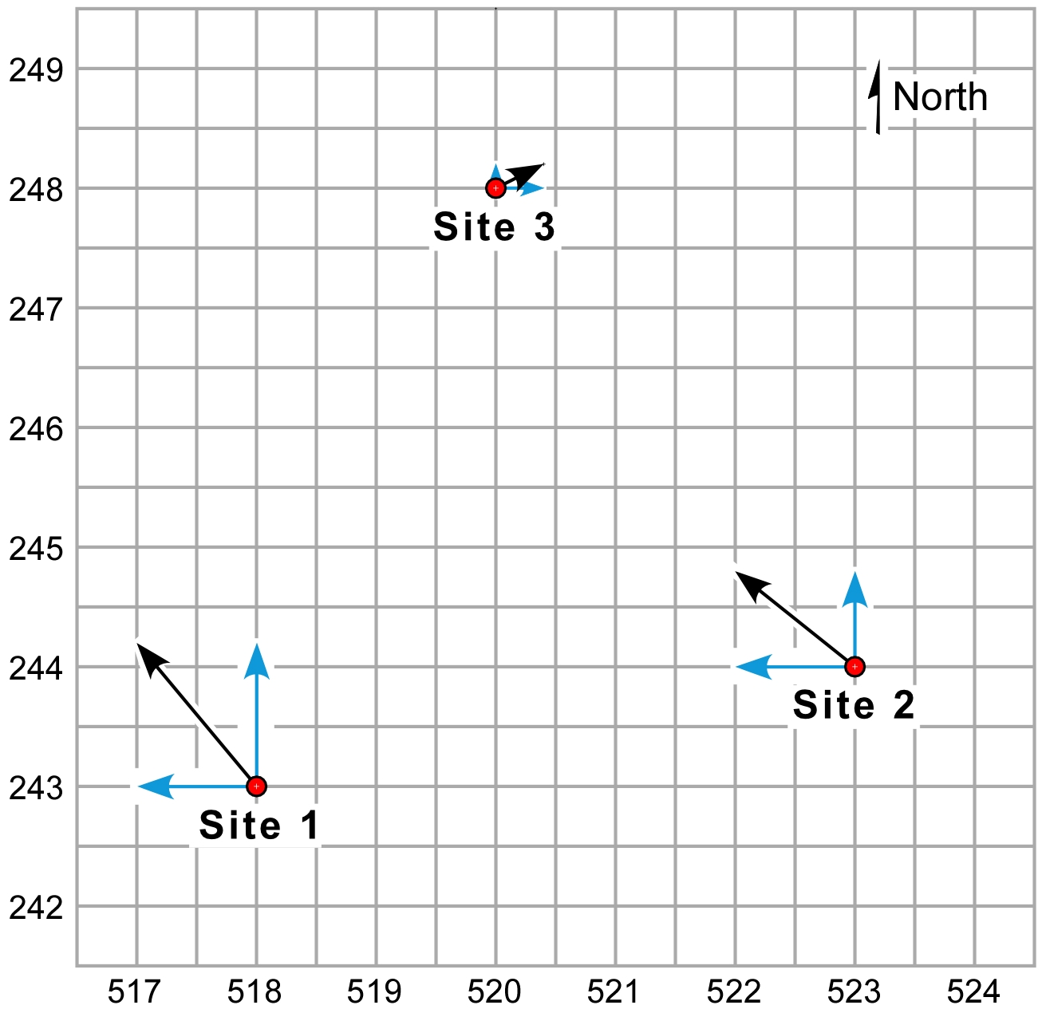
Graphical visualization of
crustal strain defined by GPS velocities
E-W + N-S components = total horizontal velocity of site
5
Notes:
Adding the N-S component vector and the E-W component vector yields the total velocity vector for each site, shown as black arrows.

Slide 6
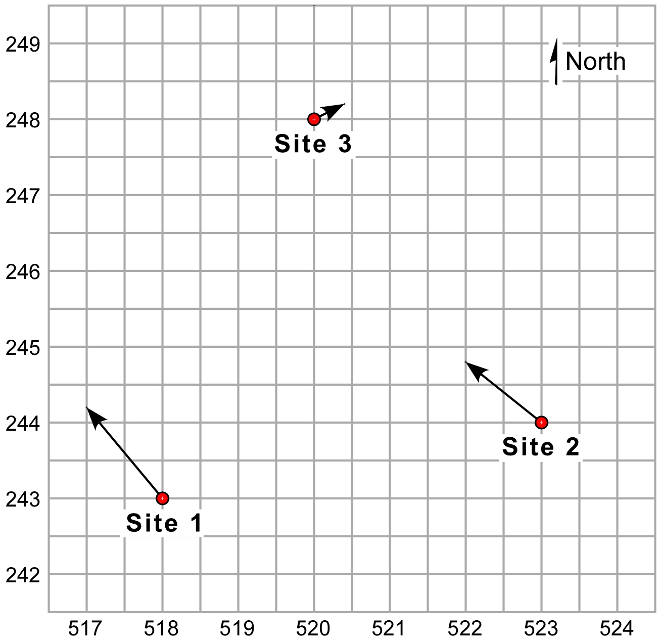
Graphical visualization of
crustal strain defined by GPS velocities
Total horizontal velocities of the three sites
6
Notes:
Here are the horizontal velocities of the three GPS sites, presented relative to the same frame of reference.

Slide 7
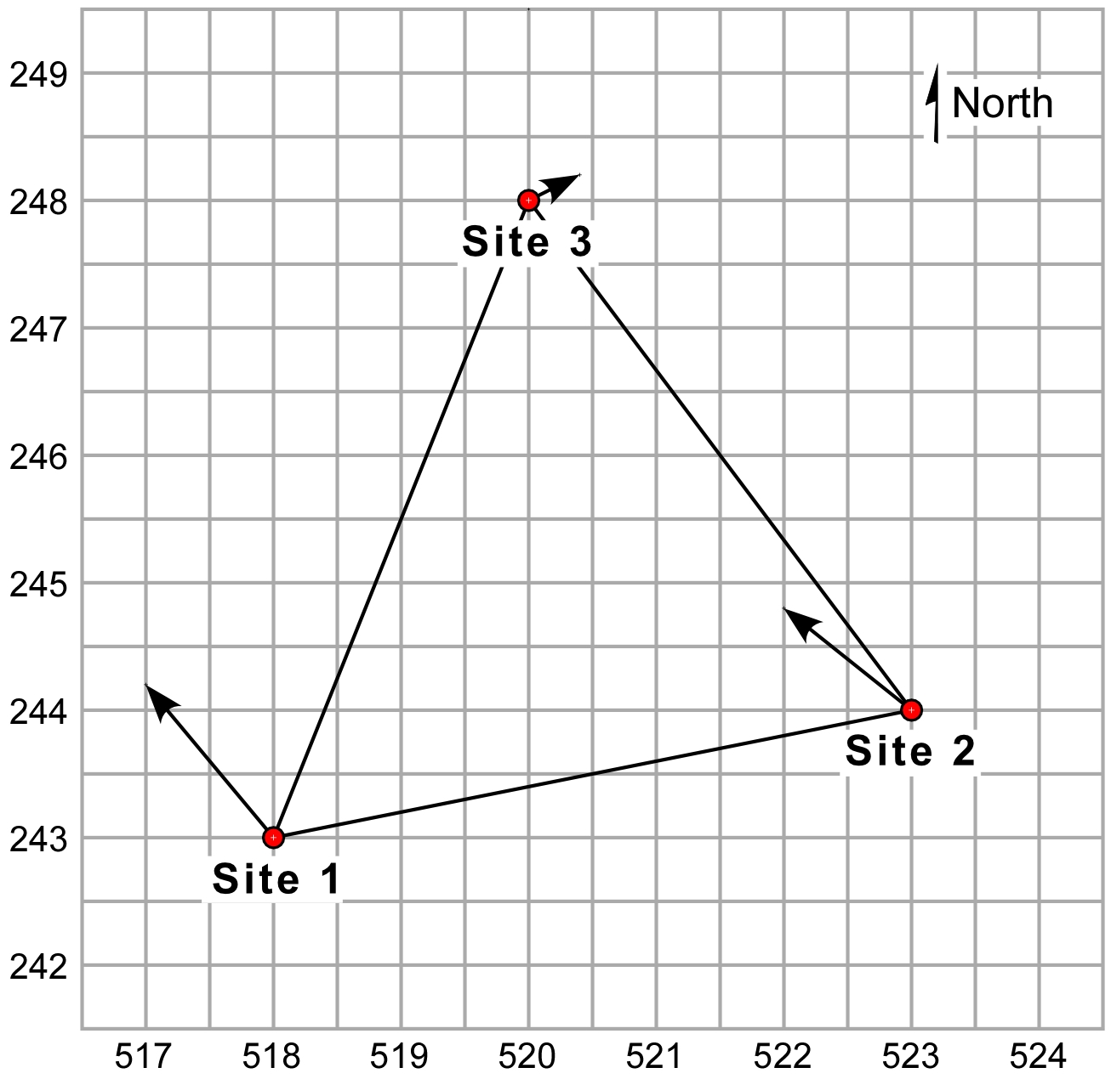
Graphical visualization of
crustal strain defined by GPS velocities
Define the triangle between the GPS sites
7
Notes:
We visualize a triangle, with the initial locations of the GPS sites forming the vertices of the triangle.

Slide 8
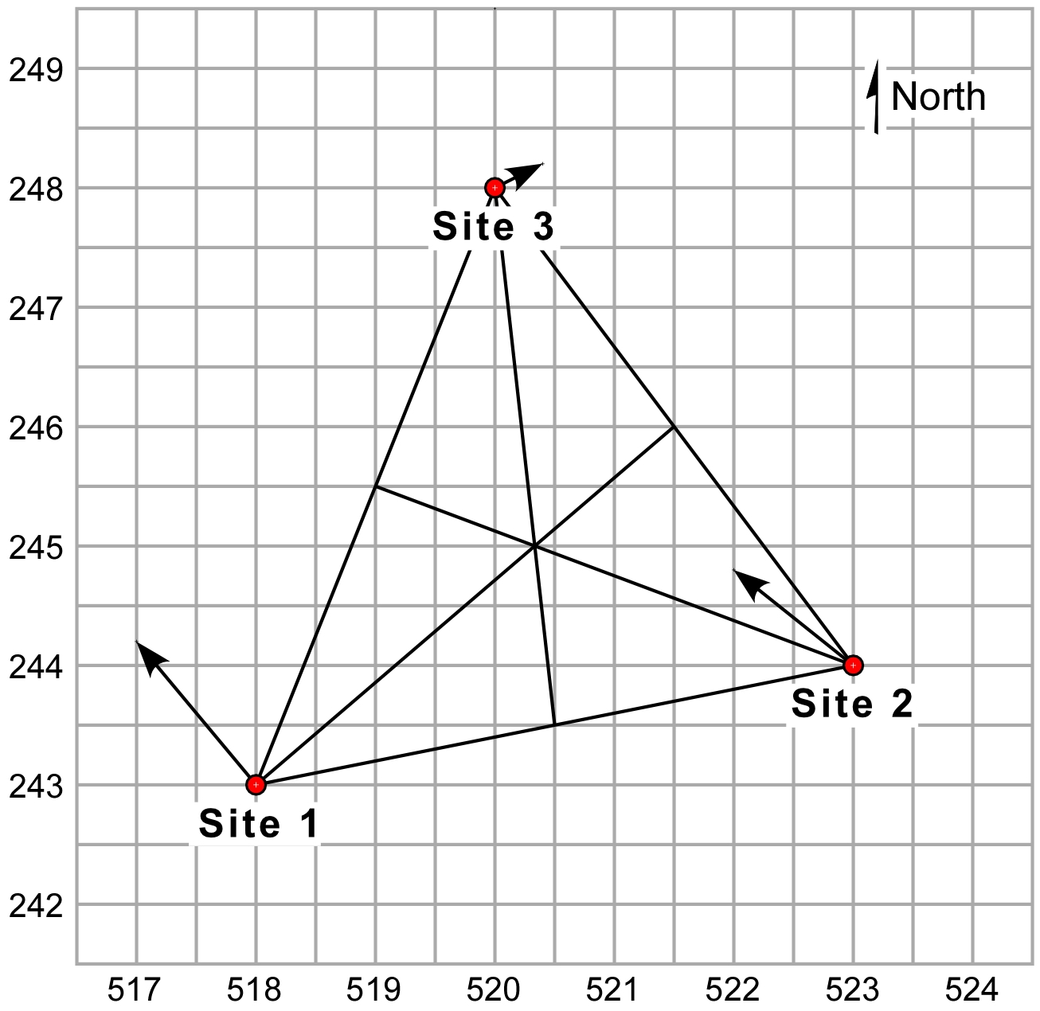
Graphical visualization of
crustal strain defined by GPS velocities
Define the centroid of the triangle
8
Notes:
We can find the centroid of the triangle by projecting a line from each vertex to the midpoint of the side opposite that vertex. The intersection of those three lines is the center (or centroid) of the triangle.

Slide 9
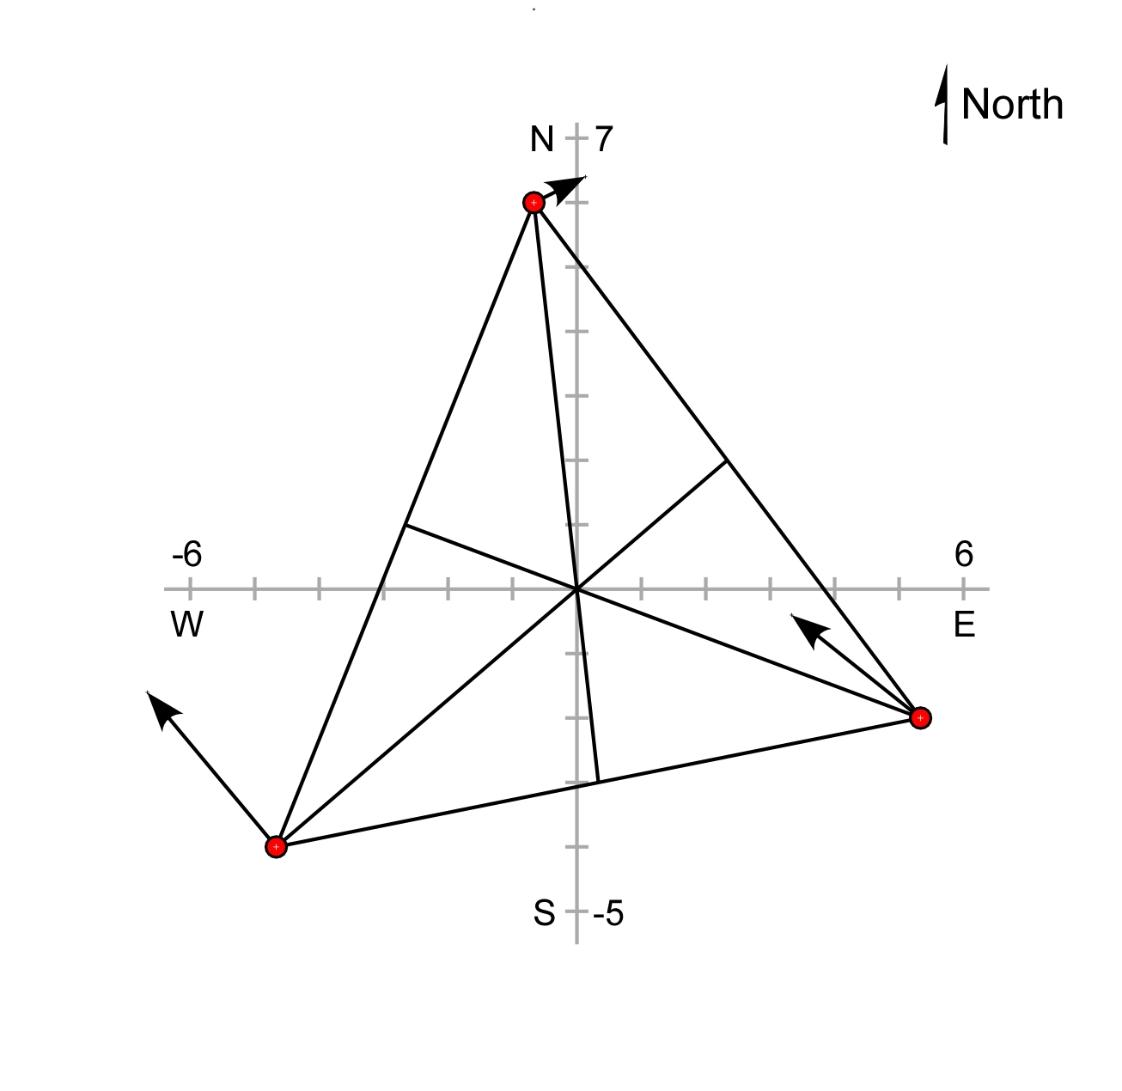
Graphical visualization of
crustal strain defined by GPS velocities
Transform coordinate system to a new origin at the centroid of the triangle
9
Notes:
We establish a new coordinate system whose origin is the center of the triangle. The units of the new coordinate system are the same as the original system, and the axes of the two coordinate systems are parallel to each other. This is an example of a coordinate transformation by simple translation of coordinate axes.

Slide 10
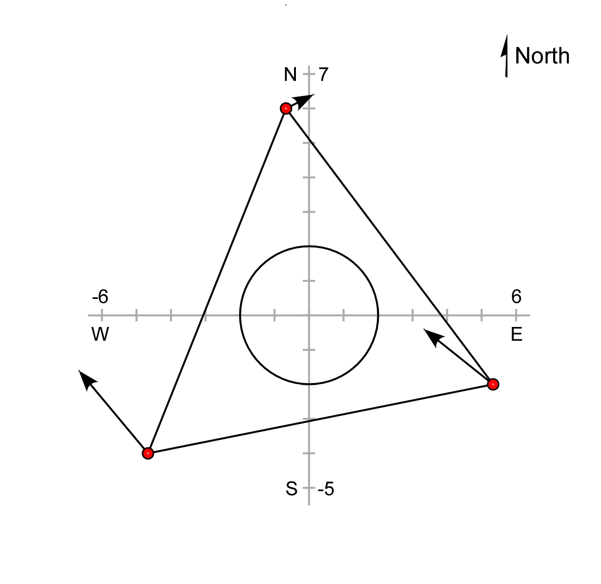
Graphical visualization of
crustal strain defined by GPS velocities
Inscribe a circle at the center of the undeformed triangle
10
Notes:
We inscribe a circle around the origin of our new coordinate system within the original or undeformed triangle. As the triangle changes position and shape in the slides to come, so too will the circle change its position and shape, becoming an ellipse. The resulting ellipse is the 2-dimensional strain ellipse for this deformation.

Slide 11
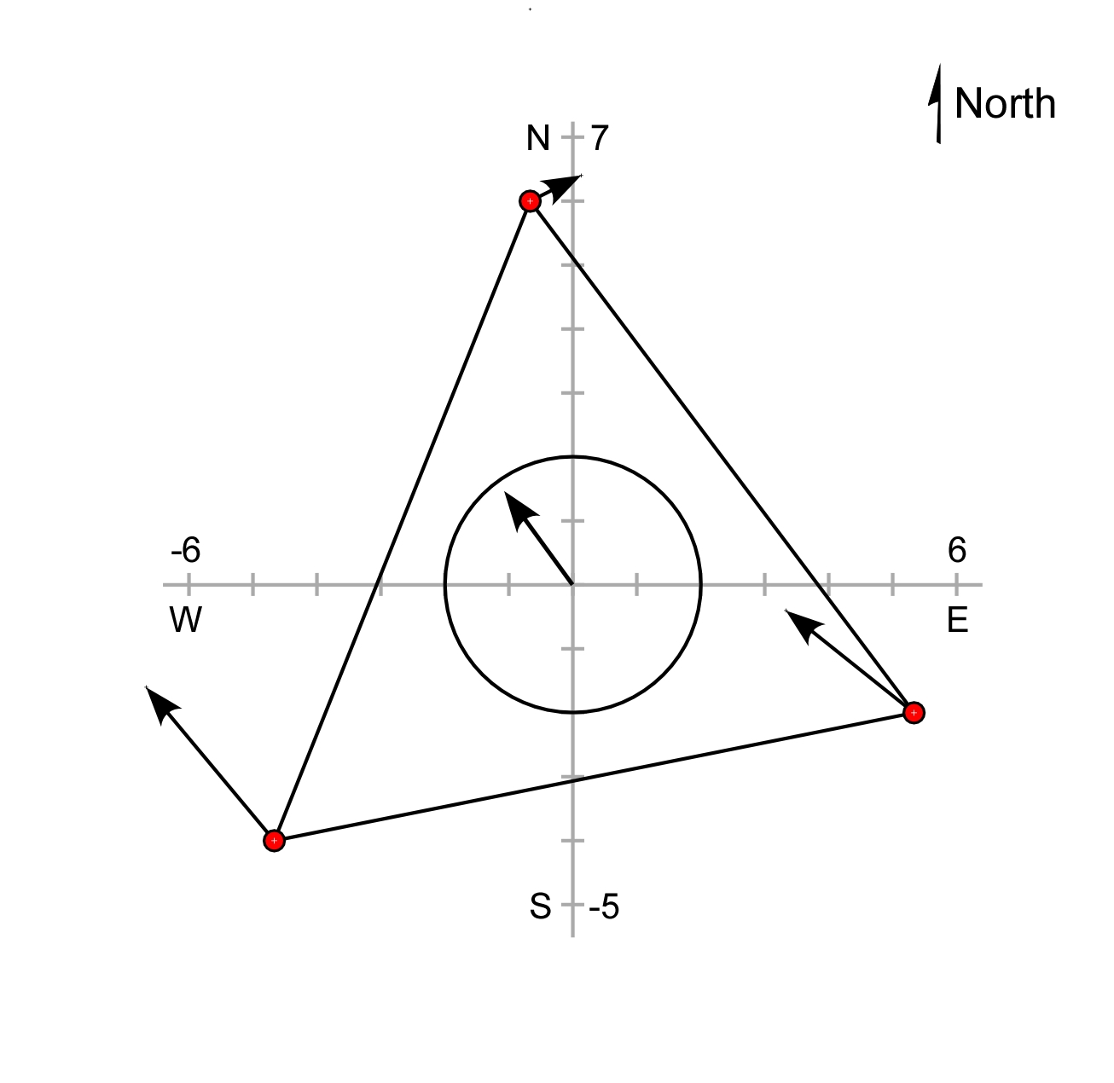
Graphical visualization of
crustal strain defined by GPS velocities
The average of the three total site velocities is the translation vector
11
Notes:
The average of the total horizontal velocity vectors for the three GPS sites is equal to the translation vector, shown at the origin of the coordinate system.

Slide 12
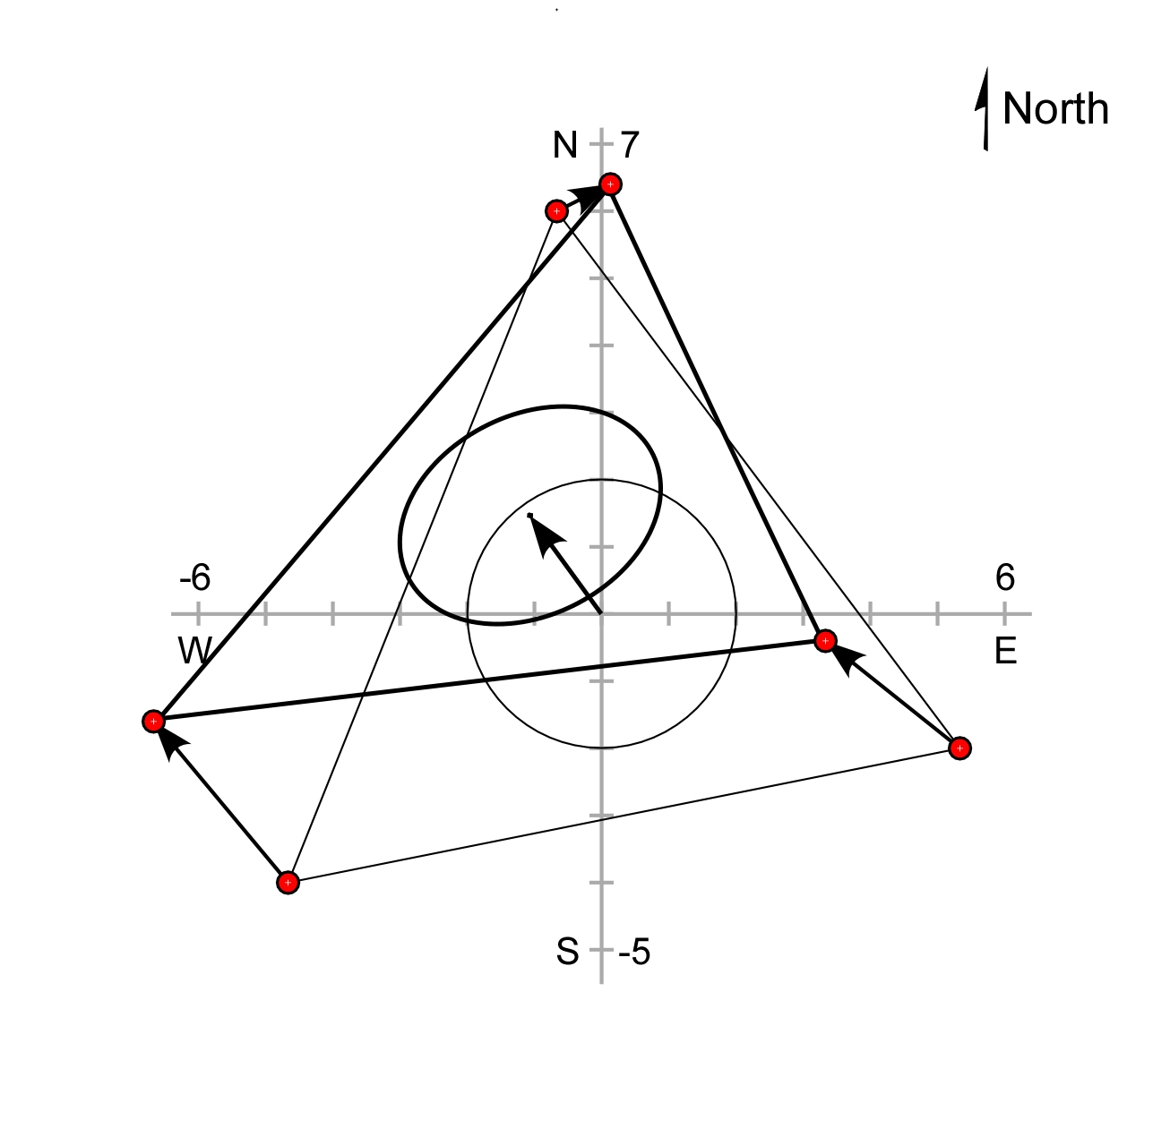
Graphical visualization of
crustal strain defined by GPS velocities
The triangle deforms as each of the sites moves. The vector from the centroid of the undeformed triangle to the centroid of the deformed triangle is the same as the horizontal translation vector.
12
Notes:
When we move the triangle with its attached circle so that the vertices are located at the heads of the three site velocity vectors, the triangle deforms. The lengths of its sides are different than the original lengths, and the interior angles of the triangle have also changed. The original circle has now been distorted into an ellipse. The translation vector defined in a previous slide (as the sum of the three GPS site velocity vectors) is shown to be the vector between the centroid of the undeformed triangle and the centroid of the deformed triangle.

Slide 13
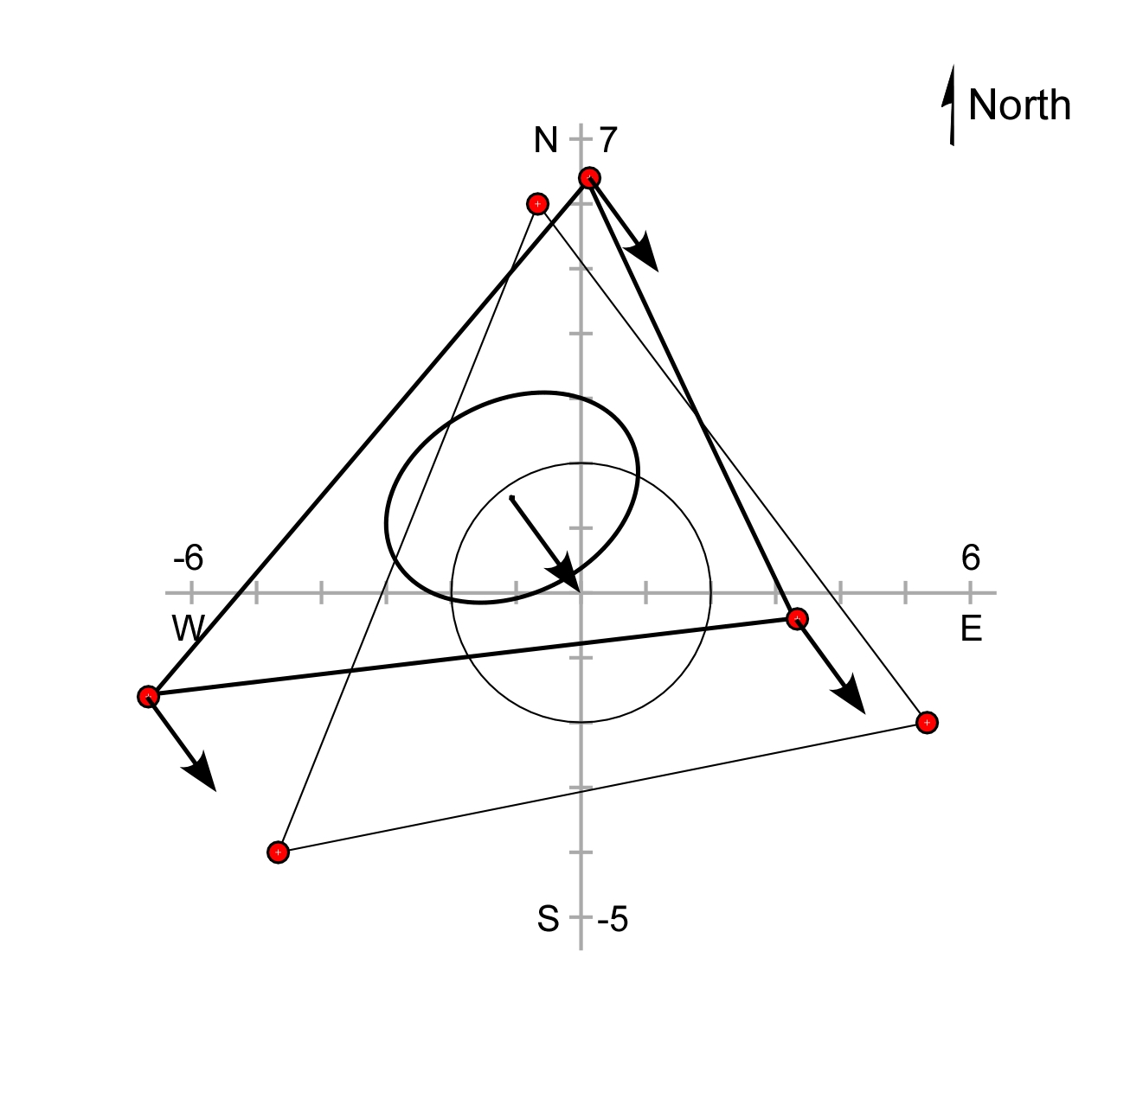
Graphical visualization of
crustal strain defined by GPS velocities
Subtracting the translation vector from the site velocities brings the two triangle centroids together.
13
Notes:
If we subtract the translation vector from the location of each vertex of the deformed triangle, …

Slide 14
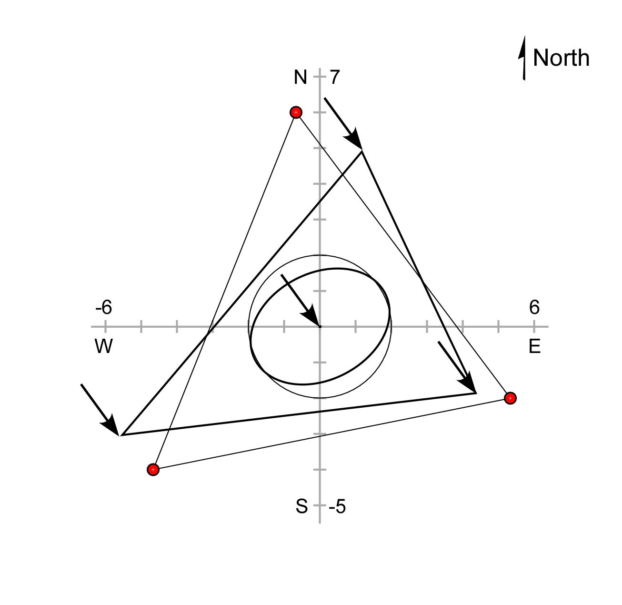
Graphical visualization of
crustal strain defined by GPS velocities
Subtracting the translation vector from the site velocities brings the two triangle centroids together.
14
Notes:
… we bring the centroid of the deformed triangle back to the origin of our coordinate system.

Slide 15
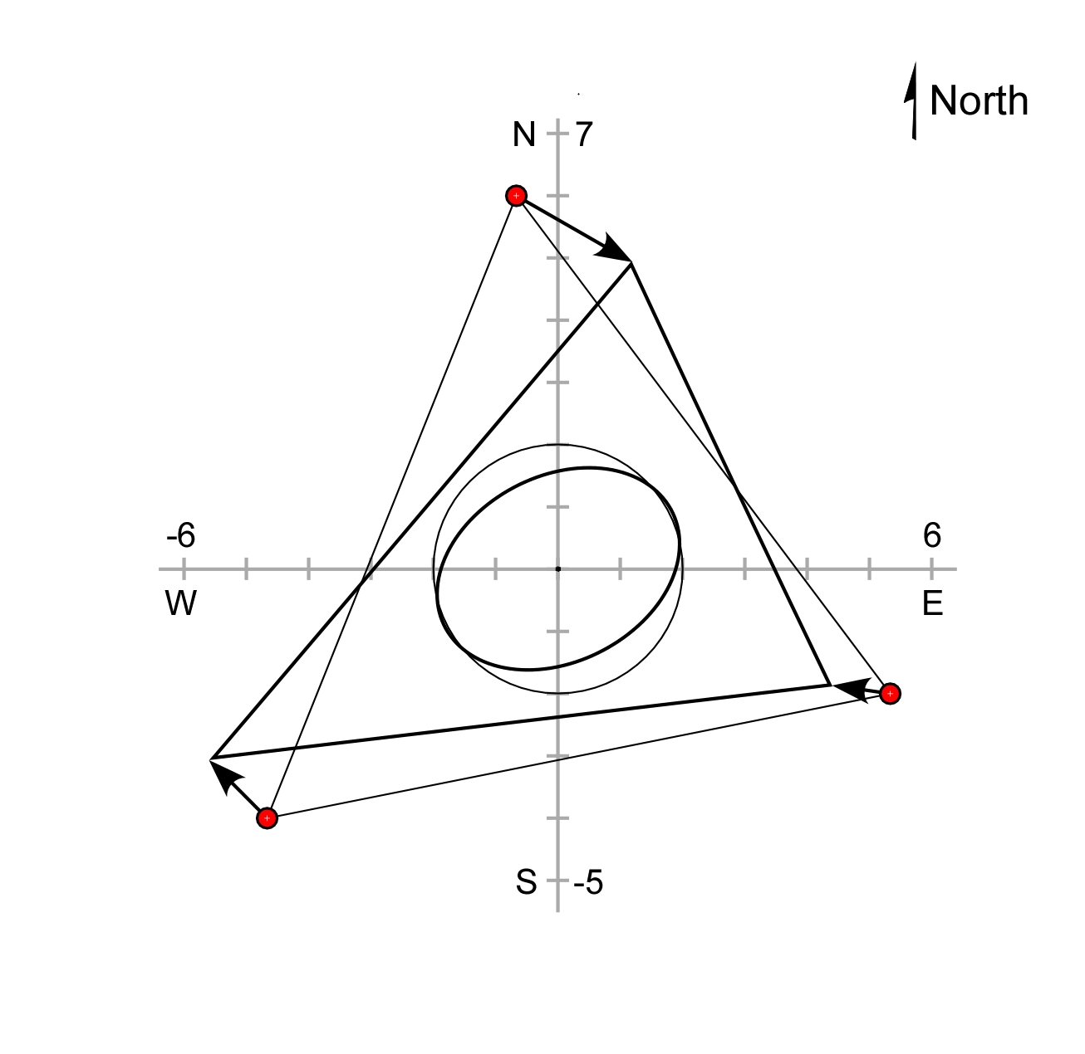
Graphical visualization of
crustal strain defined by GPS velocities
The total site velocities minus the translation vector yields the site vectors associated with the change in shape of the triangle.
15
Notes:
The total site velocities minus the translation vector yields the site vector associated with the change in orientation and shape of the triangle. Deformation is equal to translation plus rotation plus distortion. Here, we have removed the effect of the translation. This superposition of the original undistorted triangle with the distorted triangle clearly shows the change in shape of both the triangle and its inscribed circle, which is now an ellipse.

Slide 16
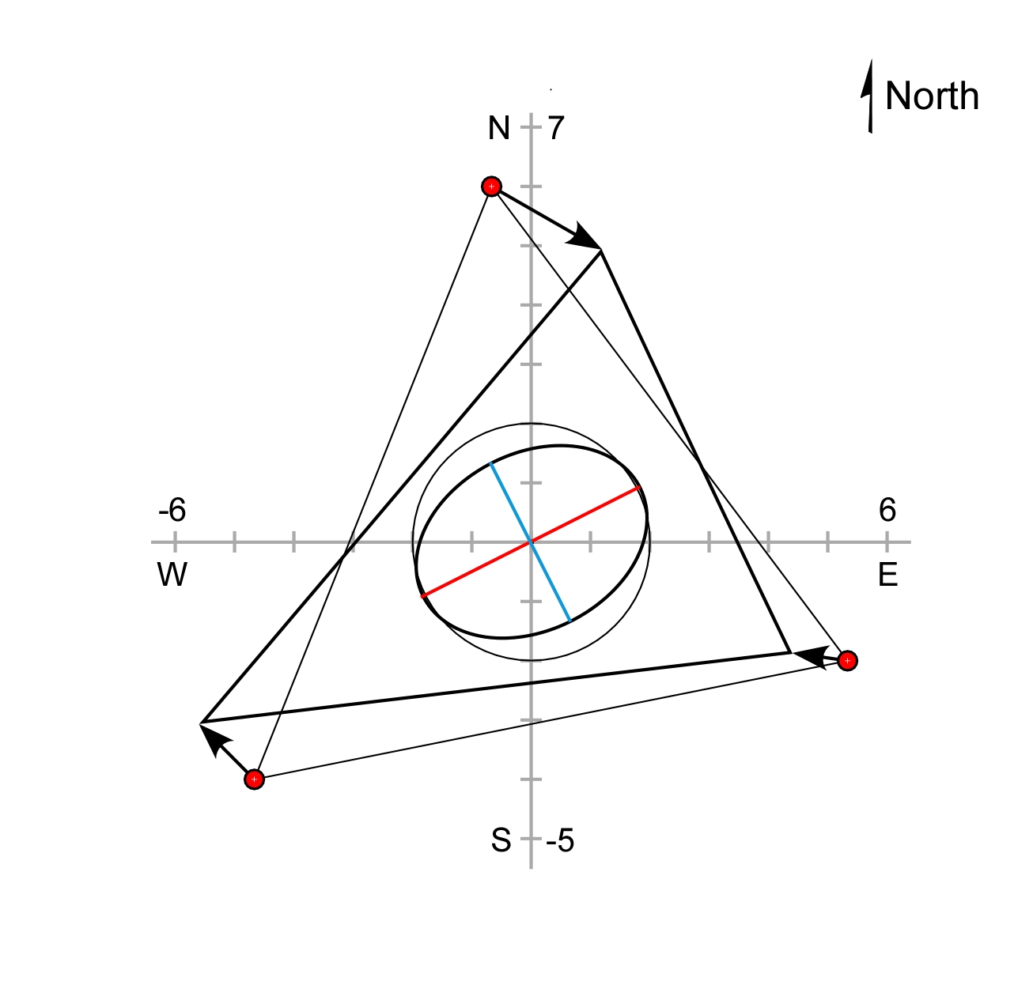
Graphical visualization of
crustal strain defined by GPS velocities
The red line is the major axis of the horizontal strain ellipse, and the blue line is the minor axis
16
Notes:
The ellipse is the horizontal strain ellipse. The major axis of the strain ellipse is shown as the red line, and the blue line is the minor axis of the strain ellipse. The red and blue lines are perpendicular to each other.
If we take the strained triangle with its inscribed circle and the red and blue lines, group them all together and move the vertices of the strained triangle back into their original (unstrained) positions…

Slide 17
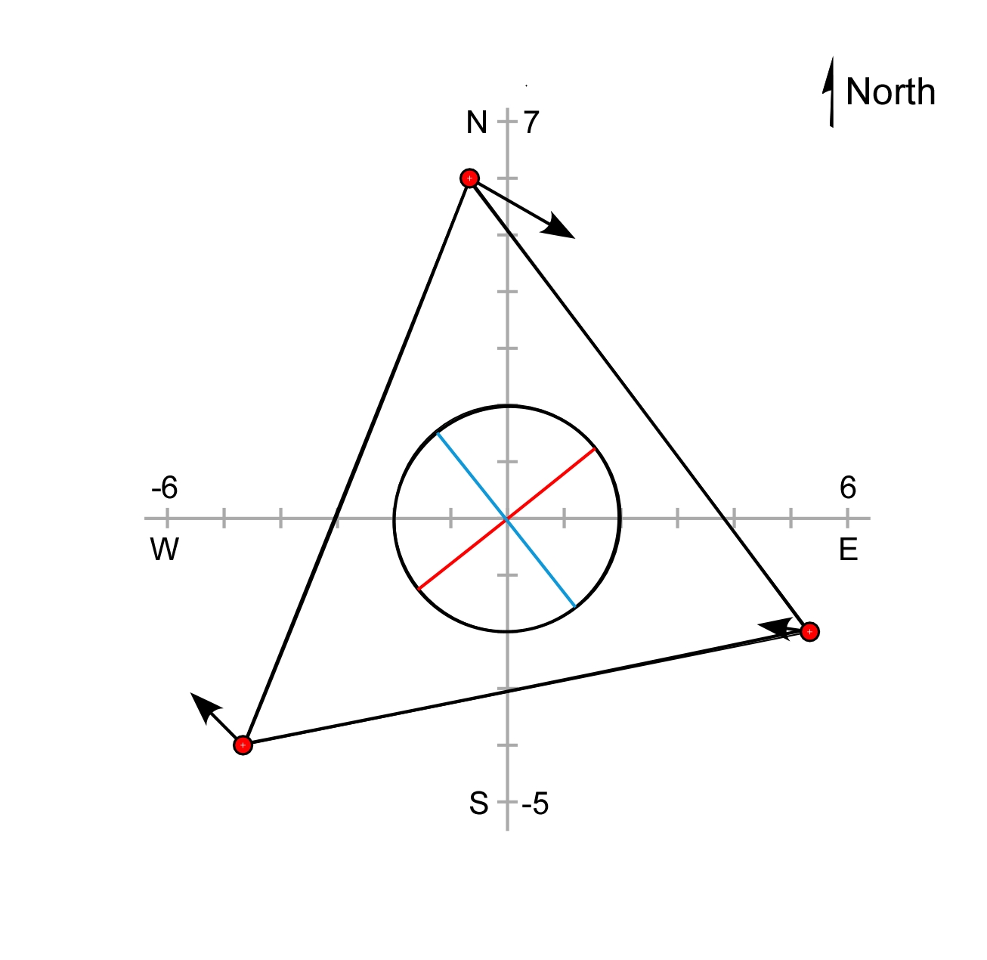
Graphical visualization of
crustal strain defined by GPS velocities
The ellipse axes remain perpendicular to each other when the strain is reversed.
17
Notes:
… we find that the ellipse becomes a circle. Somewhat surprisingly, the red and blue lines marking the original positions of the lines that would become the major and minor axes of the strain ellipse are perpendicular to each other in their original state. At any intermediate state in the deformation process, these lines would not be perpendicular.

Slide 18
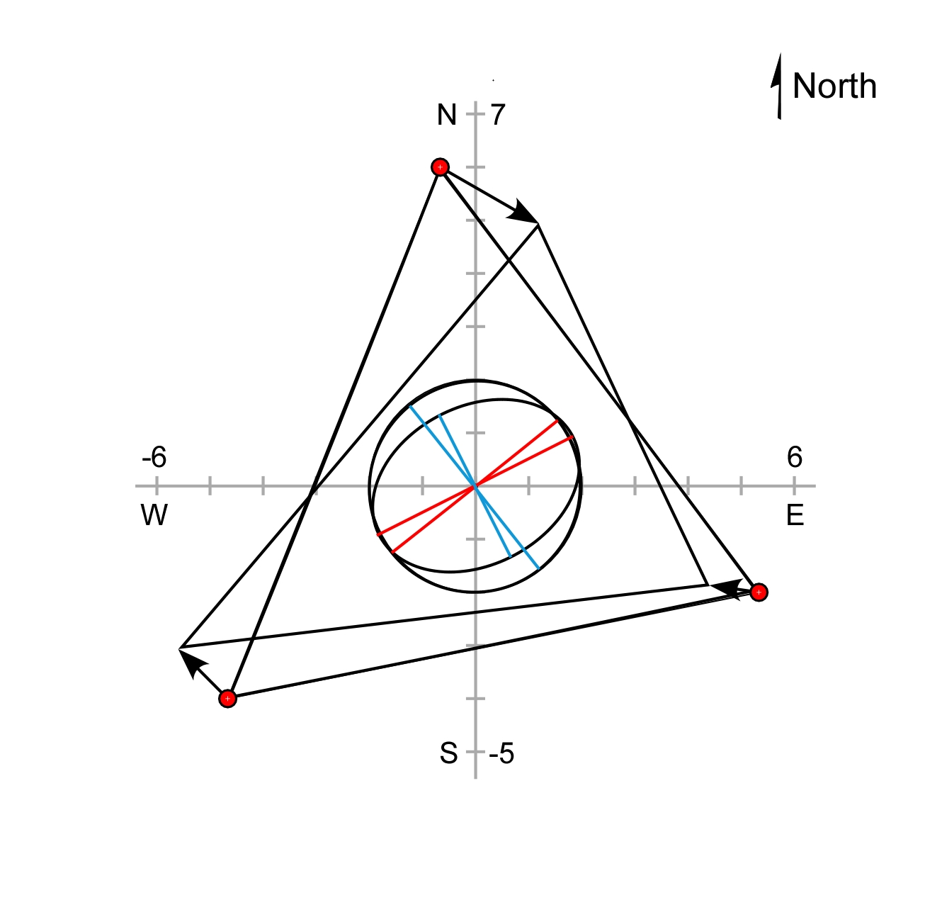
Graphical visualization of
crustal strain defined by GPS velocities
Superimposing the deformed triangle and the original triangle allows us to recognize the rotation during deformation.
18
Notes:
If we superimpose the centroids of the deformed and the undeformed triangles onto each other at the origin of our coordinate system, we find a slight angular divergence between the red lines and the blue lines. The angle between the two red lines is the same as the angle between the two blue lines.

Slide 19
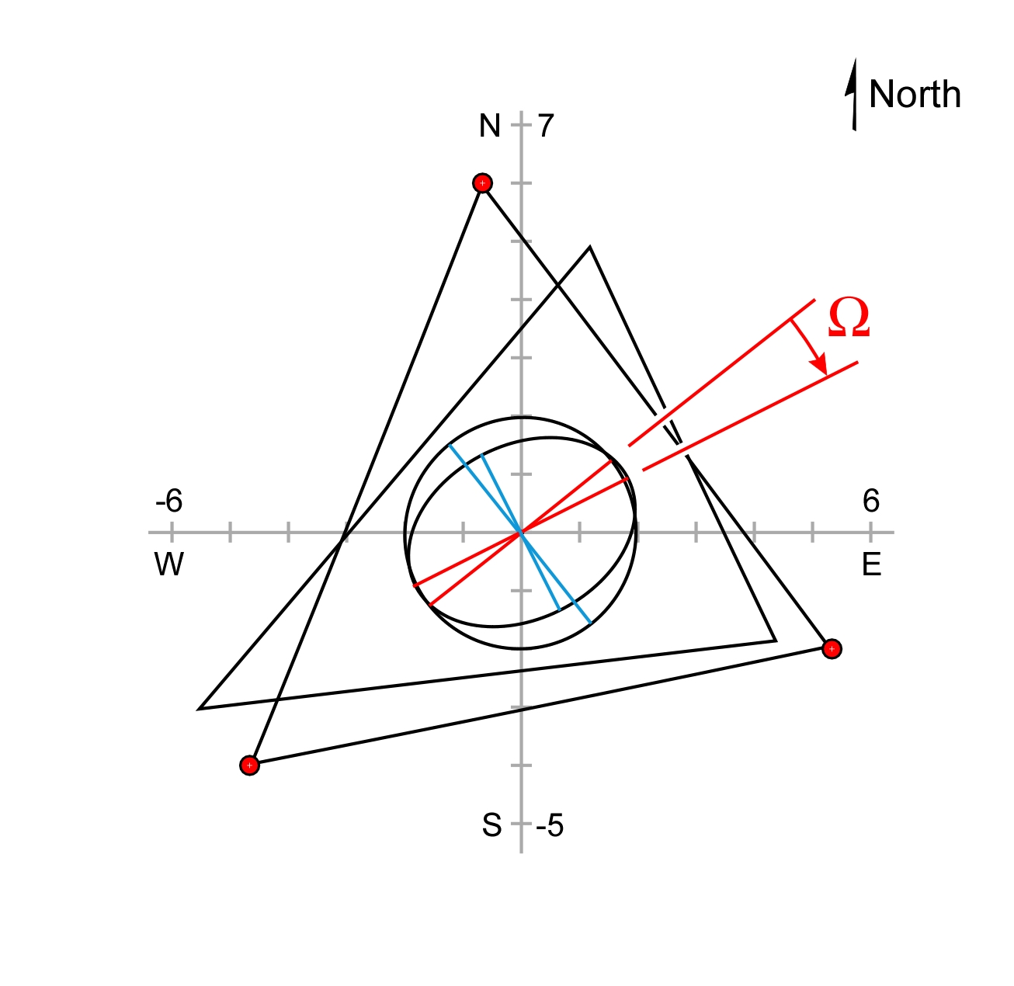
Graphical visualization of
crustal strain defined by GPS velocities
The rotational component of strain is indicated by the angular change in the orientation of the red lines.
19
Notes:
The angle by which the two sets of colored axes diverge from each other, labeled ωιτη α χαπιταλ ομεγα in this slide, is the rotational component of strain. Recall that the total deformation includes translation plus rotation plus distortion. We have now accounted for all components of the horizontal deformation of the crust between three GPS stations, as defined by their velocities relative to a common reference frame.

Slide 20
Graphical visualization of
crustal strain defined by GPS velocities
(3 supplemental slides follow...)
20
Notes:
The three supplemental slides expand upon the matter of subtracting the translation vector from the original site velocity vectors.

Slide 21
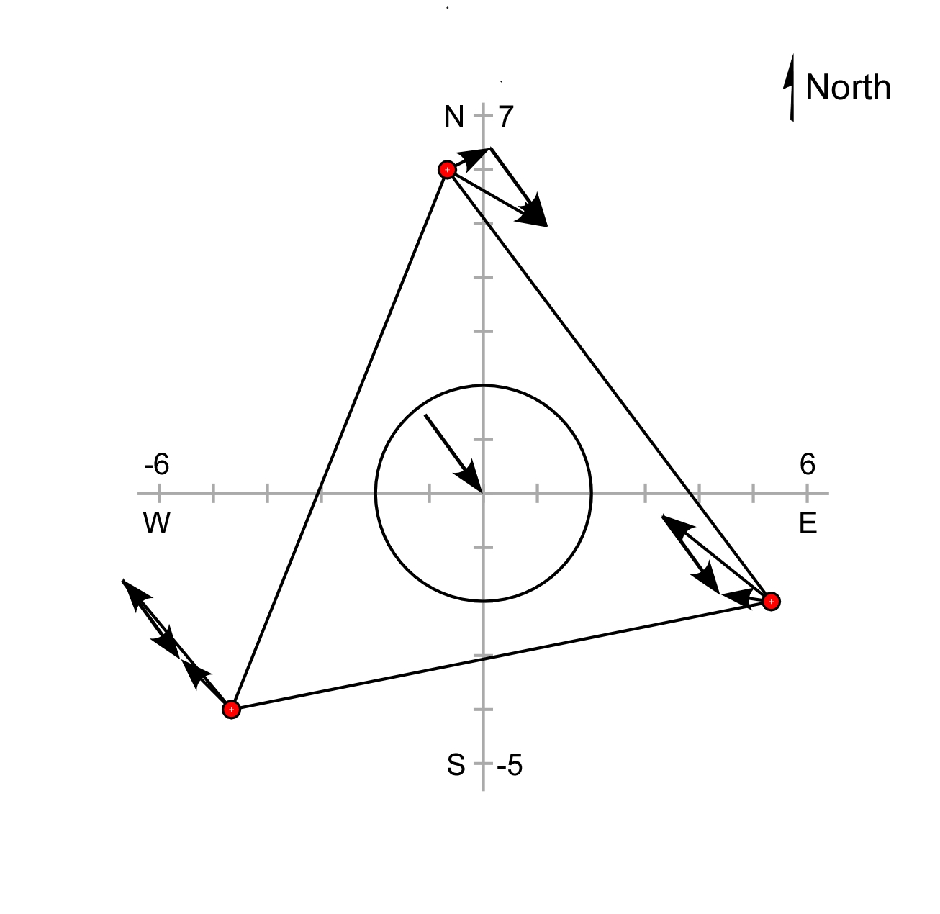
Graphical visualization of
crustal strain defined by GPS velocities
The total site velocities minus the translation vector yields the site vectors associated with the change in shape of the triangle.
21
Notes:
The total site velocities minus the translation vector yields the site vector associated with the change in shape (distortion) of the triangle.

Slide 22
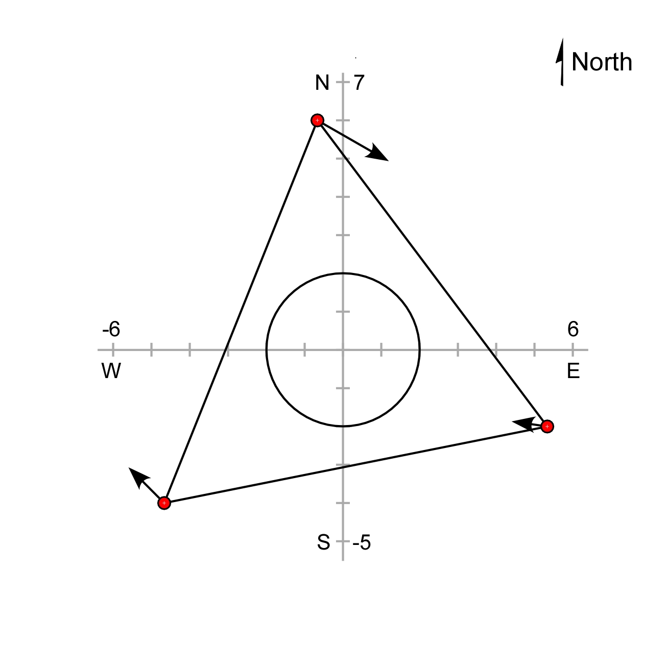
Graphical visualization of
crustal strain defined by GPS velocities
The total site velocities minus the translation vector yields the site vectors associated with the change in shape of the triangle.
22
Notes:
The vector result of subtracting the translation vector from the original site velocity vector for each GPS site is shown. These vectors are associated only with the change in shape or distortion of the triangle, without any contribution from translation.

Slide 23
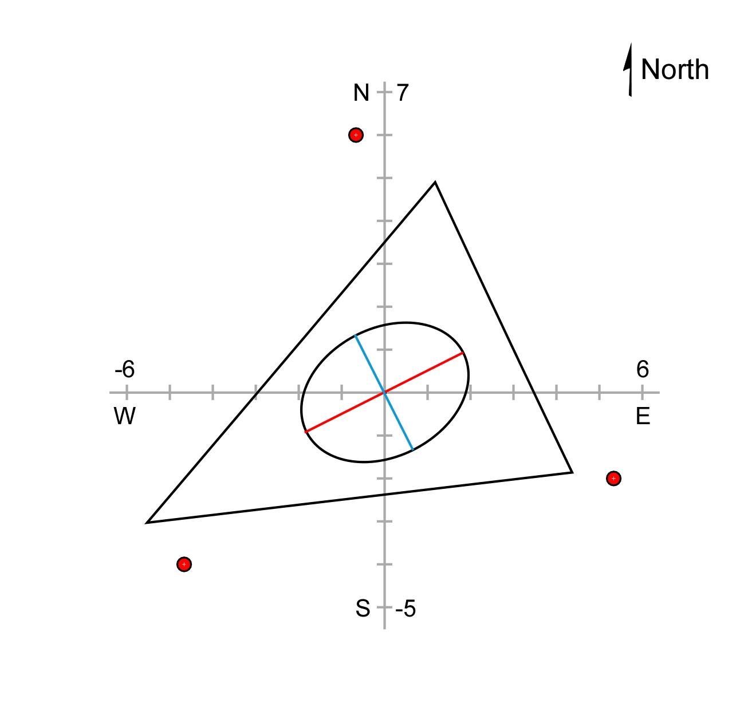
Graphical visualization of
crustal strain defined by GPS velocities
The total site velocities minus the translation vector yields the site vectors associated with the change in shape of the triangle.
23
Notes:
The distorted triangle and the circle distorted into an ellipse. The ellipse within the distorted triangle is the strain ellipse. The red line is the major axis of the strain ellipse, and the blue line is the minor axis.

