Slide 1
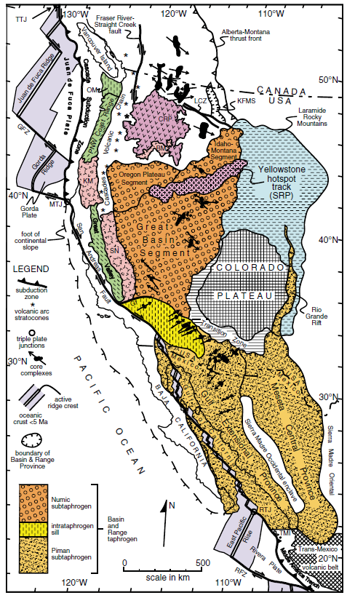
Tectonic Setting of the Great Basin Through Geologic Time: Implications for Metallogeny
William R. Dickinson, 2001. Colored figures from Dickinson, 2006
Atticus Proctor, November 2021

Slide 2
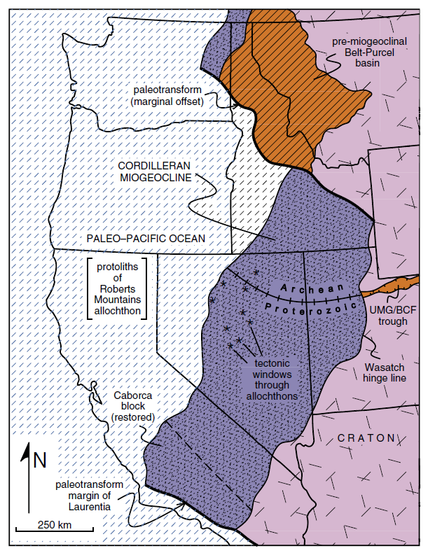
Precambrian before the Miogeocline
Significance of Precambrian metallogeny is obscure
Maybe some, maybe none
Basement rocks are a potential reservoir for metals mobilized in Phanerozoic events.
Miogeocline
Cordilleran passive margin forms after rifting of Rodinia.
Proposes that thinning of the crust due to rifting could have led to the injection of mantle melts that introduced metals into the crust

Slide 3
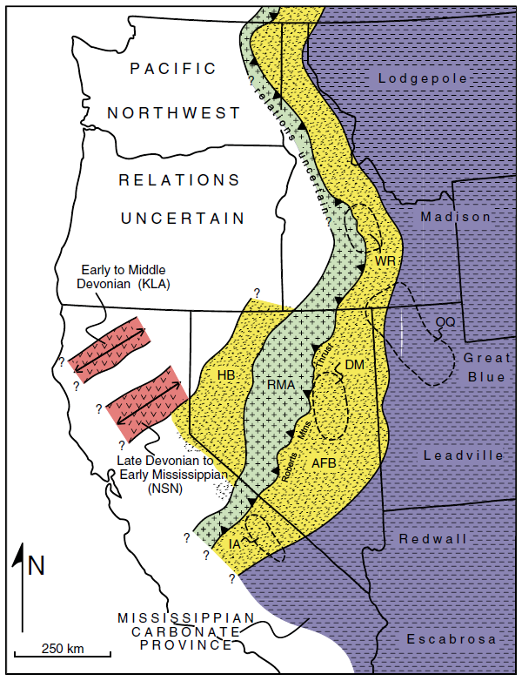
Antler-Sonoma Orogenesis
“Subducting” the miogeoclinal prism
As the RMT thrust over the miogeocline fluids were likely driven up dip (east).
Metals could have been scavenged from sediments and concentrated at the base of the allochthon.
Carlin-type deposits?
Foreland normal faults could have been fluid conduits

Slide 4
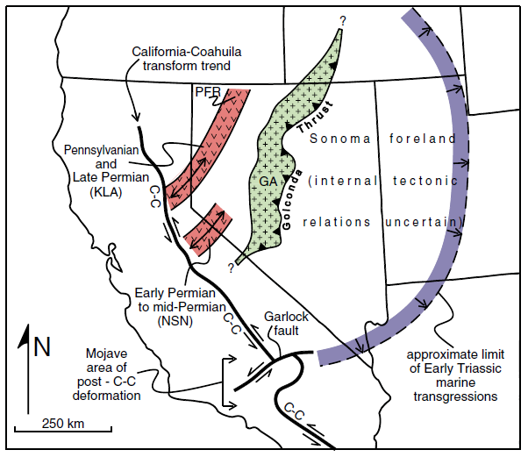
Syn-Sonoma Orogeny
Metal bearing hydrothermal fluids could have made deposits far eastward of the edge of the RMT and Golconda allochthons.
Favorable geometries in the Sonoma and Antler foreland basins could have aided in metal deposition

Slide 5
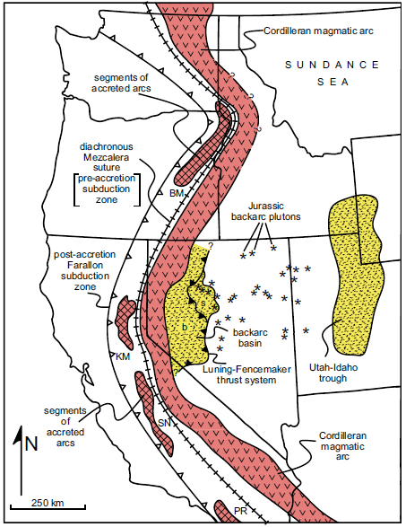
Cordilleran Arc and Back Arc
Isotopic data show a stronger mantle influence on Jurassic magmatism in Nevada than Cretaceous magmatism.
Potential implications for metallogeny

Slide 6
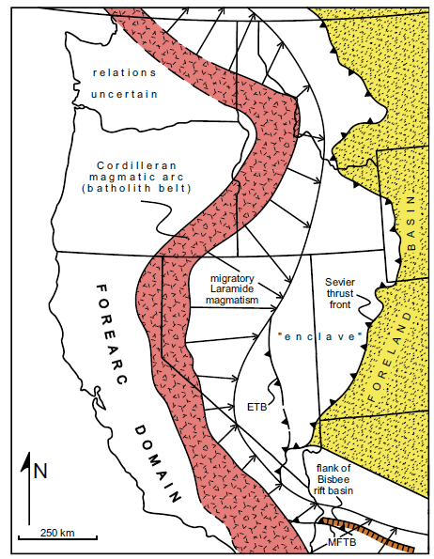
Cretaceous-Paleogene
Intense Cretaceous magmatism in western Great Basin
Mesozoic thrusting along (Jurassic) Luning-Fencemaker and (Cretaceous) Eureka thrusts could have mobilized fluids on a sub-regional scale.

Slide 7
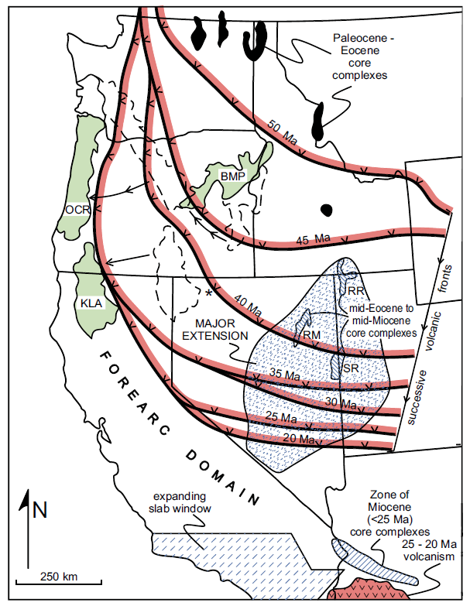
Cretaceous-Paleogene continued
Paleogene magmatism, believed not to be related to subduction, but to intracontinental extension.
Widespread ore deposition accompanied Cenozoic magmatism
Cordilleran magmatic arc likely has significant metallogenic influence
Addition of mantle components
Advective heat flux transported metals and likely superimposed hydrothermal events

Slide 8
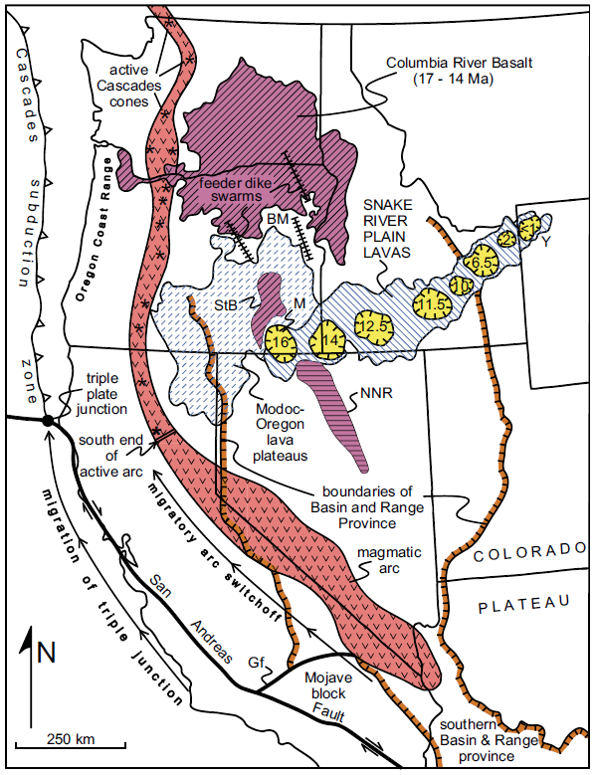
Great Basin Extension
Mantle derived magmas could have contributed metals via direct injection or through providing a heat source to cycle fluids through the crust.
Crustal extension could have generated hydrothermal systems associated with igneous centers and exhumation of rock from the mid-crust.
Extension and faulting can bring ore deposits closer to the surface (Yerington)

Slide 9
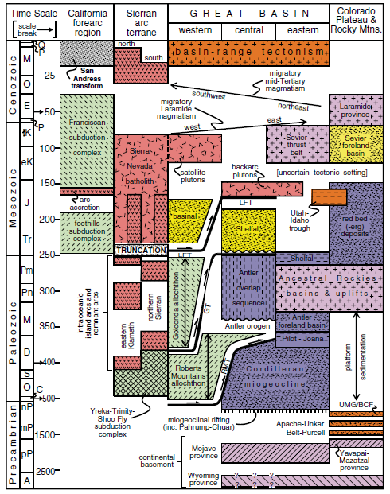
Conclusions for metallogeny
Metals derived from the mantle after crustal genesis could have entered the crust during rifting events
Neoproterzoic along miogeocline
Neogene Basin and Range
Arc or back arc extension
Metals derived from basement rocks could be scavenged by fluids during rift or arc related igneous episodes
Metals potentially derived from sedimentary rocks could have been moved in response to igneous episodes or thrusting causing fluids to move
Metalliferous fluids likely followed any local, subregional, or regional structures to transport metals (i.e bedding, faults, etc.)

