Slide 1
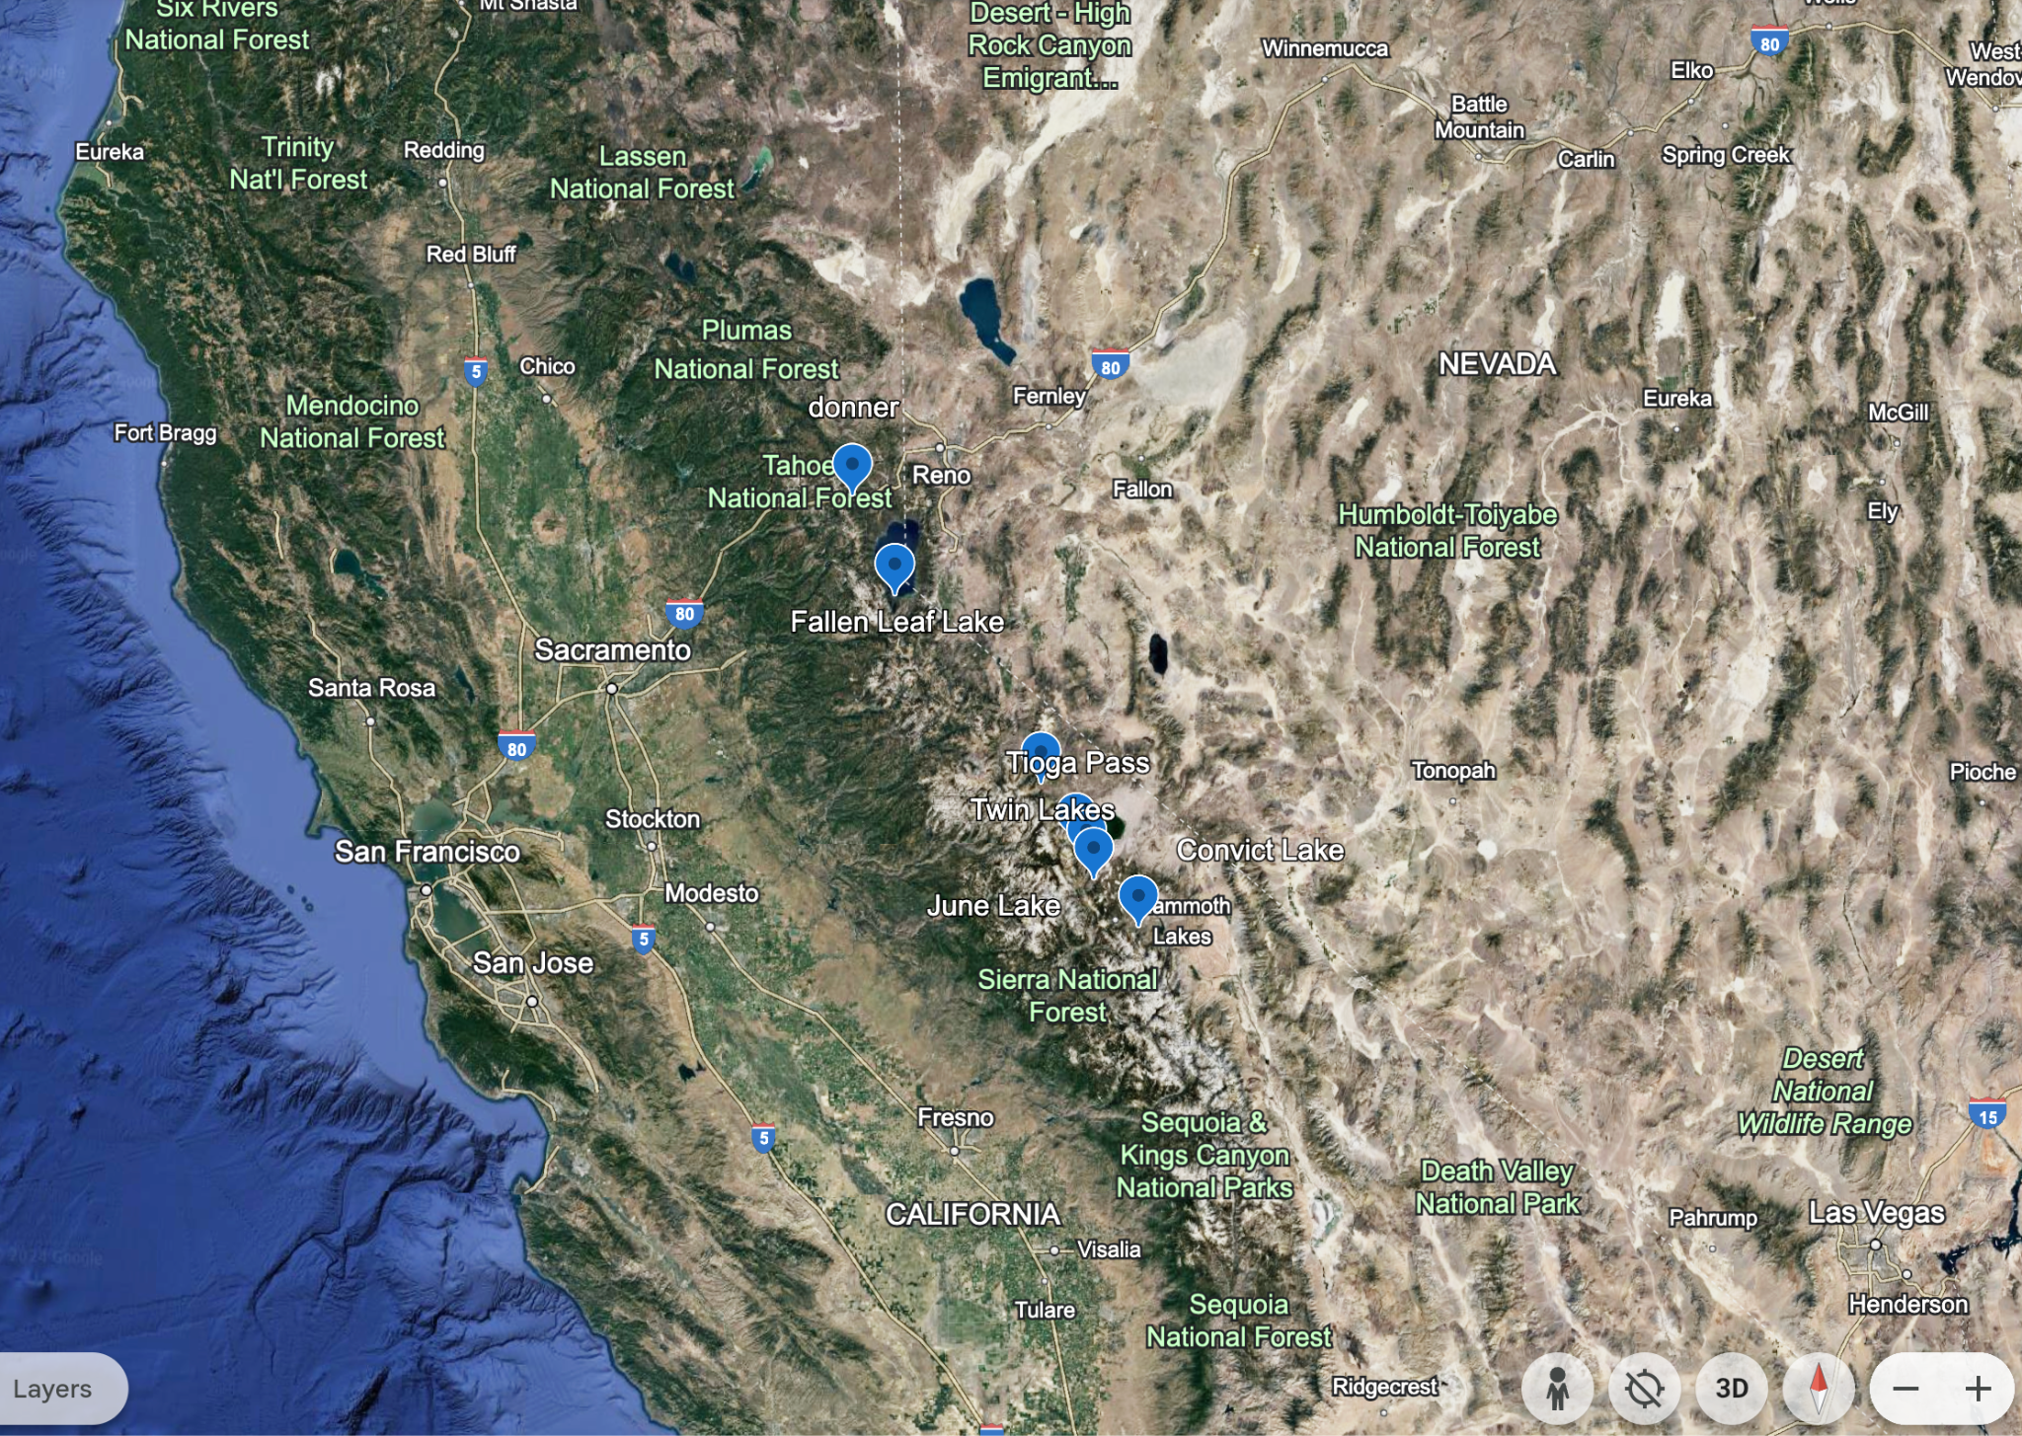
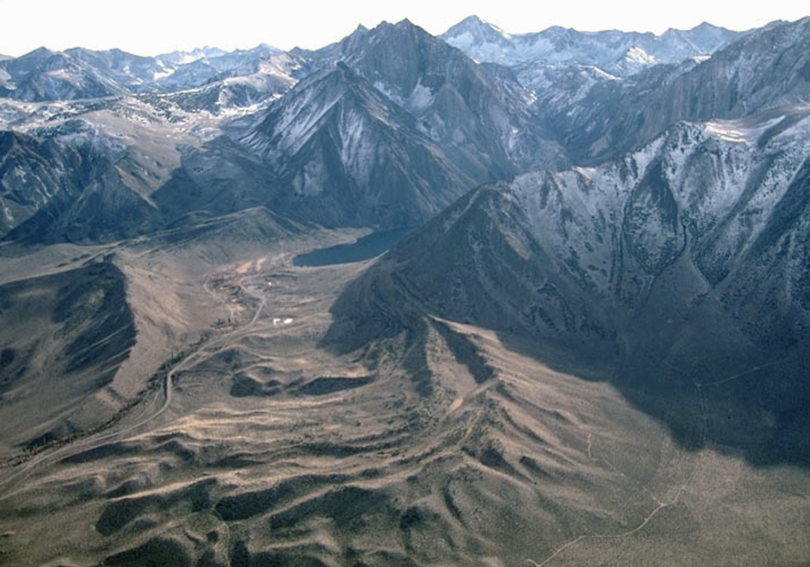
Pleistocene glaciation in the Sierra Nevada and Basin Range
Summary of USGS Bulletin by Eliot Blackwelder 1931
& GSA Bulletin by Sharp and Birman 1963
Alyssa Lindsey, 2024
Bloody Canyon
The authors of this paper examined the morphology and weathering characteristics of glacial moraines along the east flank of the Sierra Nevada at multiple sites along east flank of Sierra Nevada. At these sites moraine deposits are evident, like here at Convict Lake. There observations show multiple episodes of glaciation in the Sierra Nevada.
Notes:
Here knock down principal

Slide 2
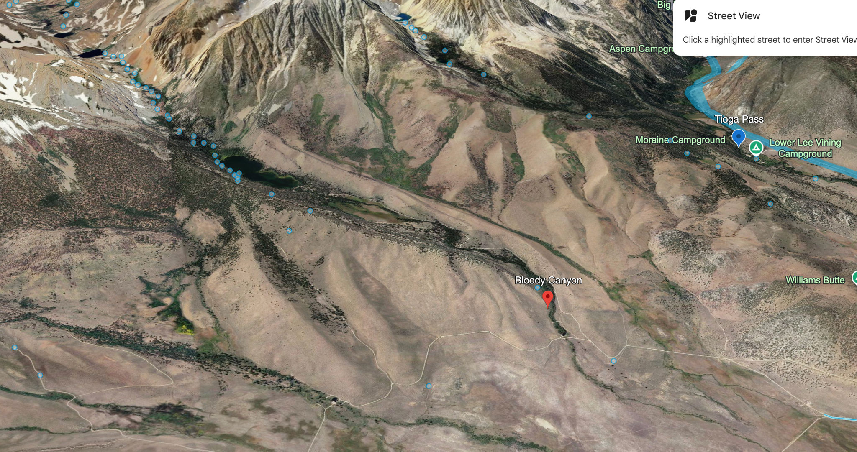
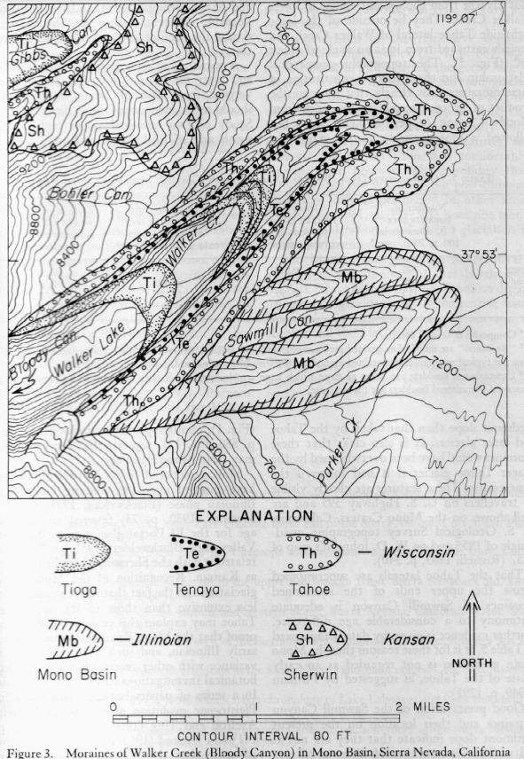
Tioga
Tahoe
Mono Basin
Bloody Canyon as an example:
Inset Relationships and Cross-cutting relationships are used to interpret 3 distinct periods of moraine development.
From youngest to oldest: Tioga, Tenaya, Tahoe, and Mono Basin Moraines (periods):
Evidence: Tioga moraines inset into larger Tahoe Moraines and Mono Basin Moraine is cut by Tahoe moraine.
Not expressed at Bloody Canyon but observed and interpreted elsewhere are periods Sherwin and McGee Stages
Notes:
Here provides principle approach and result

Slide 3
The authors also indicate weathering characteristics support their interpretations of relative age – such as relative weathering of boulders is ‘greater’ on older moraines and crests of older moraines are not so sharp – though reports are not so well documented with photos or plots to show here…
Tioga
Tenaya
Tahoe
Characteristics: Large and massive moraines, more extensive glaciation than the Sherwin or Tioga stages. Moraines reach heights of 500-1000 ft
Evidence for Age:
Moraine Preservation: Still bold embankments but more eroded than Tioga moraines. Typically lack terminal moraines and boulders.
Erosional Features: Some valleys show more erosion compared to Tioga; still possess notable features like roches moutonnées.
Boulder Decay: Moderate weathering and decay, with a noticeable reduction in striated surfaces on granite. Siliceous boulders show striations
Volcanics: Lava flows (with spatter cones) over moraines NE of June lake. Also ash from the Mono volcanics (1-10 inches).
Terminal Elevation: 7000ft
“The lateral moraines generally stand out as bold embankments, marred only by a few landslides and by sharp ravines where tributary brooks descend the canyon sides.”
Characteristics: Best preserved glacial features with minimal erosion; clear moraine formations and polished rock surfaces.
Evidence for Age:
Freshness of Moraines: Moraines and rock surfaces are relatively unaltered and well-preserved.
Limited Erosion: Little valley erosion, fresh moraines with minimal breaches.
Boulder Weathering: Most boulders remain almost unweathered, with high visibility of striations on resistant rocks.
Characteristics: Previously mapped as Tioga and Tahoe, by 1950-1960, the Tenaya was broken out as a separate glacial stage.
Evidence for Age:
-Separate ridges between the Tioga and Tahoe lateral moraines are evidence of the Tenaya stage.
- Did not build large terminal moraines.
- Distinctly fresher and more topographically ragged moraines than Tahoe.
- Tenaya moraines pass under Tioga moraines.
Notes:
Here you and audience can compare without trying to remember what was on last slide…

Slide 4
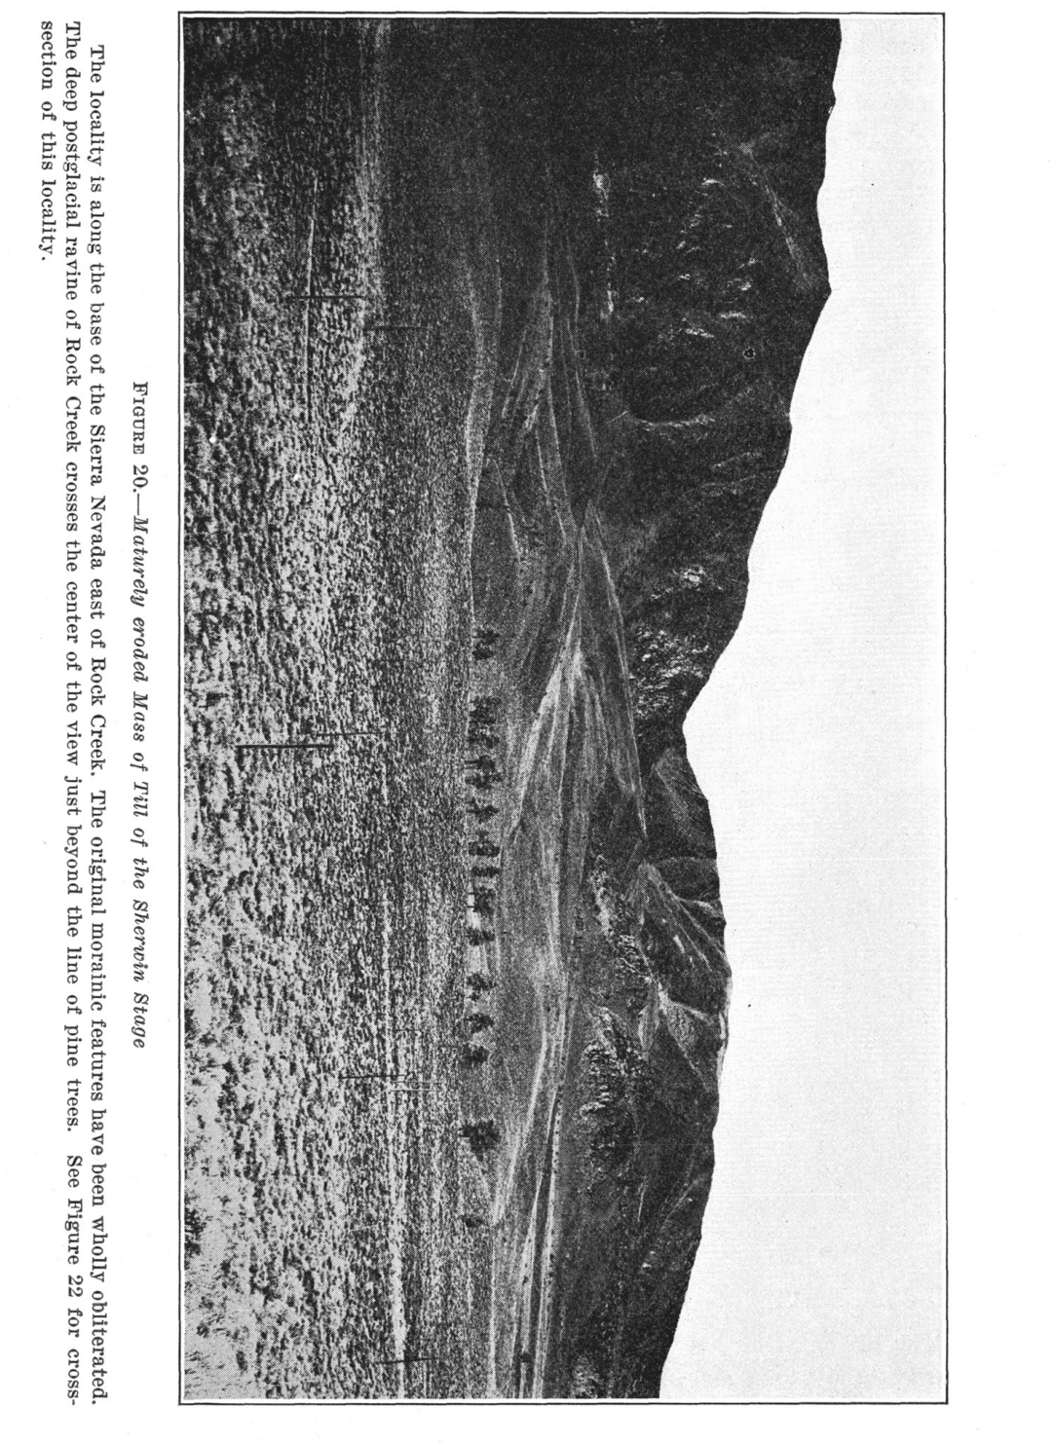
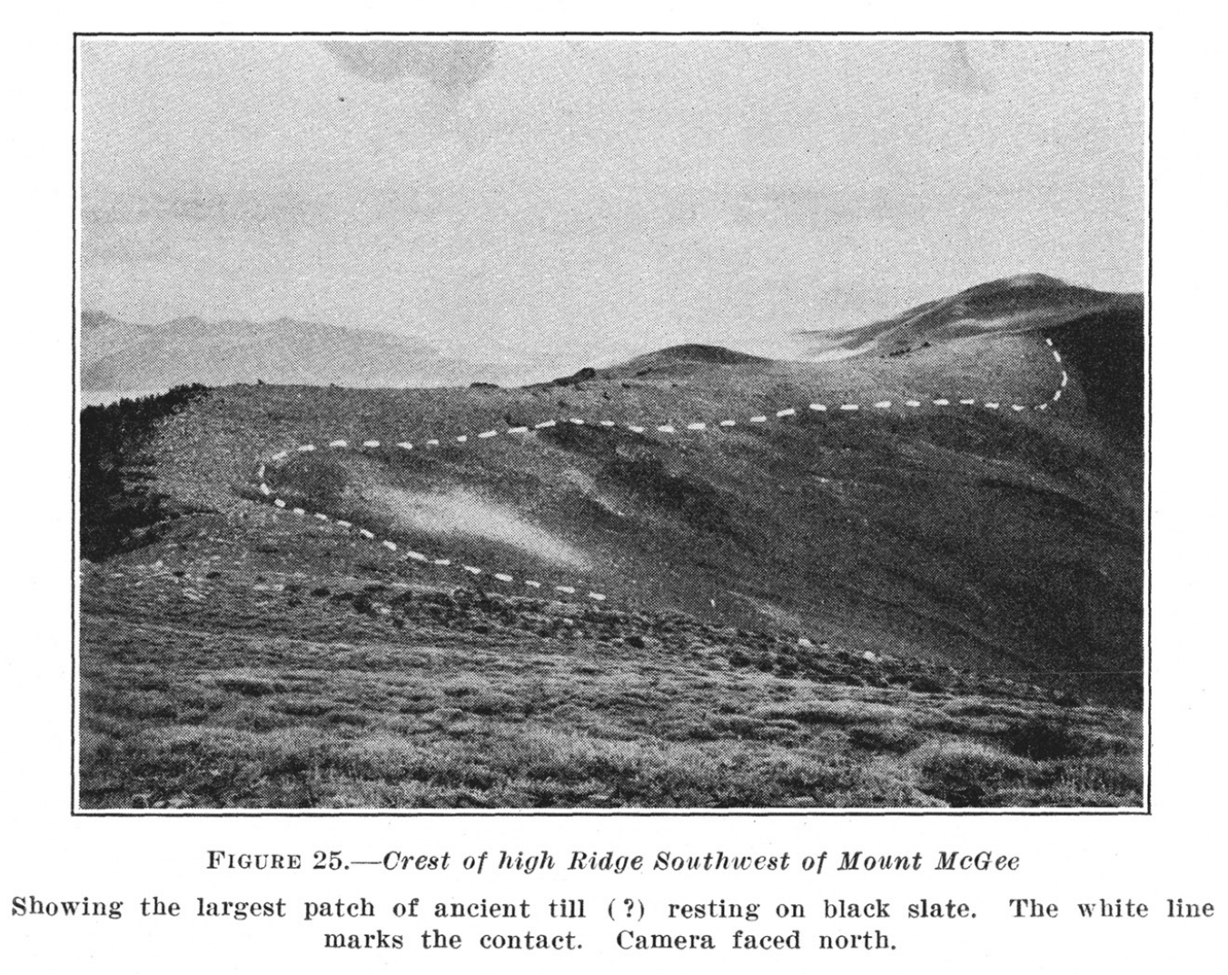
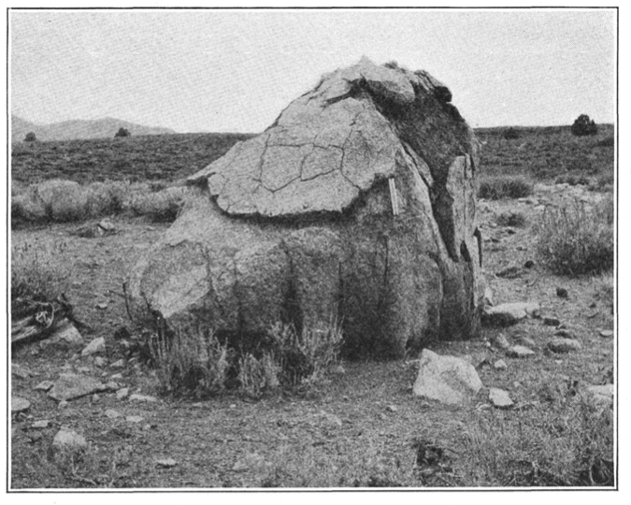
Two older periods of glaciation are reported from presence of glacial tills in general absence of moraine morphology
Sherwin Stage
McGee Stage
Mt MCGEE
ROCK CREEK
Characteristics: Original glacial topographic features almost entirely lost; recognized by isolated patches of till.
Evidence for Age:
A deposit resembling till, of granite debris, rests on a ridge of Paleozoic slate and marble. Although more evidence is needed to confidently determine the origin as glacial.
Granites are determined to have been transported as much as 3.5 miles.
Striated fragments were found
Characteristics: Original glacial topographic features almost entirely lost; remnants of moraines significantly eroded. Recognized almost entirely by remnant till.
Evidence for Age:
Moraine Preservation: Few, if any, terminal moraines remain, with eroded lateral moraines suggesting extensive glaciation. Boulders are sparse.
Erosional Features: Valleys show advanced erosion with no clear roches moutonnées, indicating substantial post-glacial geomorphic activity.
Boulder Decay: Severe weathering and decay of boulders; granite surfaces heavily degraded with almost no striations visible. Siliceous boulders show remnants of striations indicating significant age.
Volcanics: Most Sherwin evidence is covered by ash 3-10ft deep.
Would have been more extensive than Tahoe or Tioga

Slide 5
— In SUM - Glacial Stages —
Determined by:
Moraine morphology
Glacial striation
Erosional features
Creeks
Ravines
Correlation w/ lava flows
Stream terraces
Six Glacial Stages - Notable retreats and advances of glaciation in the Pleistocene
Tioga stage
Tenaya Stage (Sharp & Birman, 1963)
Tahoe stage
Mono Basin stage (Sharp & Birman, 1963)
Sherwin stage
McGee stage
Time
Comment made by Blackwelder that we could still be in the glacial period as there are current glaciers in the Sierra Nevada

