Slide 1
Chronology of Glaciations in the Sierra Nevada
Phillips 1990 and Phillips et al., 2009

Slide 2
Glaciations in the Sierra Nevada initially dated using relative-ages based on criteria of weathering patterns (Blackwelder, 1931)
Following development of marine isotopes in marine sediments which revolutionized the study of quaternary glacial history, the conceptual framework of relative ages were incompatible with the new chronology.
Phillips, 1990 and Phillips., et al 2009 aimed to quantitatively date glacial moraines in the Sierra Nevada using modern techniques and correlate them with global climate cycles.

Slide 3
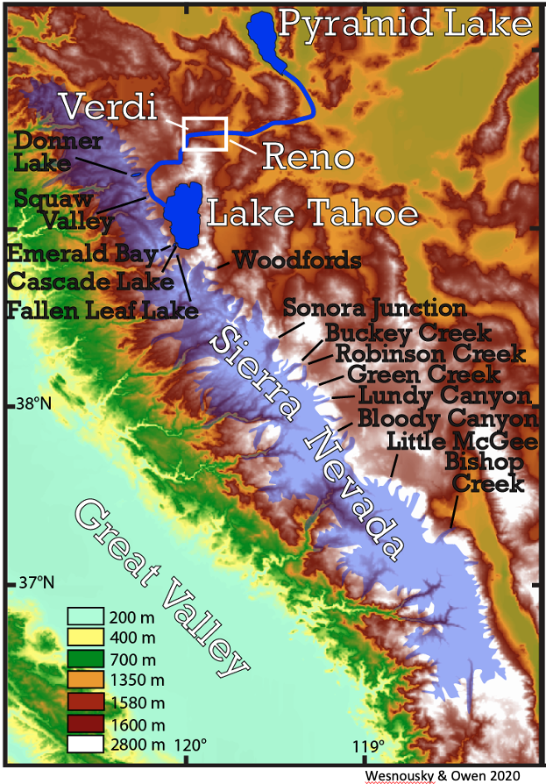
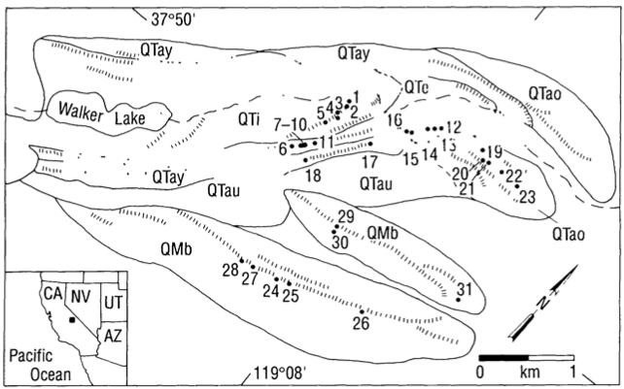
Study Sites
Bloody Canyon
Well studied
Large number of morphologically distinct moraines
Relative age sequence can be clearly inferred from the topographic relations among many of the moraines
(Phillips, 1990)

Slide 4
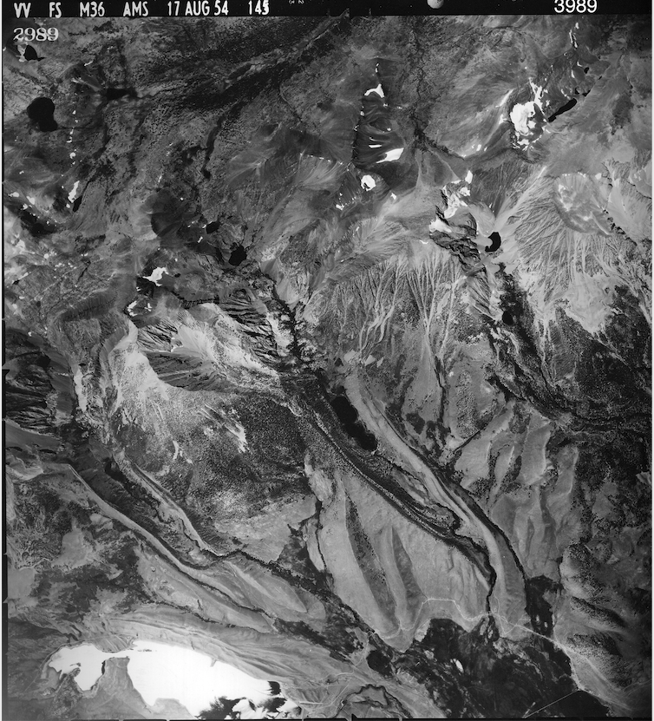
Study Sites
Bishop Creek
Tahoe terminal moraine complex isolated from glacial advances during the Tioga Glaciation by avulsion of the glacier course through the Tahoe right-lateral moraine
Dry climate limiting erosion
Unusually complete sequence of Tahoe glacial deposits
(Phillips et al., 2009)

Slide 5
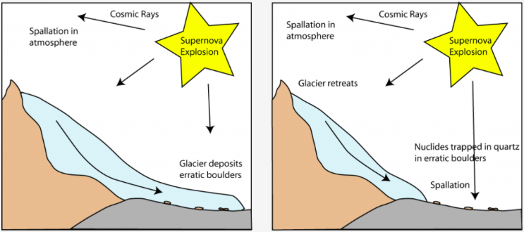
Methods
Cosmogenic dating of 36Cl in boulders deposited along the moraine crests
Rock on a moraine originated from underneath the glacier, where it was plucked and transported subglacially.
When it reaches the terminus of the glacier, the boulder is deposited and exposed to cosmogenic rays

Slide 6
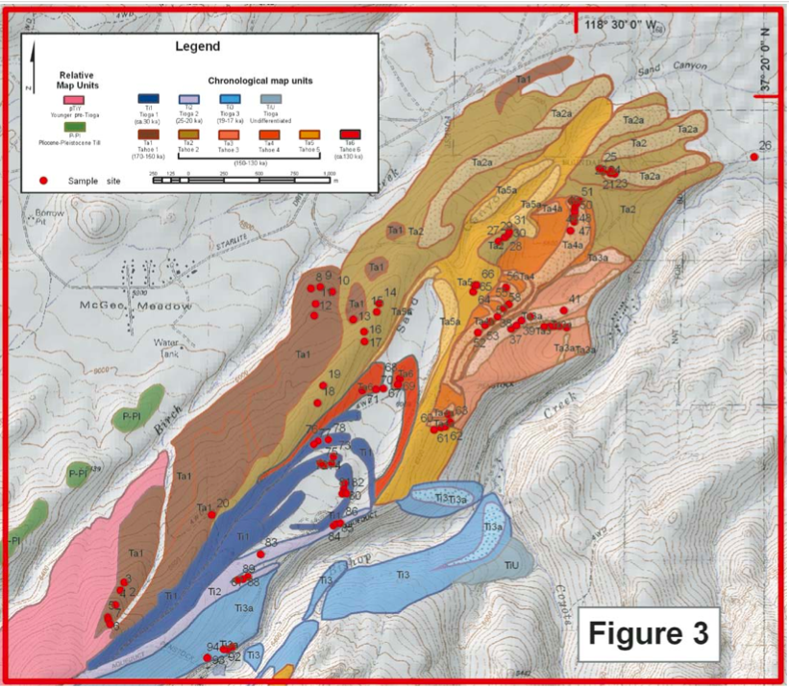
Glacial Chronology
Four glaciations identified in the Sierra Nevada over the last ~ 200,000 years from lateral and terminal moraines
Bishops Creek (Phillips et al., 2009)

Slide 7
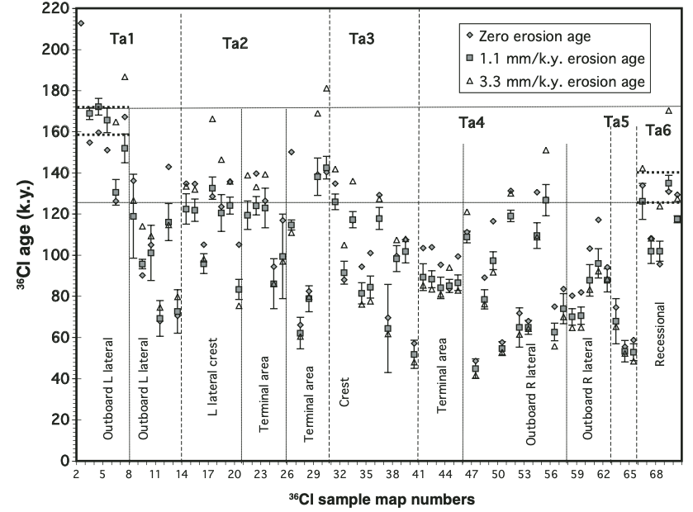
Glacial Chronology
Tahoe Glaciation
36C ages show deposition predominately between 200 – 135 ka during Marine Isotope Stage 6
Evidence for a younger Tahoe phase ~ 60 ka at Bloody Canyon, similar to that proposed by the relative dating framework
Extensive and voluminous, marking a significant glacial advance
Detailed history of advances and retreats can’t be distinguished
(Phillips, 1990, Phillips et al., 2009)

Slide 8
Glacial Chronology
Tenaya Glaciation
Hypothesized to result from a glaciation in between Tahoe and Tioga glaciations
May represent an early and extensive stage of the same glacial advance as the Tioga glaciation
No evidence of Tenaya moraines at Bishops Creek
  May have been destroyed by obliterative overlap
(Phillips, 1990)

Slide 9
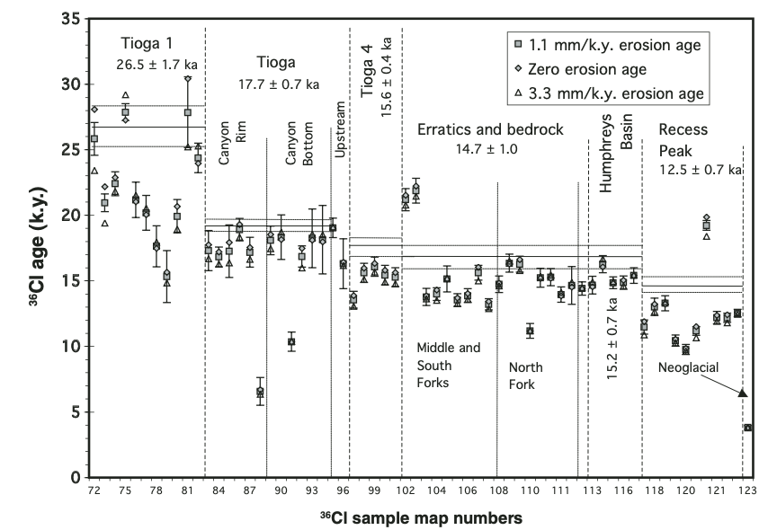
Glacial Chronology
Tioga Glaciation
Moraines deposited between 28 – 14 ka during Marine Isotope Stage 2
Subdivided into four phases of advance and retreat
  Initial advancement ~28 ka (Tioga 1)
  No evidence of Tioga 2
  Reached max. extent ~ 17 ka (Tioga 3) followed by rapid retreat by 17 – 16.5 ka synchronous with the end of the LGM
  Tioga 4 – Readvance coinciding with Heinrich Event 1
  Final retreat occurred very rapidly between 15 – 14.5 ka correlated with North Atlantic Boiling Event
(Phillips, 1990, Phillips et al., 2009)

Slide 10
Glacial Chronology
Tioga Glaciation
Mapping of Tioga terminal moraines at Bishop Creek indicate Tioga glaciers were significantly smaller in volume than Tahoe glaciers
(Phillips et al., 2009)

Slide 11
Glacial Chronology
Recess Peak Glaciation
Brief and relatively minor Recess Peak advance ~ 13.3 ka
Correlates with Inter-Allerod Cold Period
No significant advancement during the Younger Dryas, contrasting with other regions
  Potentially due to lack of precipitation in Sierra Nevada
(Phillips, 1990, Phillips et al., 2009)

