Slide 1
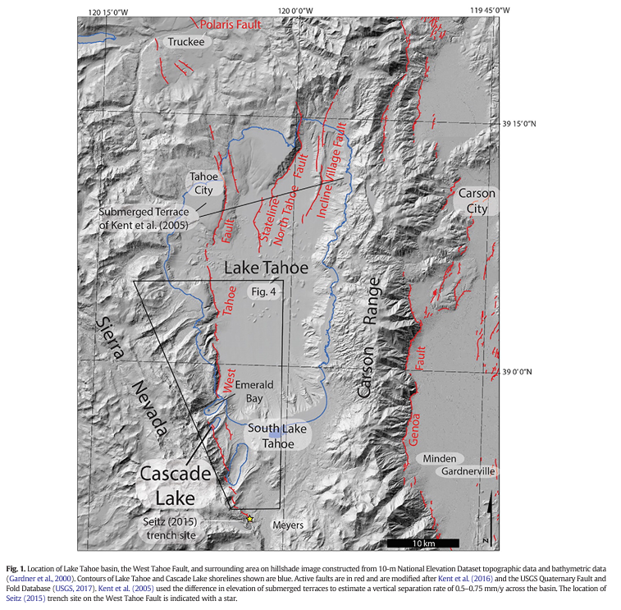
Terrestrial cosmogenic surface exposure dating of moraines at Lake Tahoe in the Sierra Nevada of California and slip rate estimate for the West Tahoe Fault Ian K.D. Pierce , Steven G. Wesnousky, Lewis A. Owen
By Ian Adams, 2024
Purpose of Paper:
To apply TCN dating methods to glacial moraines on the west side of Lake Tahoe at Cascade Lake to determine age(s) of glaciation.
Measure amount the moraines are offset by the West Tahoe Fault and with the determined ages interpret the rate at which the West Tahoe Fault is slipping.

Slide 2
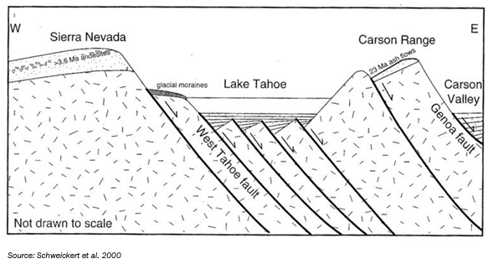
Lake Tahoe is generally interpreted to be a faulted half-graben and the West Tahoe Fault a major normal fault responsible for development of the basin.

Slide 3
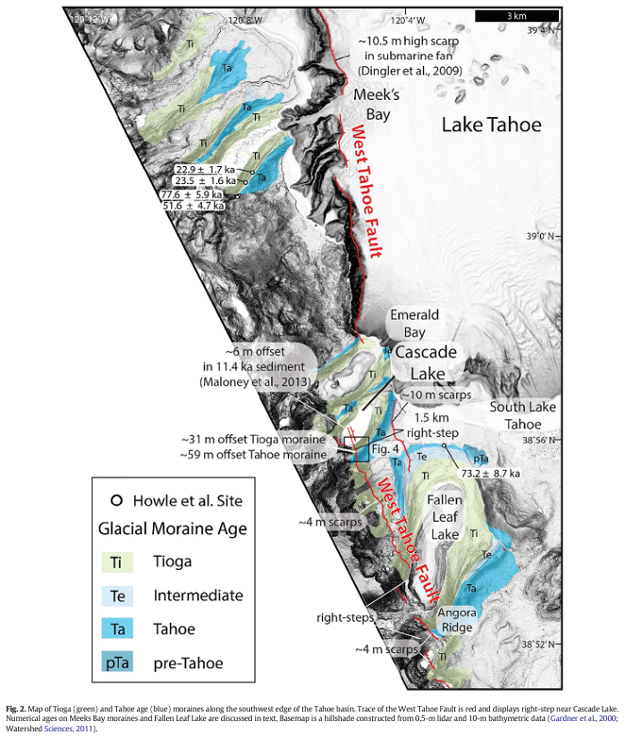
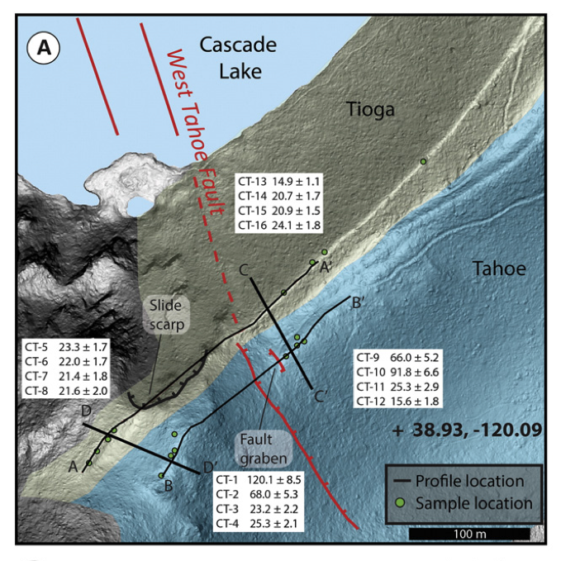
Rocks were sampled from the right-lateral moraines at Cascade Lake. There are two distinct moraine crests (not so well illustrated with figure given). The inner Moraine has been defined as Tioga and the outer as Tahoe.

Slide 4
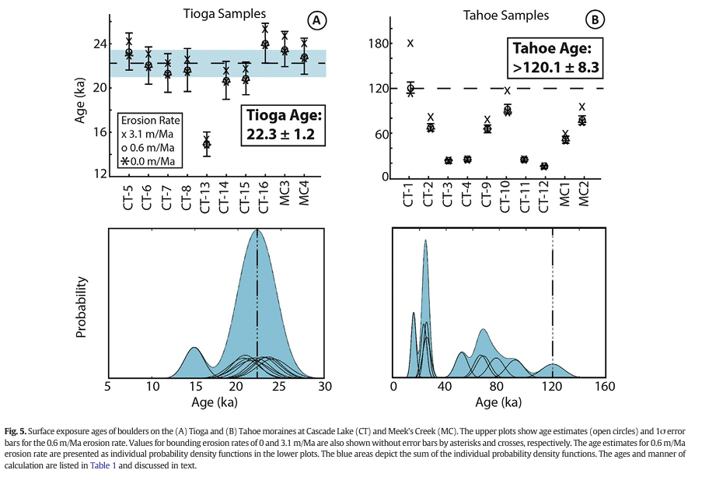
Plots of the TCN Ages…
Boulders on younger Tioga moraine yield exposure ages consistent with Stage II of MIS record and average about 22 k (older than 18ka which is often cited as time of maximum advance of continental glaciers.
Boulders on Tahoe moraine show much scatter in ages – with oldest about 120 ka, consistent with MIS stage 6. – Why such scatter? Authors choose older 120 ka age as most likely

Slide 5
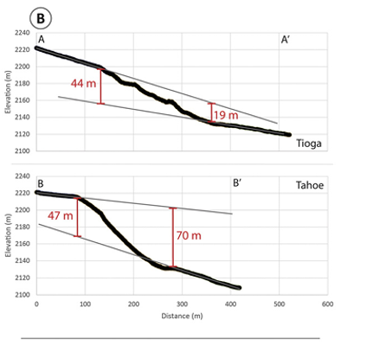
Dividing the vertical separations of the Tioga (31.5 ± 12.5 m) and Tahoe (62 ± 15m) moraines by the estimated ages of the Tioga and the Tahoe moraines to be about 1.4 ± 0.7 mm/yr and 0.6 ± 0.2 mm/y, respectively.
It may be suggested from the result that slip rate has increased, though authors give reason why may not be so….
Elevation profiles AA’ and BB’ along moraine crests show between 19 and 44 m of offset on Tioga Moraine and 47 - 70 m on older Tahoe moraine crest.

Slide 6
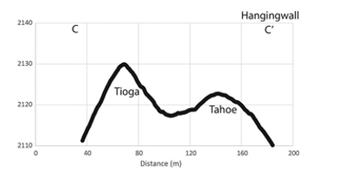
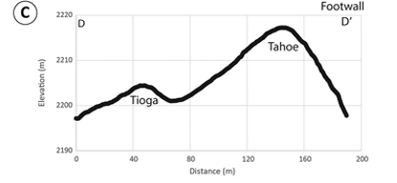
Elevation profiles across the moraine crests at DD’ and CC’, on the foot and hanging walls, respectively.
It is downward fault displacement that is responsible for lowering the crest of the Tahoe moraine on the hanging wall

Slide 7
Discussion? Questions?

