Slide 1
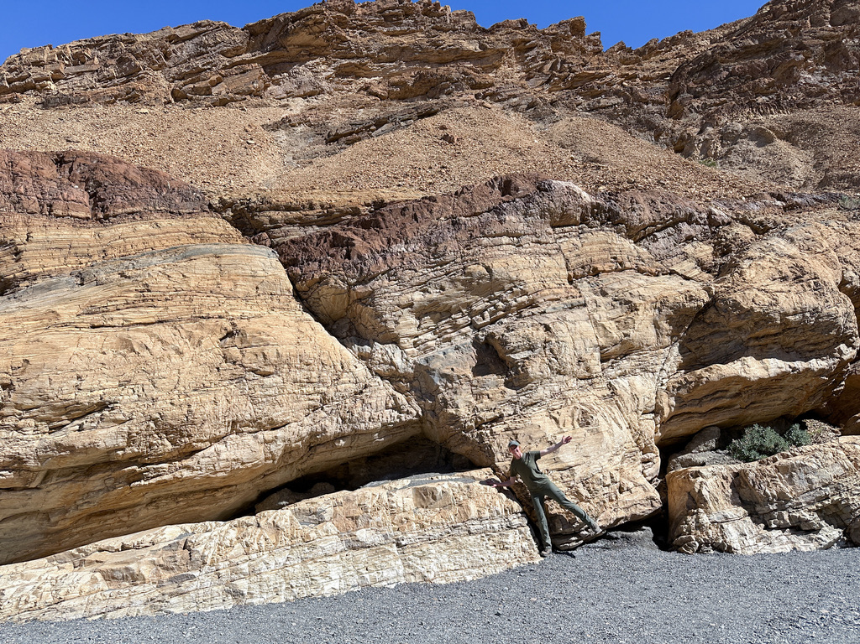
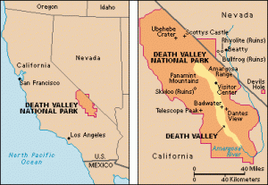
Tectonics of Death Valley Region: From Basin & Range to Shear Zone in 1966
Authors: Hill & Troxel, Burchfiel & Stewart
Location: Death Valley, California
Hill & Troxel (1966): Examine the features at Death Valley that cannot be explained by Basin & Range movement and propose different mechanisms
Burchfiel & Stewart (1966): Illustrate the mechanisms that Hill & Troxel discuss
Alyssa Lindsey, 2024
Notes:
Here knock down principal

Slide 2
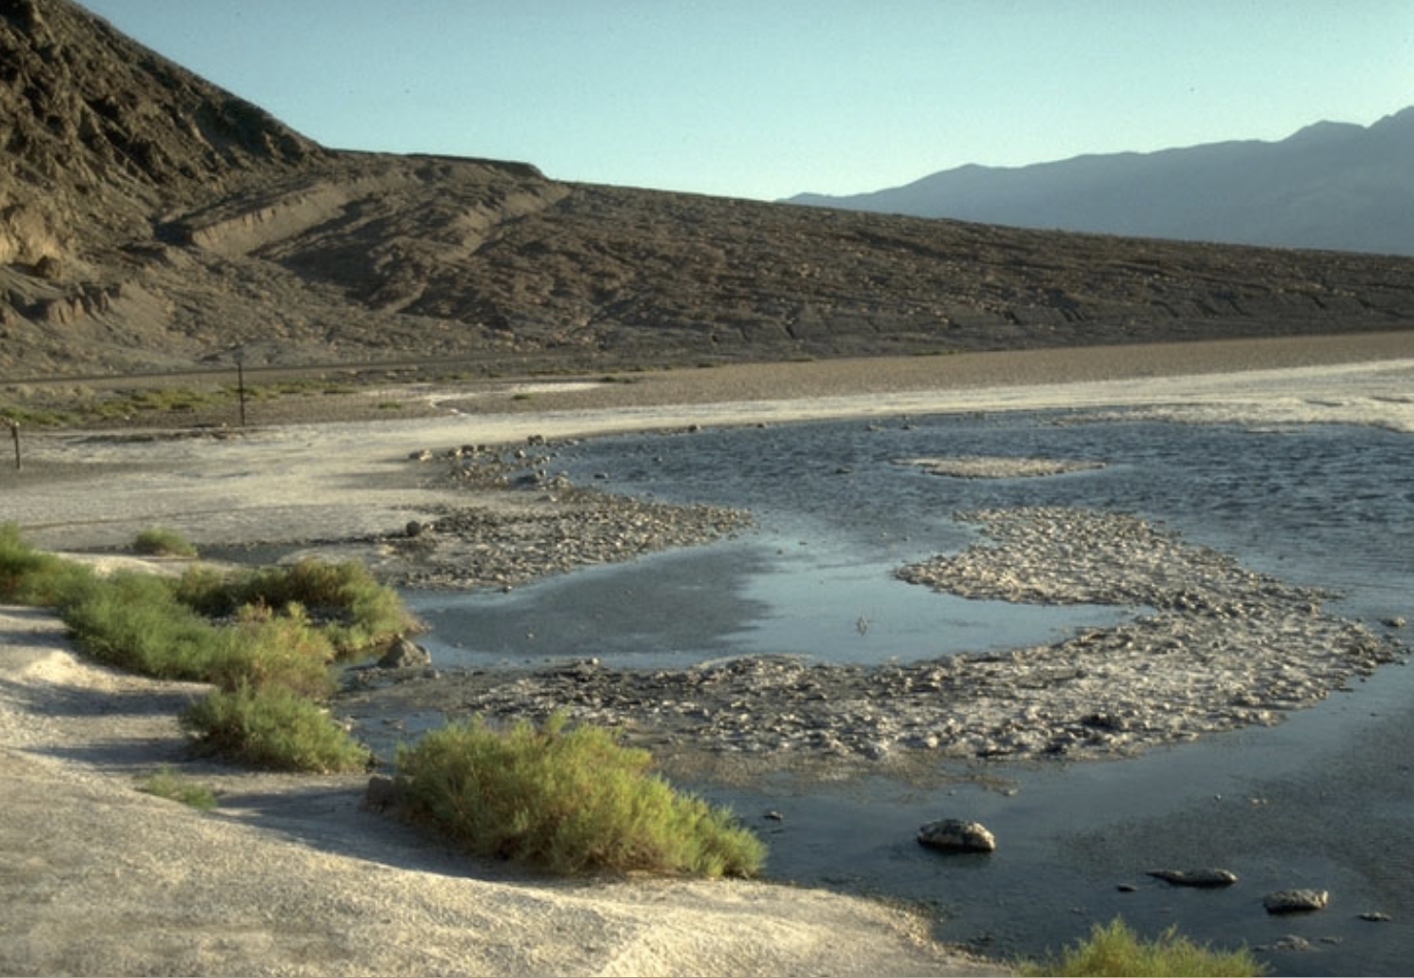
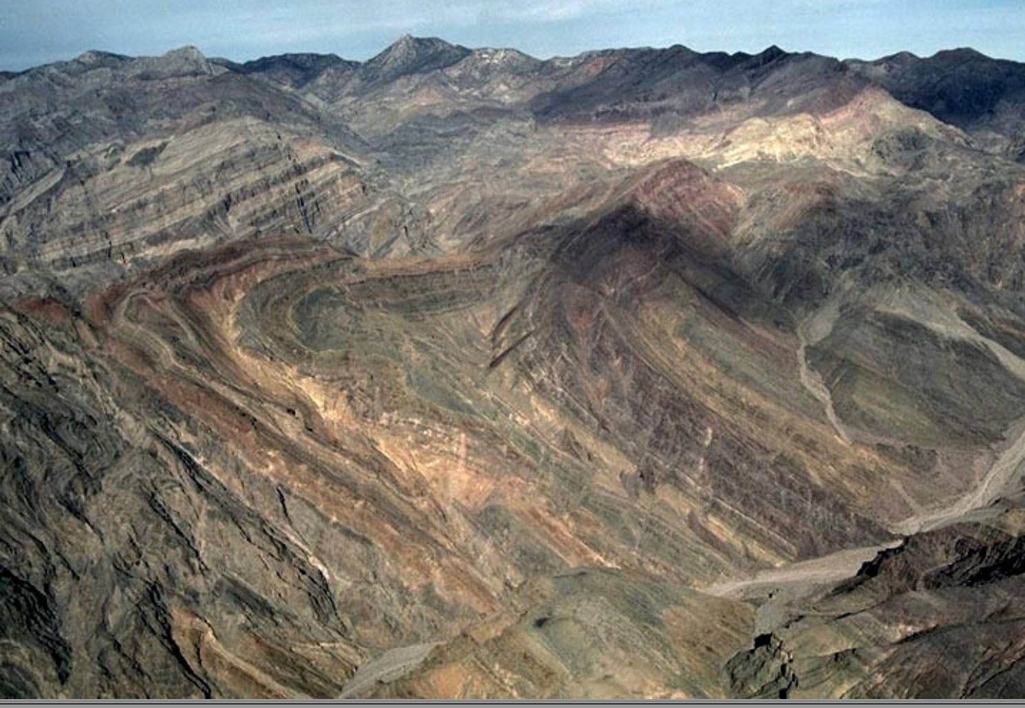
Hill & Troxel (1966)
Methodology: Detailed mapping faults and folds
Strat
Faults
Folds
Shear sense: Drag folds, striations, offset volcanic units, dike orientation
Turtlebacks (interpretations have changed since)
Badwater spring and fault scarps
Mosaic Canyon mini normal fault
Seds/volcanics
Basement rock
Titus Canyon overturned anticline

Slide 3
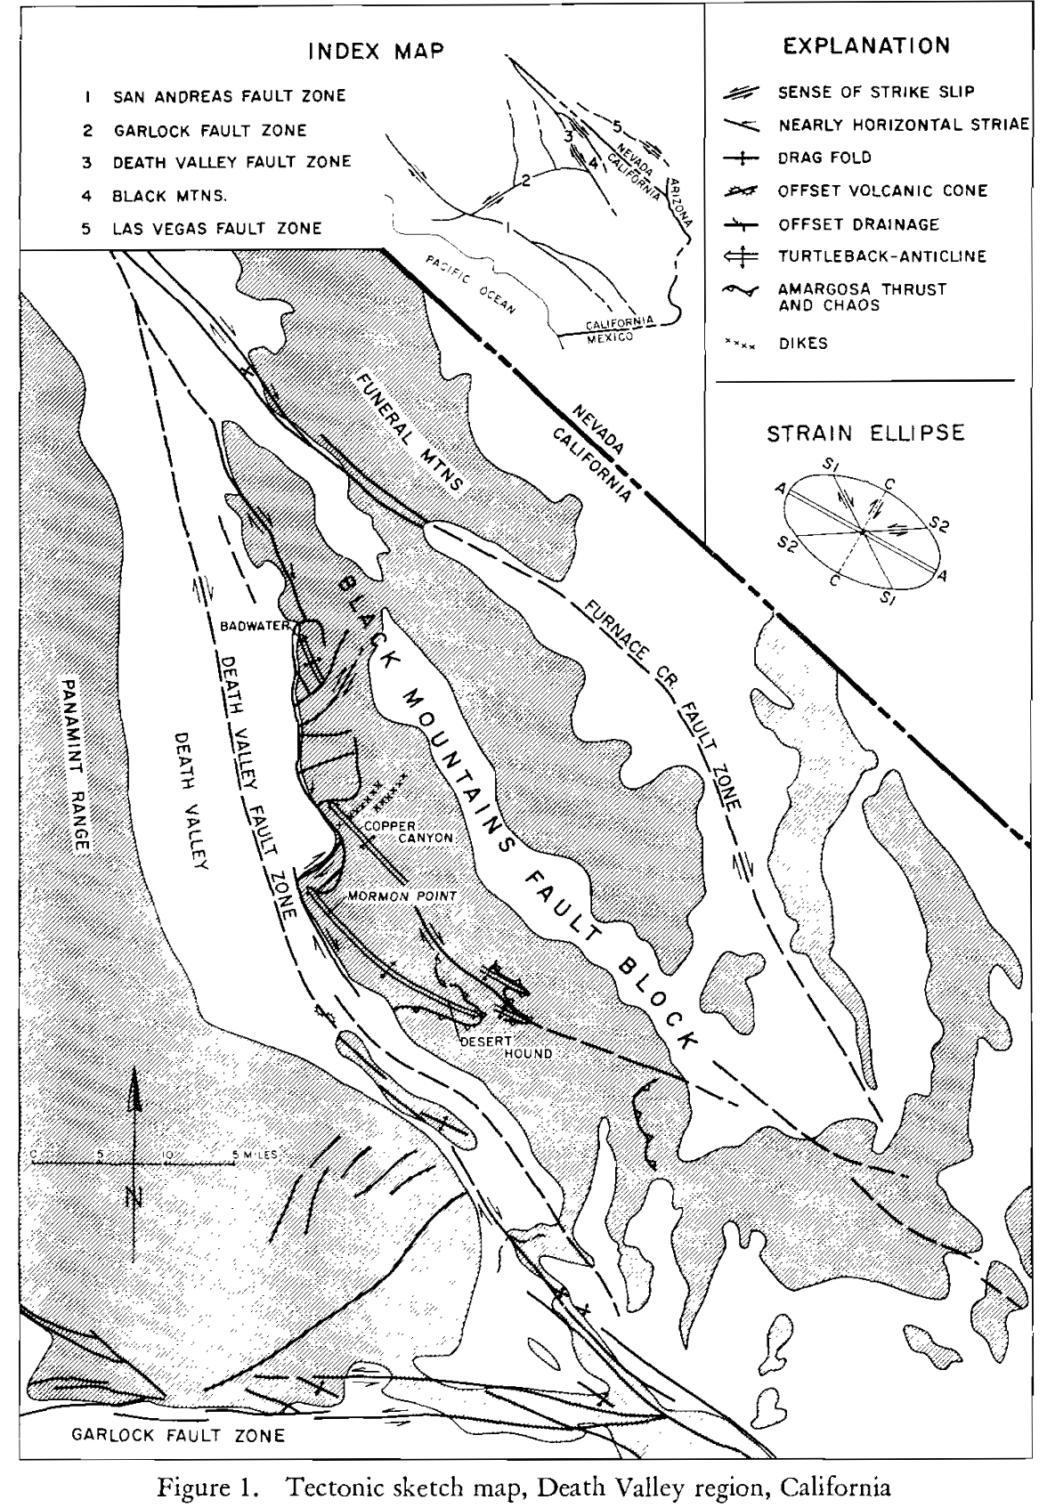
Hill & Troxel (1966)
Results: Structures of the Death Valley region are manifestations of…
shortening in a northeast-southwest direction
relative extension in a northwest-southeast direction
Death Valley results from a strike-slip fault system where some normal movement must occur to create the topographic relief.

Slide 4
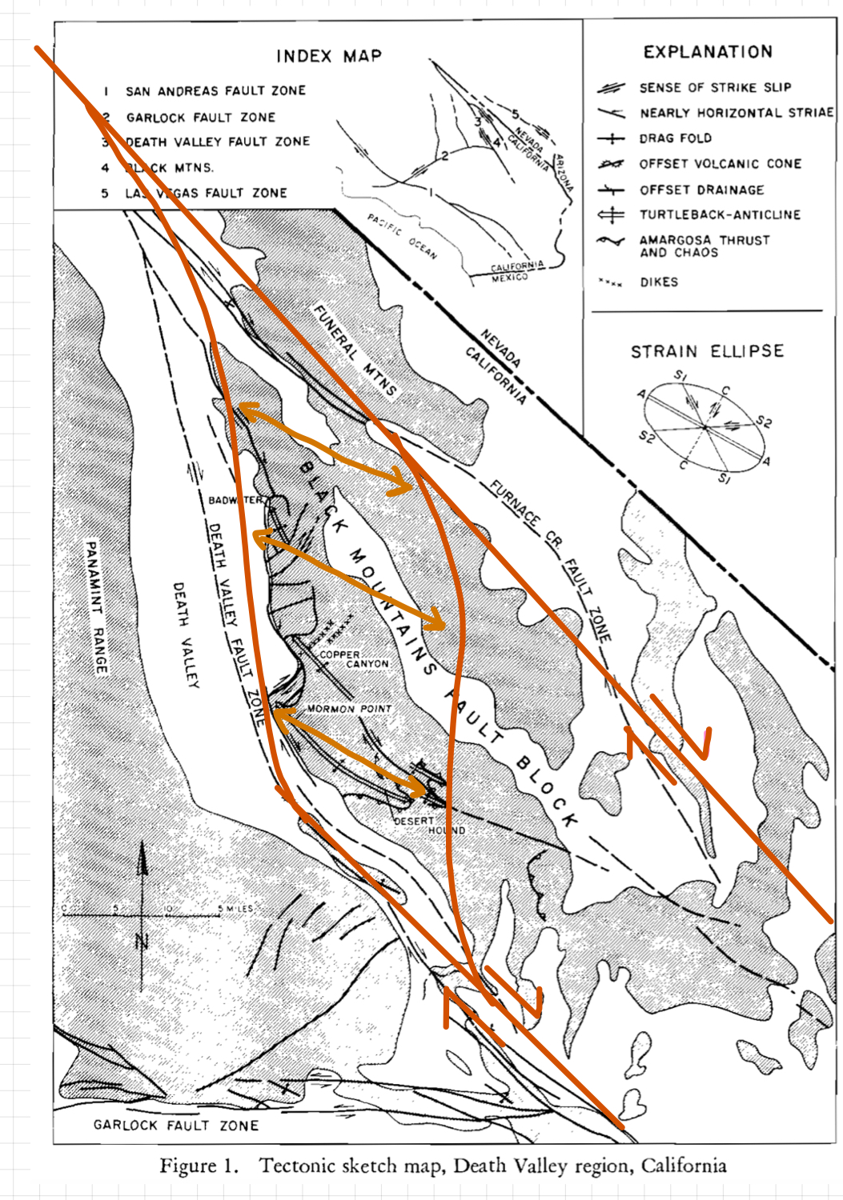
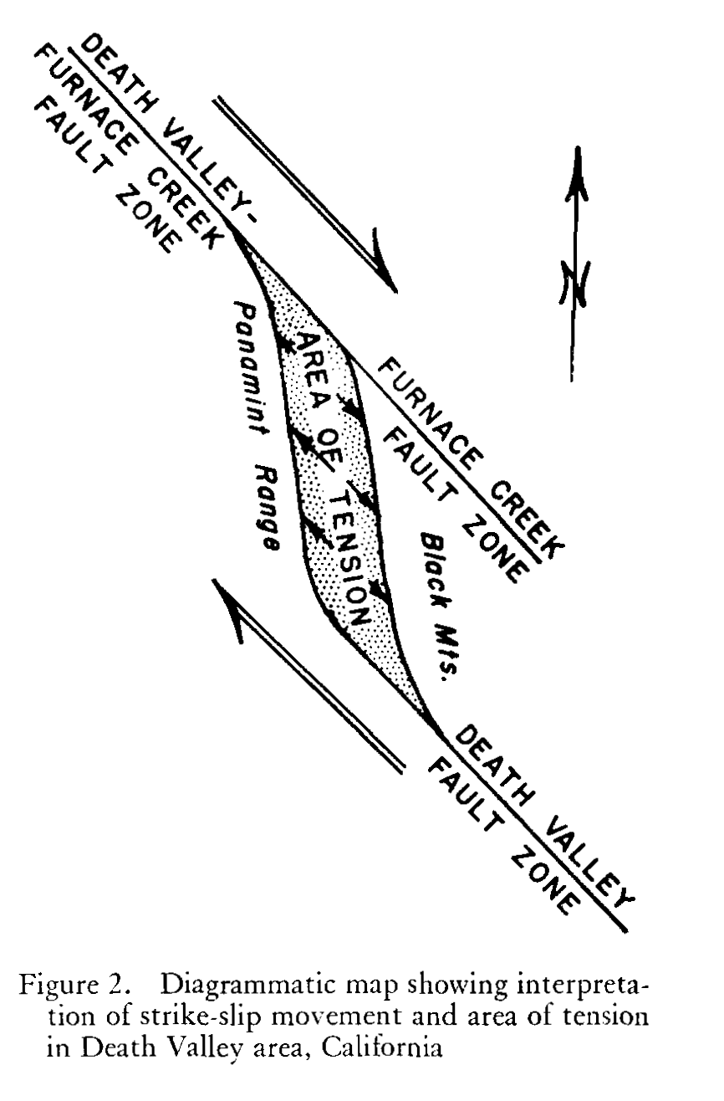
Burchfiel & Stewart (1966)
“Hill and Troxel (1966) have suggested that much of the tectonic history of the area may be related to this strike-slip movement, although they do not indicate how this movement produced the valley.
We suggest that the central part of Death Valley is related to tension along a segment of a strike-slip fault that is slightly oblique to the main trend of the fault zone.”
- Burchfiel & Stewart
Turtlebacks aren’t mentioned in this paper
Notes:
Here provides principle approach and result

Slide 5
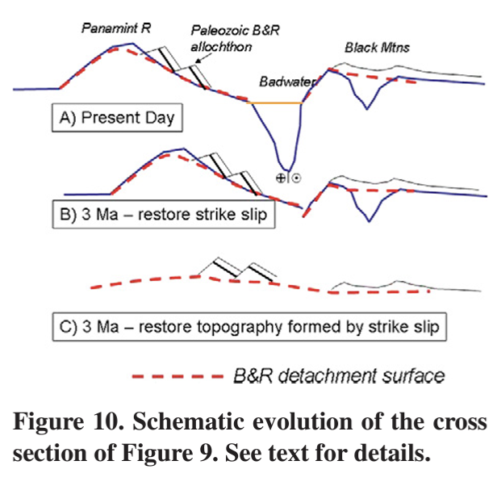
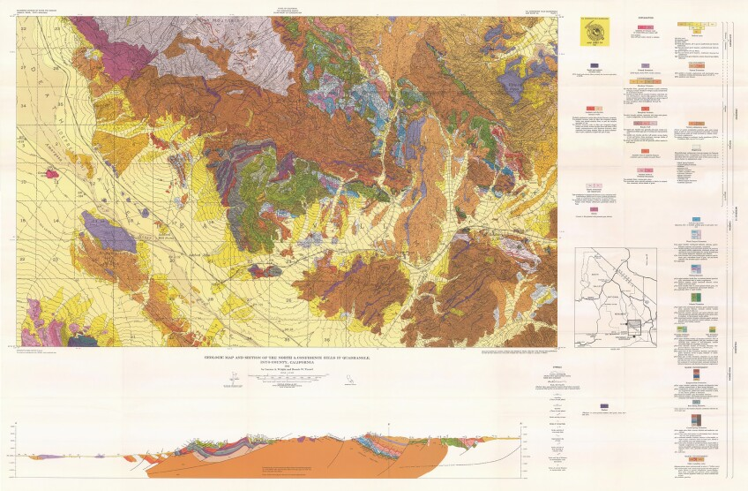
These early papers built the framework for the current understanding of the Death Valley region
3 Ma: initiation of the East California Shear Zone
18 to 5 Ma: low-angle Basin and Range extension
USGS Map by Troxel & Wright, 1984
Example from Norton, 2011: Two-stage formation of Death Valley

