Slide 1
Transport of the Panamint Range Structural Block in the Death Valley Area
Stewart 1983

Slide 2
Geology
Death Valley contains diverse array of complex geological structures
Two major fault zones
Furnace Creek Fault Zone
Death Valley Fault Zone

Slide 3
Geology
Furnace Creek and Death Valley fault zones previously thought to be connected
Discrepancies between the observed strike slip lateral offset have provided persistent problems in structural interpretations of how much strike slip offset has occurred
If connected, fault zones should have the same amount of approximate offset

Slide 4
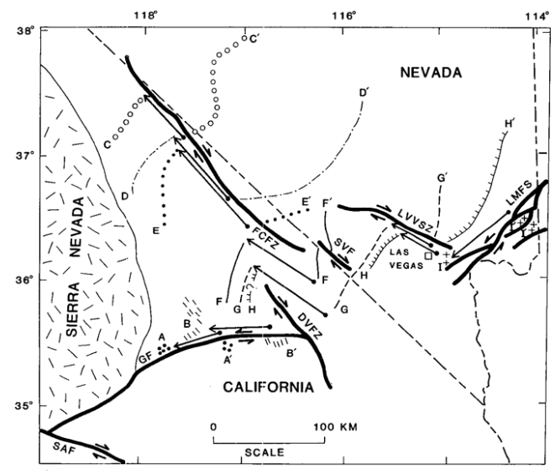
Geology
Apparent offsets in stratigraphic trends show
Furnace Creek Fault Zone:
40 – 100 km right lateral offset
Death Valley Fault Zone
< 8 km right lateral offset
in southern DVFZ (not shown)
Stratigraphy used to determine FCFZ offset
Facies boundary of lower Cambrian Harkless Formation and Zabriskie Quartzite
Western limit of Lower Mississippian limestone unit
Upper Ordovician rocks

Slide 5
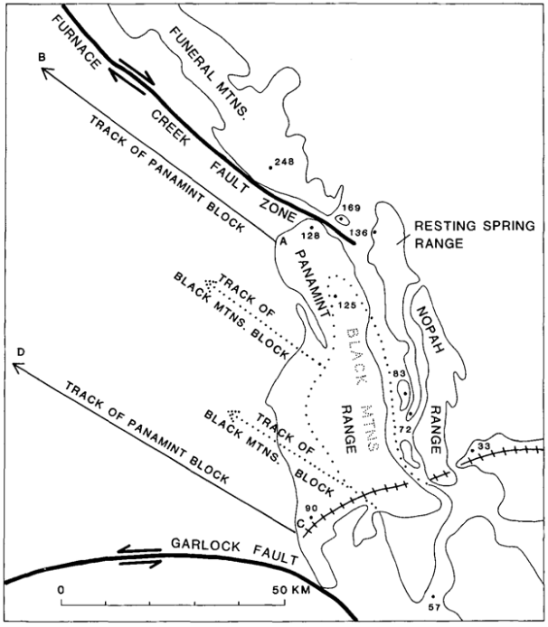
Hypothesis
Reconstruction of Death Valley prior to detachment faulting
PreCambrian – Mesozoic rocks of the Panamint Range once lay adjacent to the resting springs and Nopah Ranges and were detached from underlying rocks of the Black Mountains and transported northwest along detachment fault
Northwest movement of Black Mountain was on a separate and structurally lower detachment fault

Slide 6
Evidence
Complex mosaic of upper Precambrian, Paleozoic, and Tertiary blocks and slices termed “Amargosa Chaos” observed overlying a flat surface
First interpreted as a thrust fault
Later classified as the product of drag as the blocks rotated along normal faults as the Panamint Mountains were detached and moved northward on a deep rooted normal detachment fault
Amargosa Chaos

Slide 7
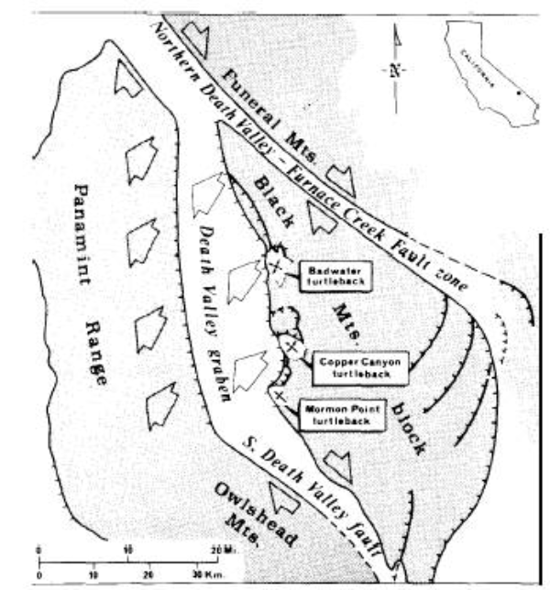
Evidence
Turtleback surfaces in the Black Mountain Block
Smooth curved surfaces which form northwest plunging domes
Extensional fractures and slickensides
Elongated in the northwest direction
Part of the detachment surface which the Panamint Range moved northwards
(Troxel and Wright, 1987)

Slide 8
Evidence
Relative ages of latest detachment faulting from Artist Drive Formation
Tertiary volcanics (6 – 8 ma) incorporated in the Amargosa Chaos
Sedimentary rocks (upper Cenozoic) deposited in basins resulting from void produced from northwest movement of Panamint Range
Latest movement of the detachment fault in the Cenozoic time prior to or synchronous with Late Cenozoic volcanism and sedimentation

Slide 9
Conclusion
Reconstruction of Death Valley prior to detachment faulting
Detachment and northwest movement of the Panamint Range block occurred on north-west dipping low-angle fault
Region west of Panamint Range must have moved at similar time explaining the large right-lateral offset of the Furnace Creek Fault Zone
Garlock Fault viewed as southern boundary of relatively great extension
Amargosa Chaos

Slide 10
Conclusion
High angle faults cut the detachment surfaces bounding the major blocks in Death Valley
Fragmentation of Death Valley into major 5 – 25 km wide basin – range blocks occurred after the Panamint Range detachment
Late phase of right lateral movement possible to account for development of Death Valley Fault Zone
Death Valley graben may be pull apart structure resulting from right lateral displacement

