Slide 1
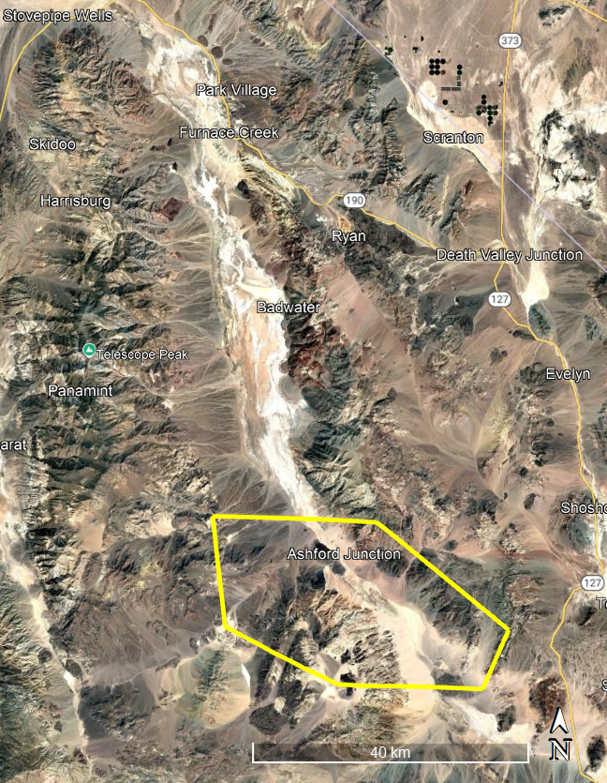
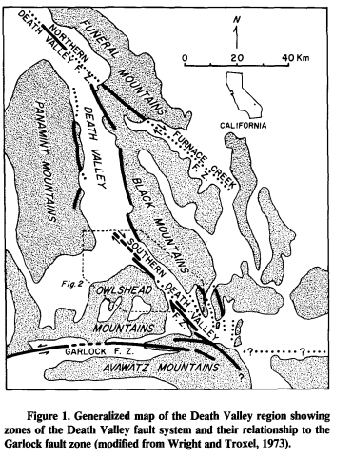
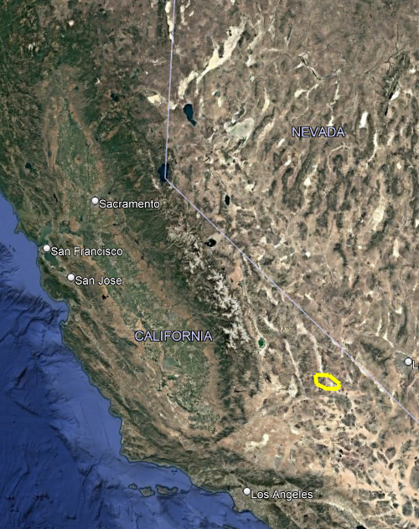
Late Cenozoic history and styles of deformation along the southern Death Valley fault zone, California Butler, P.R., Troxel, B.W. and Verosub, K.L
Purpose:
Investigate tectonic evolution and deformation pattern in southern Death Valley
Enhance understanding of fault dynamics in Basin and Range Province

Slide 2
Tectonic Setting
The southern Death Valley fault zone is apart of a NW trending right lateral strike slip fault system
To the South it intersects with the East trending
left lateral Garlock fault zone
Other studies have concluded southern
Death Valley fault zone and the Furnace Creek
fault zone are related to extension in the Southern
Great Basin and Range
Suggesting the movement of faults creates a
pull apart basin within Death Valley

Slide 3
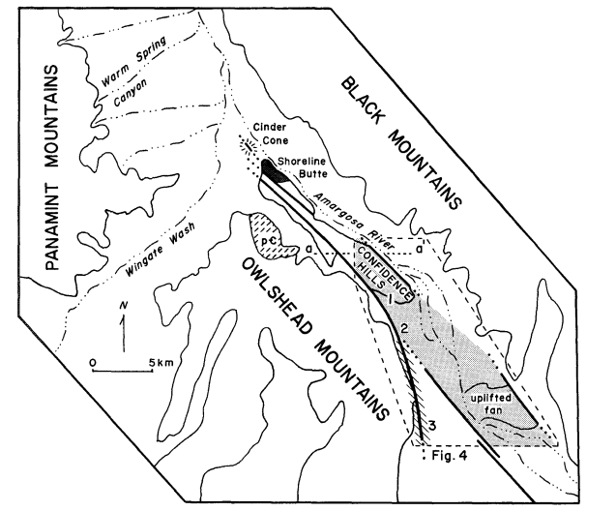
Geologic Setting
Mapped the area at a 1:24,000 scale
Study area is between the Owlshead and Black mountains
OwlShead Mtns. are composed of Cretaceous granitic rocks and Miocene volcanic rocks
Black Mtns. are composed of Precambrian gneiss and sedimentary rocks
The topography is composed of broad alluvial fans
The alluvial fans are interrupted by small hills of fan gravels and lake sediments that have been uplifted along the southern Death Valley fault zone
Most notable of the hills are confidence hills rising 200m above valley

Slide 4
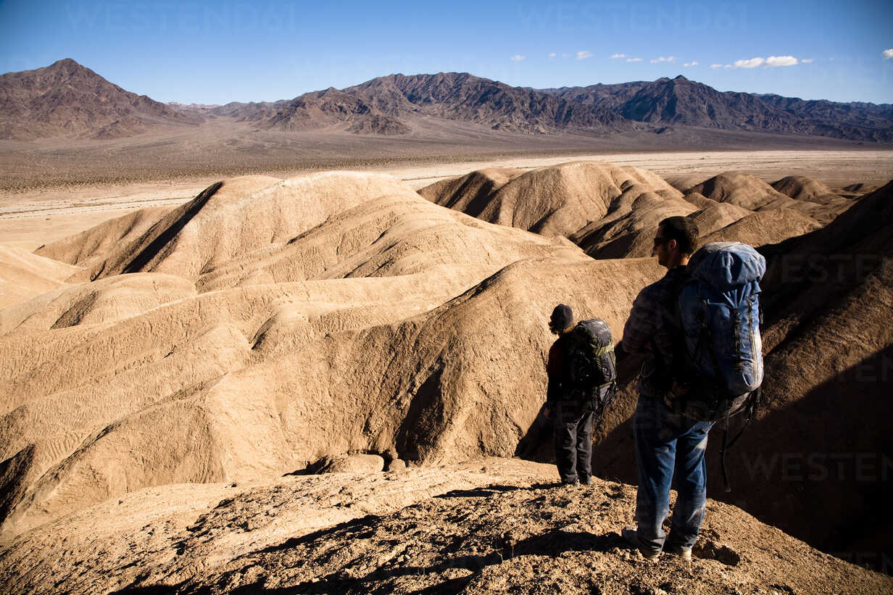
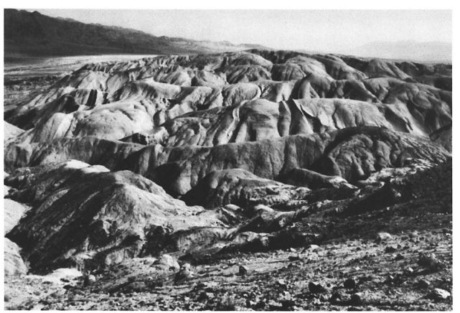
Confidence Hills

Slide 5
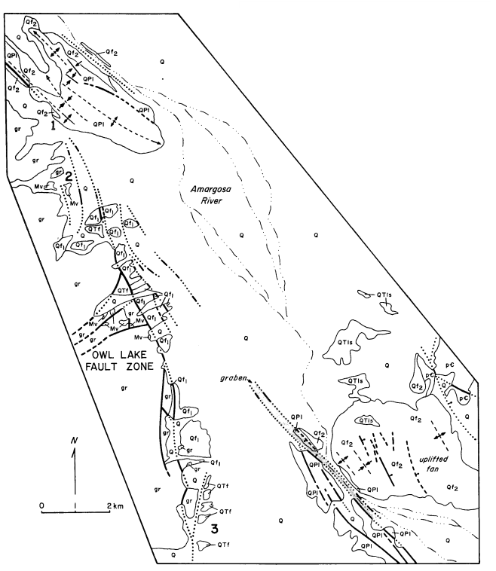
Methodology
The southern Death Valley fault zone was divided into two subzones the Eastern and Western
Subzones merge at intersection of Death Valley fault zone and the Owl lake fault zone

Slide 6
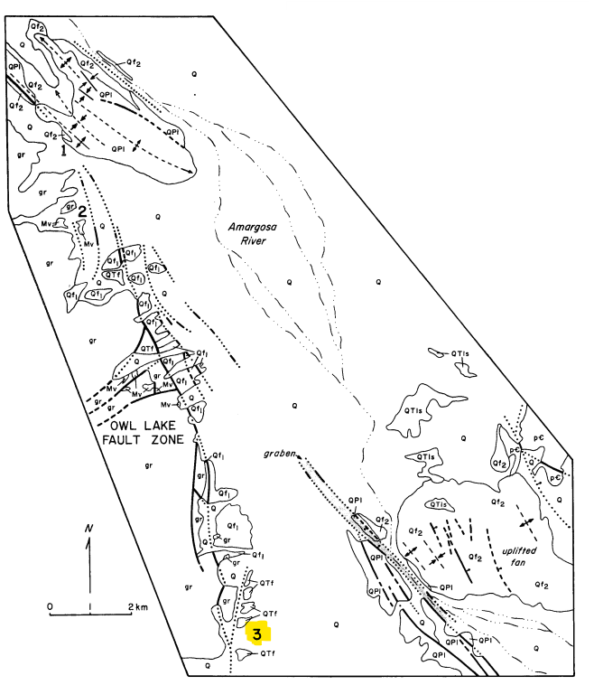
Western Subzone
They found evidence for ~35 km of right lateral displacement by matching alluvial fan gravel from its source in the NW
Using clasts from the Crystal Spring Formation, Kingston Peak Formation, and macro fossils in carbonate rock they determined it corresponded with the Panamint Mountain
Lateral displacement occurred from mid Miocene time to around ~1 mya found by K-Ar dating the volcanic rocks that predated the fan
Displacement stopped before deposition
of the Qf2 alluvial fans sometime after
~ 1 mya
Notes:
Fluvial transport couldn’t have been involved fluvial due to angularity and no clasts from the east side of death valley

Slide 7
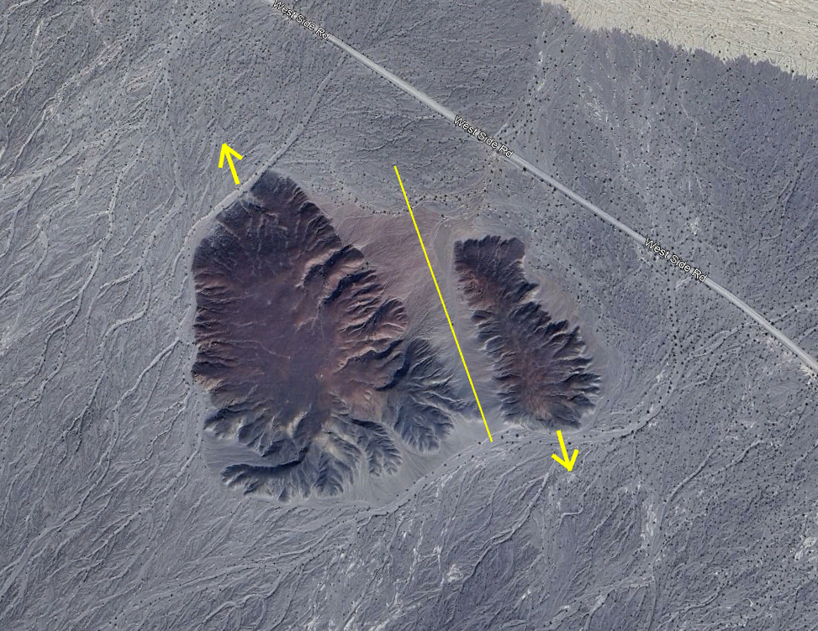
Eastern Subzone
Eastern Subzone has both lateral and vertical components of movement
The deformation can be seen in two volcanic bodies in the Eastern subzone
in the Shoreline butte lava flow it has been uplifted and tilted
Also in a small cinder cone that has been split right laterally by a few hundred meters.
The Eastern Subzone can be further broken up into its northern part the Confidence hills and its southern Uplifted alluvial fan

Slide 8
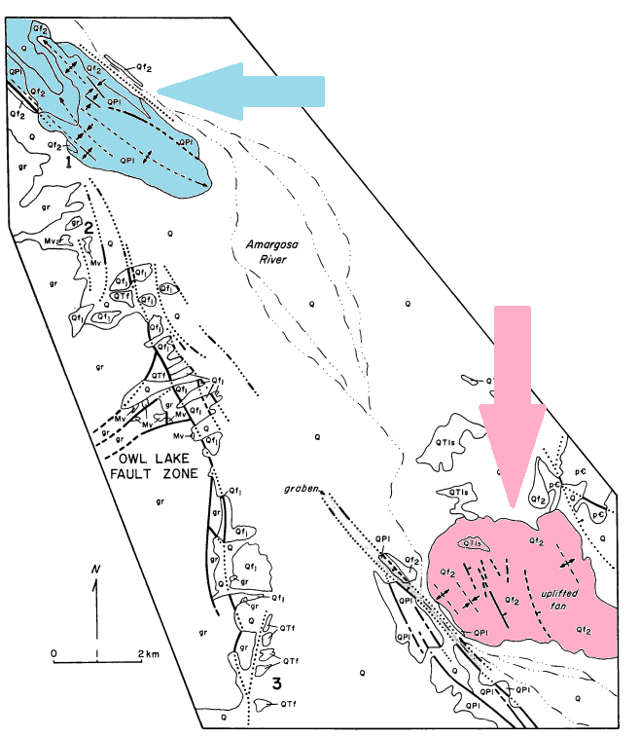
Confidence Hills
Vertical to near vertical isoclinal folds
No significant lateral offset
Confidence Hills
Uplifted alluvial fan
Deformed by NW trending Horst and grabens and shallow folds
Pebble count on both side of the fault showed negligible lateral offset
Uplifter Alluvial fan

Slide 9
Garlock Fault
Western subzone has 35-65 degree east/northeast dipping branches
Eastern subzone has westerly near vertical dipping branches
The Garlock fault, a major left-lateral strike-slip fault, intersects with the southern Death Valley fault zone
The Garlock transitions from left-lateral strike-slip motion to east-vergent thrusting
The transition is thought to be the cause of deformation patterns observed in the Confidence Hills and the uplifted alluvial fan zone

Slide 10
