Slide 1
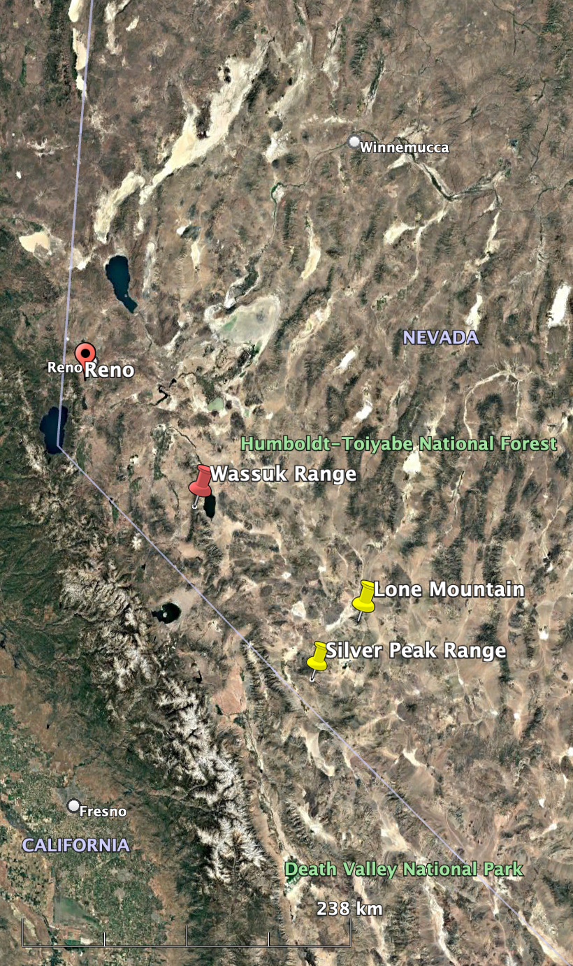
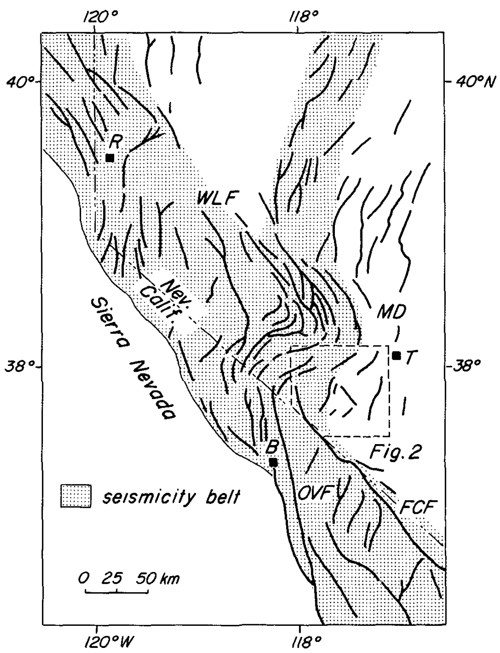
The extension and right slip of the middle and southern Walker Lane since the mid-Miocene
Henry
Stockli, Daniel F., et al. "Thermochronological constraints on the timing and magnitude of Miocene and Pliocene extension in the central Wassuk Range, western Nevada." Tectonics 21.4 (2002): 10-1.
Oldow, John S., Gretchen Kohler, and Raymond A. Donelick. "Late Cenozoic extensional transfer in the Walker Lane strike-slip belt, Nevada." Geology 22.7 (1994): 637-640.

Slide 2
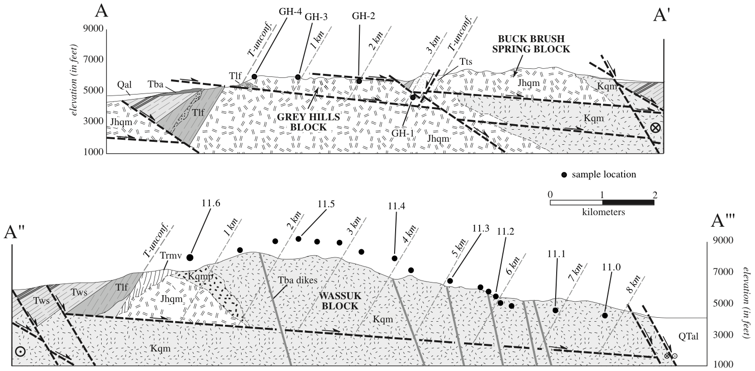
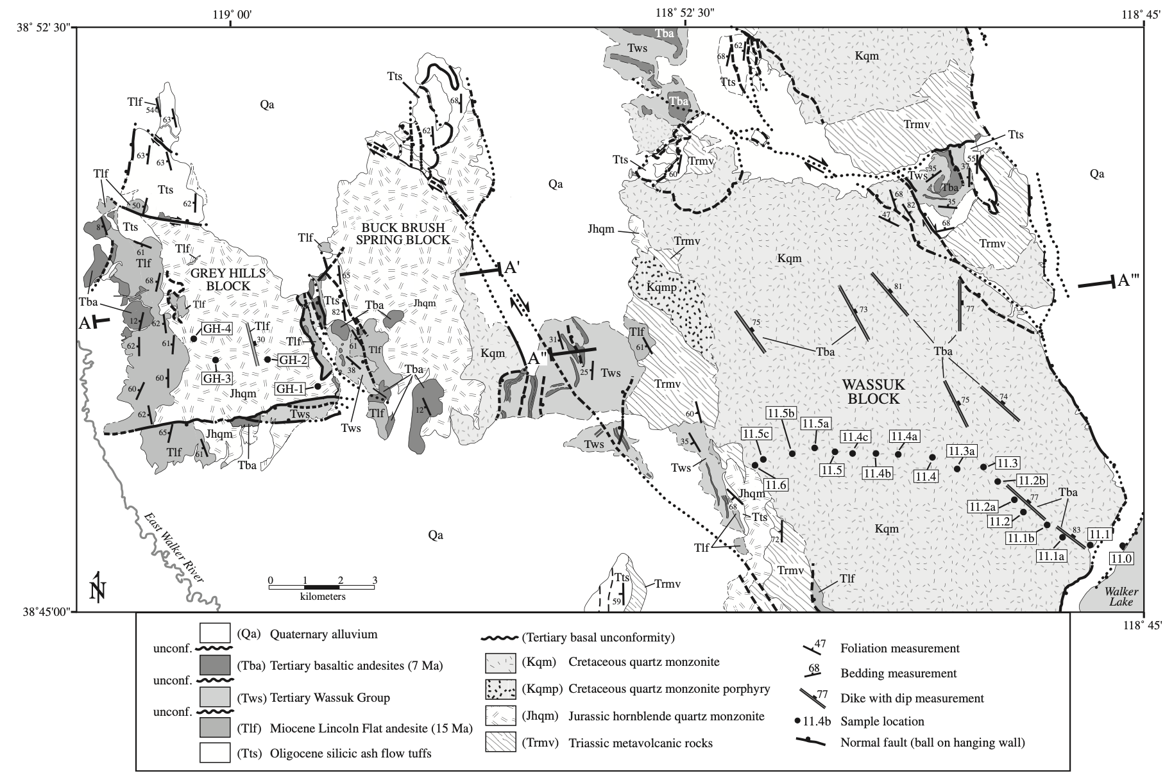
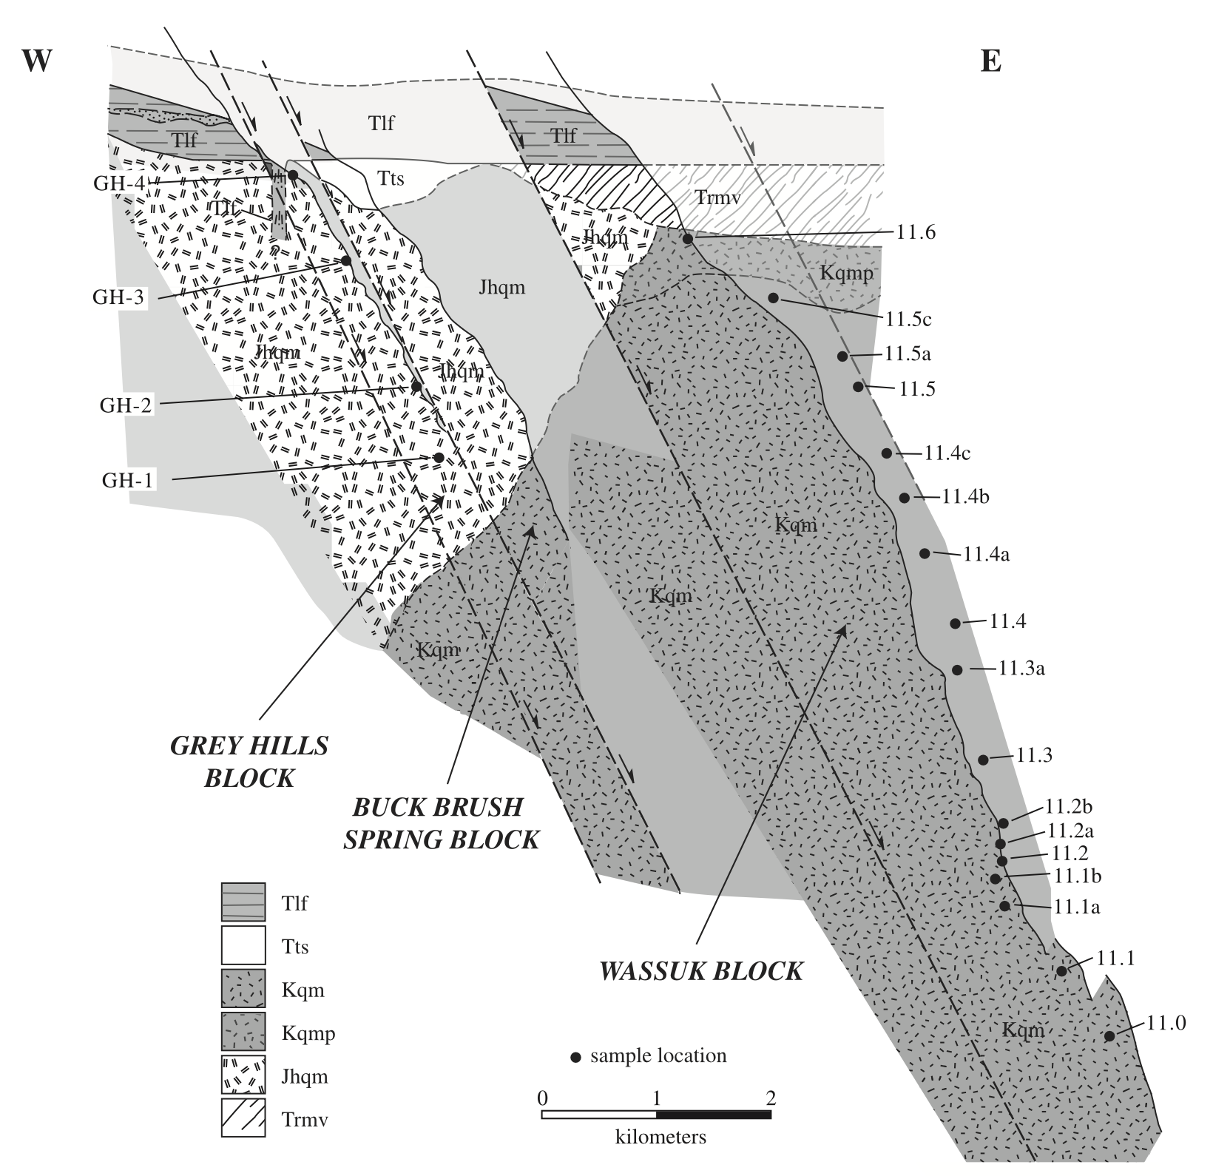
Wassuk Range
Two sets of faults: the rotation of the dip angle suggests accommodation of ENE-WSW oriented extension.
The extension tilted and exposed the fault blocks (quartz monzonite of the Mesozoic Sierran magmatic arc).
The Lincoln Flat andesite represents the youngest preextensional unit (~14.9 Ma, cut by stage-one normal faults) and defines a preextensional paleohorizontal reference plane.
How about the thermochronology?

Slide 3
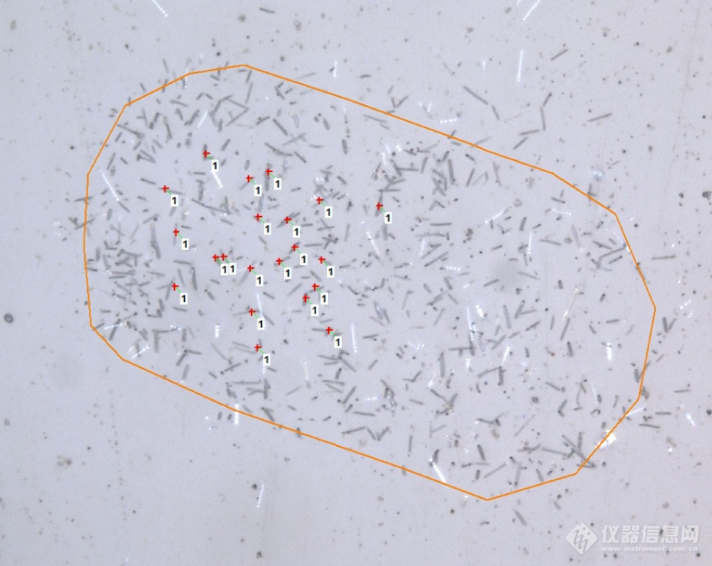
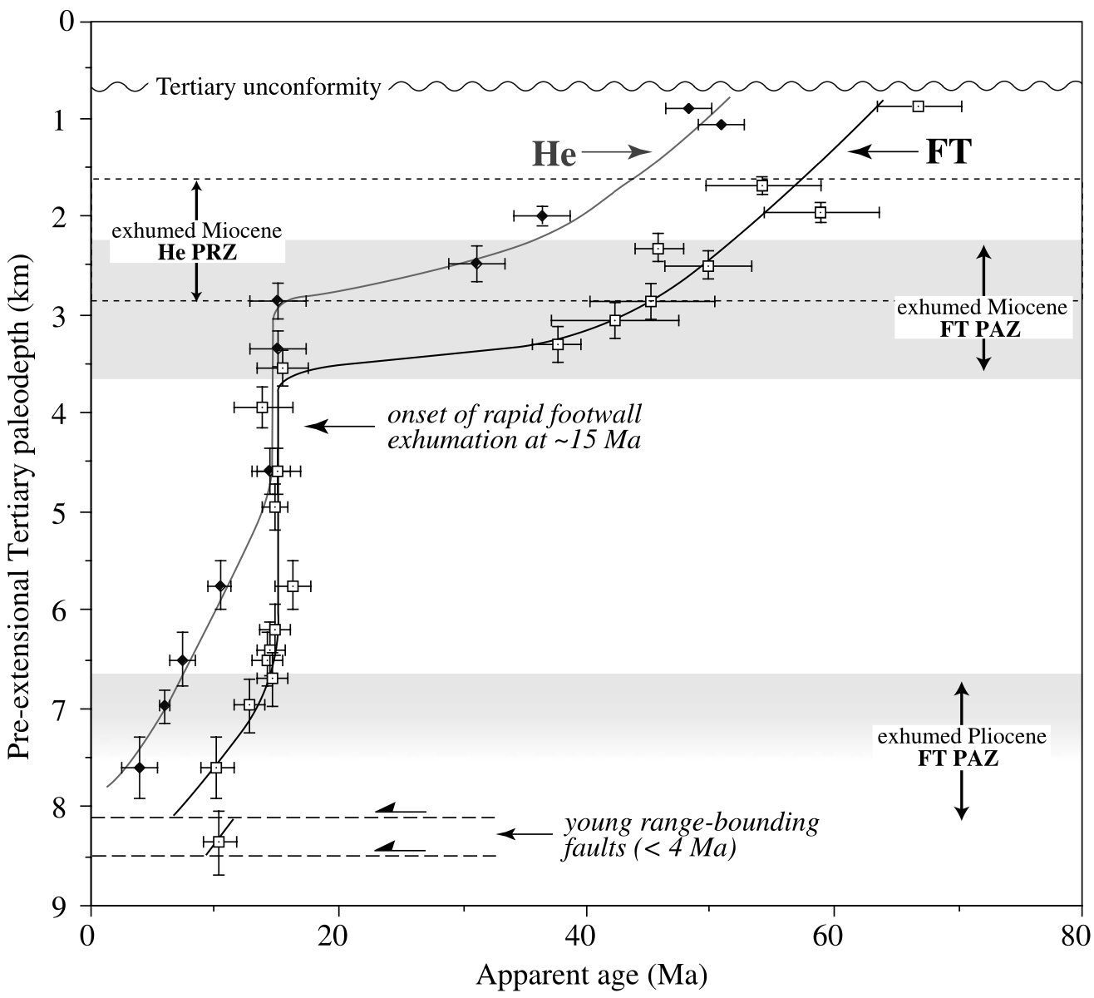
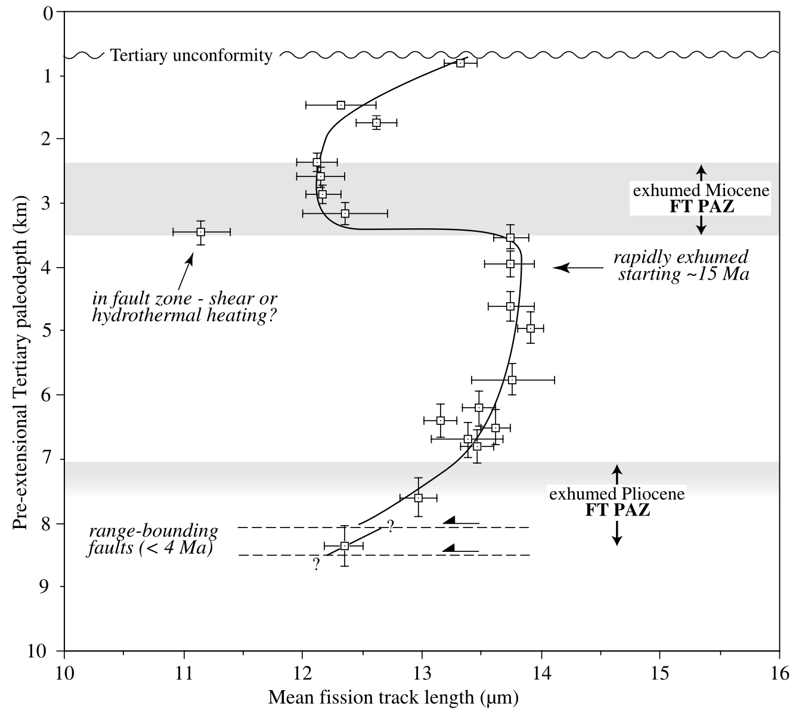
Fission Track Dating
The decay of radioactive isotopes creates high energy particles to break the crystal.
Two features of the track:
Number (density)
length
For the fission track of apatite:
>100 °C (closure temperature): totally anneal (disappear)
60-100 °C (partial anneal zone): partial anneal (decrease in length)
<60 °C: stable
He of (U-Th)/He:
>80 °C: entirely lost
40-80 °C: partially remained
<40 °C：stable
When the temperature dropped to the closure temperature
Mean track length becomes shorter when the rock stays in PAZ for too long
Notes:
Anneal: a gradual process to disappear

Slide 4
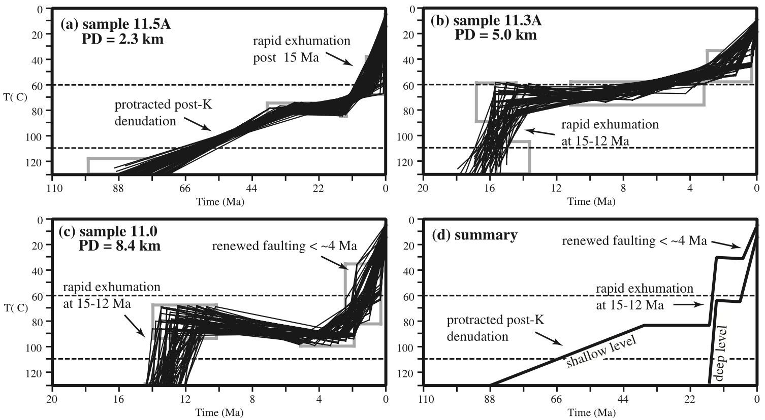
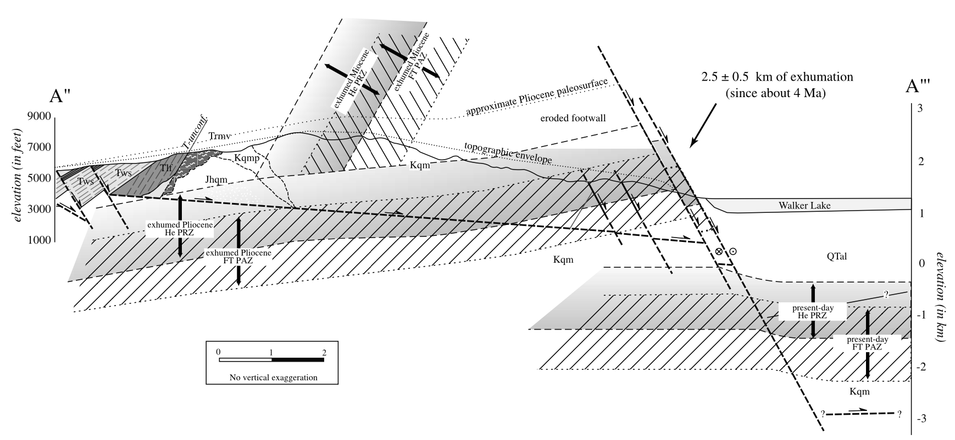
Three-stage thermal history:
A rapid middle Miocene extensional faulting began at ~15 Ma and ends by ~12 Ma
The episode following the rapid extension is a period of much reduced cooling rates and near isothermal conditions
The second major cooling and exhumation event starting at ~4 Ma and continuing to the present day.

Slide 5
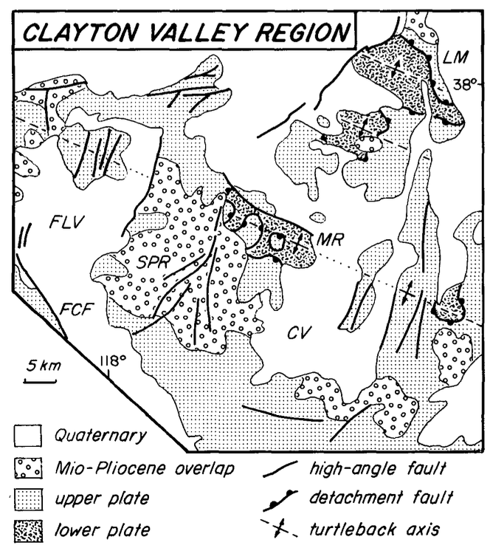
Silver Peak-Lone Mountain extensional complex
Geologic settings:
Furnace Creek fault: Right slip of 40 to 50 km, 12-8 Ma
Owens Valley fault systems: Right slip < 10 km, 5-3 Ma
Suggest pull-apart basin and extension (displacement transfer)
Structural features (Turtleback structure):
Normal faults with NNE-SSW strike
Extension occurs through a detachment fault
Folds in the lower-plate with axis parallel to the extensional direction

Slide 6
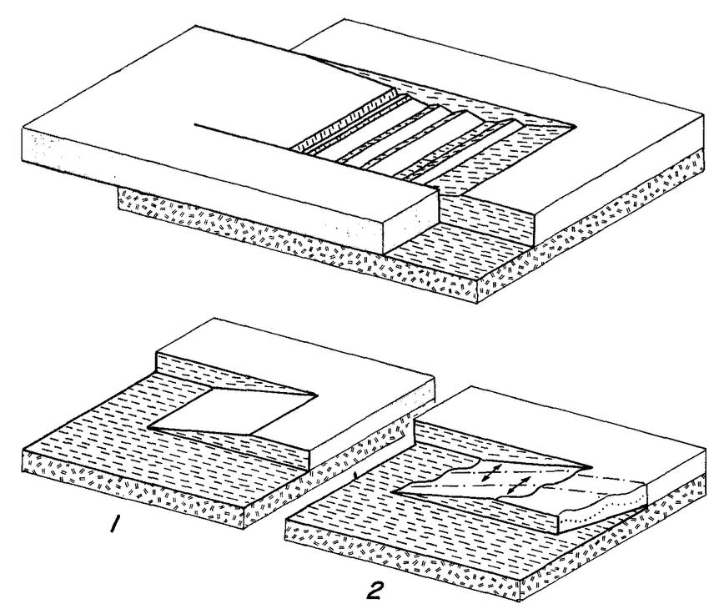
Original dip angle of the detachment fault <15°：
Vertical: cooling history to exhumation rate, 1.0- 0.6 mm/yr
Horizontal: Post-late Miocene slip rates for the Furnace Creek fault, 4-6 mm/yr
Conclusions:
Silver Peak-Lone Mountain detachment: shallow northwest-dipping structure
Right slip on the strike-slip faults resulted in displacement of the upper plate to the northwest.
Normal faults in the upper plate merged with the shallowly dipping detachment and formed tilted blocks as the lower plate was drawn from beneath the overlying cover.
Northwest-trending folds of the detachment system are part of progressive deformation associated with displacement transfer and are not due to later superposed deformation nor crustal constriction

Slide 7
Extension and right slip since mid-Miocene

Slide 8
U-TH dating indicates
Rapid uplift/unroofing 15-12 Ma – another pulse post 3Ma?
Miocene detachment at right step exposes core complex at Lone Mtn

