Slide 1
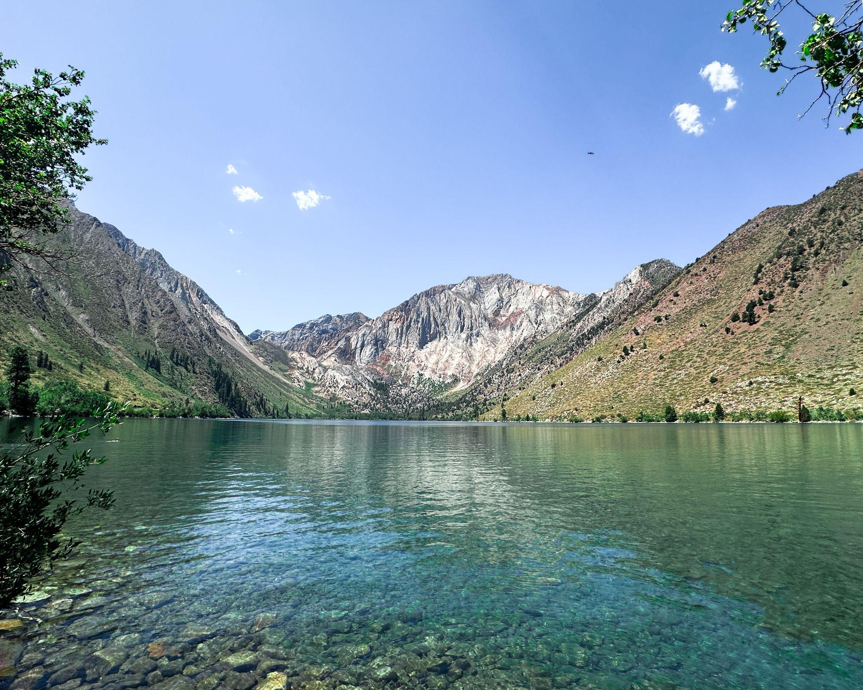
Pleistocene glaciation in the Sierra Nevada and Basin Range
Summary of USGS Bulletin by Eliot Blackwelder 1931
& GSA Bulletin by Sharp and Birman 1963

Slide 2
— Glacial Stages —
Determined by:
Moraine morphology
Glacial striation
Erosional features
Creeks
Ravines
Correlation w/ lava flows
Stream terraces
Six Glacial Stages - Notable retreats and advances of glaciation in the Pleistocene
Tioga stage
Tenaya Stage (Sharp & Birman, 1963)
Tahoe stage
Mono Basin stage (Sharp & Birman, 1963)
Sherwin stage
McGee stage
Time
Comment made by Blackwelder that we could still be in the glacial period as there are current glaciers in the Sierra Nevada

Slide 3
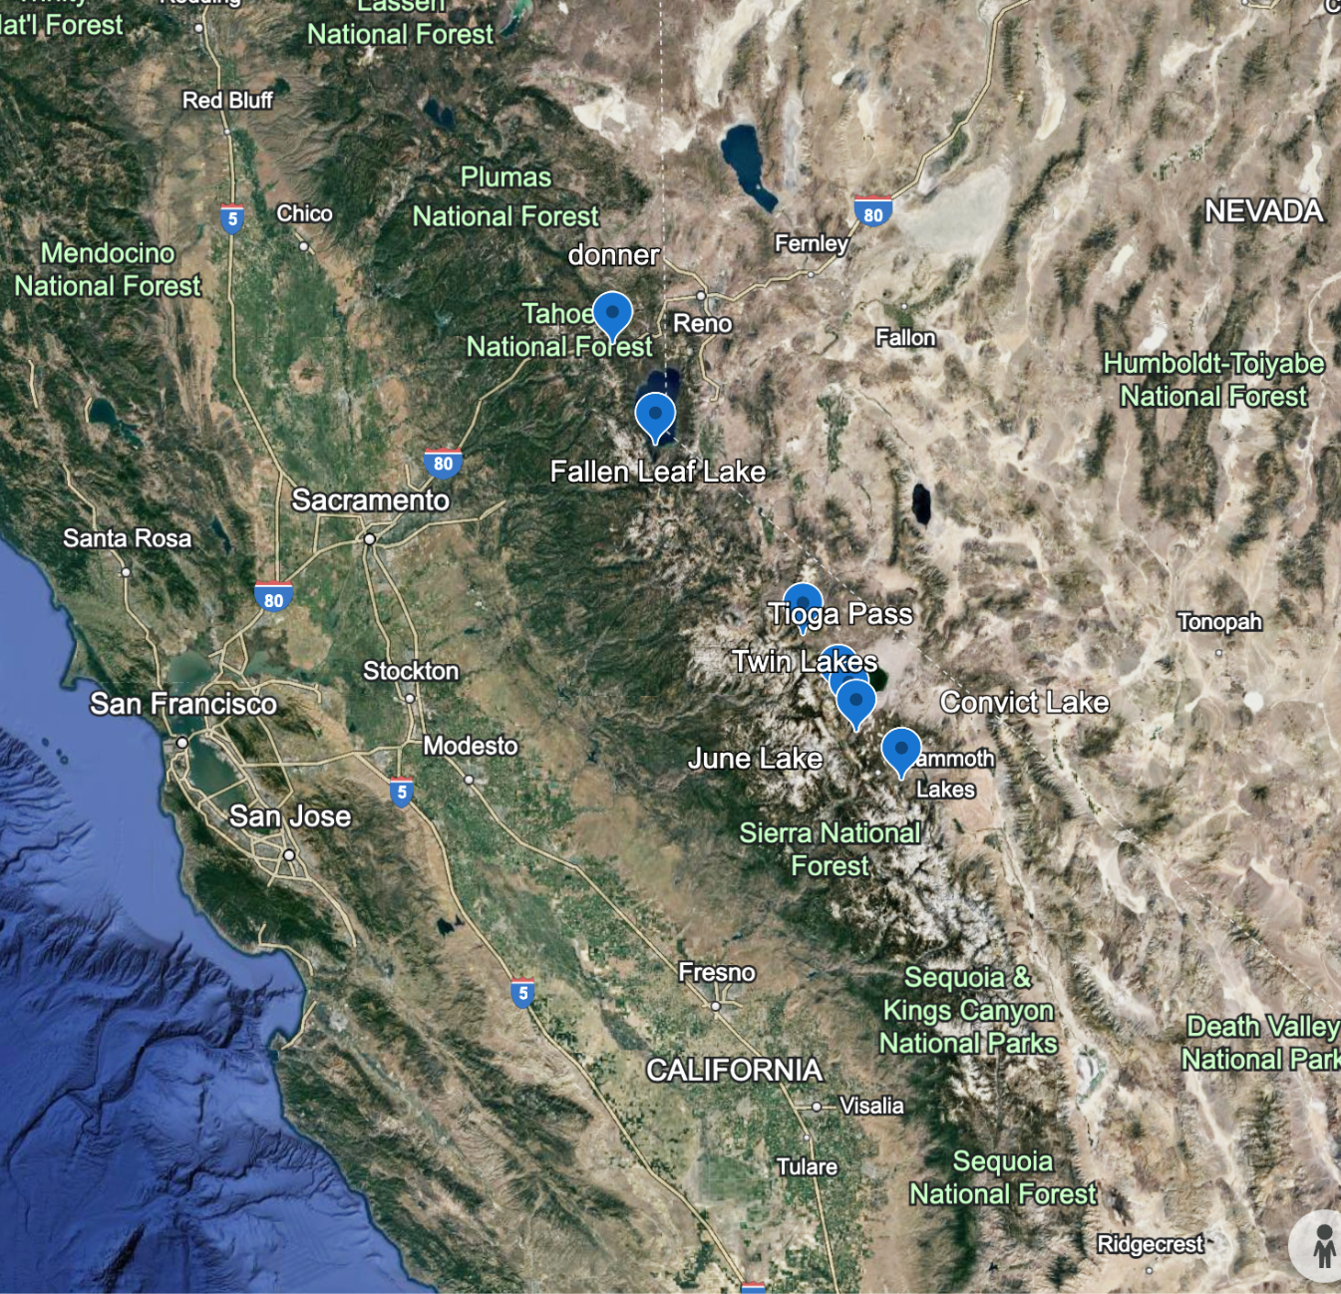
— Tioga Stage (most recent)—
“The lateral moraines generally stand out as bold embankments, marred only by a few landslides and by sharp ravines where tributary brooks descend the canyon sides.”
Characteristics: Best preserved glacial features with minimal erosion; clear moraine formations and polished rock surfaces.
Evidence for Age:
Freshness of Moraines: Moraines and rock surfaces are relatively unaltered and well-preserved.
Limited Erosion: Little valley erosion, fresh moraines with minimal breaches.
Boulder Weathering: Most boulders remain almost unweathered, with high visibility of striations on resistant rocks.
Google Earth image of locations that show best Tioga Stage features.

Slide 4
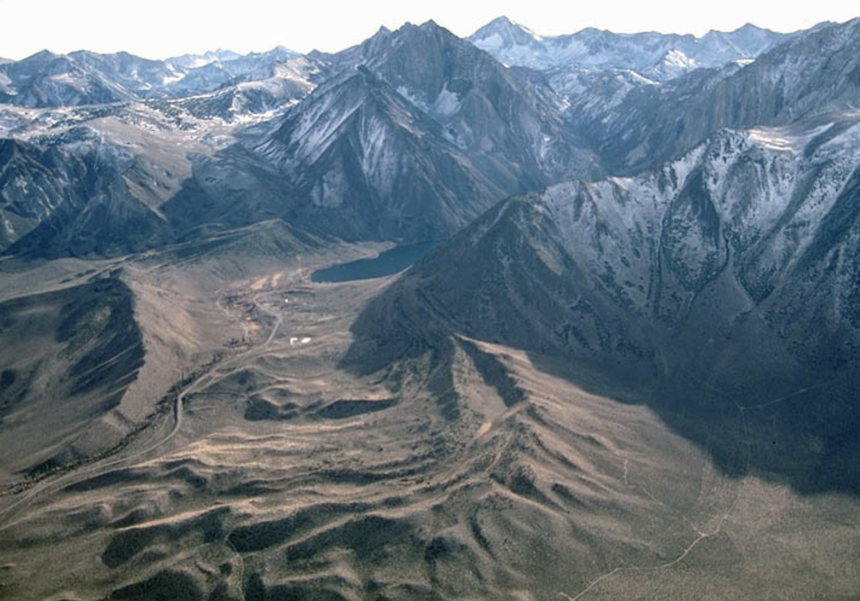
— Tioga Stage —
“The lateral moraines generally stand out as bold embankments, marred only by a few landslides and by sharp ravines where tributary brooks descend the canyon sides.”
Characteristics: Best preserved glacial features with minimal erosion; clear moraine formations and polished rock surfaces. Average height is 25ft.
Evidence for Age:
Freshness of Moraines: Moraines and rock surfaces are relatively unaltered and well-preserved.
Limited Erosion: Little valley erosion, fresh moraines with minimal breaches.
Boulder Weathering: Most boulders remain almost unweathered, with high visibility of striations on resistant rocks.
Volcanics: Mono cones may be younger than Tioga glaciation as some ash is found on nearby moraines.
Relative to other Stages: Tioga appears to be a smaller event and arranged concentrically within the earlier moraines of the Tahoe stage.
Terminal Elevation: 7500ft
Convict Lake, https://www.marlimillerphoto.com/Gl-29.html

Slide 5
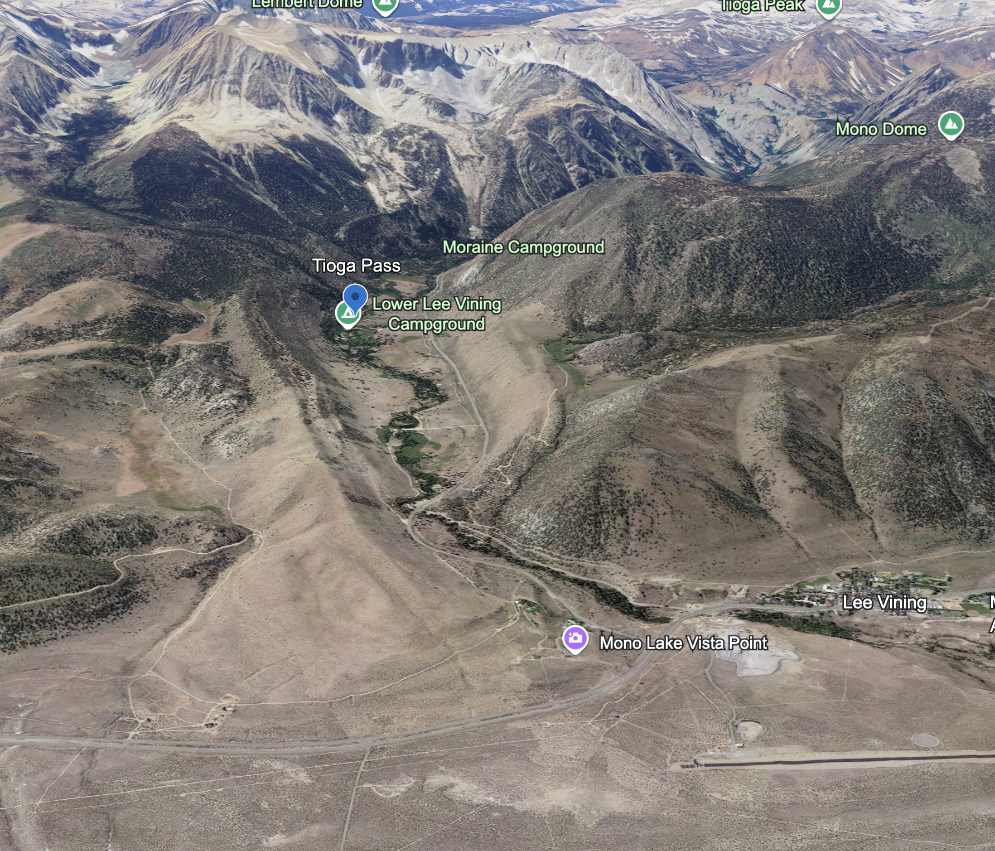
— Tenaya Stage —
Characteristics: Previously mapped as Tioga and Tahoe, by 1950-1960, the Tenaya was broken out as a separate glacial stage.
Evidence for Age:
-Separate ridges between the Tioga and Tahoe lateral moraines are evidence of the Tenaya stage.
- Did not build large terminal moraines.
- Distinctly fresher and more topographically ragged moraines than Tahoe.
- Tenaya moraines pass under Tioga moraines.
Google Earth image of Lee Vining Creek (described as having good examples of lateral moraines from the Tenaya.

Slide 6
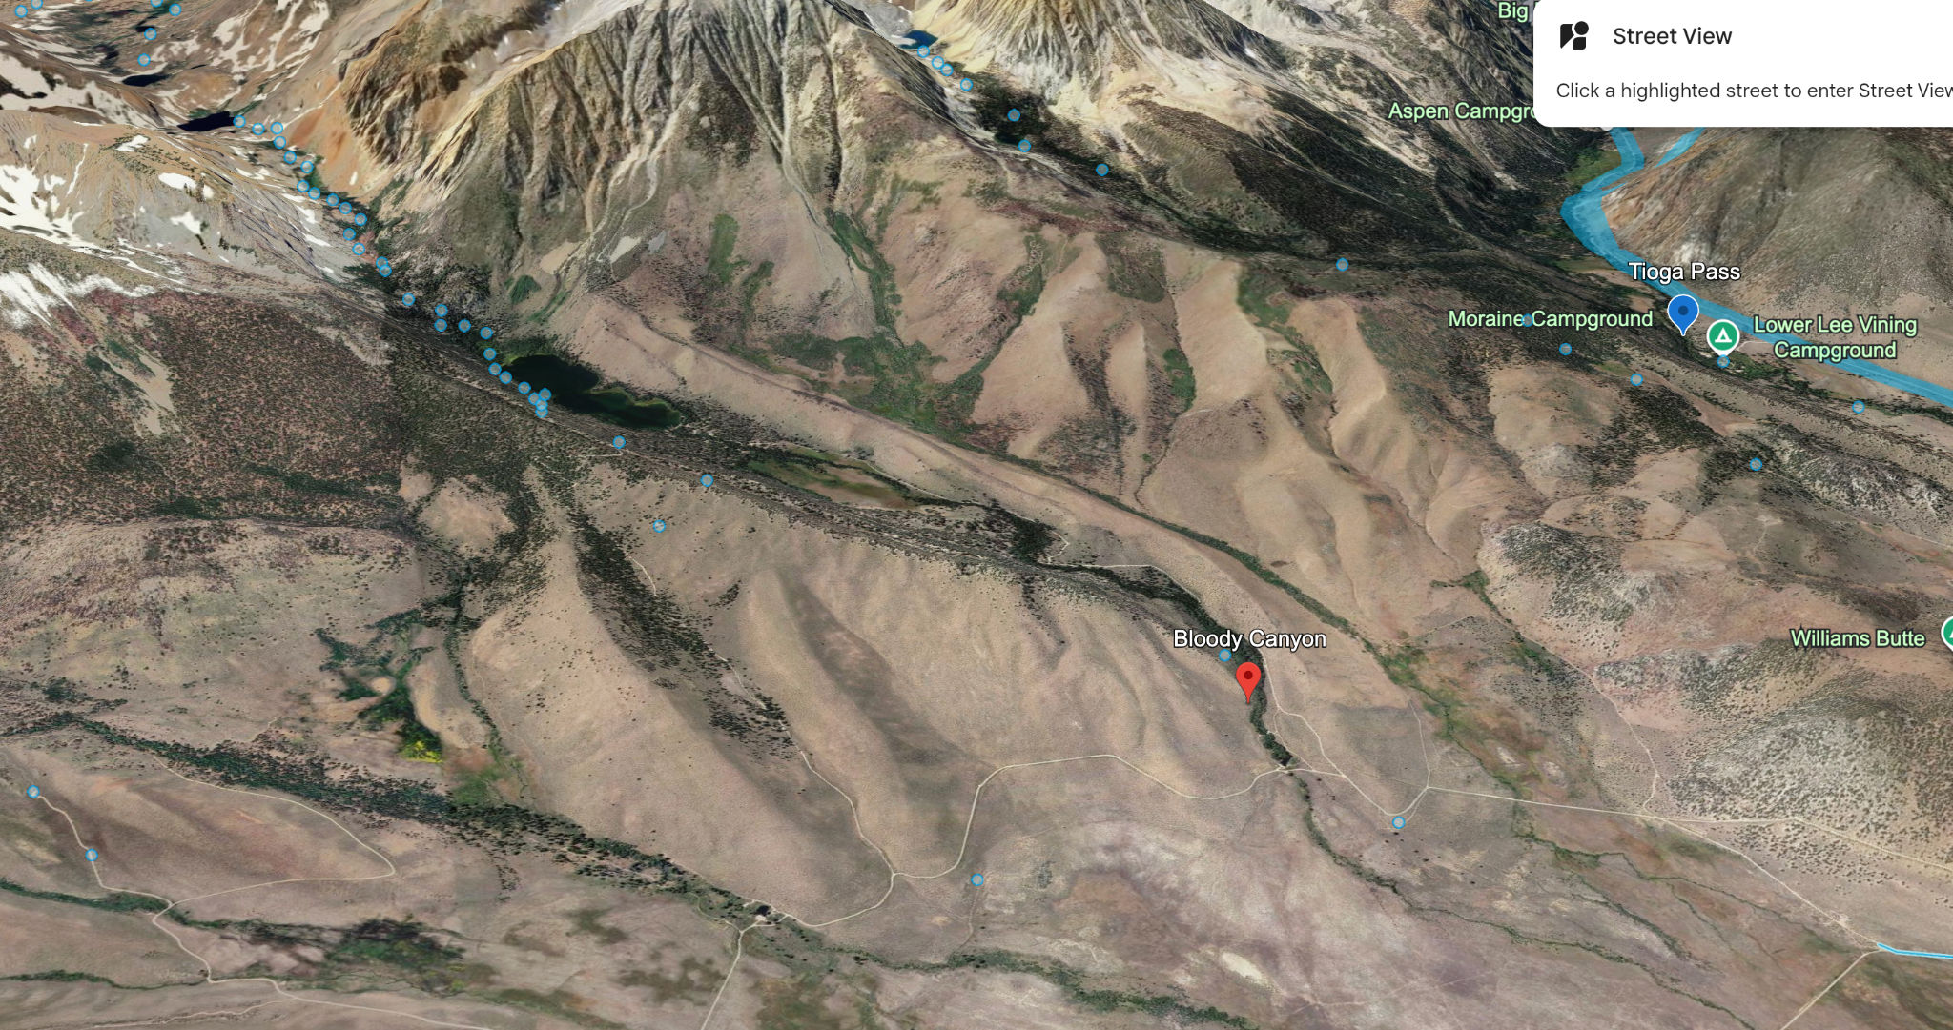
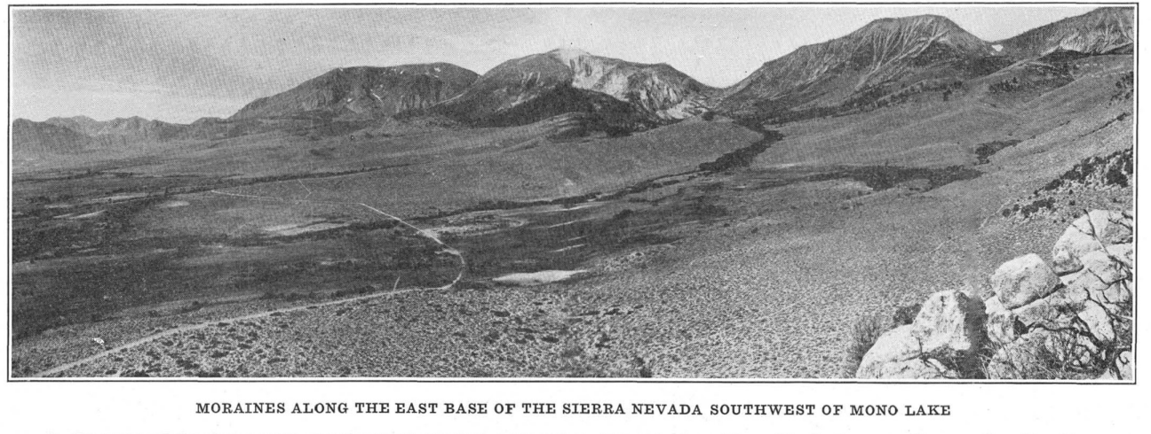
— Tahoe Stage —
Characteristics: Large and massive moraines, more extensive glaciation than the Sherwin or Tioga stages. Moraines reach heights of 500-1000 ft
Evidence for Age:
Moraine Preservation: Still bold embankments but more eroded than Tioga moraines. Typically lack terminal moraines and boulders.
Erosional Features: Some valleys show more erosion compared to Tioga; still possess notable features like roches moutonnées.
Boulder Decay: Moderate weathering and decay, with a noticeable reduction in striated surfaces on granite. Siliceous boulders show striations
Volcanics: Lava flows (with spatter cones) over moraines NE of June lake. Also ash from the Mono volcanics (1-10 inches).
Terminal Elevation: 7000ft

Slide 7
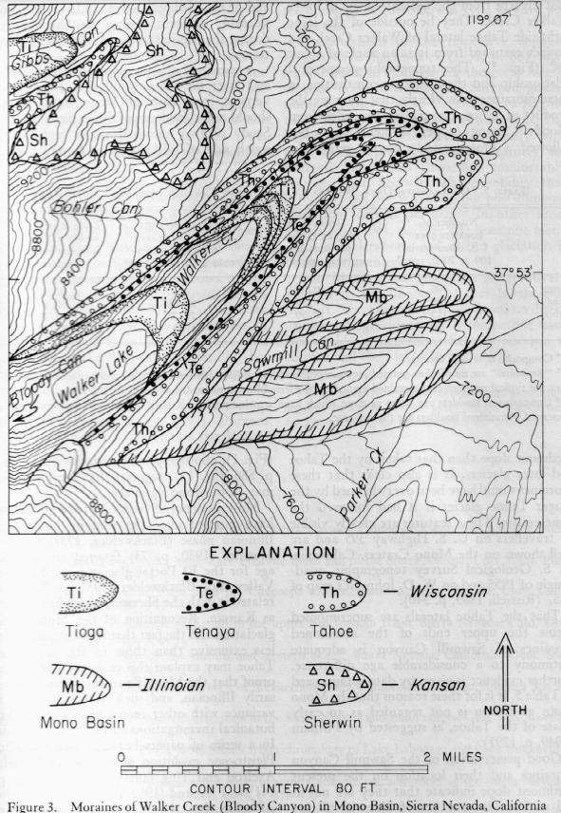
— Mono Basin Stage —
Blackwelder mentioned the possibility of this stage, but more evidence was found by Sharp. This stage has been determined to be less extensive than the following Tahoe Stage, which has wiped out evidence.
Characteristics: Best preserved glacial features with minimal erosion; clear moraine formations and polished rock surfaces.
Evidence for Age:
Lithology of glacial erratics.
Location of glacial erratics followed different paths than Tahoe Stage glaciers
The tahoe lateral moraines are superimposed on the upper end of Mono Basin moraines.

Slide 8
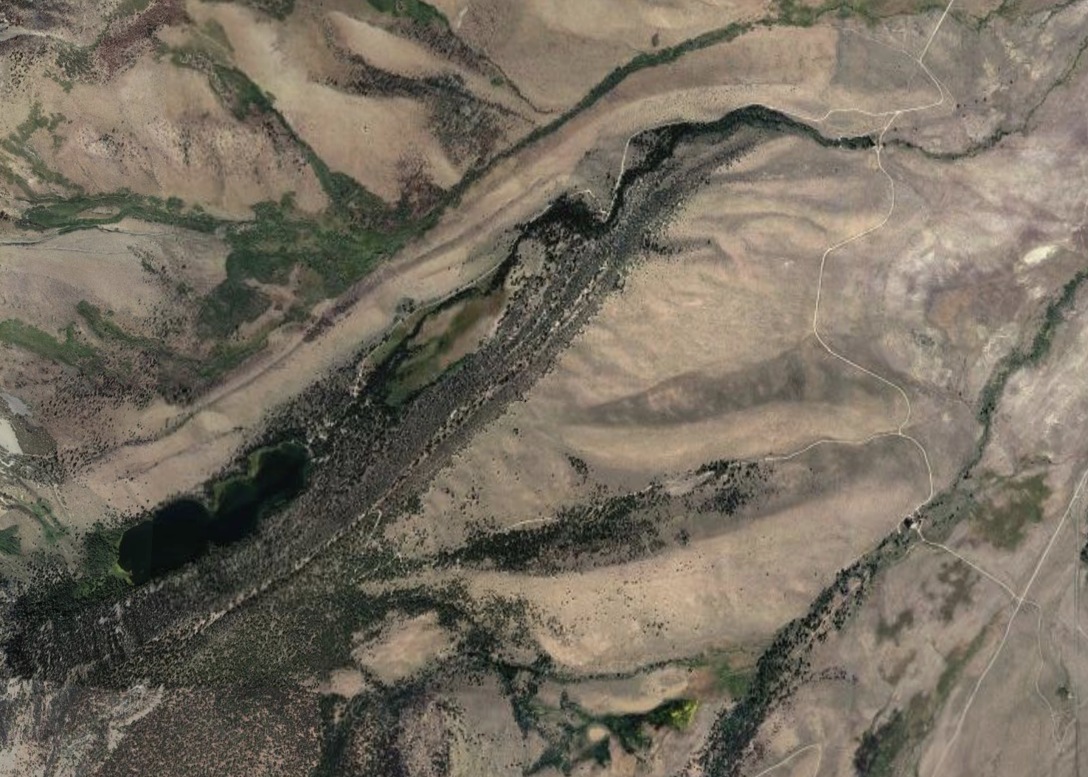
— Mono Basin Stage —
Blackwelder mentioned the possibility of thi stage, but more evidence was found by Sharp. This stage has been determined to be less extensive than the following Tahoe Stage, which has wiped out evidence.
Characteristics: Best preserved glacial features with minimal erosion; clear moraine formations and polished rock surfaces.
Evidence for Age:
Lithology of glacial erratics.
Location of glacial erratics followed different paths than Tahoe Stage glaciers
Tioga, Tenaya, and Tahoe Stages
Mono Basin Moraines

Slide 9
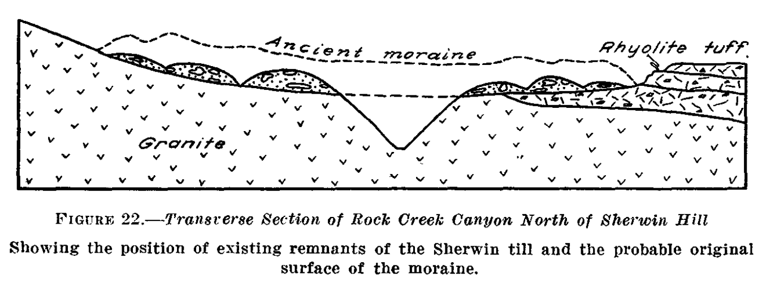
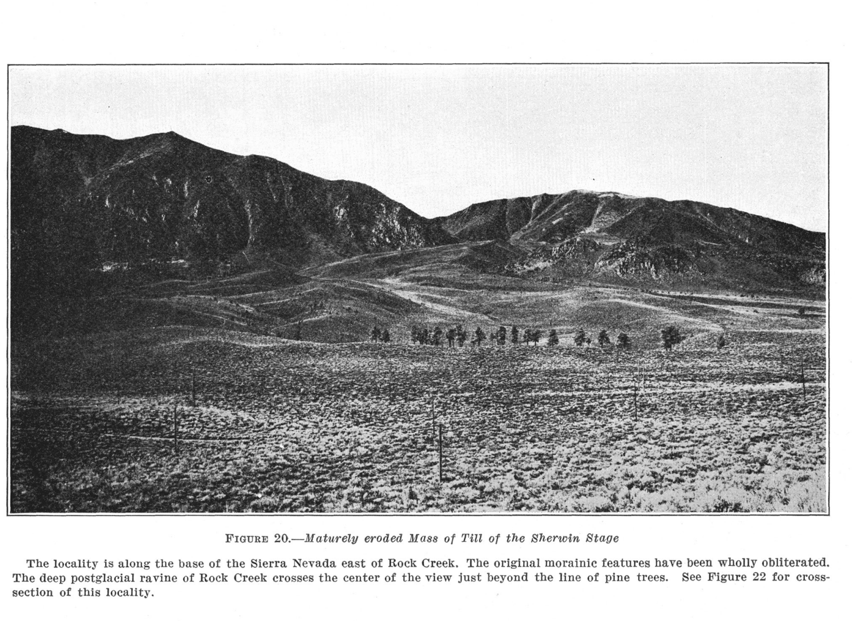
— Sherwin Stage —
Characteristics: Original glacial topographic features almost entirely lost; remnants of moraines significantly eroded. Recognized almost entirely by remnant till.
Evidence for Age:
Moraine Preservation: Few, if any, terminal moraines remain, with eroded lateral moraines suggesting extensive glaciation. Boulders are sparse.
Erosional Features: Valleys show advanced erosion with no clear roches moutonnées, indicating substantial post-glacial geomorphic activity.
Boulder Decay: Severe weathering and decay of boulders; granite surfaces heavily degraded with almost no striations visible. Siliceous boulders show remnants of striations indicating significant age.
Volcanics: Most Sherwin evidence is covered by ash 3-10ft deep.
Would have been more extensive than Tahoe or Tioga

Slide 10
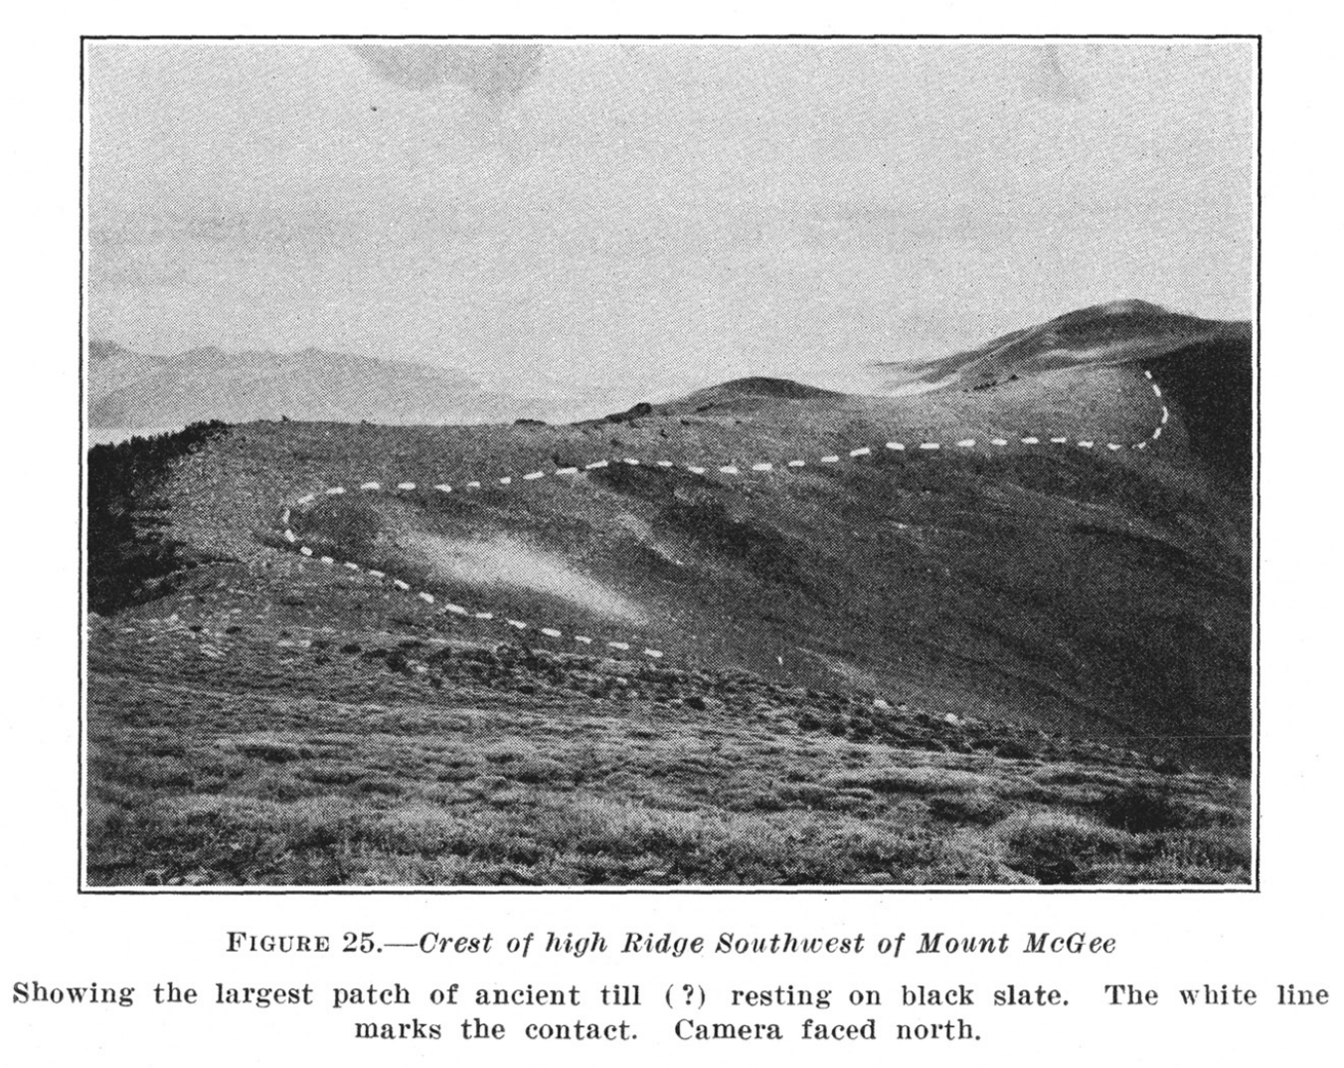
— McGee Stage —
Characteristics: Original glacial topographic features almost entirely lost; recognized by isolated patches of till.
Evidence for Age:
A deposit resembling till, of granite debris, rests on a ridge of Paleozoic slate and marble. Although more evidence is needed to confidently determine the origin as glacial.
Granites are determined to have been transported as much as 3.5 miles.
Striated fragments were found

Slide 11
— Greater Basin and Range—
RUBY MOUNTAINS, NV
SNAKE RANGE, NV
Tioga Stage: Small, fresh moraine loops, fresh cirques. Did not extend into valleys and remained about 8000ft.
Tahoe Stage: Large moraines and flood plains, terminal moraines present.
Earlier Stages?: till-like material separate from the Tahoe stage suggest a possible Sherwin stage, but more evidence is required.
Blackwelder admits a “hasty examination of the range”
Tioga Stage: Ragged cirques on the Eastern slope of Wheeler peak indicate Tioga stage glaciation.
Tahoe Stage: A bulky moraine extends from Wheeler peak.
HONORABLE MENTIONS
White Mountains, CA
Carson Range, NV
Independence Range, NV
Schell Creek Range
Sweetwater Range
Spring Mountain Range
Toiyabe Range
Humboldt Range
Onequi Range
Beaver Range

Slide 12
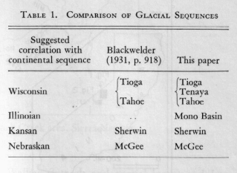
— Questions & Comments—

