Slide 1
Sierra Nevada Basin and Range Transition Near Reno
Henry and Perkins (2001)
Timing of Sierra Nevada uplift and relative elevation of the Great Basin before the middle to late Cenozoic extension have been controversial
Previously suggested that the Sierra Nevada was the western flank of a broad plateau now occupied by the Great Basin
Extended ~3 km in elevation before 15 ma
Subsided during the late Cenozoic extension
Henry and Perkins suggest an alternative development that occurred two stages

Slide 2
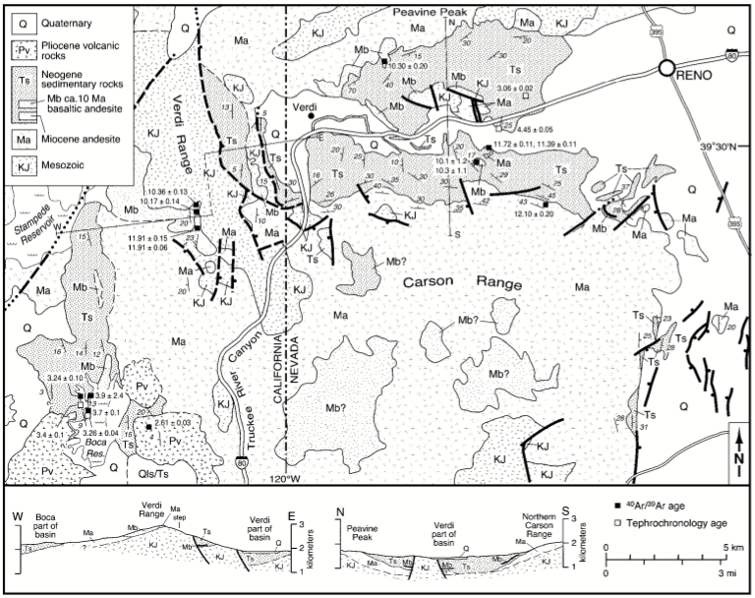
First Stage: Verdi-Boca Basin Deposition 12 Ma – 3 Ma
N
Field mapping
Stratigraphy of Neogene sediments similar in west and south of Reno and around the Boca Basin
Neogene sediments now crosscut by faulting which exposed the underlying andesites and Mesozoic rocks
Initially deposited in a once connected basin with no topographic barriers
Full extent of basin unknown
Distribution of Neogene sediments indicate the basin was at least 700 km2
E
W
S

Slide 3
First Stage: Verdi-Boca Basin Deposition 12 Ma – 3 Ma
40Ar / 39Ar and Tephrochronology from basaltic andesites in the conglomerates and ash beds preserved within the upper diatomite
3.24 ± 0.1 Ma
Diatomite and
interbedded ash
3.7 ± 0.1 Ma
3.9 ± 2.4 Ma
Neogene Sediments
Sandstone
Conglomerate
11.39 ± 0.11 Ma
11.72 ± 0.11 Ma
Andesite
(Ma)
12.10 ± 20 Ma
Extensional origin of the Verdi-Boca basin
Donner Pass Fault Zone the western boundary of basin
Basin may have been result of DPFZ faulting between 13 – 8 Ma
Deposition of the Veri-Boca Basin began shortly after the andesite was deposited around 12 Ma and ended around 3 Ma

Slide 4
Second Stage: Intense Deformation of Verdi-Boca Basin 3 Ma
N
Verdi Range
Uplifted with cumulative offset ~ 2 km
Tilted west by 20 degrees
Overlying Neogene sediments removed through rapid erosion
Neogene sediments east of the two east bounding faults also tilted 20 degrees

Slide 5
Second Stage: Intense Deformation of Verdi-Boca Basin 3 Ma
N
Boca Reservoir
Exposed conglomerates from the Neogene sediments tilted West by 20 degrees
Dips decrease westward into the diatomites which dip ~ 10 – 4 degrees, decreasing to the west
Change in dip attributed to the progressive westward decrease in footwall uplift of Verdi Range

Slide 6
Second Stage: Intense Deformation of Verdi-Boca Basin 3 Ma
N
Carson Range and Peavine Peak
Both rose relative to the preserved Verdi part of the basin
Sedimentary rocks dip northward off Carson Range and southward off Peavine Peak
Verdi-Boca strata not preserved on top of Carson Range or Peavine Peak but preserved sediments east of Carson Range indicate that the sequence did initially cover it

Slide 7
Second Stage: Intense Deformation of Verdi-Boca Basin 3 Ma
N
Ages of deformation
The age of the youngest ash bed from the Boca-Verdi Strata constrains the beginning of deformation to ~ 3.1 Ma
The age of a ~ 4 degree west dipping basaltic andesite lava that overlies 15 – 20 degree west dipping sedimentary rocks near Boca Reservoir constrain the end of deformation to 2.61 ± 0.03 Ma
Uplift of Carson Range occurred ~ 3 Ma because the youngest sedimentary rocks in that part of the basin are also dated at 3.1 Ma (?)

Slide 8
Two Stages of Development
N
First Stage
Extension around 12 Ma created the Boca-Verdi Basin
Neogene sediments infilled the basin between 12 Ma and 3 Ma
Second Stage
Deformation and dismemberment of the Boca-Verdi Basin that was more intense than the first stage
Uplifted the Verdi Range, Carson Range, and Peavine Peak

