Slide 1
Kinematics of the northern Walker Lane: An incipient transform fault along the Pacific–North American plate boundary James E. Faulds; Christopher D. Henry; Nicholas H. Hinz
The study focuses on the northern Walker Lane
The northern Walker Lane is characterized by a belt of overlapping, left-stepping dextral faults.
the western Great Basin in North America and accommodates 15%–25% of the Pacific–North American plate motion
Offset on the Walker lane since the Miocene
~50–100 km in southern California
~60–75 km in west-central Nevada
Essentially zero in northern Walker Lane
Area gives insight on how a young strike slip fault can develop

Slide 2
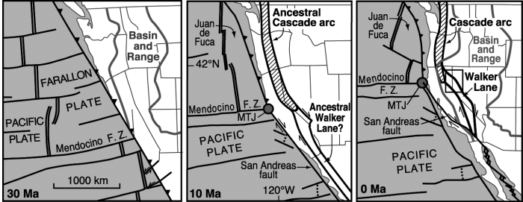
Geologic History
Western North America has evolved from convergent to transform margin in the last 30 m.y.
During the ‘Ignimbrite Flare up’ Tertiary volcanic strata like ash-flow tuffs were deposited (31–23 Ma)
Calc-alkaline intermediate-composition rocks from the ancestral cascade arc (22-5 ma)
Bimodal rocks from the Basin and Range extension (13 ma - present)
The migration of Mendocino triple junction in the past 13 ma has “pushed” the volcanism northwards
Also causing Basin and Range normal faulting to move westward and strike slip faulting in the northern Walker lane

Slide 3
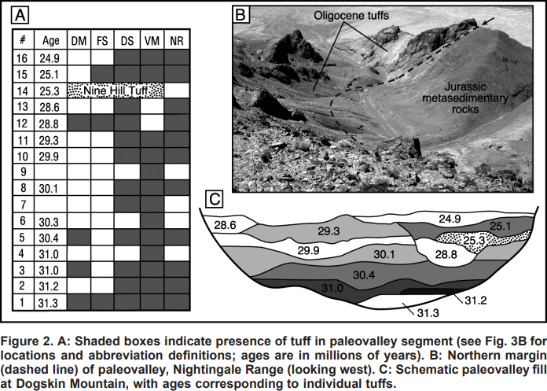
Ignimbrite Flare up
The Tertiary volcanics play a large role in understanding the history of the Northern Walker lane
The eruptions deposited thick sequences of ash flow tuffs in paleo valleys
When eruptions stopped (22 ma) the offset Oligocene paleo valleys show the total displacement prior to Walker lane development

Slide 4
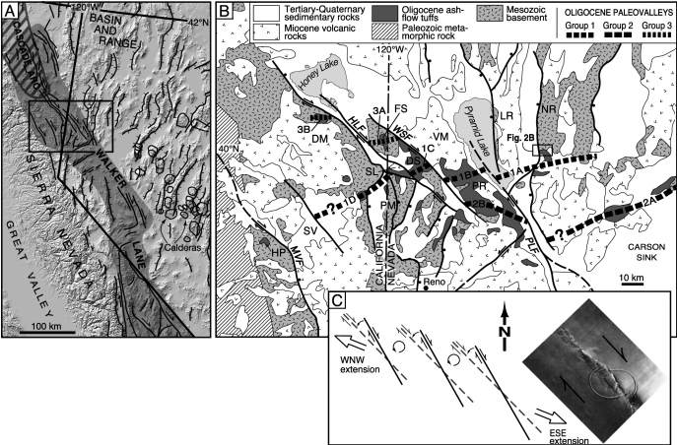
Walker lane kinematics
The Walker lane consists of NW-striking, left-stepping dextral faults, N-striking normal faults, and subordinate ENE-striking sinistral faults
Paleomagnetism indicates a ~15-degree counterclockwise rotation in Northern Walker lane vs ~35-44 clockwise rotation in the Carson sink area
Using the paleo valleys as a baseline the study measured the difference between identical tuff sequences
This showed a cumulative ~20-30 km of dextral displacement within the Oligocene paleo valleys
Suggesting a ~2-10 mm/yr offset which is comparable to GPS data taken in Northern walker lane

Slide 5
Walker lane kinematics
The relatively small cumulative dextral displacement indicates the Northern Walker lane is a young strike slip system
There are also macroscopic Riedel shears in the Walker Lane terminate into north-striking normal fault systems transferring dextral shear into west-northwest extension in the northern Great Basin
The counterclockwise rotation of the Northern Walker lane also would orientate the Riedel shear towards the normal shear zone at depth to eventually help develop a more mature strike slip fault at the surface
Notes:
a type of fault/fracture that form at an acute angle to a main fault

Slide 6
With the Mendocino triple junction moving northward it may lead to a more stable North American-Pacific plate boundary
Coupled with the history of the San Andreas fault system stepping inland
The Walker lane therefore may be the start of a lithospheric scale transform fault and create a large eastward jump in the plate boundary

