Slide 1
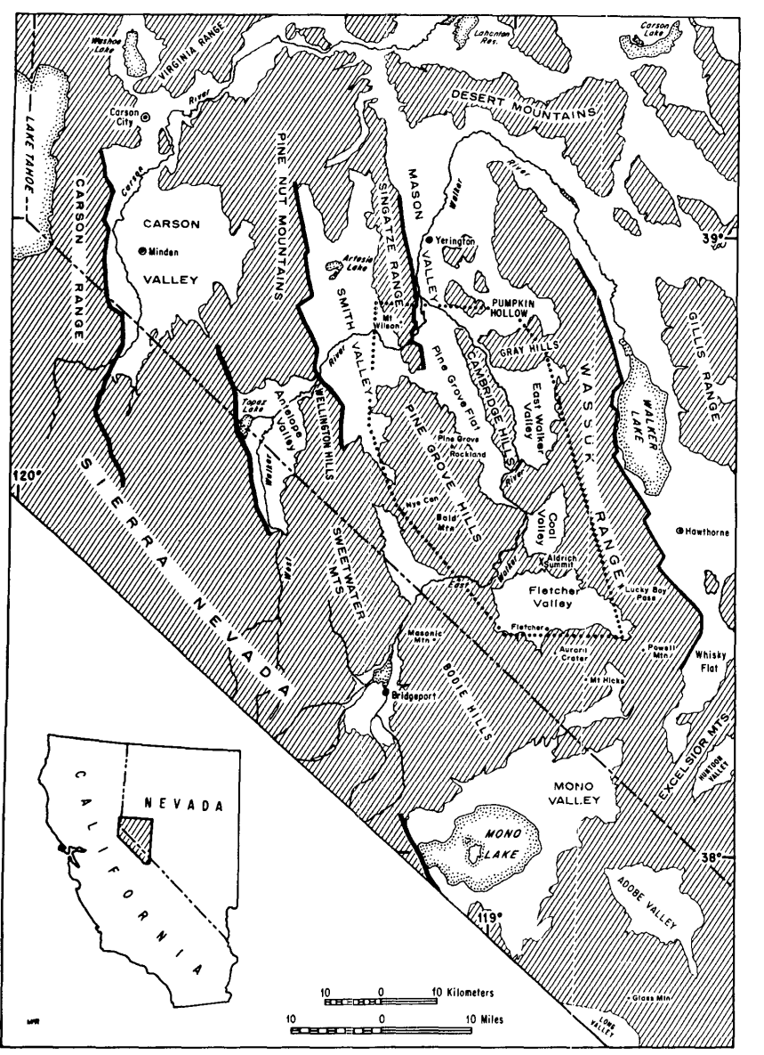
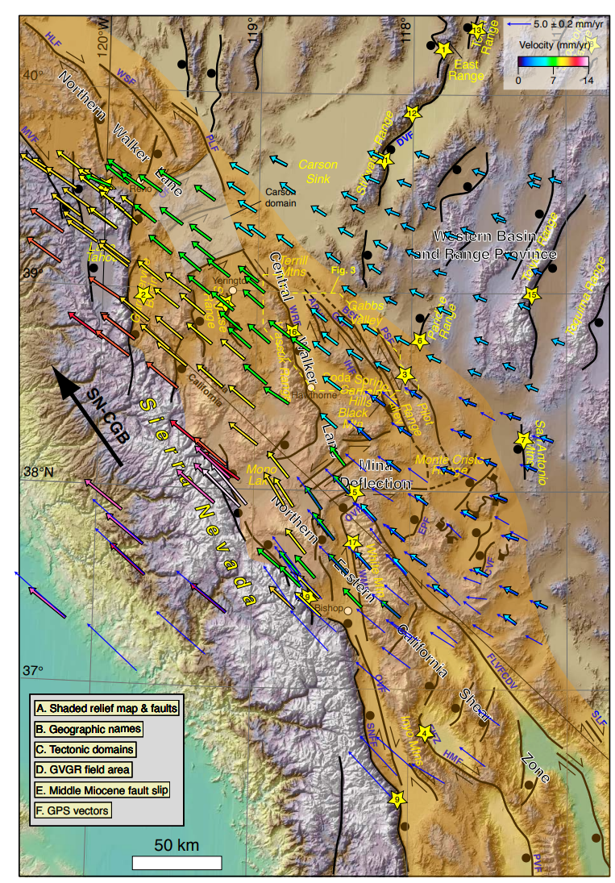
Fisher (2024)

Slide 2
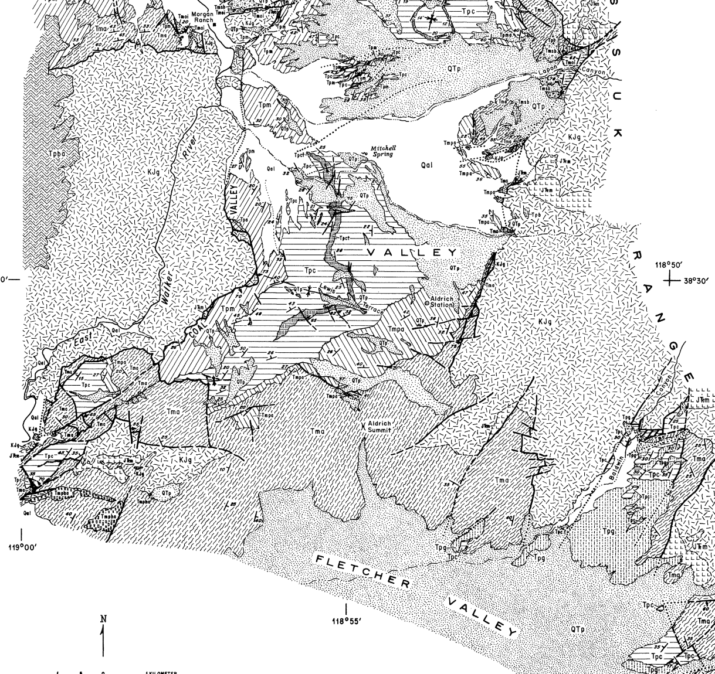
General Geology
Basement (>87 Ma)
Intrusives and metamorphic pendants
Oligocene to Early-Miocene Volcanics (28-22 Ma)
Rhyolitic ignimbrite flows
Early- to Mid-Miocene Volcanics(18.9-15 Ma)
Andesite flows and clasts
Mid- to Late-Miocene Sediments and Volcanics (12.5-9 Ma)
Fluvio-lactustrine sediments
Mid-Miocene to Pliocene Volcanics (12.5-3.4 Ma)
Sporadic eruptions producing basalt flows to andesitic tuffs and flows
Pliocene to Holocene Sediments (<5Ma)
Pediment gravels and fluvio-lacustrine sediments with intercalated Pliocene tuff.

Slide 3
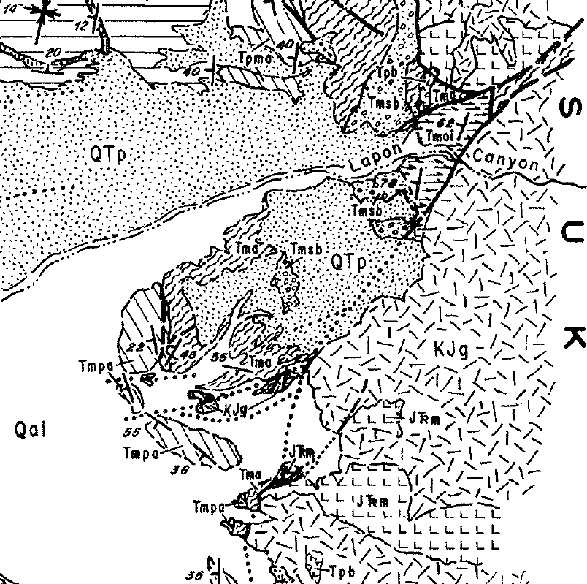
Structural History: Early Miocene
Unconformity between widespread older ignimbrites (22-28 Ma) and younger andesites (19-15 Ma) and Miocene sedimentary breccias. In some places, older ignimbrite is absent (eroded).
Older ignimbrites interpreted as being deposited over an area with low-relief followed by uplift and erosion proceeding the ~19-15Ma volcanics

Slide 4
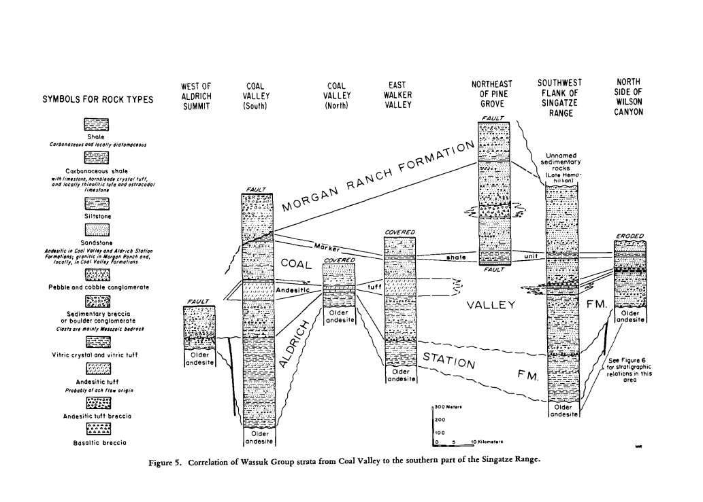
Wassuk Group: Middle- to Late-Miocene Structural Story
The Wassuk Group is composed of fluvial to lacustrine facies.
Aldrich Station Formation (12.5 to 11 Ma)
Predominantly fine-grained facies suggesting the surrounding area was of low-relief
Coal Valley Formation (11 to 9 Ma)
Generally coarser-grained rocks of andesitic provenance
Coarser-grain sizes suggests higher relief
Morgan Ranch Formation (9 to 7 Ma)
Generally coarser-grained rocks of granitic and metamorphic provenance (basement)
In areas where contact with the Coal Valley formation is observable, it is unconformable.
Sediment provenance evolves with time with the youngest sediments having clasts from the oldest metamorphic+granitic basement.
Progessive uplift
Interbedded and bracketed with volcanics allowing time constraints using geochronology. Paleontology is also used.

Slide 5
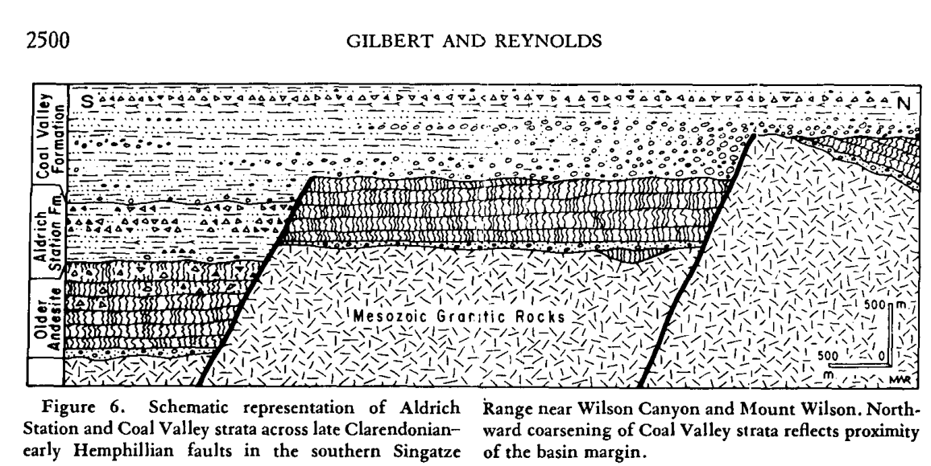
Interpretations of Wassuk Group
Deposited in a single evolving basin
The Aldritch Station Formation is interpreted to have formed in a fault-bounded basin that was surrounded by an area of lower-relief (fine grain sizes). Sediments suggest only minor changes to surrounding structural boundaries.
The Coal Canyon Formation and overlying Morgan Ranch Formation were deposited in a structurally-evolving basin with syncronous faulting and volcanism
Finer sediment away from source regions
Coarsening near basin margin

Slide 6
Structural History: Middle- to Late- Miocene
The basins ages are constrained between ~12.5 Ma and ~7 Ma.
One fault bounding the southern margin of Coal Valley is intruded by an un-deformed andesite dike dating to 12.5 Ma
Undeformed basalts dating to ~7 Ma unconformably overly tilted Morgan Ranch Formation.
Some intra-basin faults offset and are overlapped by Coal Valley strata.
The Wassuk group and contemporaneous volcanics attest to an active period of tectonics from ~15-7 Ma. By 7 Ma, the various structural blocks observable today are thought to have been developed. The faults trend generally trend NE but have NW to N strands – normal movement is the interpreted style, and they haven’t been reactivated.

Slide 7
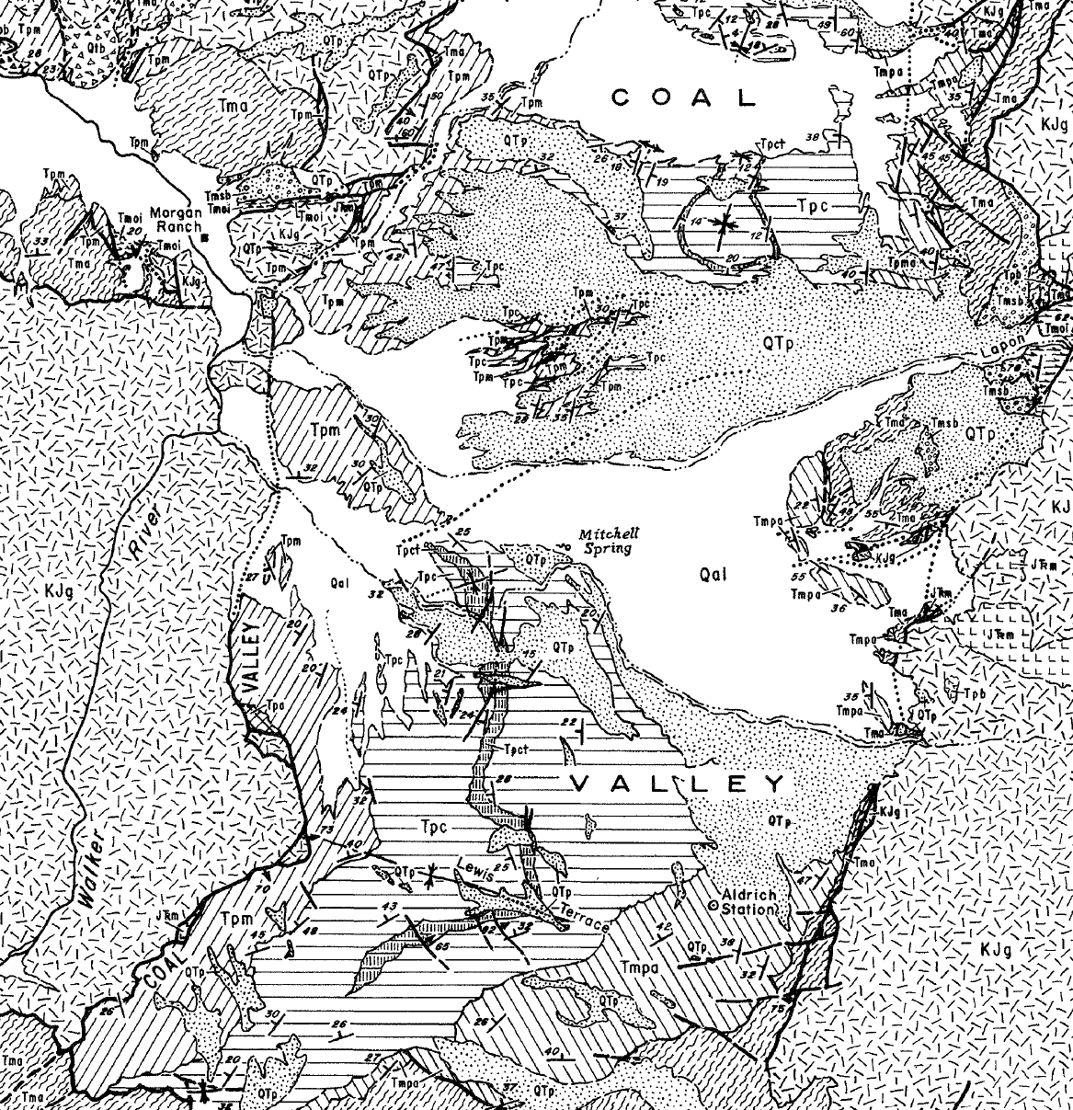
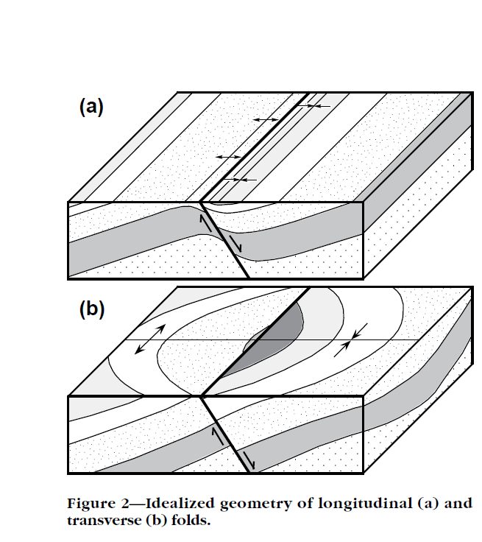
Folds Related to Normal Faults
Common when sedimentary rocks overly basement rocks in faulted basins
From Schliche (1995)

Slide 8
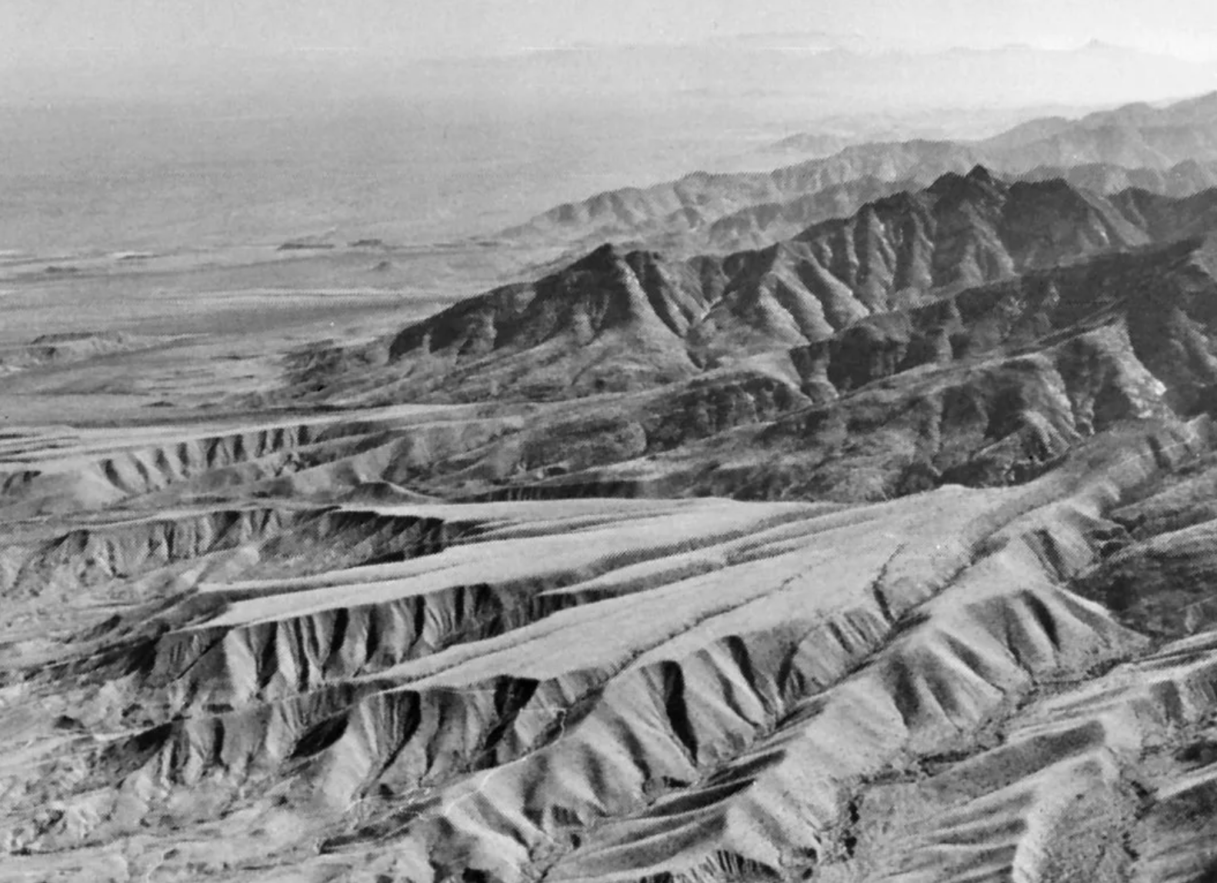
Structural History: Pliocene to Holocene
Between ~7-4 Ma, a period of relative tectonic quiescence is evidenced by the development of a widespread pediment surface called the Lewis surface.
Evidence suggests the Lewis surface was developing near the end of deposition of the Wassuk group
Tectonic activity is thought to have been reinitiated after ~5 Ma based on several lines of evidence:
Tilting of a tuff dating to 5 Ma
Uplifting of the Lewis surface resulting in incision by streams reaching 150m
A tilted sandstone contains fossils that date to 3.5 to 1.5 Ma.
From Encyclopedia Brittanica
Faults in this later period generally trend north to northwest and produce tilted fault blocks

Slide 9
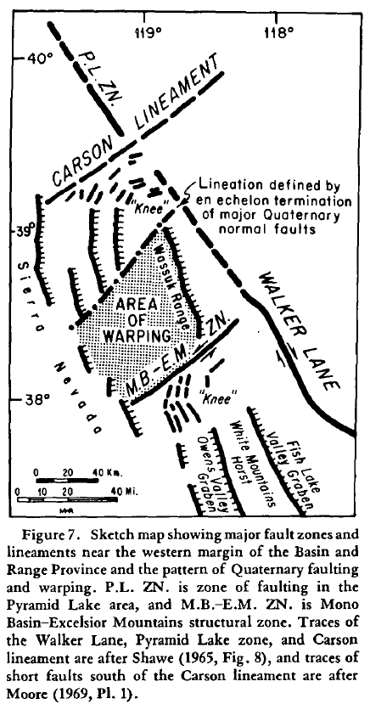
Quaternary Structural Overview
The mapped area primarily corresponds to an area of Miocene normal faulting (“Area of Warping”)
The “Area of Warping” corresponds with marked changes in Quaternary normal faults.
These lineaments are interpreted to reflect basement features

