Slide 1
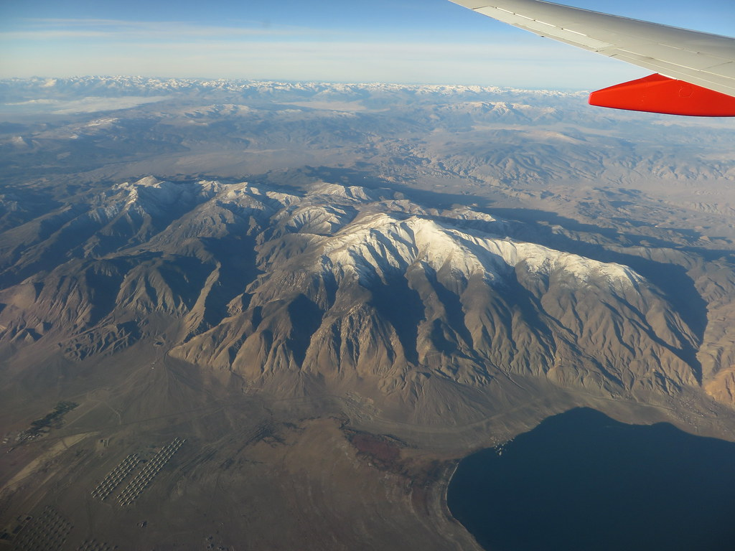
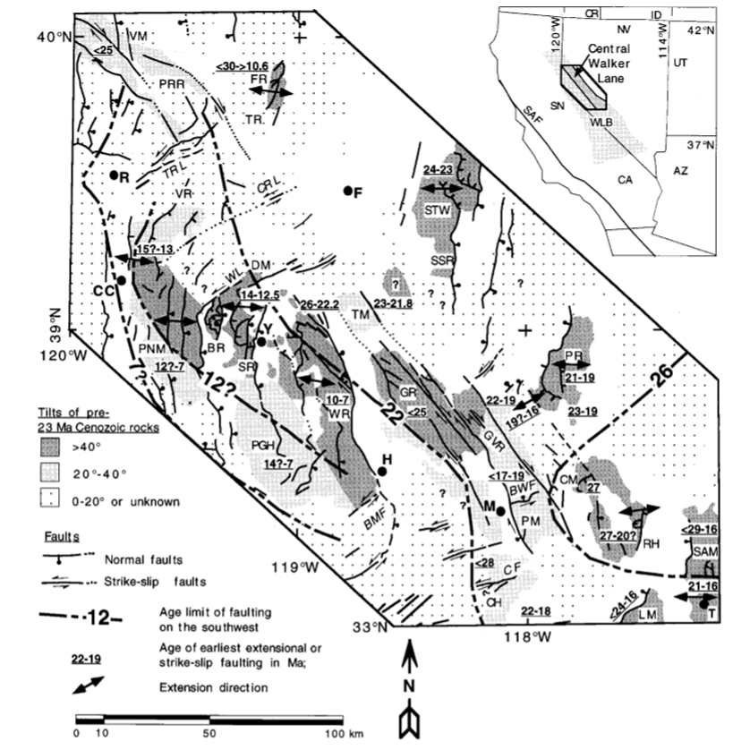
The chronology of Cenozoic volcanism and deformation in the Yerington area, western Basin and Range and Walker Lane
Research by Dilles and Gans 1995
Presented By Ruben Underwood-Aguilar

Slide 2
Motivation for study
Timing between strike slip faulting and normal faulting is unclear in geologic record
More precise ${}_{}^{40}{Ar/{}_{}^{39}{Ar}}$ dating dating provides a better understanding
Yerington district in the central-northern portion of the Walker lane provides strike-slip faults, normal faults, and volcanics useful for dating and crosscutting relationships

Slide 3
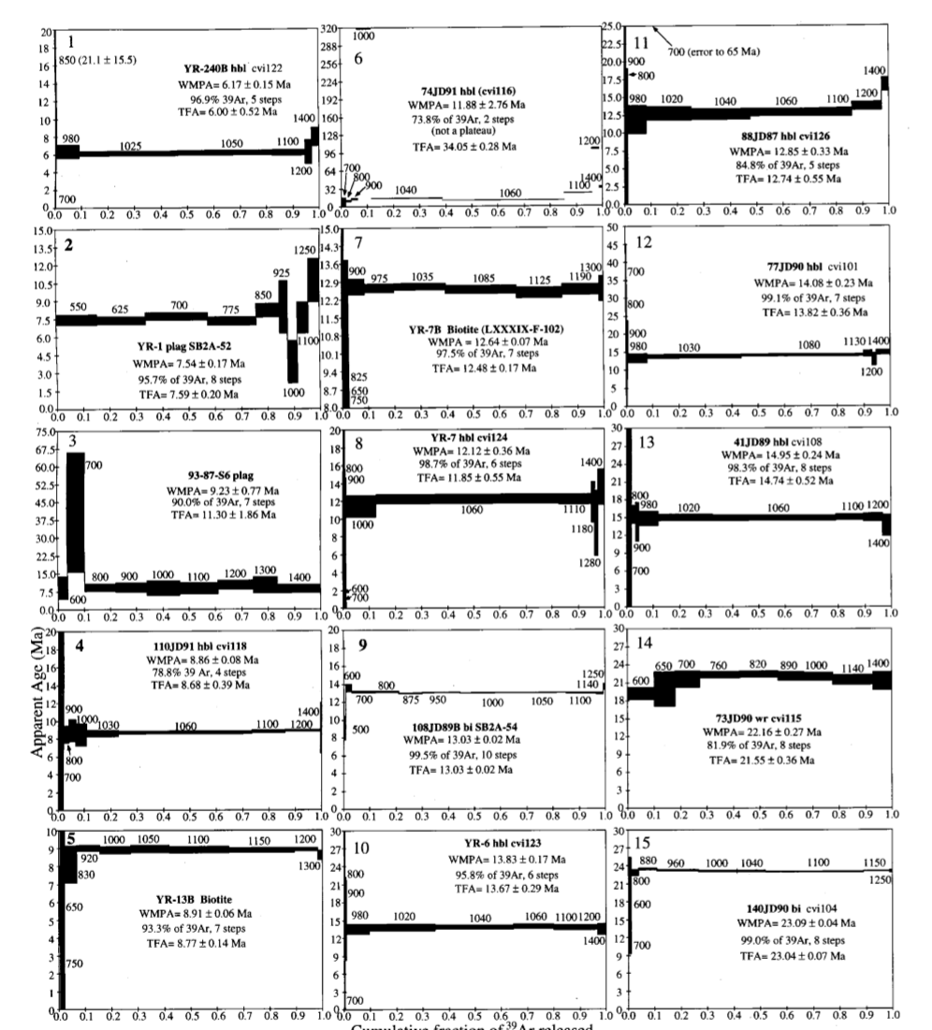
Methods
${}_{}^{40}{Ar/{}_{}^{39}{Ar}}$ dates are reported to 1sigma
Aims to correct K-Ar dates reported in Proffet and Proffet 1976 and Proffet 1977
Generally, ${}_{}^{40}{Ar/{}_{}^{39}{Ar}}$ dates are younger
Ultimately changes changes range of rapid extension from 19-17 Ma to 12.64 Ma

Slide 4
Inception of the walker LAne
Northern Wassuk range
Oldest faults N40W-striking >1km strat separation w/ right-slip
Cuts 27 Ma tuff at Mickey Pass
Strike slip and normal faulting started 26-25 Ma, active-23-22 Ma
W-NW—E-SE extension
No faults between 22.2 and 14.95 Ma

Slide 5
Southwest migration of volcanism and tectonics
Walker lane fault Zone forms at 26-25 Ma
R-L movement on SAF starts at 23-22 Ma, R-transtentional faulting even earlier.
Authors support the idea that migration of extension was episodic and generally coevolutionary with magmatism

Slide 6
Extending Walker Lane
Yerington District
Revised ${}_{}^{40}{Ar/{}_{}^{39}{Ar}}$ dates sun dacites give 14.2 -13.5 Ma and 12.8-12.5 Ma (2σ)
From a 12.64 Ma dacite that intrudes a normal fault
Inception of extension accommodated up to 163% strain with E-W extension rates 10.2 and 4.5mm/yr
Singaste has no faults prior to 14 Ma
Extension continued to the west characterized by the intense extensional zone near Yerington and closely spaced faultimg
Developed NE striking Sinistral faults (i.e. Candelaria Hills)

Slide 7
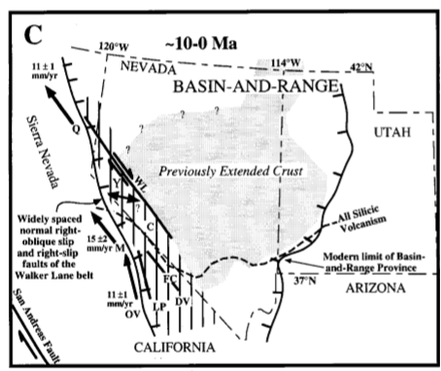
Manifault Destiny
Faulting shifted SW of Yerington into the Sierra Nevada
Right-slip faults Dominate, normal faulting continuous
Yerington district tectonism limited to 8 MA
Strain reduced to 1.7—6 mm/yr
7 Ma to present faults developed with andesitic lava flows on down-to-east normal faults

Slide 8
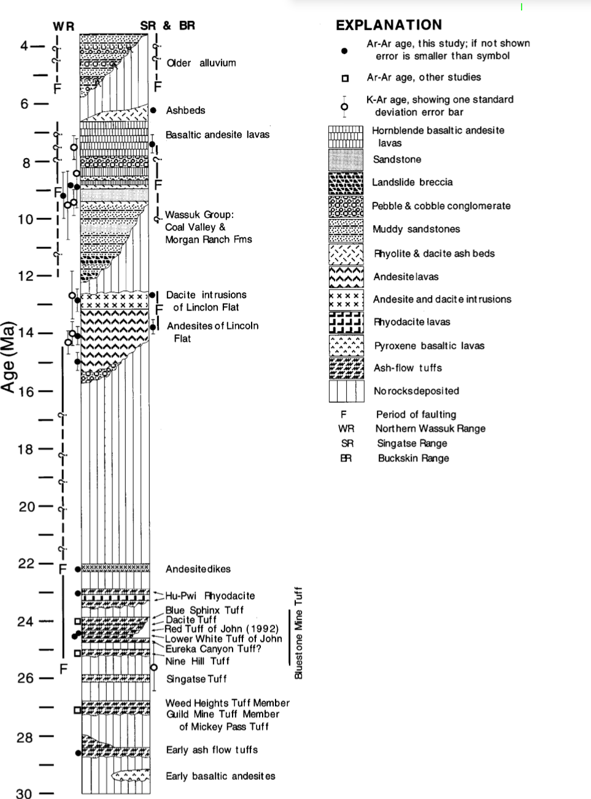

Slide 9
SUmmary
Authors argue that early movement in the central Walker Lane started as a R-L transtensional accommodation one that divided the Basin and Range extension to the east and the Sierra Nevada block to the west.
As opposed to E-W ext and LL shear
“Extreme” extensional faulting began at 27-22 Ma Ne of Walker Lane
Southwestward temporal migration of extension into Walker lane

Slide 10
Westward of Walker lane, Yerington district accommodated extreme extension >150%, and coeval with andesitic magmatism.
13.83±.17--12.64±.07
Strain rate is similar to that of modern B&R (11mm/yr)
Extensional zones may briefly accommodate most B&R ext!!!

