Slide 1
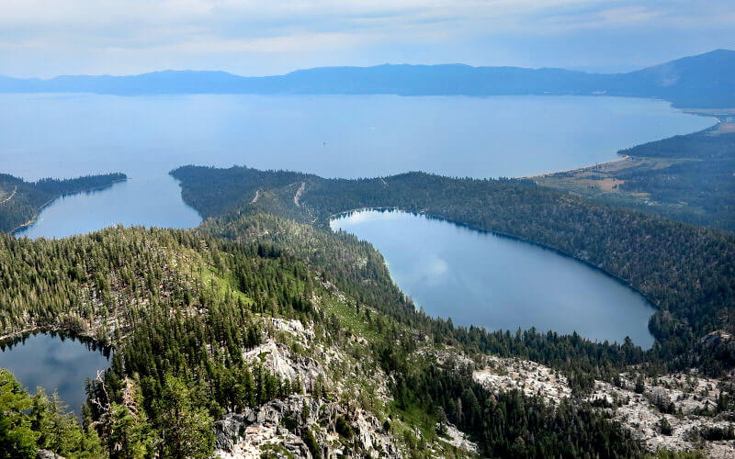
Paper synopsis: Terrestrial cosmogenic surface exposure dating of moraines at Lake Tahoe in the Sierra Nevada of California and slip rate estimate for the West Tahoe Fault Ian K.D. Pierce , Steven G. Wesnousky, Lewis A. Owen
By Ian Adams

Slide 2
Overview
This study focuses on two Pleistocene-aged moraines (Tahoe and Tioga) located on the West side of Lake Tahoe in the Sierra Nevada Mountains
Both moraines have been displaced by the West Tahoe fault (Normal Fault striking ~45 km along the west side of Lake Tahoe)
The Lake Tahoe Basin is a half-graben within the Walker Lane
The Tahoe and Tioga Moraines provide valuable information on past glacial activity and fault displacement

Slide 3
Placer County Tahoe Basin Area Plan Alternatives: Chapter 14 - Geology, Soils, Land Capability, and Coverage.

Slide 4
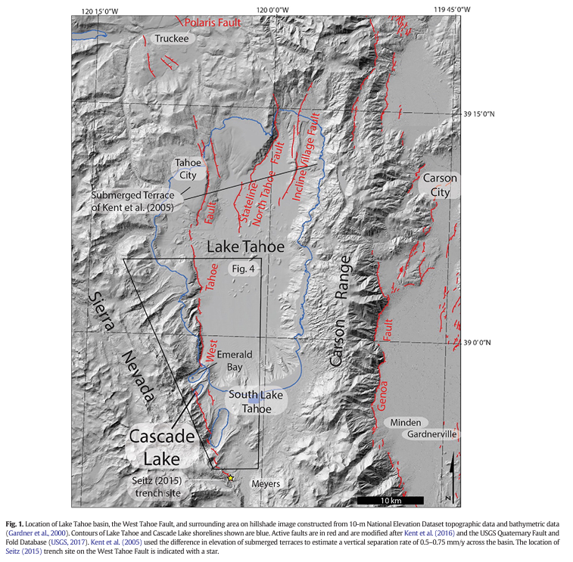
The West Tahoe Fault is a great example of a range-bounding fault (normal faults that form the boundary between a mountain range and a basin)

Slide 5
Glacial History
When the Sierra Nevada glacial deposits were first being studied, they found two sets of different aged moraines in most drainages in the Eastern Sierras
Since then they have attributed them as two distinct Pleistocene glacial stages the younger being called Tioga and the older being Tahoe
The different characteristics of the two are:
The Tahoe Moraine is broader crested than the Tioga
The granitic boulders of the Tahoe tend to be more disintegrated

Slide 6
Researchers have been able to find more accurate numerical dates of the two moraines using TCN surface exposure dating
For the younger Tioga moraines, the average age obtained was 22.3 ± 1.2 thousand years ago (ka)
This age differs a couple of thousand years from work done ~60 to 240km south of Lake Tahoe along the eastern Sierra Nevada
This could be due to different factors like different latitudes, the proximity to a large water source, and the higher rainfall present in the Lake Tahoe area compared to Eastern Sierras
The minimum age of formation for the Tahoe moraine was estimated to be 120 ± 8 ka (Though there was a larger scatter in Tahoe ages)
This age aligns with previous work that retreat of the Tahoe advance commenced at ~144ka over the entirety of the southern Sierra Nevada

Slide 7
Rates of Faulting
To obtain the amount of displacement on the fault they divided the vertical separations of the Tioga (31.5 ± 12.5 m) and Tahoe (62 ± 15m) moraines by the estimated ages of the Tioga and the Tahoe
This showed the average displacement over 120 ± 8 ka to be 0.6 ± 0.2 mm/y
A faster vertical rate of 1.4 ± 0.7 mm/y is found when averaged over the last 22.3 ± 1.2ka
Though it may seem there was an increase in slip over the past 22 ka it is not entirely thought to be a real occurrence
There is other work done on the Tioga in different areas that doesn’t support that claim
Though if it is a real occurrence, one could presume there was a post-glacial increase in slip rate like that in the Wasatch Range or the Teton Range

Slide 9
Conflicts in the Data
Geodesy shows around 8 mm/y of northwest-directed right lateral shear is accommodated across the Walker lane and over ~1 mm/y of right lateral shear is accommodated in the Lake Tahoe Basin
If the Tioga and Tahoe moraines had experienced this in their timescale one would expect to see ~22 to ~120cm of right lateral offset at Cascade Lake
The observations found in the West Tahoe Fault show none of this, creating an ongoing problem in the northern Walker Lake

Slide 10
Key Points
The Tioga and Tahoe relative ages given by TCN at Cascade Lake show a deposition time of 22.3 ± 1.2 ka and >120.1 ± 8.3 ka respectively
This aligns with the current time periods given to the last glacial maximum (LGM) in MIS 2 and MIS 6
The results indicate that Tioga moraines were deposited earlier meaning the LGM occurred earlier than farther south in the Sierra Nevada
The slip rate found when averaged over the Tahoe Moraine is consistent with geologic reports of slip rates reported else where along the fault system
The horizontal slip rate is at the lower end of values based on geodesy as is common across many basins of the northern Walker Lane

Slide 13
Discussion

