Slide 1
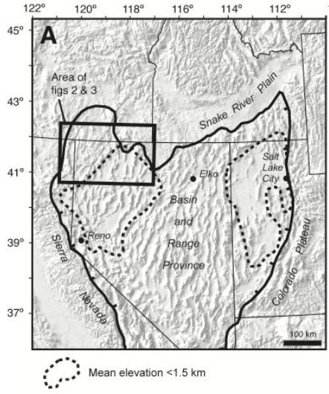
Cenozoic Tectonic Evolution of the Basin and Range Province in Northwestern Nevada
Joseph P. Colgan, Trevor A. Dumitru, Peter W. Reiners, Joseph L. Wooden, and Elizabeth L. Miller
By Henry
Northwestern Nevada
The comparisons between Northwestern and Central Nevada
The magnitude and timing of extension in Northwestern Nevada
40°
Central Nevada
38°

Slide 2
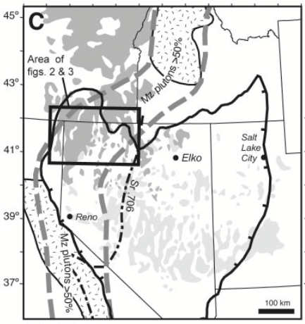
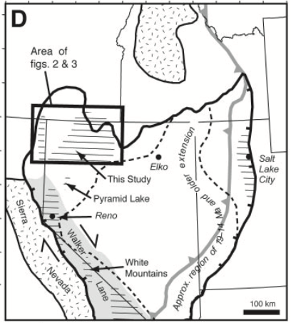
Comparisons between Northwestern and Central Nevada
Northwestern Nevada:
Extension:
Began at ～12 Ma
Magnitude～12 %
Entirely accommodated by high-angle normal faults
Volcanism:
Large-scale middle Miocene bimodal volcanism, attributed to the Yellowstone hotspot at 16.5 Ma.
Northwestern Nevada
Central Nevada
Central Nevada:
Extension:
Old extensional structures formed during Eocene-early Miocene time
Modern basin-range topography began forming during a widespread episode of major normal fault slip ~19 to 14 Ma.
Magnitude >50%
Volcanism:
Peaked in the late Oligocene - early Miocene (34 – 23 Ma)
Main phase of Miocene extension (19 – 14 Ma) was largely amagmatic.

Slide 3
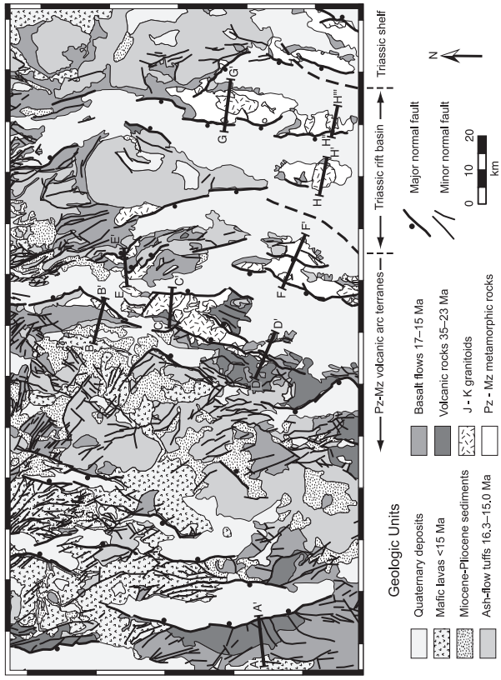
The magnitude and timing of extension in Northwestern Nevada: Field observations
Extension:
Intact pre-Tertiary basement and the absence of gently-dipping normal faults in the modern ranges indicate the lack of extension before Tertiary.
The onset of extensional faulting is constrained to be <15 Ma (volcanic rocks cut and tilted by major normal faults)
Extension was accommodated almost entirely by the small number of widely-spaced, large-offset, N-S trending faults
Magnitude of extension ~ 12%
Volcanism:
Older volcanic rocks: 35 – 23 Ma
Middle Miocene basalts and overlying ash-flow tuffs: 17 – 15 Ma (interpreted as the earliest eruptions of the Yellowstone hotspot)

Slide 4
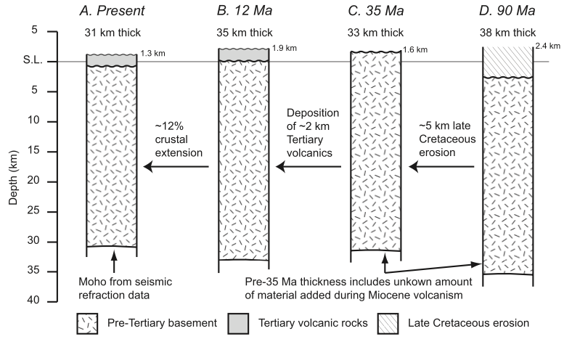
The magnitude and timing of extension in Northwestern Nevada: Crustal thickness
Northwestern Nevada:
Slightly thinned from 38 km to 31km since late Cretaceous
Central Nevada:
The crust was thickened to at least 45 to 50 km by Cretaceous thrusting
Thinned to 30 km by large magnitude (50%) extension.
～5 km exhumation estimated by the exposure of contact aureoles, caldera remnants or other shallow volcanic features
Notes:
This stands in contrast to other parts of the Basin and Range, where

Slide 5
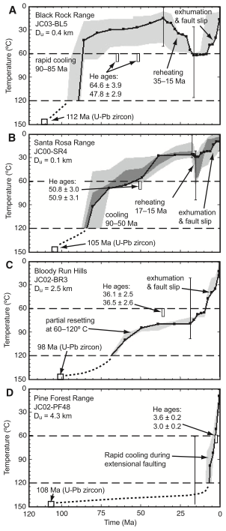
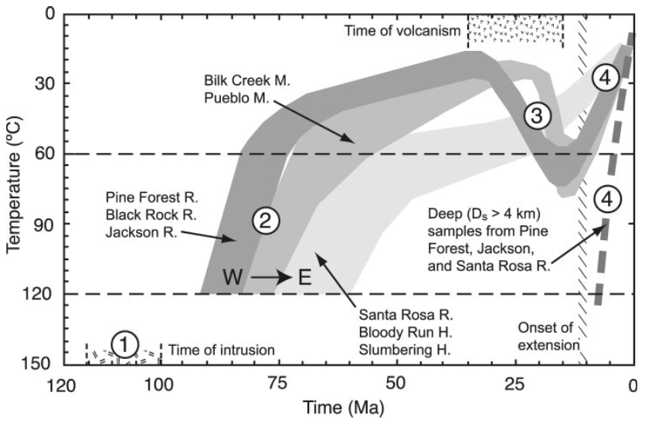
The magnitude and timing of extension in Northwestern Nevada: ~35Ma - present
35-15Ma:
Shallow rocks reheated by the volcanism
Deep rocks were not reheated
<12 Ma:
Extensional faulting continuing up to the present day

Slide 6
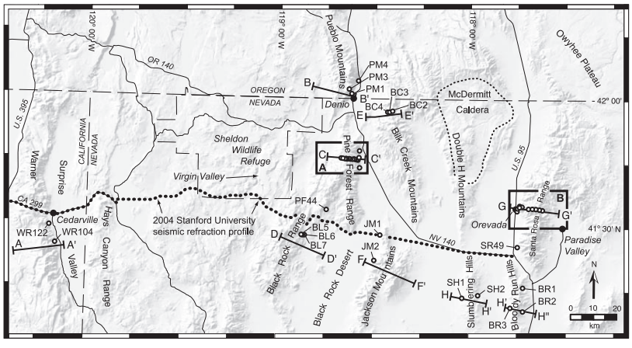
The magnitude and timing of extension in Northwestern Nevada: pre-35 Ma
80-70 Ma:
Cooling event at (may correspond to the erosion of ~5 km)
Samples from the eastern part shows slightly younger apparent fission-track ages and somewhat longer cooling histories than samples from the western part of the area
70-35 Ma:
A long period of very little erosion, deposition, or tectonism
Notes:
One potential complication with the timing of exhumation is the possibility of Laramide (ca. 75 – 45 Ma) shallow-slab “refrigeration,” which could cause a regional drop in the geothermal gradient without significant exhumation (for example; Dumitru, 1990; Dumitru and others, 1991).

Slide 7
Conclusion
Volcanism, 35-15 Ma
Northwestern Nevada
40°
Central Nevada
38°
Though northwestern Nevada is similar to the Basin and Range Province in topography, it seems to have experienced a notably different history of volcanism and extension.

Slide 8
