Slide 1
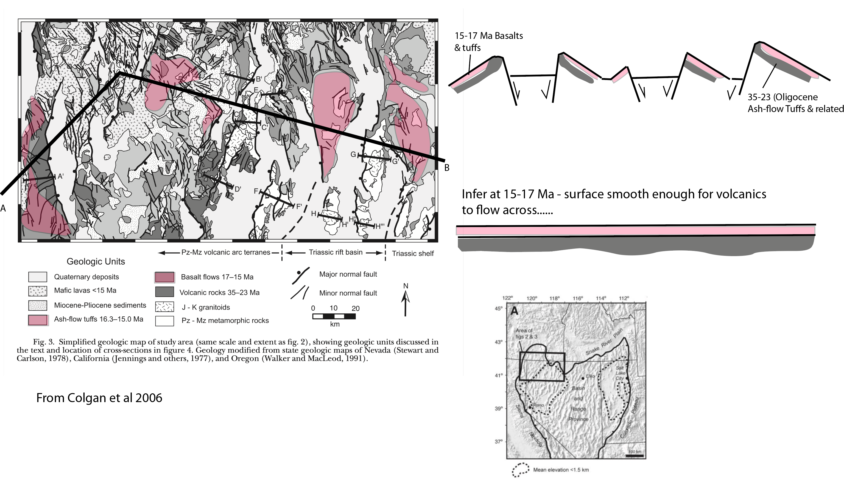
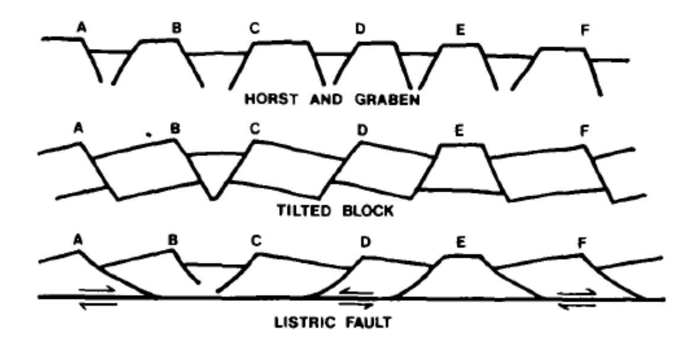
Stewart 1980

Slide 2
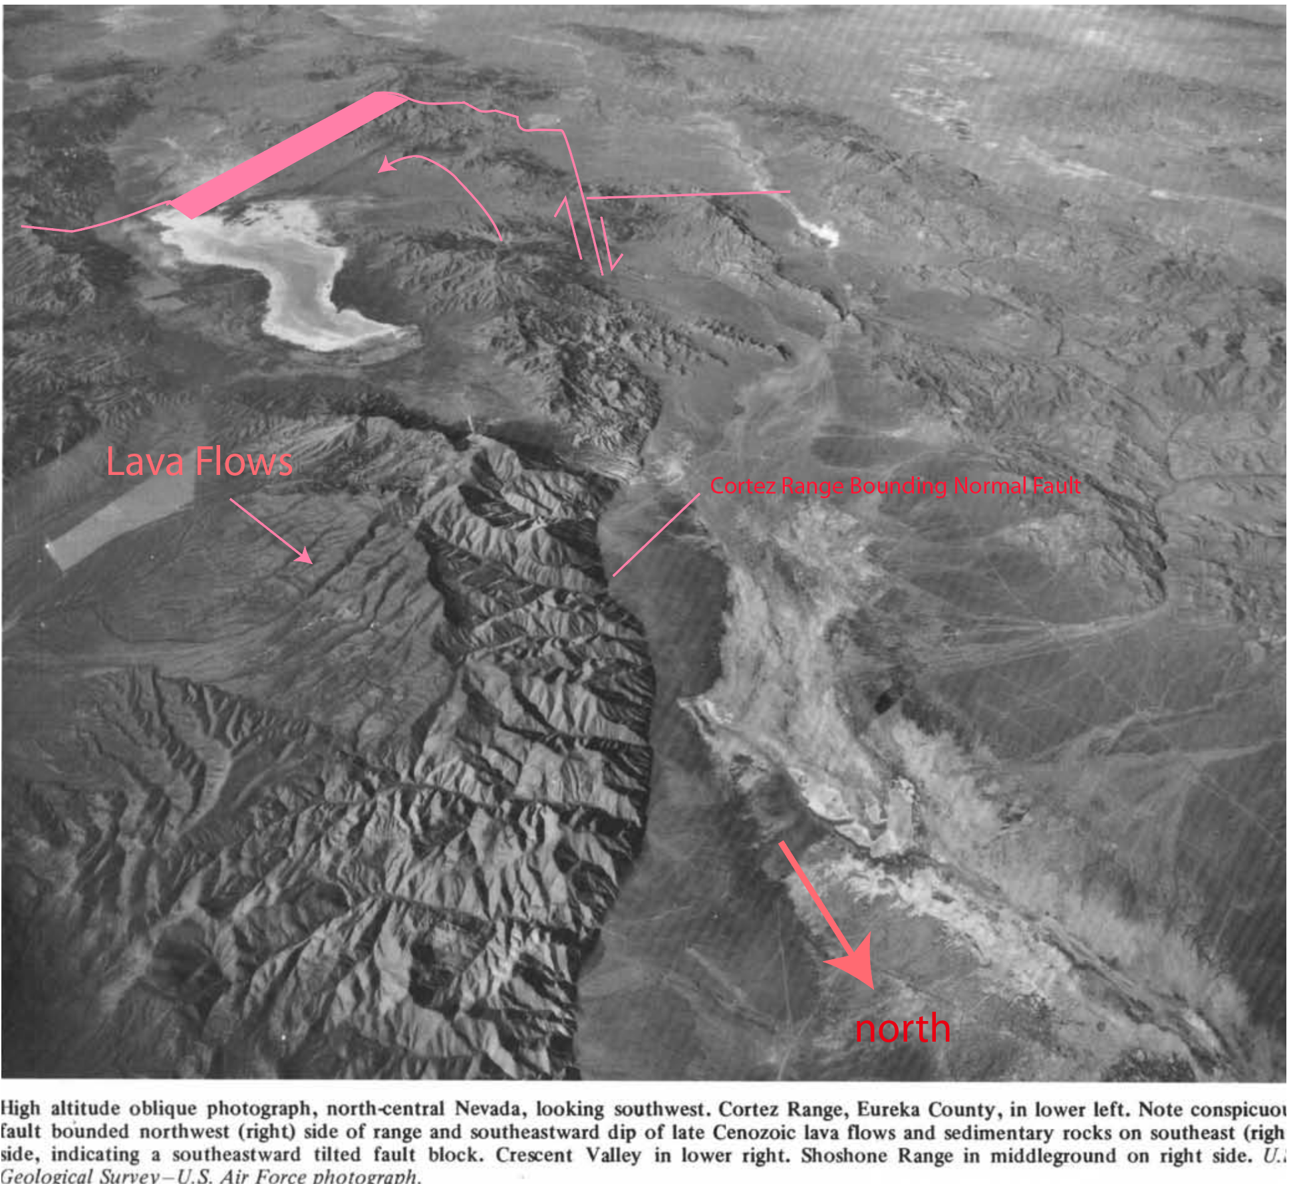
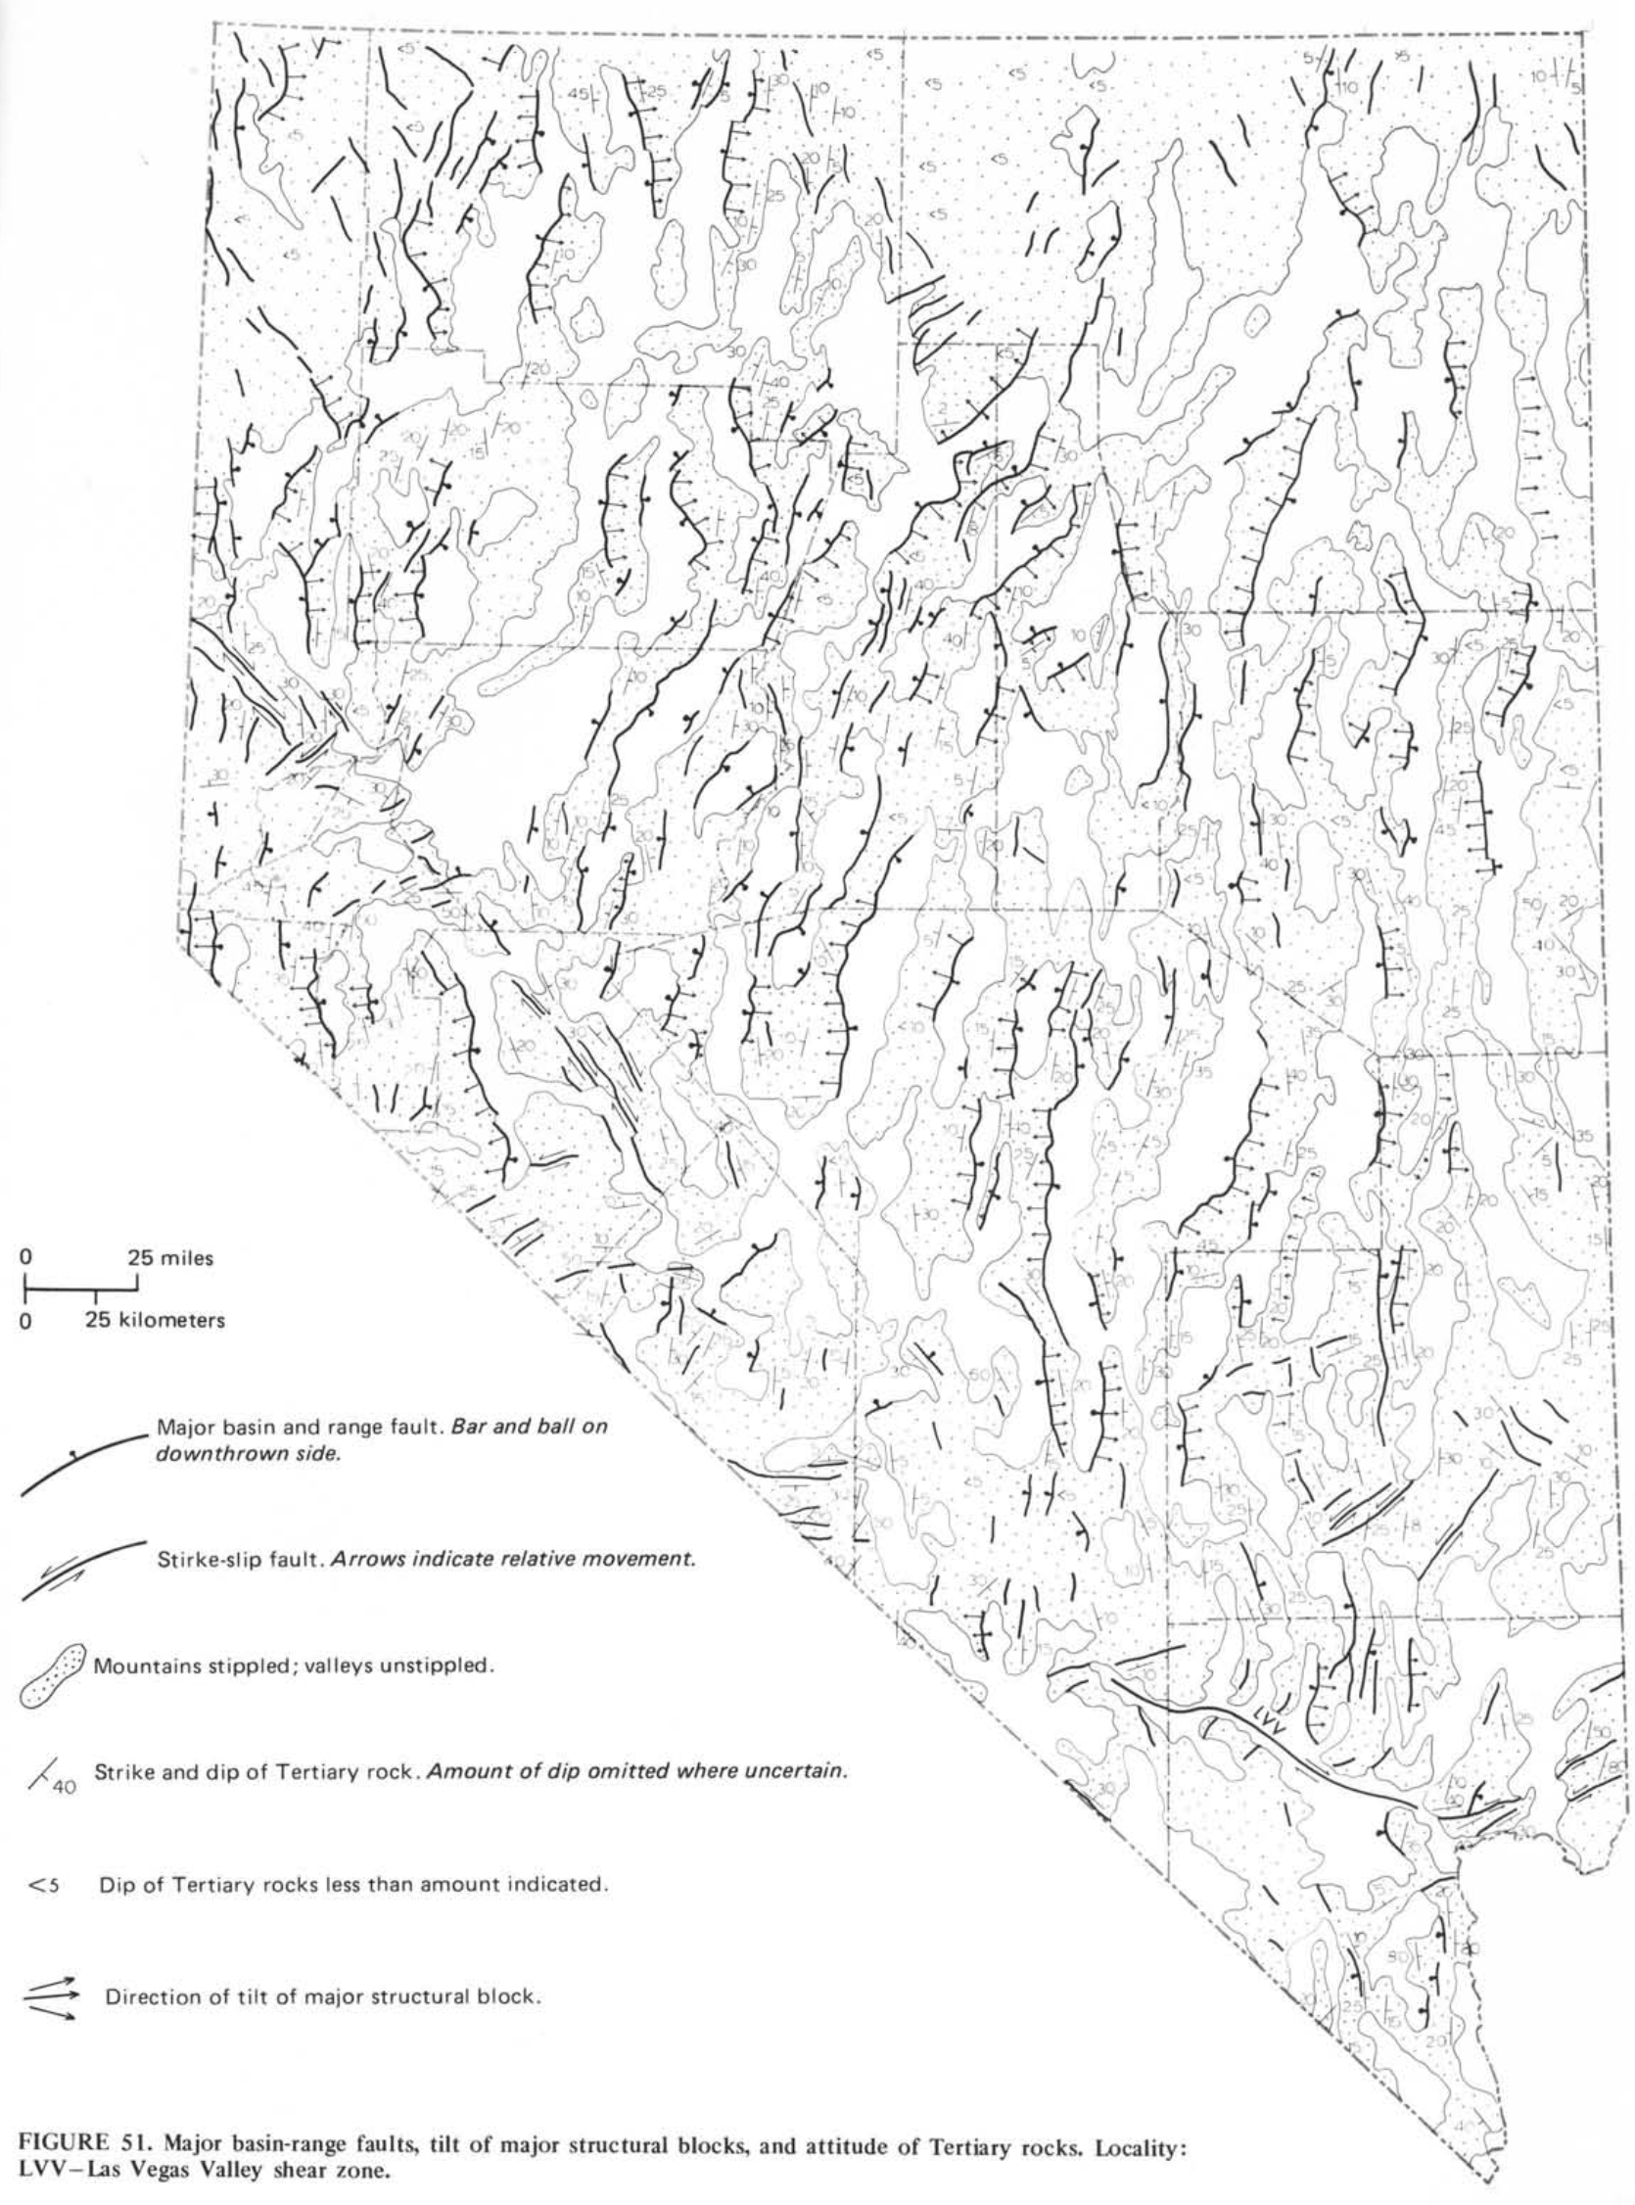
Stewart 1980

Slide 3
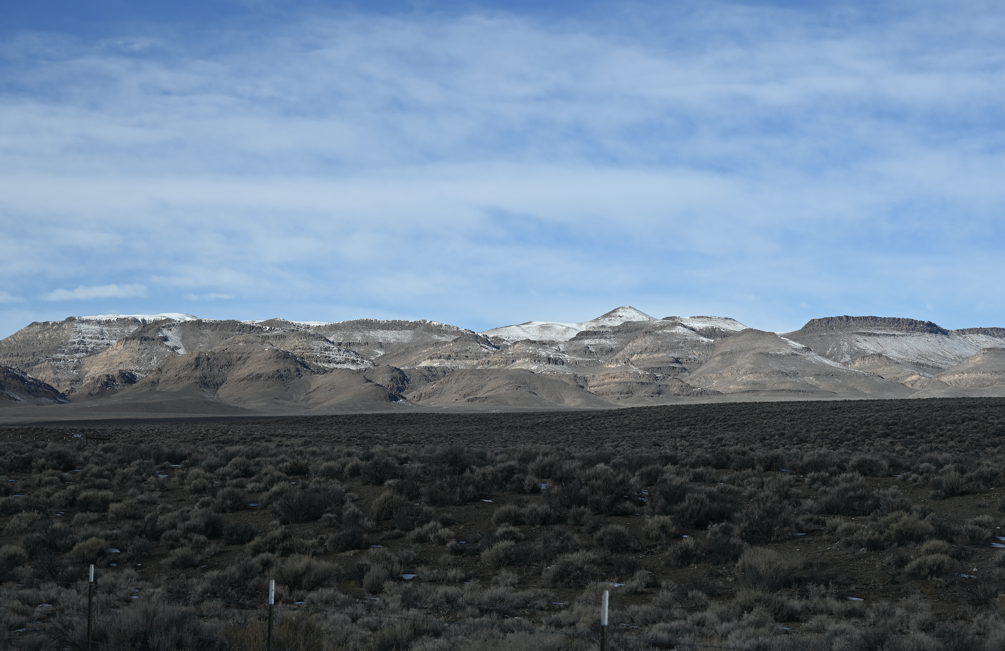
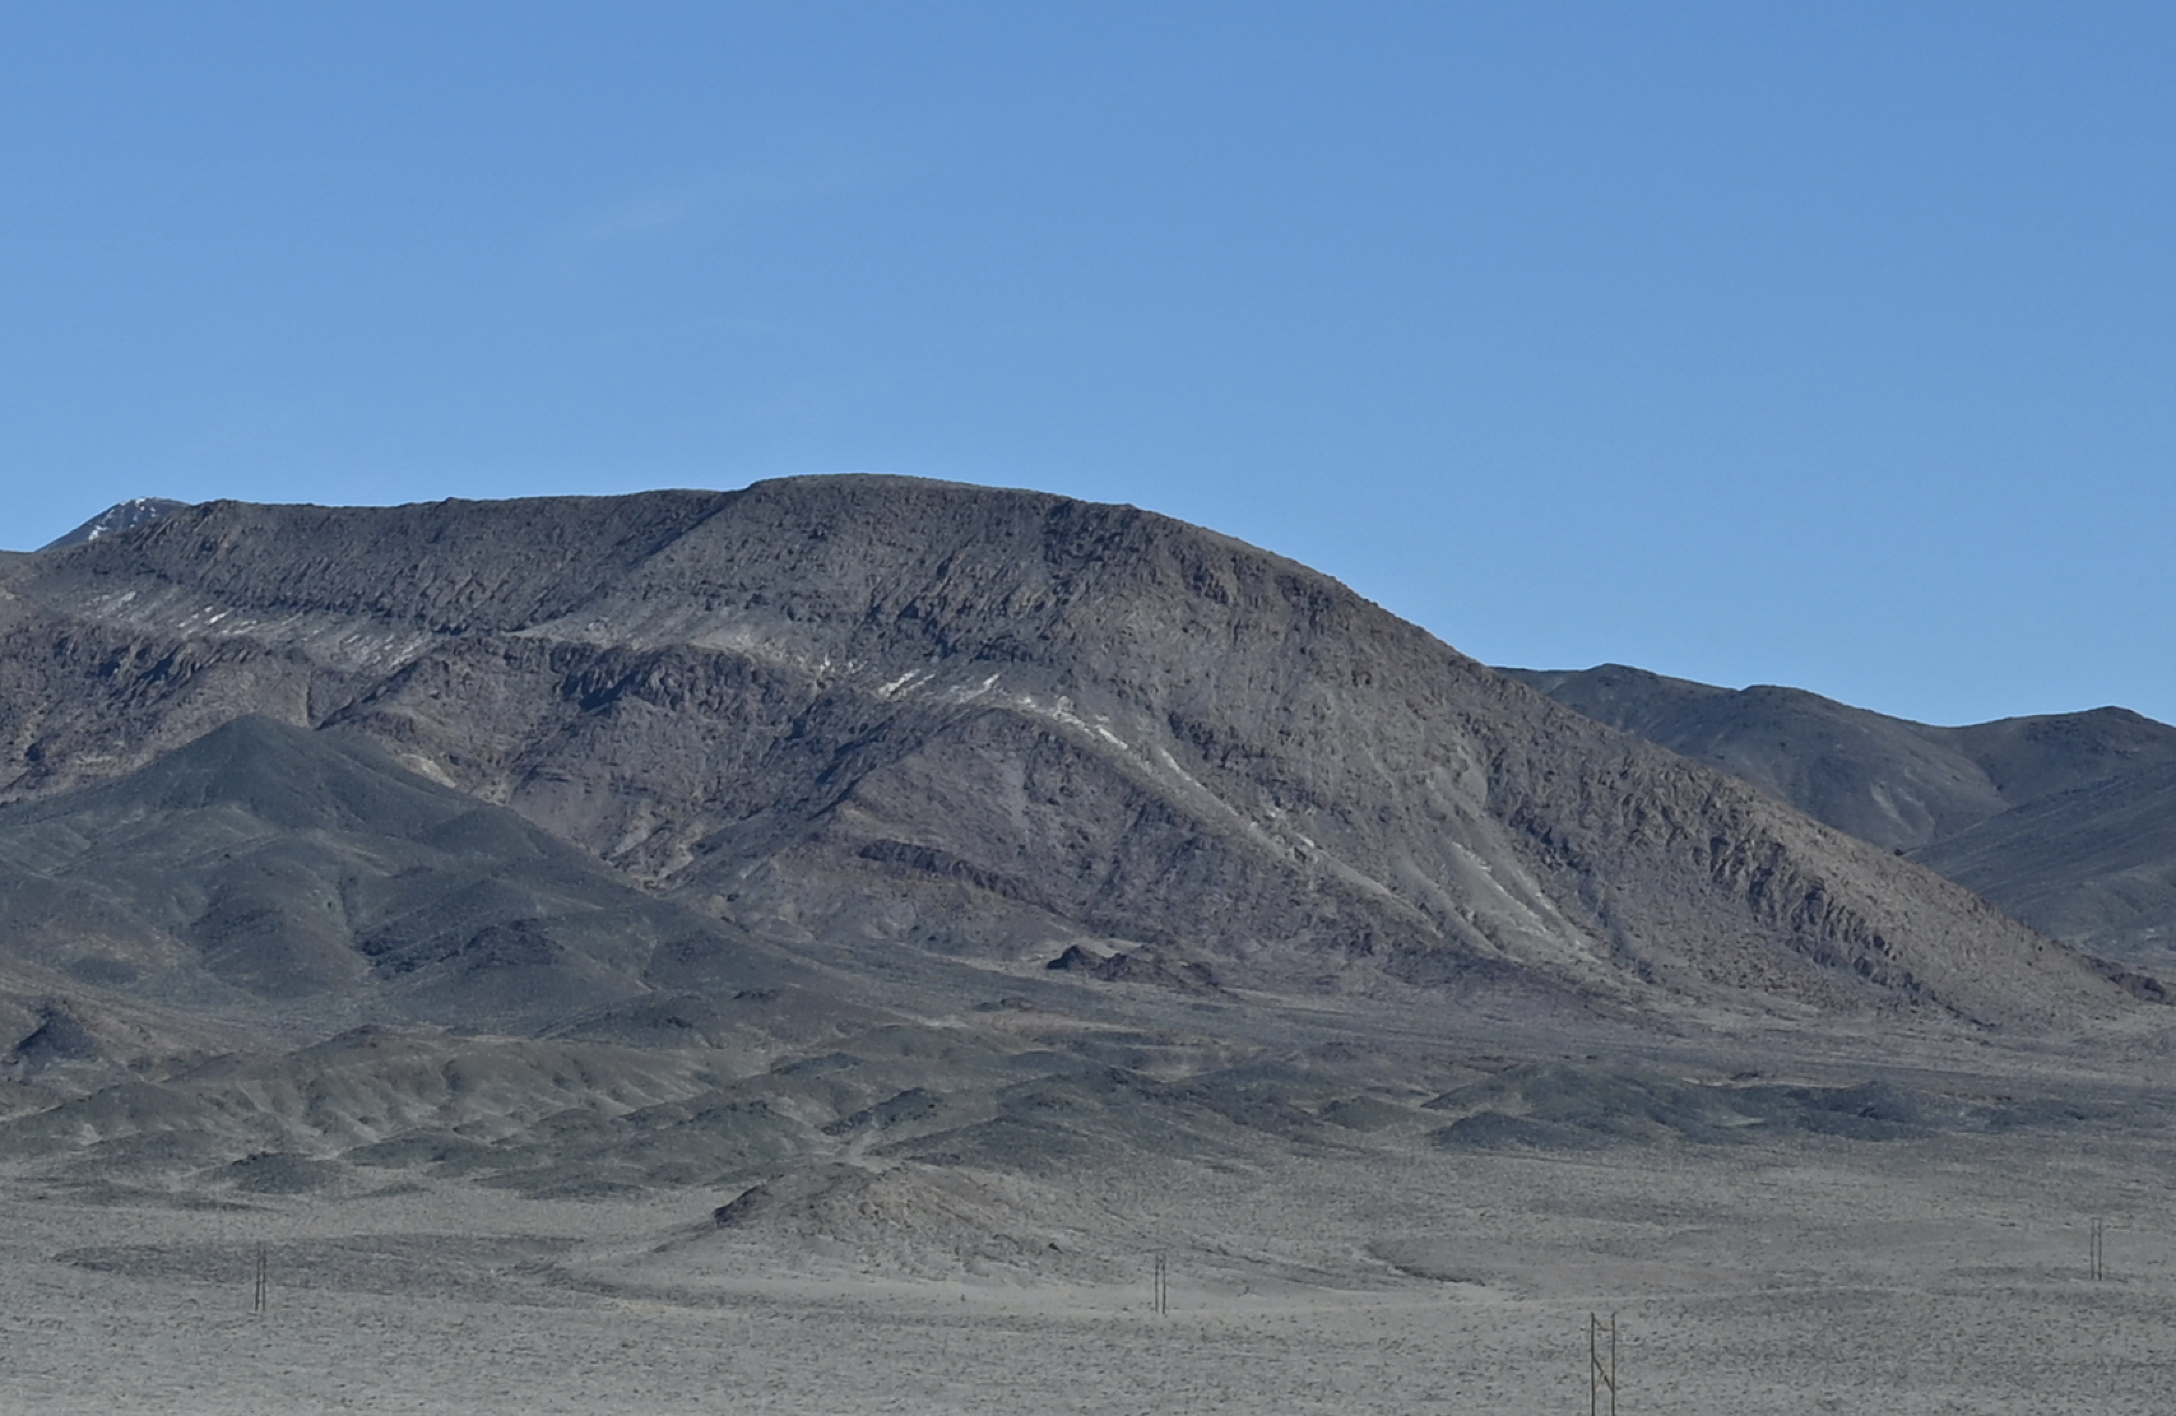
Miocene Basaltic Lava flows capping fault blocks prevalent along many of Nevada highways

Slide 4
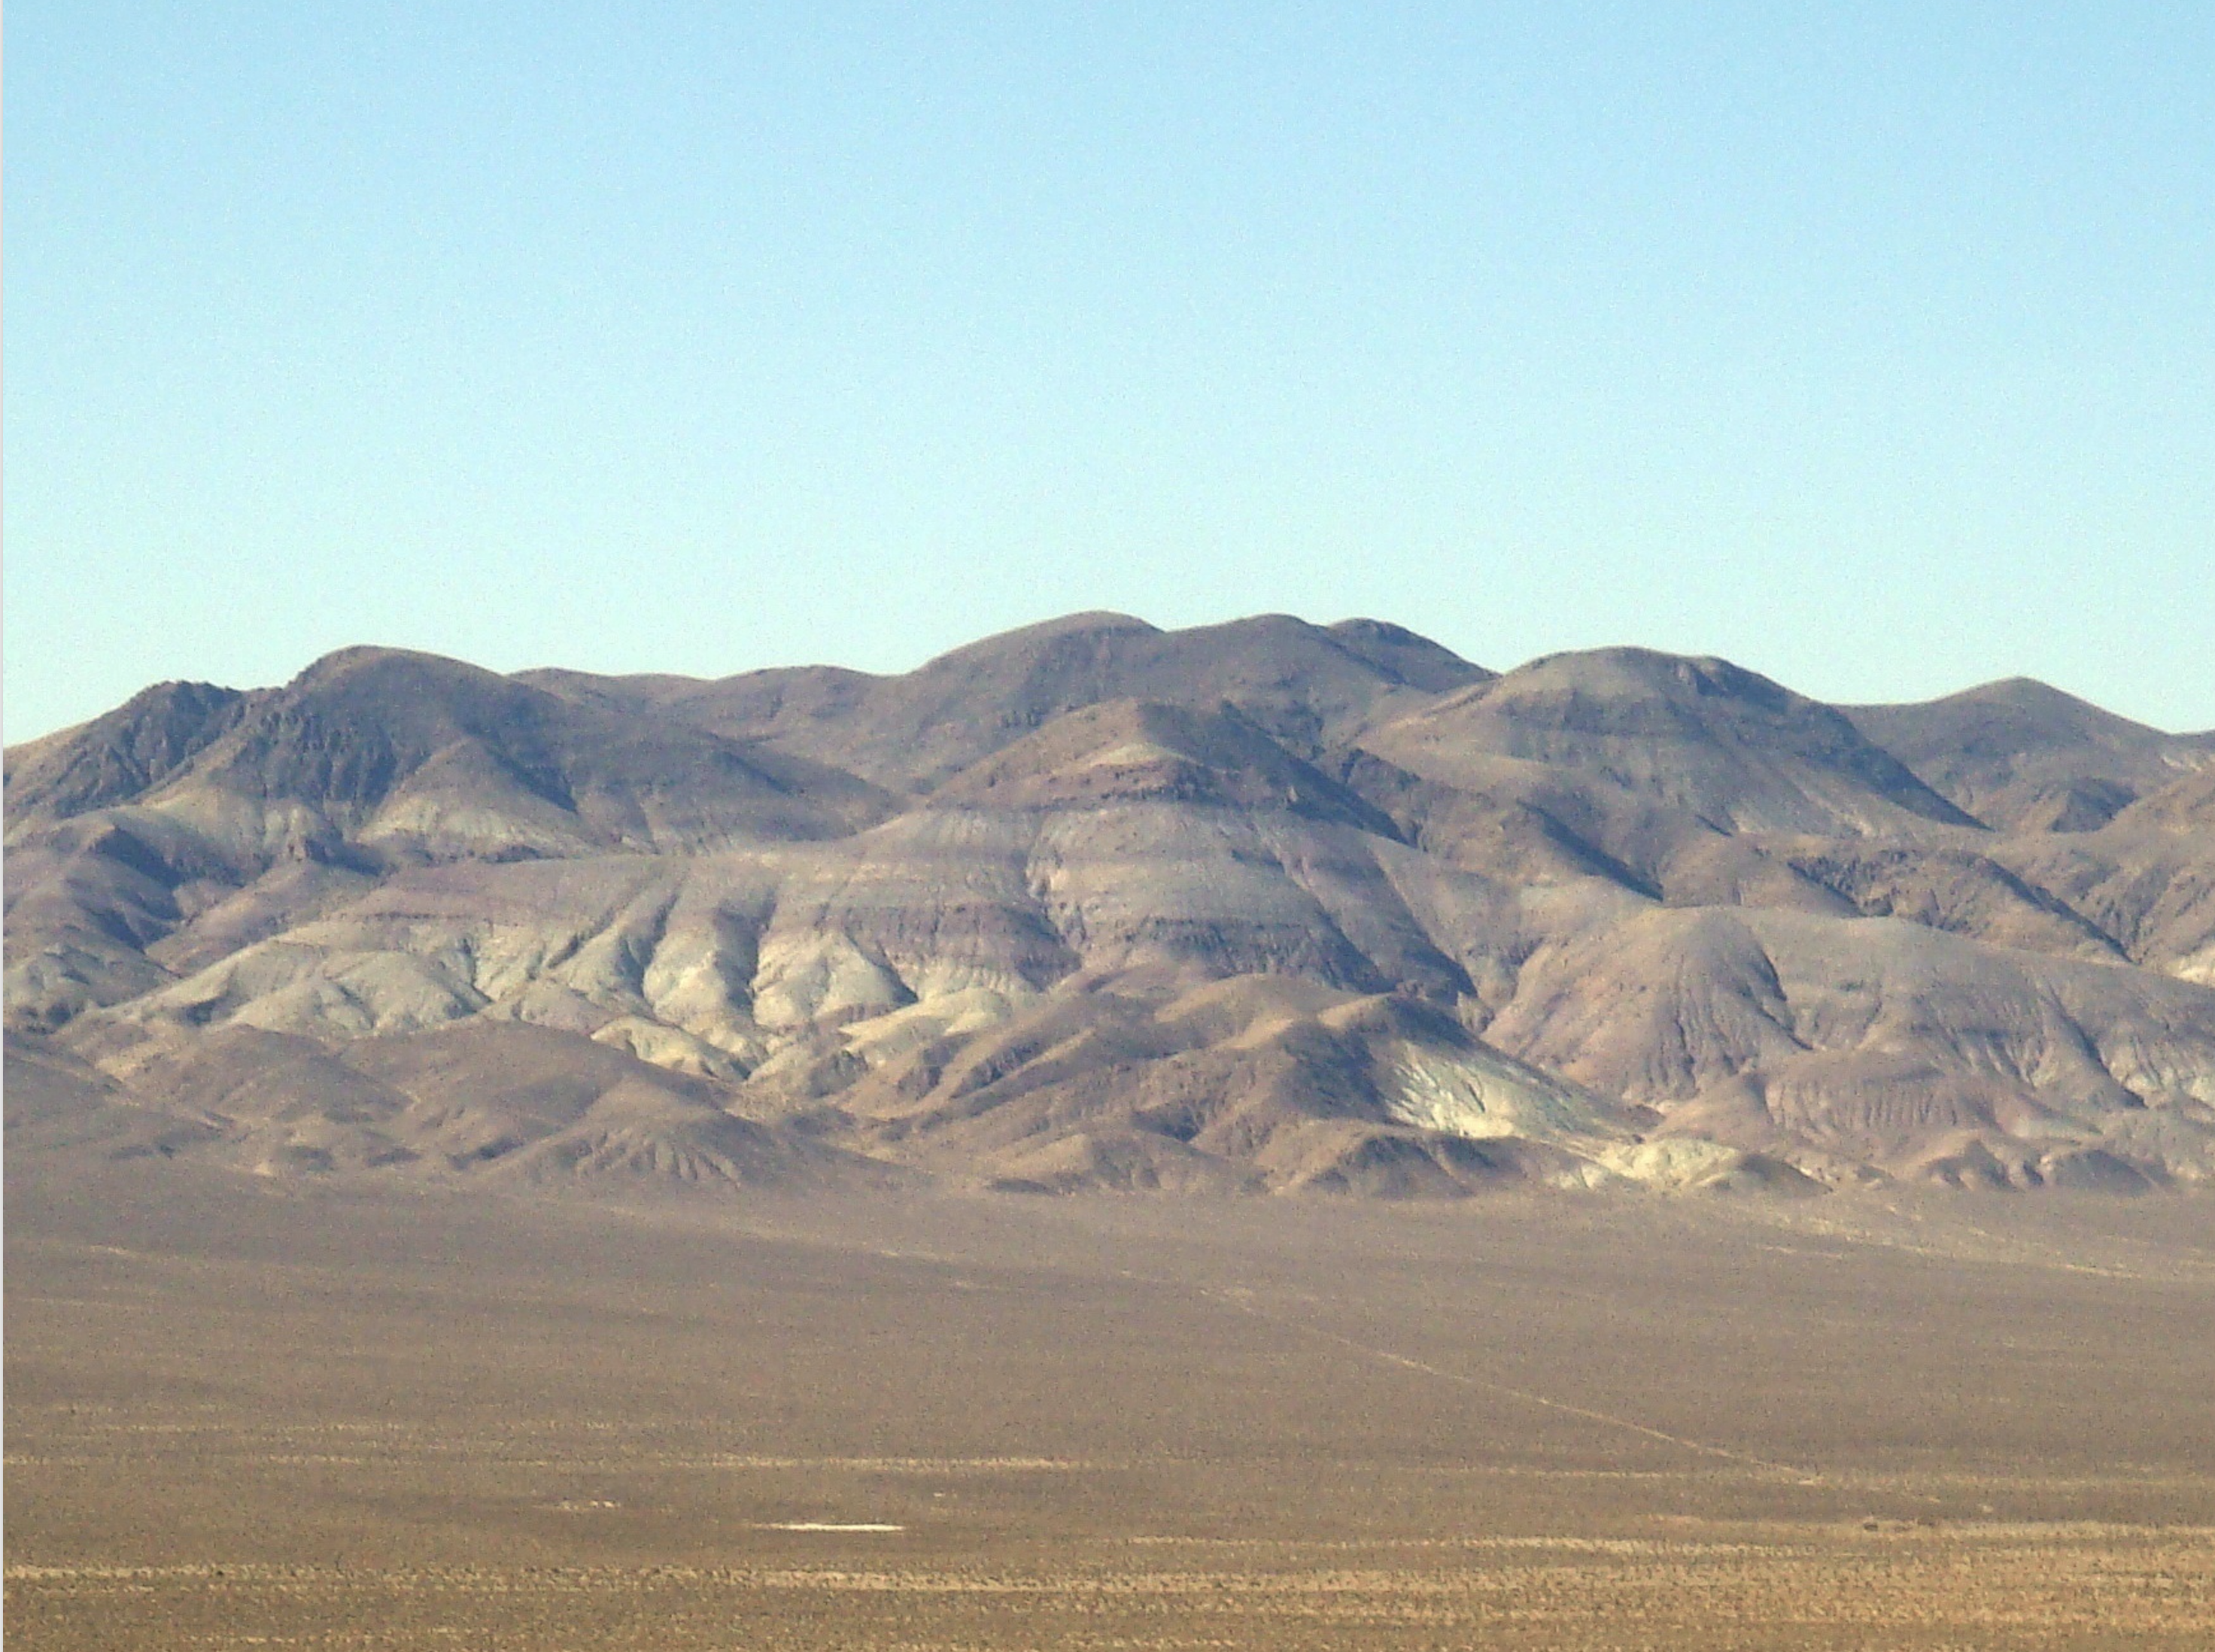
Lack of relief prior to basin and range faulting (ash flow sheets and stratigraphy) Stratigraphy of Tertiary volcanic rocks in eastern Nevada
Cook 1965!.
In the fault blocks the beneath the capping Miocene basaltic flows are commonly found older Bedded lava flows and
Ash Flow Tuffs
… more often of Andestic composition…
In these layers are recorded the history of what was happening immediately before emission of the capping Miocene basaltic flows and the faulting that produced the basin and range structure we observe today.

Slide 5
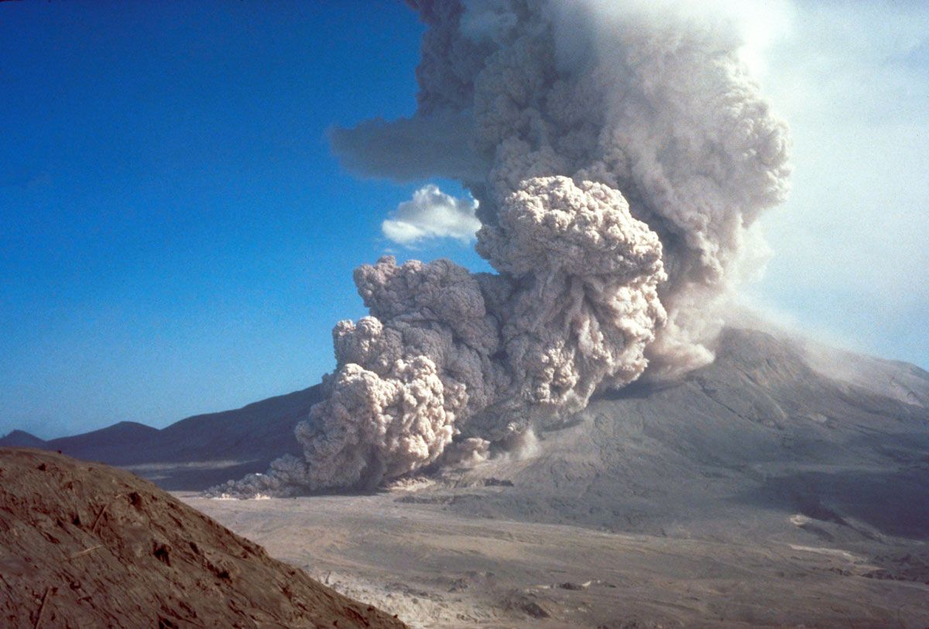
Pyroclastic ash flow occurring on flank of Mt. St. Helens 1980
Velocities up to 450 mph
Layers of rock laid down during these ash flows are
‘Ash Flow Tuffs’
Also called
‘Ignimbrites’
Ignimbrite is rock formed by deposition and consolidation of pyroclastic density currents (pyroclastic flows.
Also known as welded tuffs or ash flow tuffs
Clast – fragment
Pyro – from fire

Slide 6
Mt. Unzen, Japan
Pyroclastic Flows: Dense Hot mixtures of tephra and gas that race down the mountainsides at velocities of 100’s km/hr

Slide 7
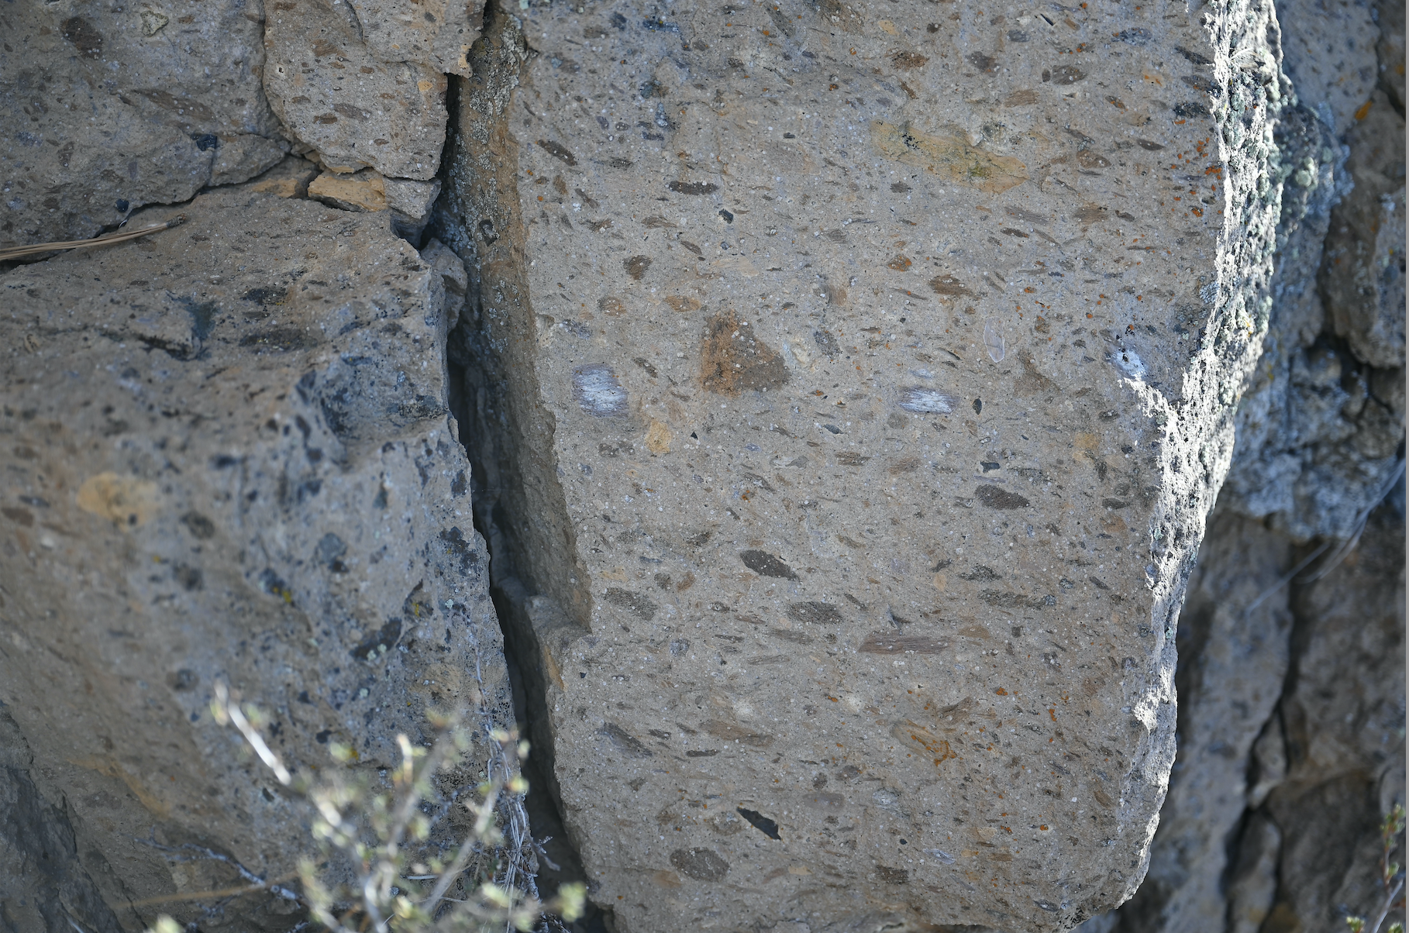
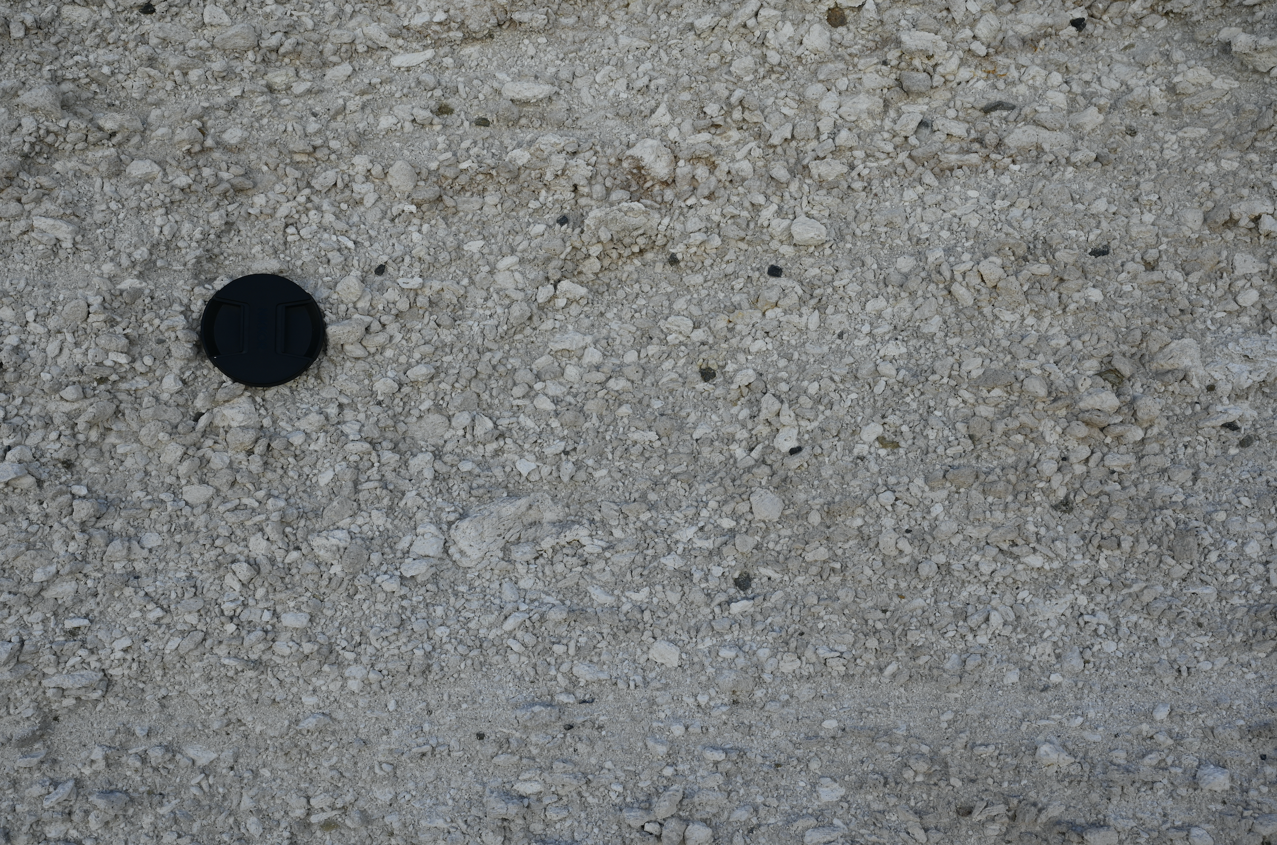
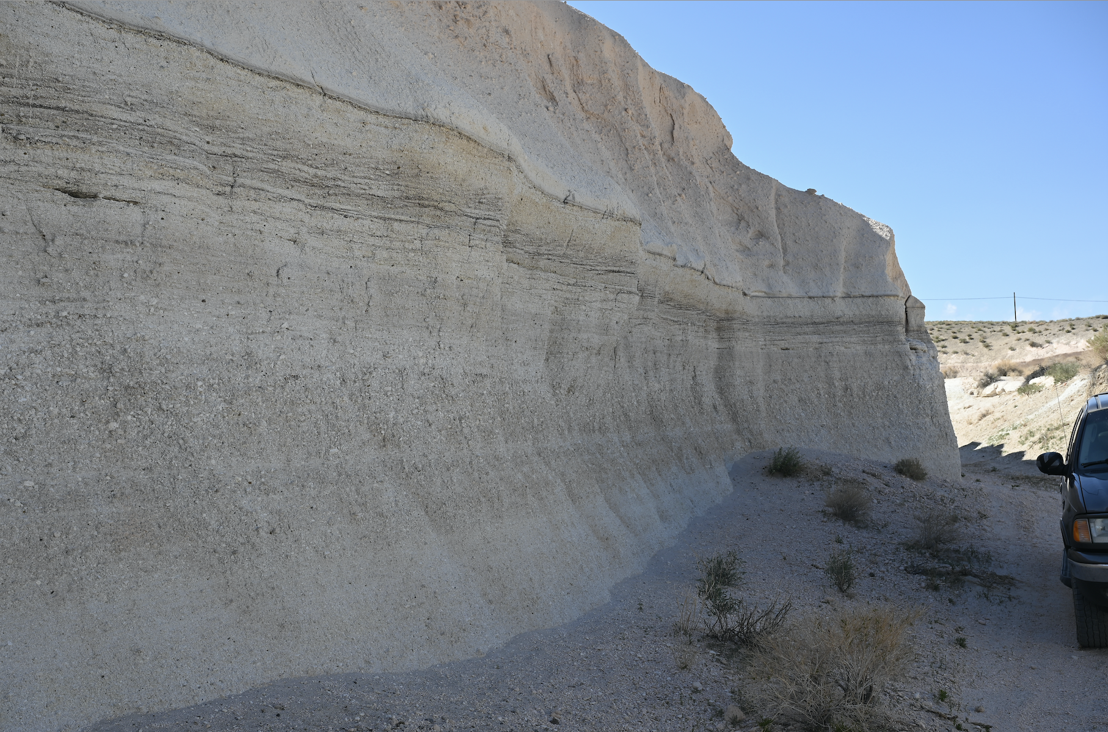
‘welded’ ash flow tuff
Pumice and ash (unwelded tuff)

Slide 8
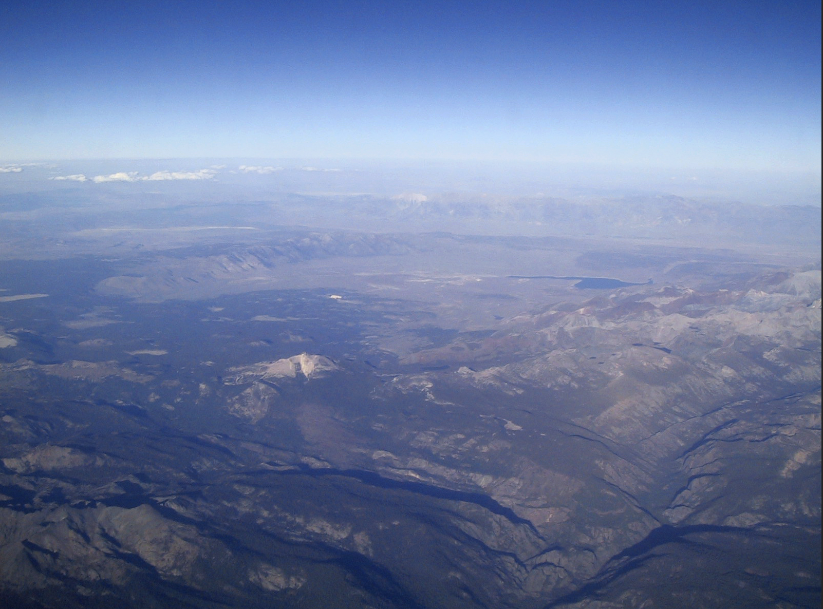
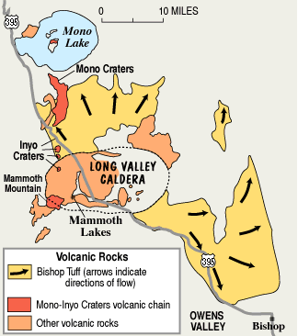
Best nearby example or demonstration of potential size of explosions producing ash flow tuffs is the 760 k old Long Valley Caldera
View to southeast from Sierra Nevada over long Valley Caldera
20 miles

Slide 9
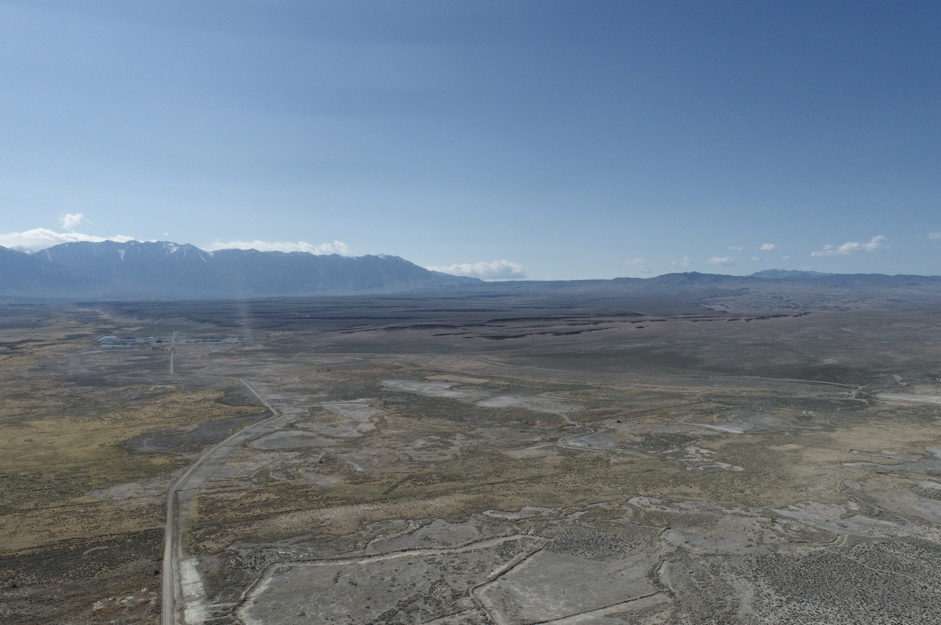
Long Valley Caldera
Ash Flow Tuff (Bishop Tuff)
Sierra Nevada

Slide 10
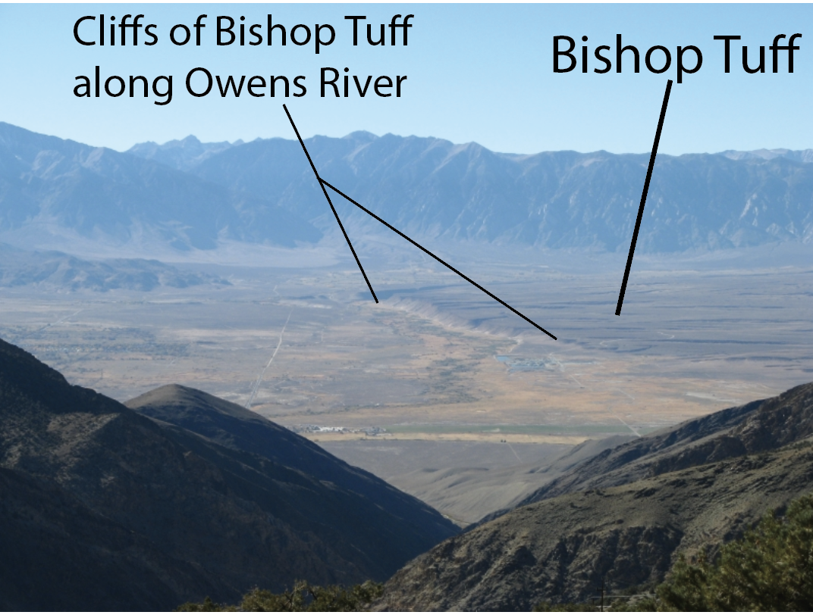

Slide 11
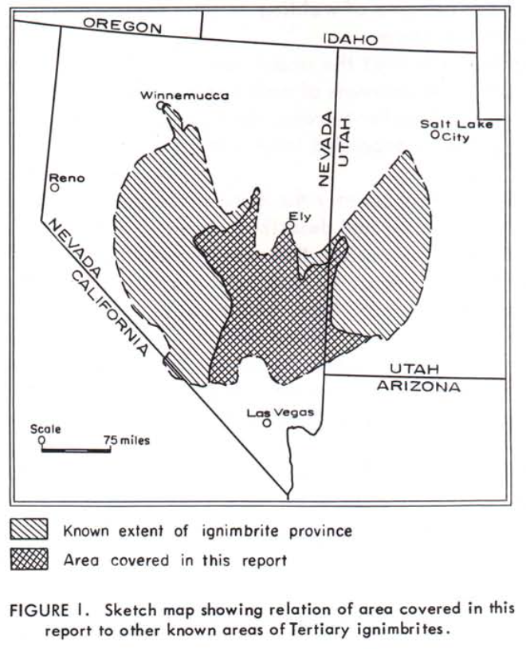
Stratigraphy of Tertiary Volcanic Rocks in Eastern Nevada
Nevada Bureau of Mines Report (1965) Earl F. Cook
In 1955 Gulf Refining Company decided to sponsor a study of the volcanic rocks of the Eastern Great Basin
84 volcanic sections
1,300 specimens
100 thin sections
25,000 square miles
Only the central portion of the ignimbrite province
Ignimbrites = sheet-like deposits of relatively non-sorted and non-stratified pyroclastic material

Slide 12
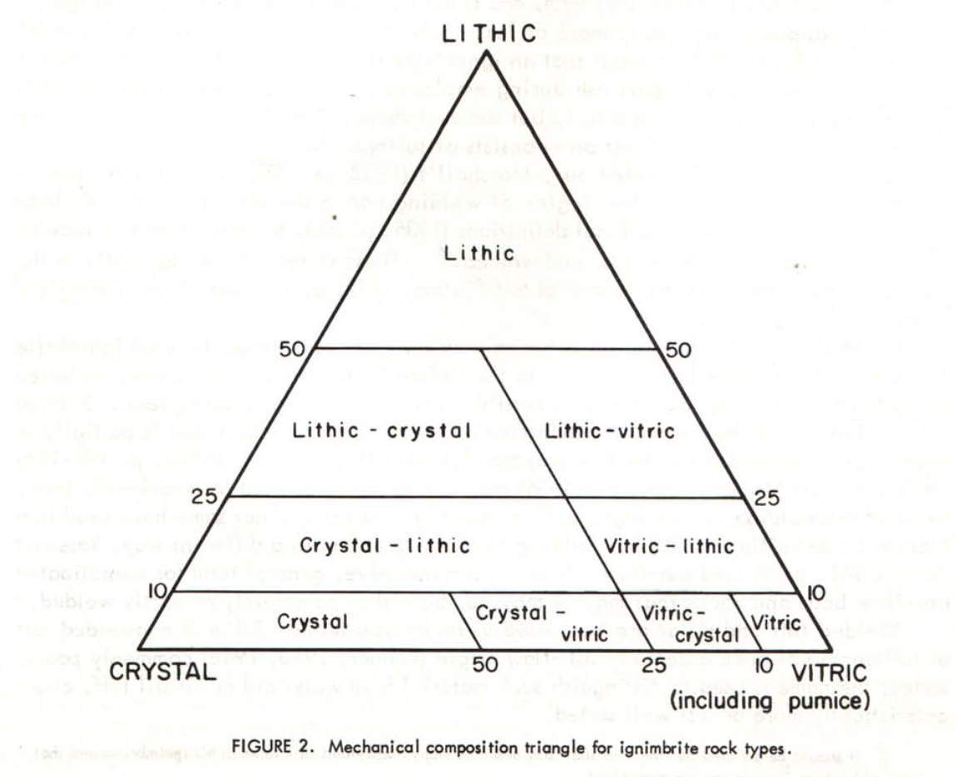
Good old fashioned geological observations of Compositon, Fabric, and Texture used to delineate different ignimbrite units in the area
Quartz
Sanidine
Plagioclase
Mafics
Crystals (percentage)
Ratio between lithic, crystal and vitric components
Identifiable minerals and their proportions
Vertical variations in, and overall degree of welding within, units
Presence and nature of planar discoidal structures
Finding: Lateral lithologic variation in most ignimbries is small, wherea variety between units is great – so ignimbrites readily recognized in widely separated sections (i.e. mountain ranges)

Slide 13
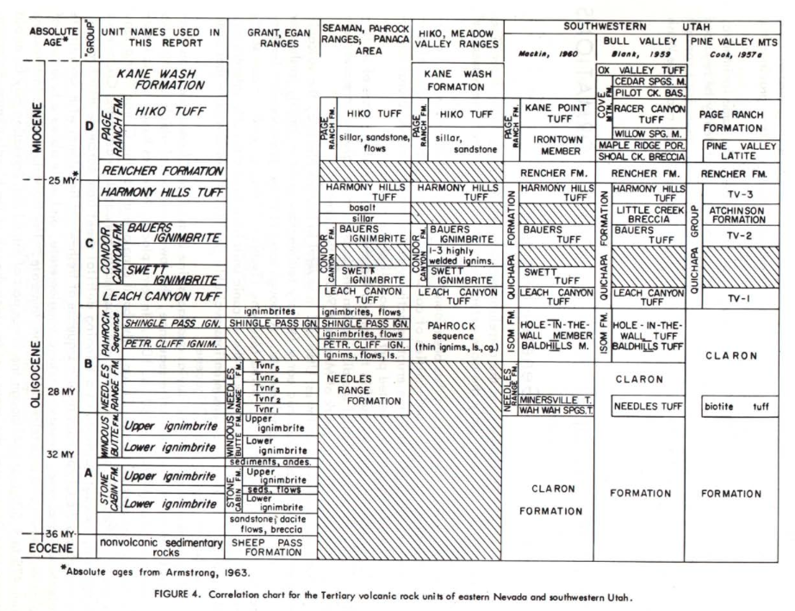
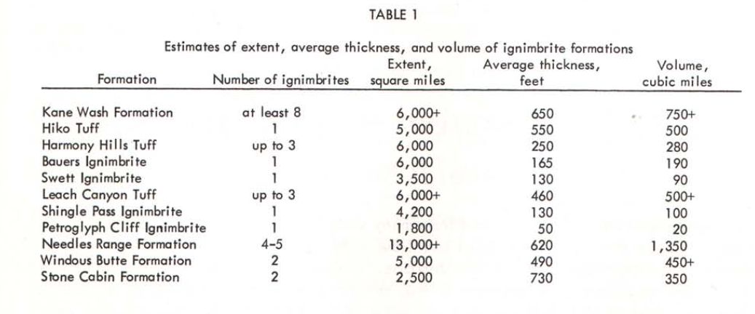
AGE – EXTENT – VOLUME
Individua units traceable more than 100 miles!

Slide 14
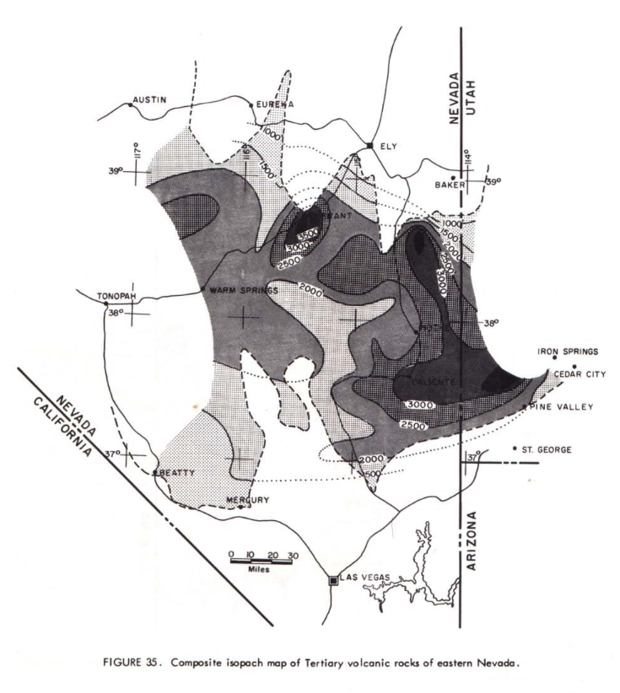
Overall Isopach Map
Thousands of feet thicknesses of ignimbrite deposits!!!!!

Slide 15
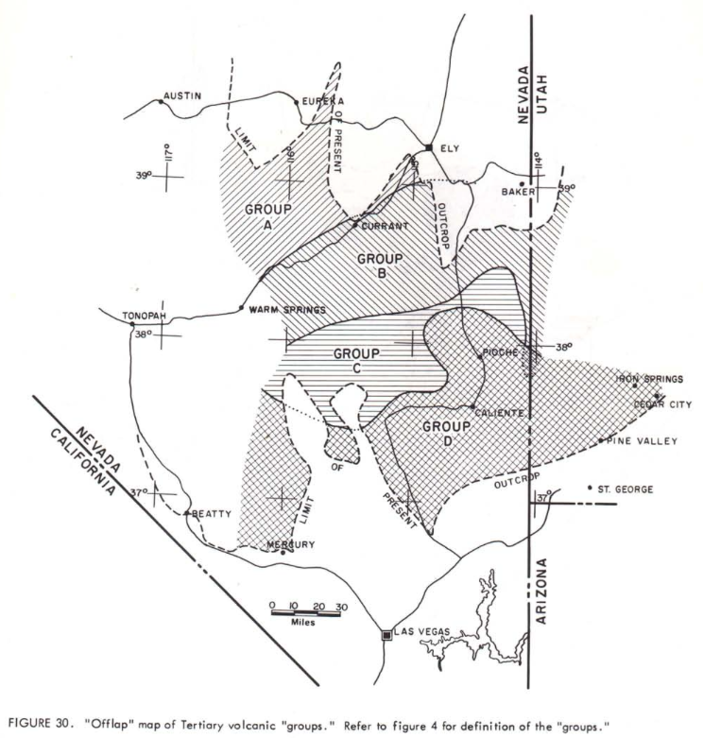
Arbitrarily dividing mapped ignimbrites into four groups of about equal thickness
Cook shows progressive displacement of younger groups toward the southeast
younging

Slide 16
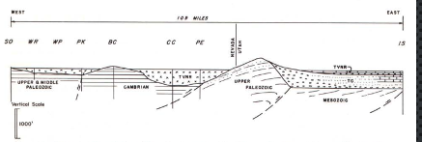
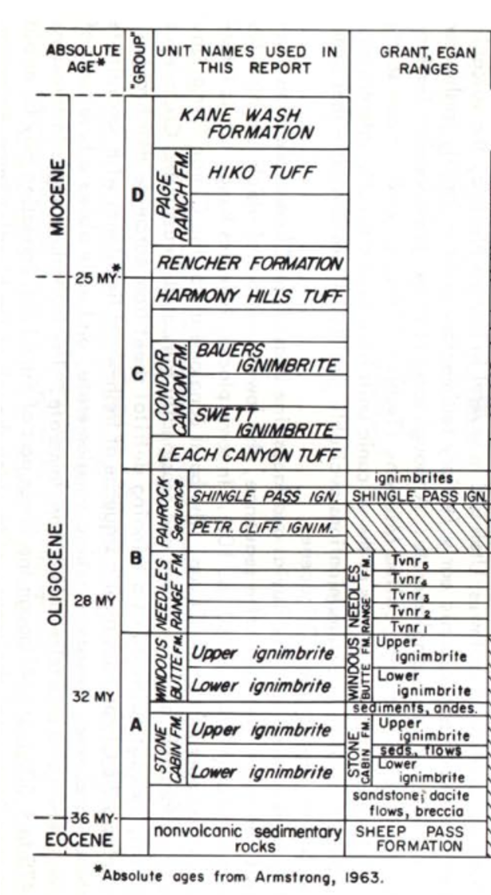
Things known in 1965…
Most of the volcanics in E NV are ignimbrites that are extensive and can be correlated.
Field relations show upper surfaces of ignimbrites were horizontal when deposited – stated but not so well illustrated
Ignimbrites appeared in Oligocene and decrease in age towards the S/SE
E. NV volcanics are essentially parallel to underlying Cambrian – Eocene sedimentary rocks –stated but not so well illustrated.
Basin-range topography originated after the extrusion of widespread ignimbrites

