Slide 1
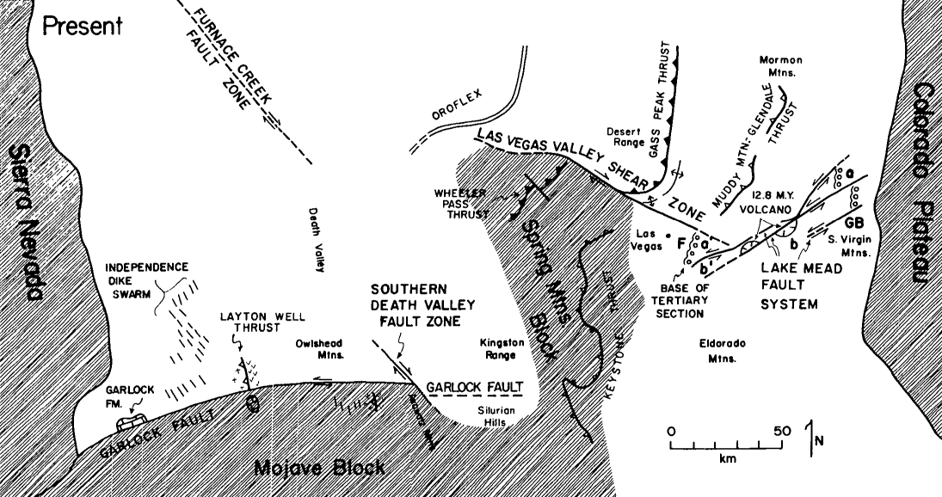
Magnitude of crustal extension in the southern Great Basin Brian Wernicke et al
The region includes the Garlock fault, Las Vegas Valley shear zone, and Lake Mead faults system and use Southern Sierra Nevada, Mojave Desert, and Colorado Plateau as stable regions
Strike-slip faults separate Cenozoic upper crustal extension from stable tectonic blocks
Cenozoic extension has been hard to constrain in the past with estimates from 10-100 % increase over original width
This paper looks to reconstruct the pre-extension crustal model to estimate extension

Slide 2
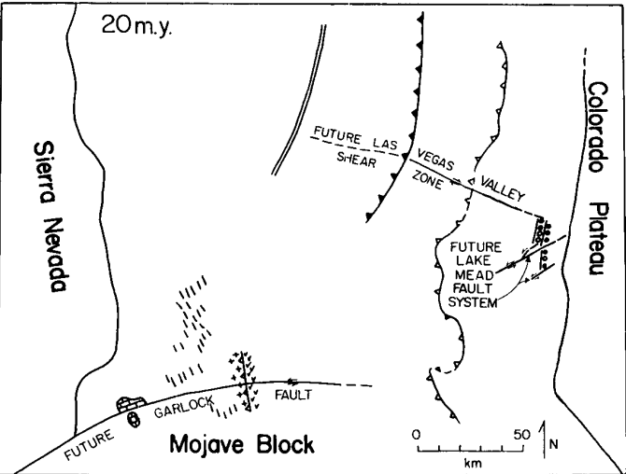
Garlock Fault
Reconstruction uses matching correlative features on either side of the fault
Using this method the eastern Garlock fault has around 60 km offset
Offset is accommodated by extensional
faulting across an area of around 115 km
wide
Must have undergone 100% of
extension

Slide 3
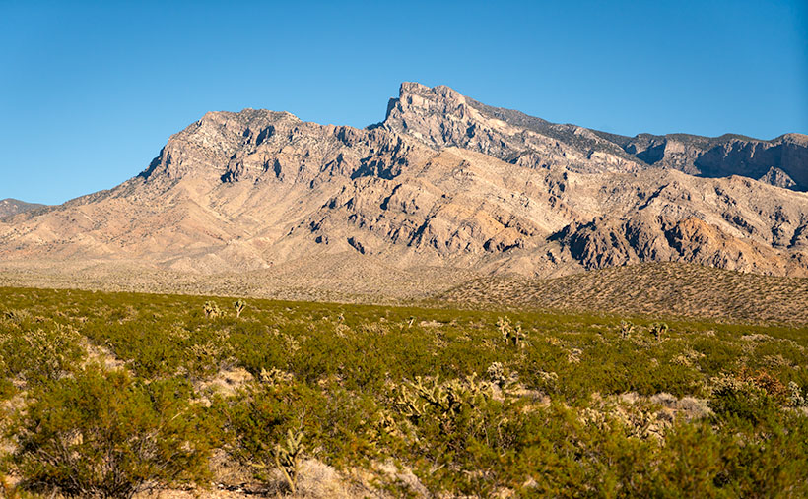
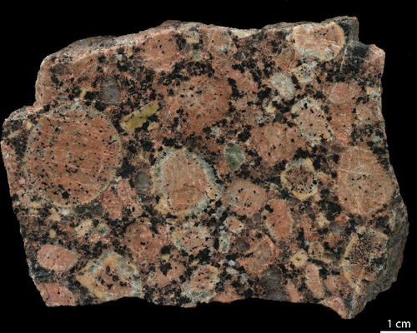
Las Vegas Valley Shear zone and Lake Mead Fault System
Las Vegas Valley shear zone is right lateral strike slip zone and Lake Mead Faut System is left lateral strike slip zone
Reconstruction found correlation of Frenchman Mtn(loc F) and South Virgin Mtn
Stratigraphic sequence at base of Tertiary section
Gradual pinch out of identical Mesozoic Frm. Beneath unconformity
Presence of distinct monolithologic breccia sheets of gold butte rapakivi granite
This correlation supports 40 km offset in the area

Slide 4
Uncertainties
Reconstruction of offset features along the strike slip faults yields a total pull apart of 140 km a 65 percent increase on its original length between the Sierra Mtn block and Colorado plateau
This is based on both sides are stable and haven’t been extended but Mojave has had extreme NW-SE extension 21- 16 mya
Other “stable” areas in the study also almost
certainly, went through some extension

Slide 5
Key Points
The 30 km thick crust of today would have been 45-50km thick following the Mesozoic Sevier Orogeny
Using Strike slip offset reconstruction the lower limit of total offset in the Southern Great Basin is 140 km or 65% extension
Area still needs work on dating and kinematics of the individual extended terranes to the strike slip faults

