Slide 1
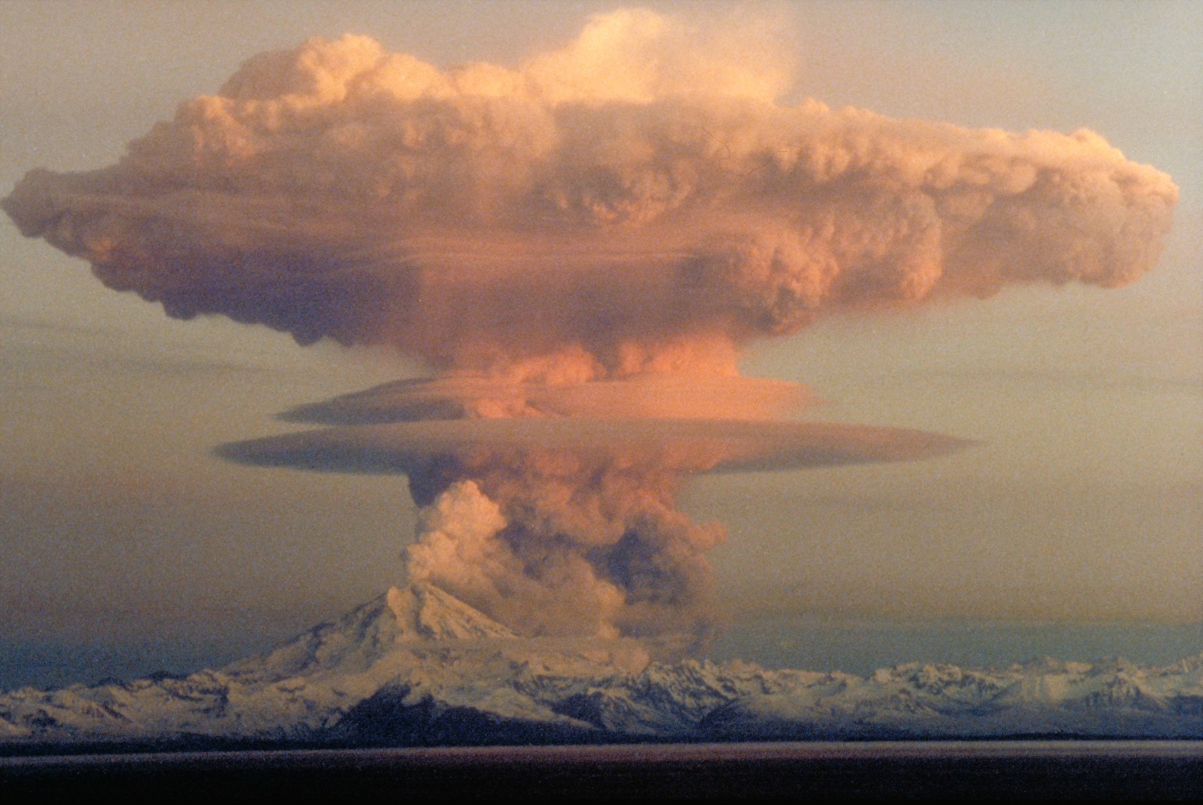
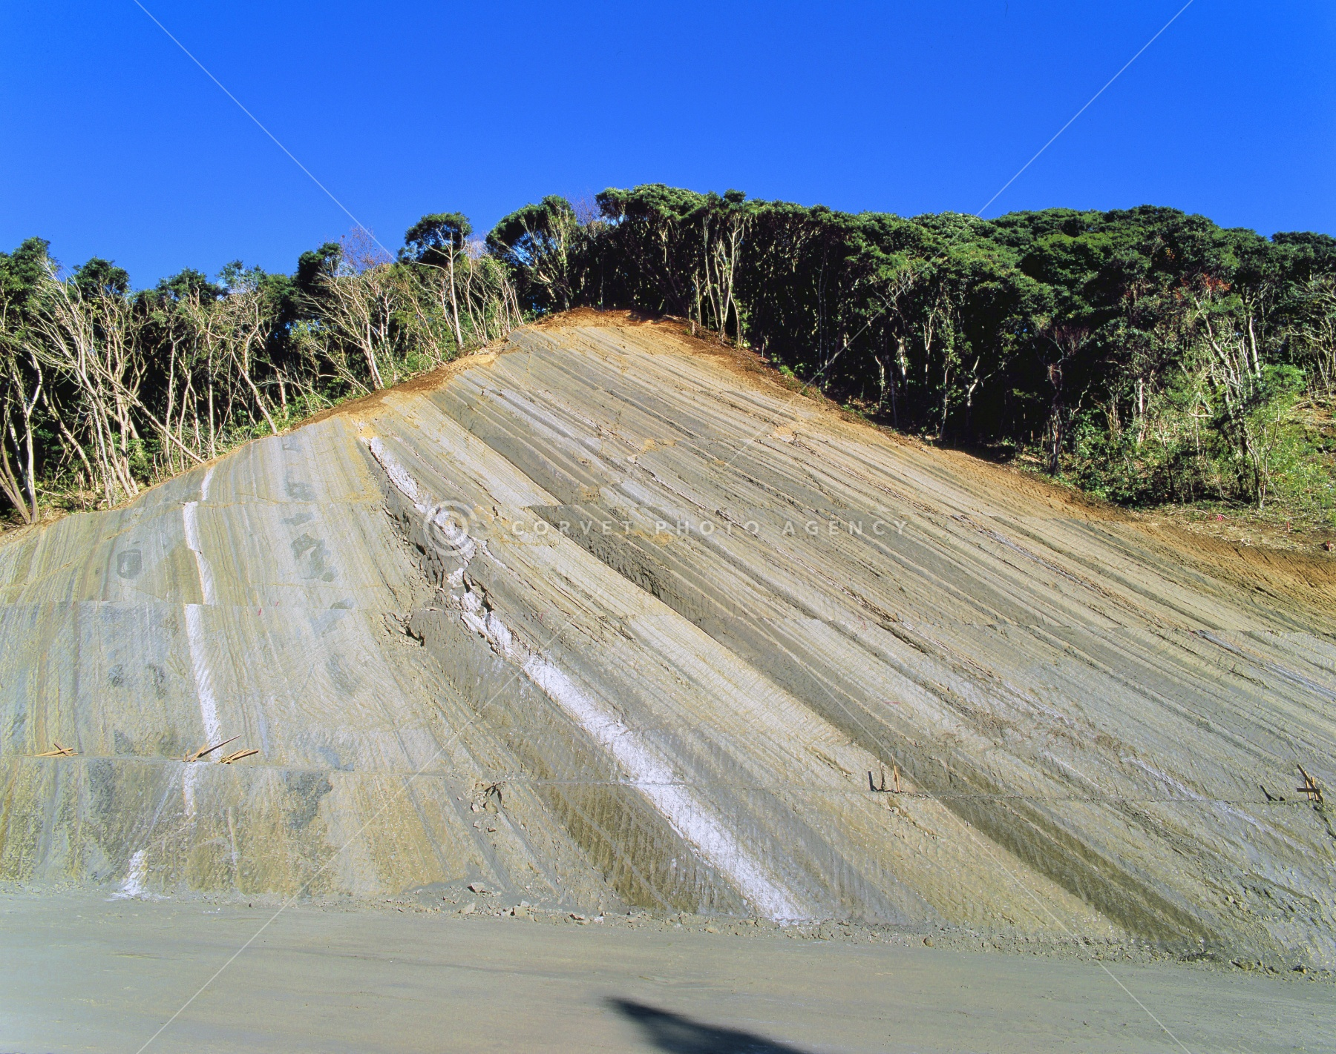
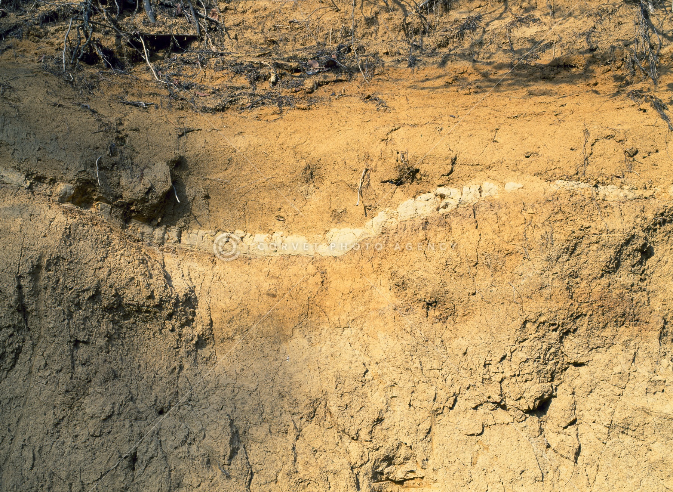
Quaternary Tephrochronology
Sarna, A.M. and Davis, J.O., 1991
By Henry
The terminology, concepts, and research methods of tephrochronology
Sources, ages, and areal distributions of widespread tephra layers in the United States
Tephra:
Pyroclastic material erupted from a volcanic vent
The material that forms tephra layers or beds
Tephrochronology:
The study of tephra for purposes of correlation and dating of sediments, rocks, and structures.
Subdisciplines:
Tephrostratigraphy
Tephrochronometry

Slide 2
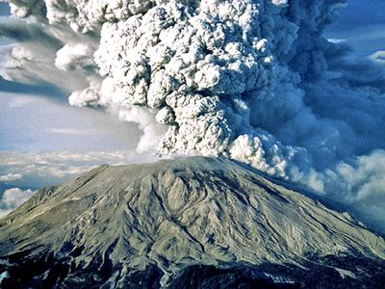
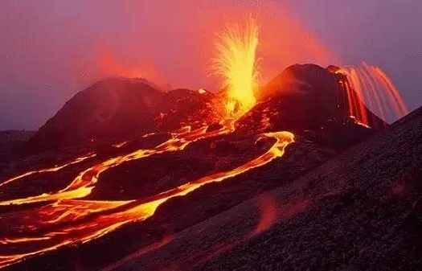
Tephrochronology: Plinian eruption
Plinian eruption
✅
Why use tephra for chronology?
The layer at the surface of the earth that results from tephra fallout after Plinian eruption provides an instantaneous time datum that is precise enough for most geologic studies.
Plinian eruption (the only eruption type people are concerned with):
Explosive volcanic eruptions that have injected large amounts of volcanic material into the atmosphere.
Produced from viscous, silicic magmas not basaltic or andesitic magma (less viscous)
Hawaiian eruption
❎

Slide 3
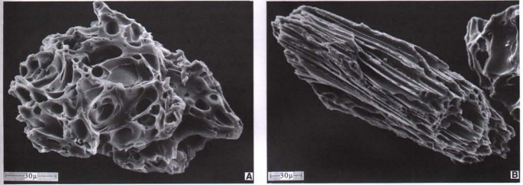
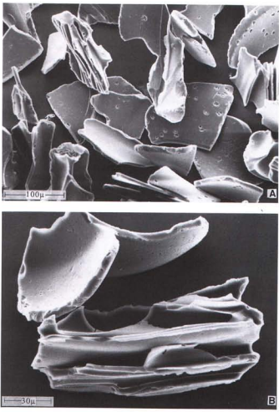
Tephrochronology: Tephrostratigraphy: Composition of tephra: Petrological and mineralogical composition
Tephrostratigraphy:
The correlation of tephra layers by their distinguishing physical and chemical characteristics, and by the characteristic stratigraphic sequences.
The characteristics to distinguish different tephra layers:
Petrological and mineralogical composition:
Glass shards, crystalline minerals and crystal fragments
Chemical composition
The type G and W tephra layers often contain plagioclase feldspar and sanidine, quartz, orthopyroxene, and hornblende.
Dacitic tephra layers usually contain plagioclase feldspar but no comagmatic quartz or sanidine.
Dacitic type (more color)
Type W (white)
Type G (grey)

Slide 4
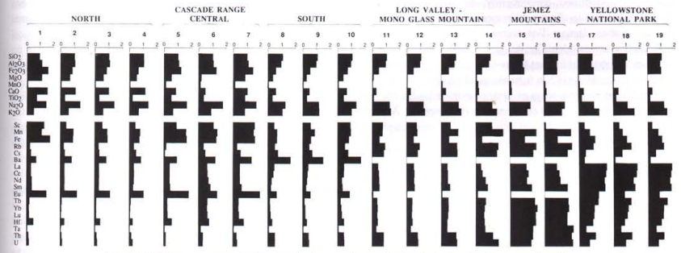
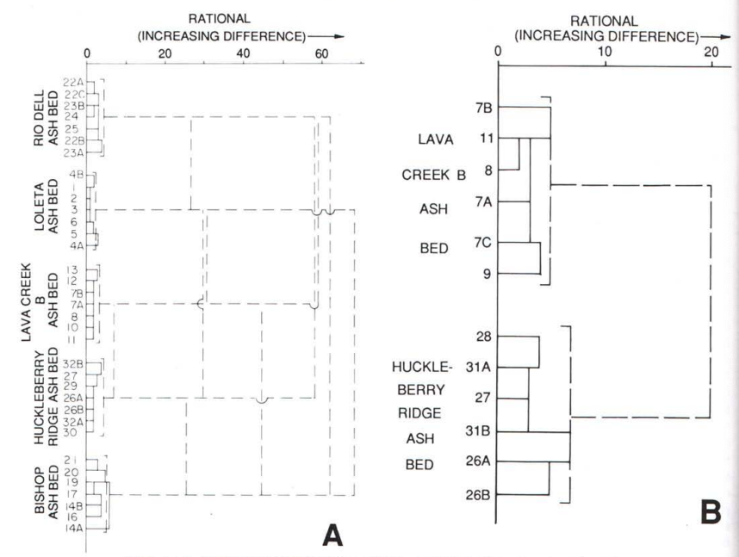
Tephrochronology: Tephrostratigraphy: Chemical techniques
Method:
Electron-microprobe analysis X-ray fluorescence analysis(XRF)
Instrumental neutron activation analysis(INA)
Data evaluation:
Goal:
Identify the tectonic setting, specific geographic region, volcanic field, and vent
Assumption:
Smaller compositional differences generally are observed among tephra erupted from the same volcanic province or field, and still smaller differences usually are found among tephra erupted from the same volcano or vent. Smallest chemical differences are usually observed among samples of the same tephra layer.

Slide 5
Tephrochronology: Tephrostratigraphy: Error analysis
The basic premise of tephrochronology:
Tephra layers have unique characteristics, physical or chemical, by which they can be distinguished one from another, and by which they can be consistently and correctly identified.
Chance for sequence:
7 choices of the feature of one layer
If you want to create the same sequence of the same feature, the possibility is: $$\frac{1}{8^{7}}=\frac{1}{2097152}$$
Is the correspondence a coincidence?
8 layers in this sequence
A sequence of tephra layers with the same set of characteristics can be duplicated at different times by a cyclic process
People have not seen eruptive sequences, as determined by the glass composition of tephra layers, repeated through time.

Slide 6
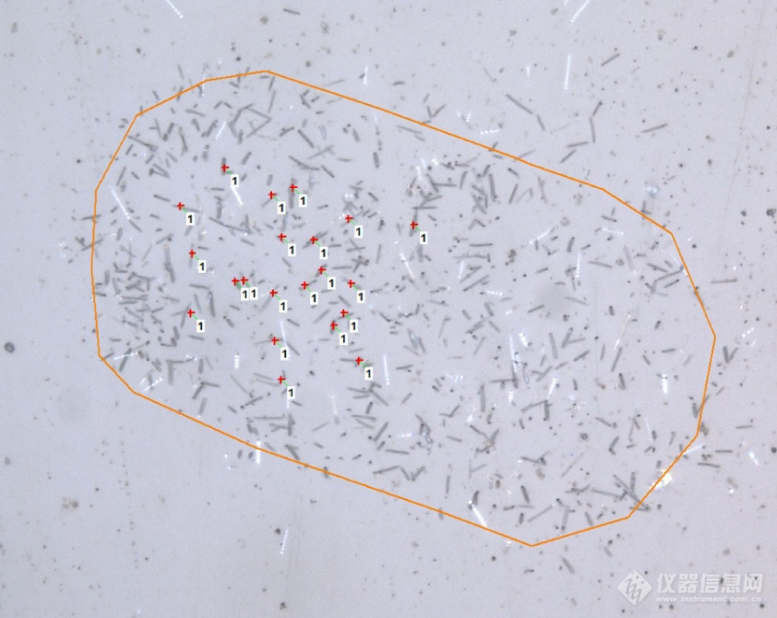
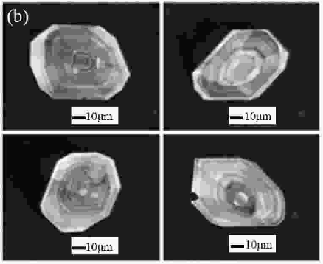
Tephrochronology: Tephrochronometry
Tephrochronometry:
The numerical age determination of tephra layers, either directly from the tephra itself, or indirectly from ages of strata stratigraphically above and below a tephra layer.
Method:
Conventional potassium-argon dating (many limitations)
Laser-fusion 40 Ar/30 Ar potassium-argon analysis
Fission-track dating of zircons and glass shards of tephra lavers

Slide 7
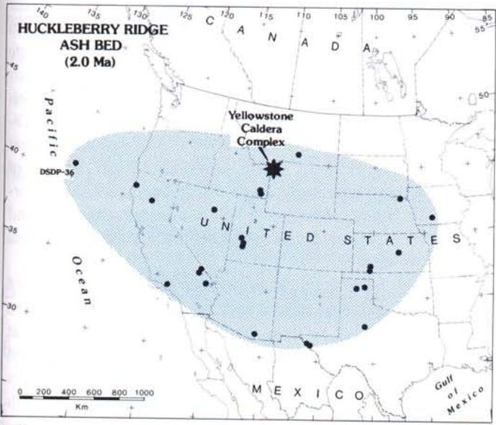
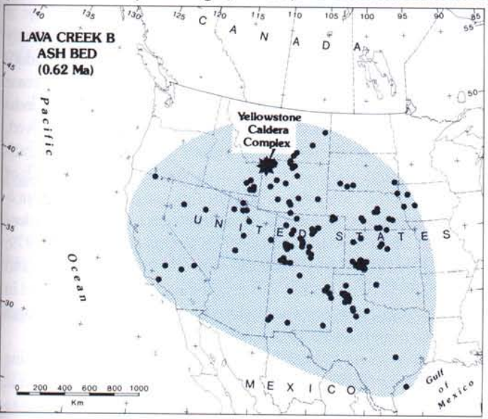
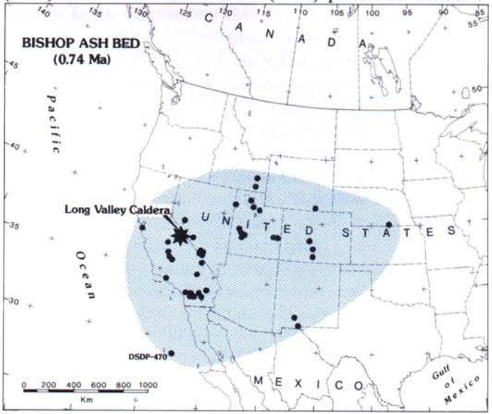
Sources, ages, and areal distributions of widespread tephra layers in the United States
0.62 Ma
2 Ma
Marker for upper Pliocene and lower Quaternary sections in the United States
0.74 Ma
Key time-stratigraphic datums for middle Quaternary continental and marine sequences.

Slide 8
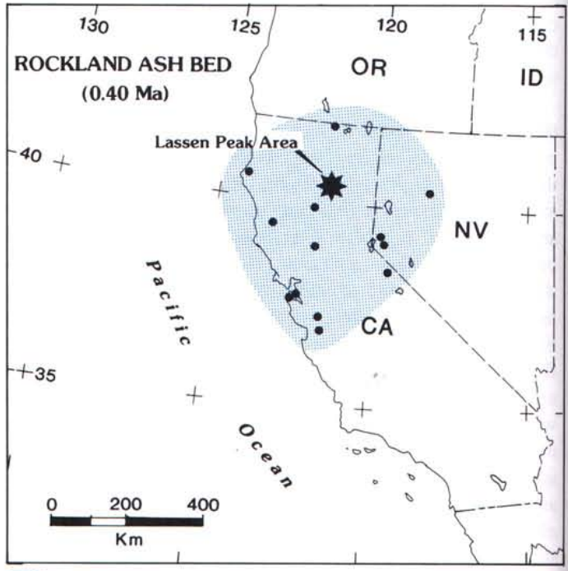
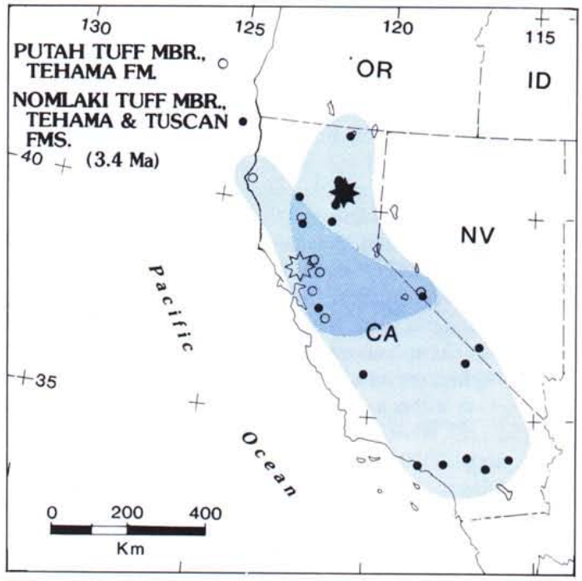
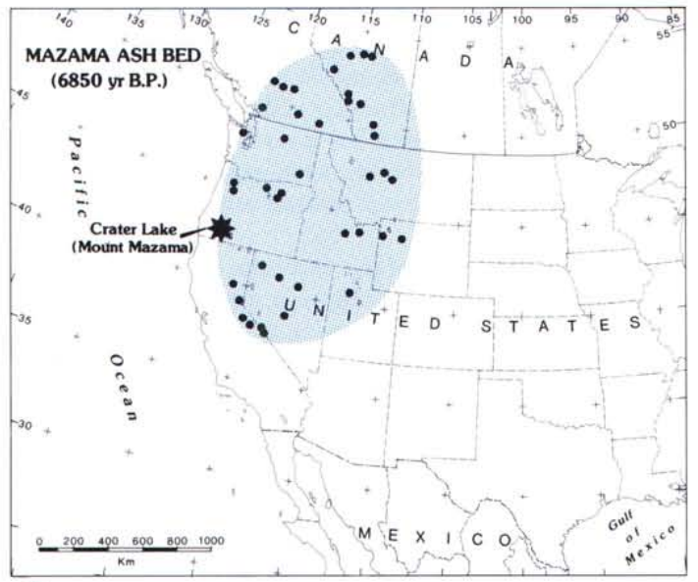
Sources, ages, and areal distributions of widespread tephra layers in the United States
Datum for upper Quaternary deposits
Age control for the upper Pliocene stratigraphic and structural framework of Quaternary deposits in the western United States
Marker for lower Holocene deposits in the northwestern United States

Slide 9
Summary
Composition of tephra:
Petrological and mineralogical composition
Sources, ages, and areal distributions of widespread tephra layers in the United States
Tephra
Chemical techniques
Plinian eruption creates wide-spreading tephra bed
Plinian eruption
✅

