Slide 1
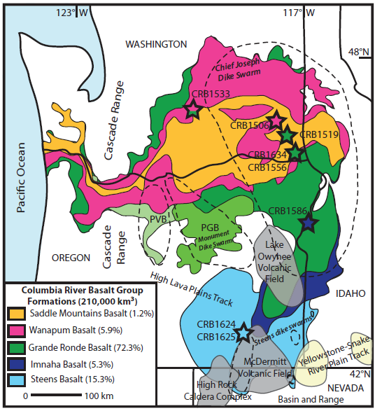
Purpose:
Baksi criticises the ages of the Columbia River Flood Basalts that Hooper published
highlight discrepancies in dating methodologies
issues with K-Ar and 40Ar/39Ar ages due to alteration
Hooper defends his work
Kasbohm & Schoene (2018)

Slide 2
— Baksi Commentary —
The K-Ar dates on altered whole-rock material are 10% younger than the crystallization value. Baksi
Grande Ronde
Grande Ronde Basalt ~ 16-15 Ma (Hooper age)
Baski Ar/Ar age of 16.5Ma
“Since the R1 magnetostratigraphic unit lies below this horizon [16.5Ma], extrusion of the Grande Ronde Basalt commenced ca. 17.0 Ma. The older Imnaha Basalt must then be >17 Ma in age.” Baksi
Imnaha
Imnaha Basalt ~ 15.5 Ma (Hooper age)
Baski cites recent Ar/Ar incremental heating data puts it at 17.5 Ma OLDEST
This date is 10% younger than it should be due to alteration in the samples
Steens
Steens Basalt ~ 16.6 Ma (Hooper age)
Baski cites recent Ar/Ar incremental heating data puts it at 16.5-16.6 Ma

Slide 3
— Baksi Commentary —
Steens
Grande Ronde Basalt ~ 16.5Ma
Baski Ar/Ar age of 16.5Ma
“Since the R1 magnetostratigraphic unit lies below this horizon [16.5Ma], extrusion of the Grande Ronde Basalt commenced ca. 17.0 Ma. The older Imnaha Basalt must then be >17 Ma in age.” Baksi
Hooper
Grande Ronde
Grande Ronde
Baksi
Imnaha
Steens Basalt ~ 16.5-16.6 Ma
Baski cites recent Ar/Ar incremental heating data puts it at 16.5-16.6 Ma
Imnaha Basalt ~17.5 Ma
Baski cites recent Ar/Ar incremental heating data puts it at 17.5 Ma OLDEST
This date is 10% younger than it should be due to alteration in the samples
Steens
Imnaha

Slide 4
— Hooper’s Clap Back —
“Absolute ages from three laboratories appear entirely compatible with [field observations of relative ages], emphasizing that 90% of the Columbia River Basalt erupted in the very short period between 16.6 and 15.0 Ma.” Hooper
Grande Ronde
Grande Ronde Basalt ~ 16.1-15 Ma
Had a third party do incremental heating dating and came up with comparable results.
Imnaha Basalt ~ 15.5 Ma
Hooper cites stratigraphic and Ar/Ar data from 3 labs to back up his date of 15.5 (and younger relative to Steens)
3. Steens Basalt ~ 16.6 Ma
Imnaha
Steens
“In part, this is a disagreement between specialized dating laboratories and the best absolute dates must eventually be resolved between those laboratories.” Hooper

