Slide 1
Geometry of Subducted slabs related to San Andreas Transform Dickinson et al.
Evolution of San Andreas transform fault has played a large role in geometry of subducted slabs into the mantle along western North America
Though plate subduction happens to the North and South of Mendocino and Rivera triple junction there is no subduction between the two spots
A slab free region has been created in area of no subduction
As the slab free region changes over time one can expect changes in volcanism and tectonic behavior

Slide 2
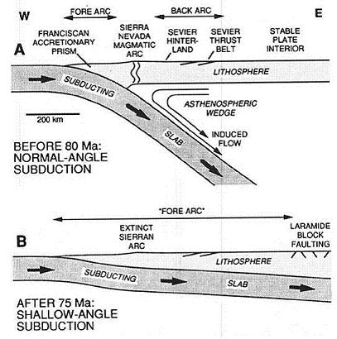
Subduction Context
Cretaceous- Plate consumption near coast created magmatism that built batholiths of the western Cordillera
Paleogene- plate subduction at a shallow angle triggering Laramide tectonism in Eastern Cordillera
Oligocene- Dip increased causing arc magmatism to occur in West Cordillera into the Miocene
San Andreas was generated along the coast

Slide 3
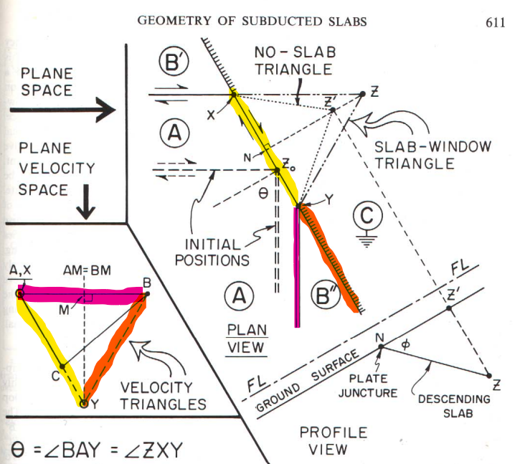
Plate Geometry

Slide 4
Notes:
Using this geometry u can estimate the location of Z’ or X and Y by assuming the dip angle of th esubducted slab

Slide 5
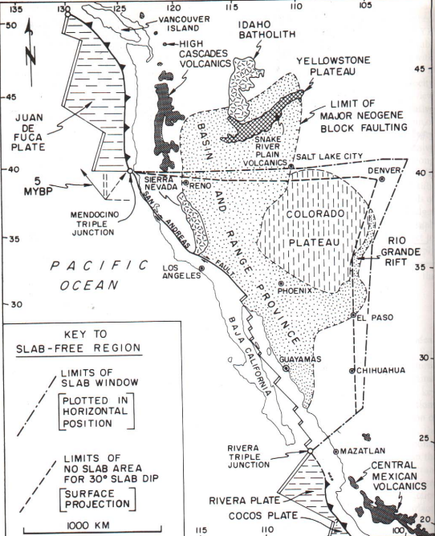
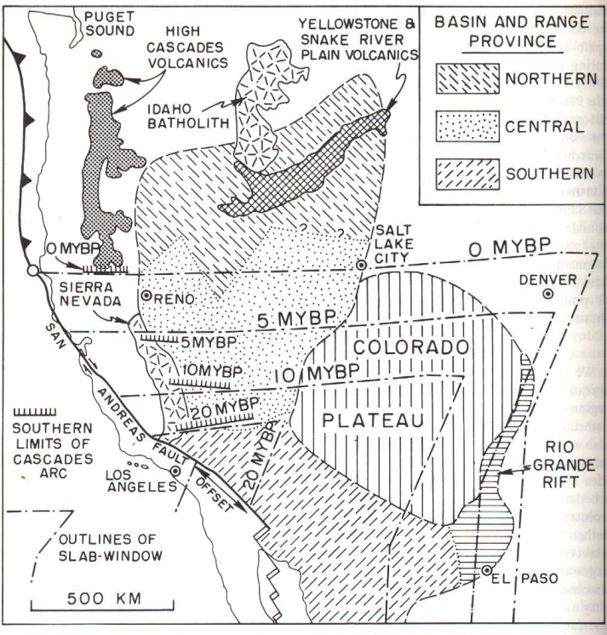
Arc Volcanism
Oligocene to Early Miocene(25-20 Mya)- active magmatic arc parallel to subduction
20 mya slab free zone cut the arc causing it to retreat through Neogene and arc volcanism ending in Arizona and New Mexico at this time
Southern end of Cascades retreated northward in harmony with the slab free region

Slide 6
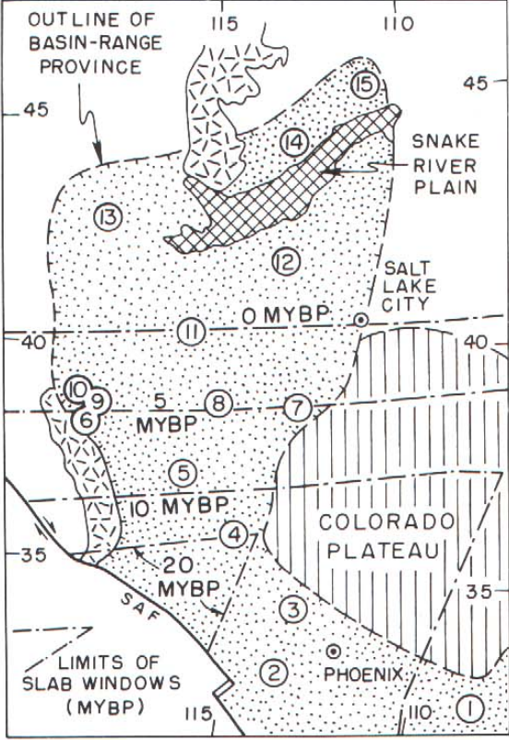
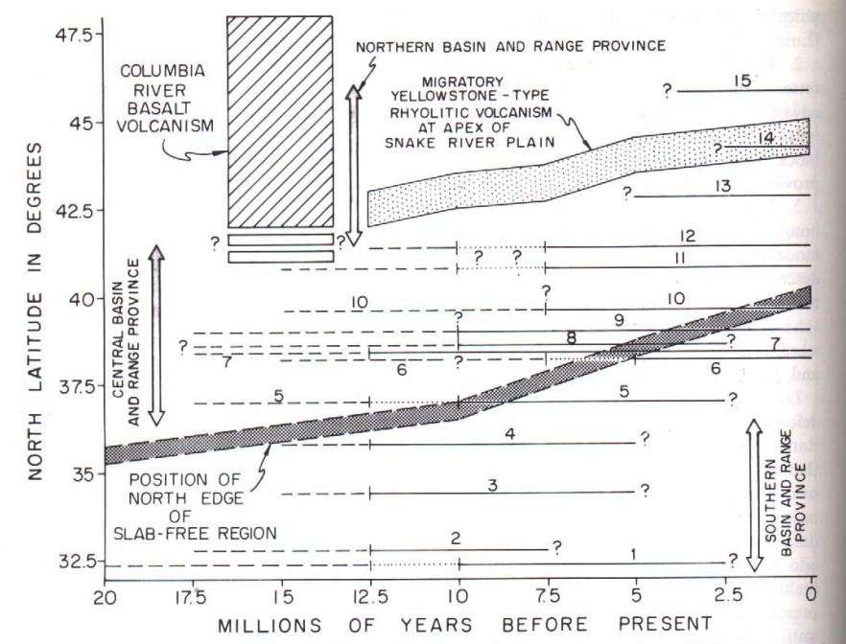
Tectonism
The absence of a slab allows asthenosphere upwelling into the gap left by the retreat of the subducting Plate promoting crustal extension
The same processes caused Colorado Plateau uplift
Southern Basin and Range faulting began 12.5 mya and ended 5 mya
Central Basin and Range faulting was from 10-5 mya
Northern Basin and Range
lavas erupted around 15 mya
and tectonism began 5 mya
In the North deformation
cannot be directly linked to
slab free zone unless the
upwelling can be inferred to
affect larger area on the
surface than at depth

Slide 7
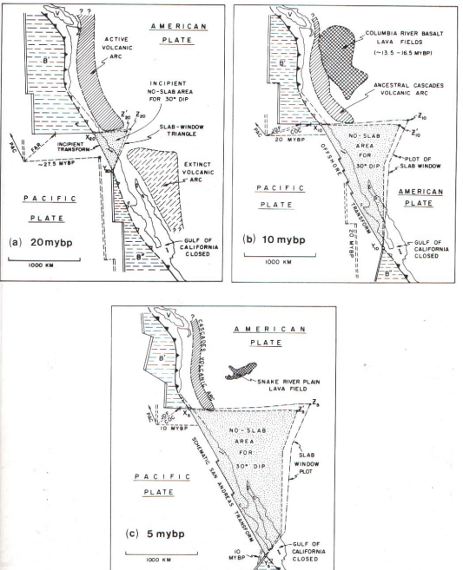
Conclusion
Using geometry and kinematic allows for a model for past and future extent of slab free zone
Distribution of Neogene volcanism has systematic link to the slab free region
Extension in B+R and uplift of Colorado plateau are largely due to Neogene upwelling of asthenosphere
B+R extension occurred earlier in the South

