Slide 1
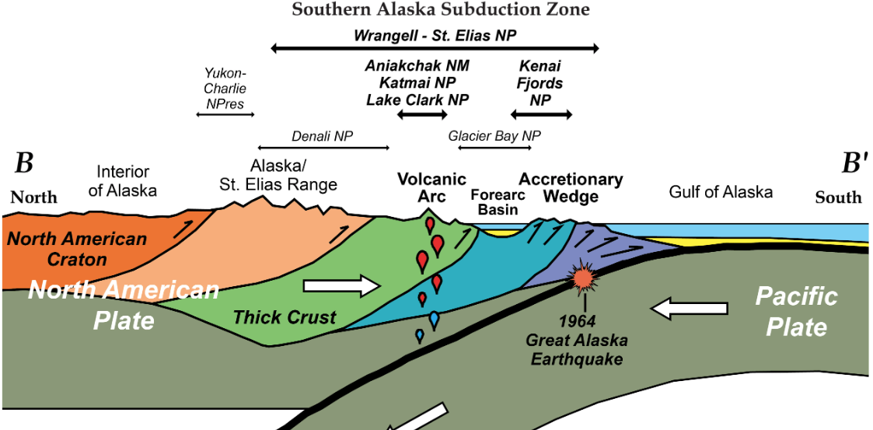
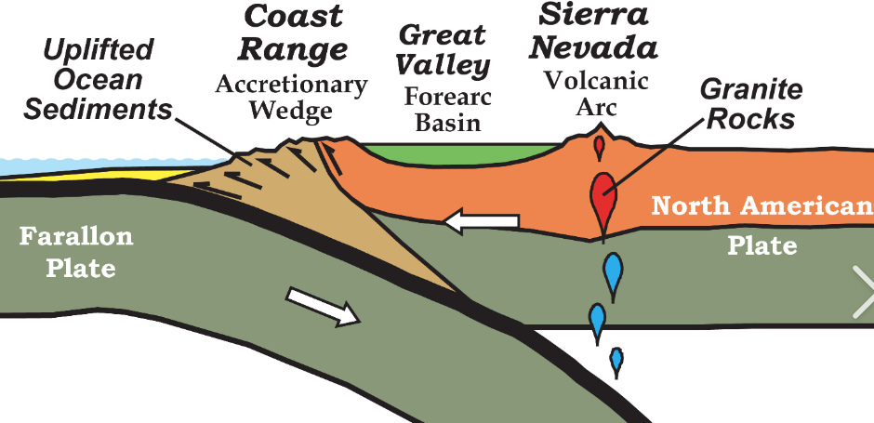
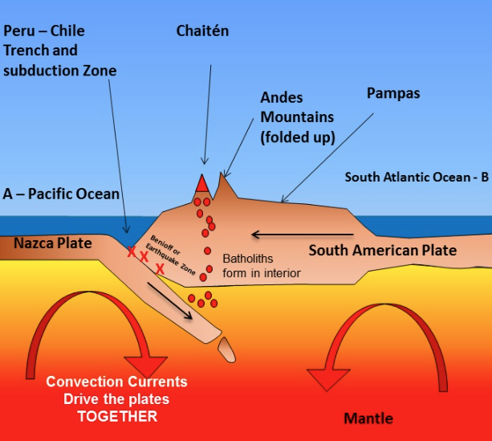
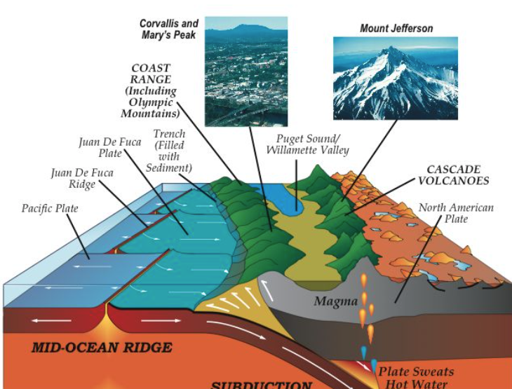
Arc Magmatic Tempos: Gathering the Evidence
Paterson and Ducea 2015; Issue 11 of ELEMENTS
Alaska
California
Oregon
Chile

Slide 2
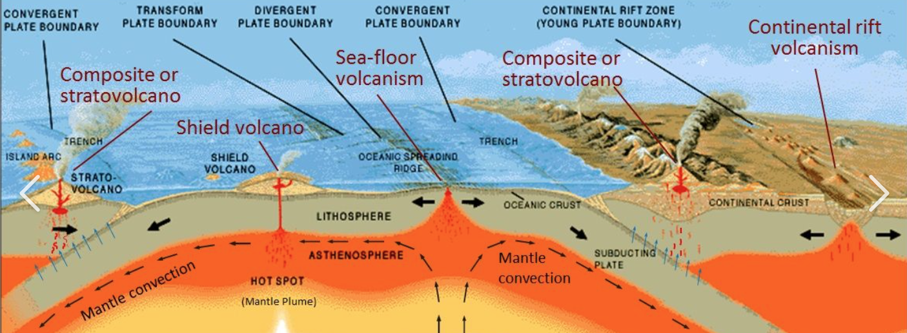
Episodic Magmatism
Despite continuous subduction magmatic systems and subsequential volcanic eruptions are highly episodic.
U-Pb dates for both igneous and volcanics show an episodic behavior in both continental arcs and oceanic to a lesser degree
Occurs in flare –ups and lulls
Subduction along North and South America generally simplified, but highly varried

Slide 3
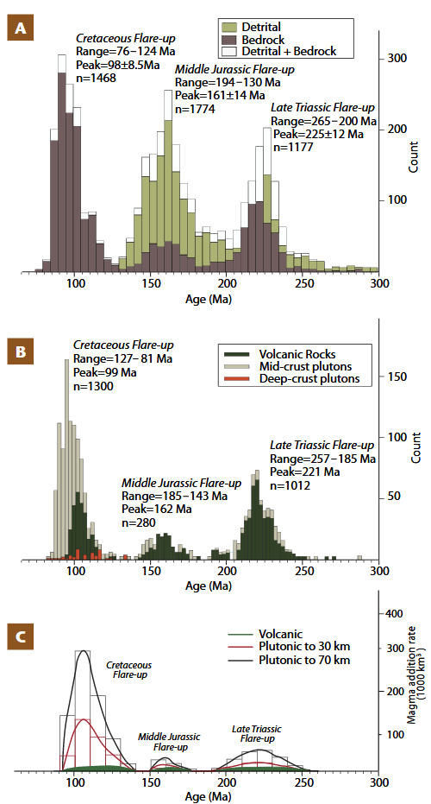
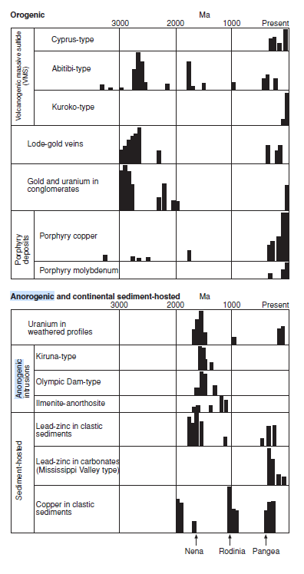
Lags may be due to latent heat of fusion/xtlzn, magma conduits reorganize, or crustal rheology shifts

Slide 4
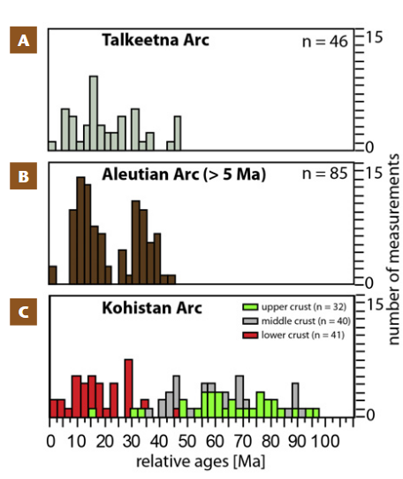
Determining Oceanic arc component
Challenging factors:
Shroter Magmatic history
Once subducted or collided it is lost or deformed respectively
Very few tilted oceanic arcs
Zircon (Zr) less common in these predominately mafic rocks.
These volumetrically large systems will provide important input into magmatic influx calculations
What we do know is that lifespan ~ 60-70 My

Slide 5
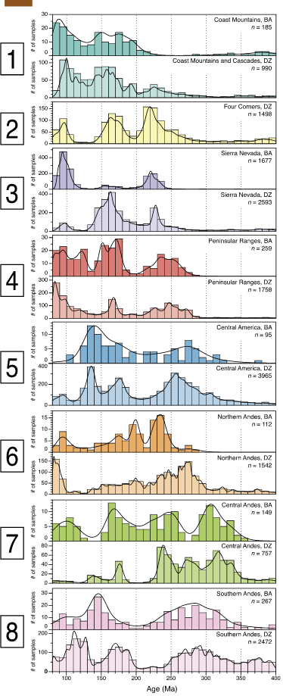
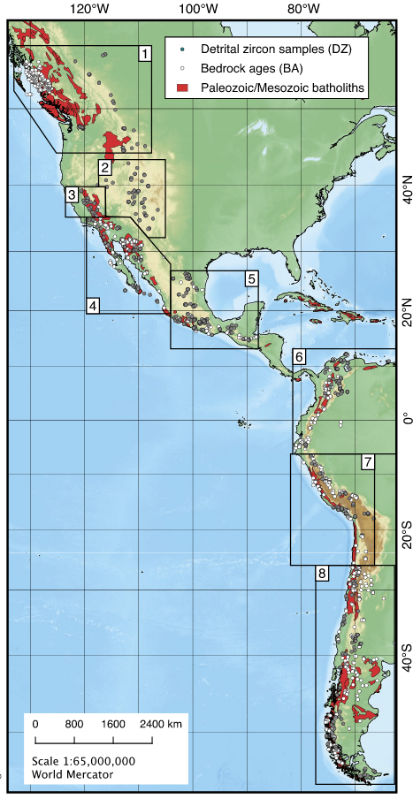
Magmatic addition Rates (MAR) define lulls and flare-ups
Good because can be normalized to and along strike by scale.
Arc tempos
Large geochronological base from detrital and bedrock Zr
Unfortunately, does not provide much insight on volume

Slide 6
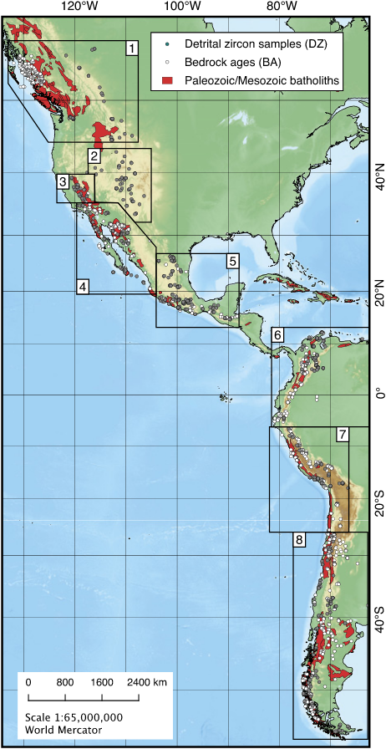
To get volume estimates, holistic approaches can provide insight relative differences between lulls and flare-ups
Ex, Sierra Nevada's. 100-1000x more magma during a flare-up
Ratio between volcanics/plutonic rocks is 1/30
What’s happening to recycling crust, and ophiolites need to be considered.

Slide 7
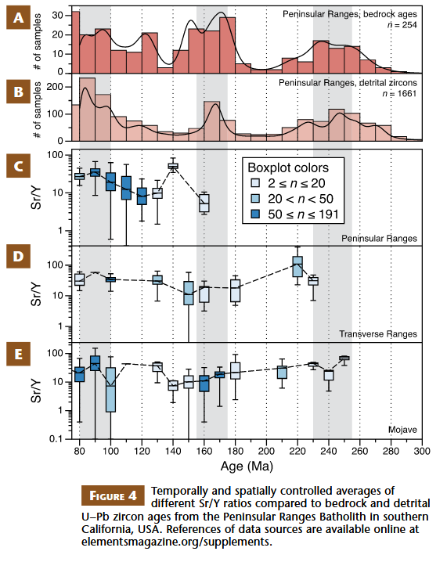
Isotope evidence to periodicity
Chemistry changes in coordination with tectonics.
Greater MAR→ more radiogenic isotope spread→ More input from lithosphere

Slide 8
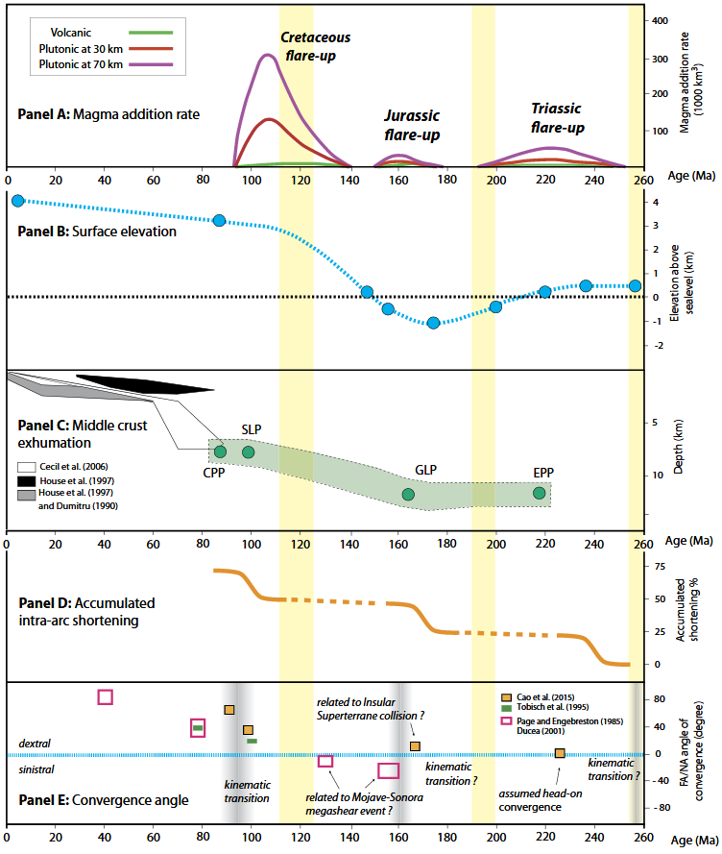
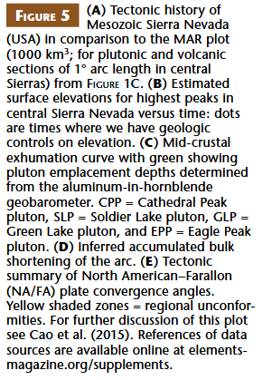
Conclusions
Geochemical/chronological databases are being developed however structural evolutions are lacking.
Understanding the episodicity, and frequency of magmatic arcs plays a role in orogenies, ore deposits, water resources, climate change, volcanic eruptions, earthquakes and landslides.

Slide 9
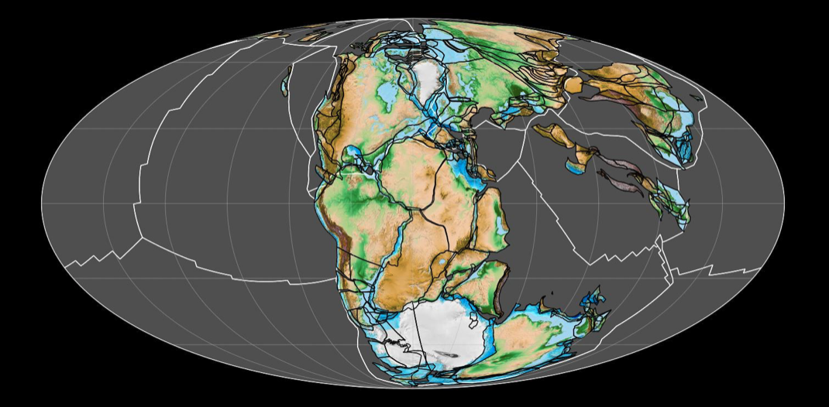
Plate tectonics circa 200 ma

