Slide 1
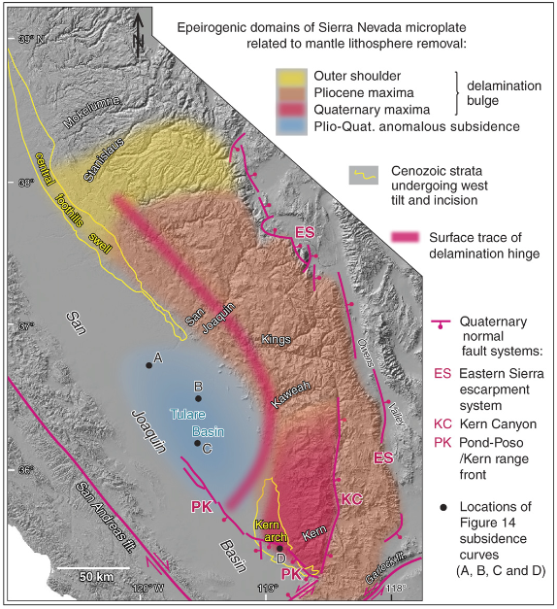
Epeirogenic transients related to mantle lithosphere removal in the southern Sierra Nevada region, California
J. Saleeby, L. Le Pourhiet, Z. Saleeby, and M. Gurnis, 2012
By Henry
Evidences of mantle lithosphere removal
Modeling of removal
Surface expressions to the removal

Slide 2
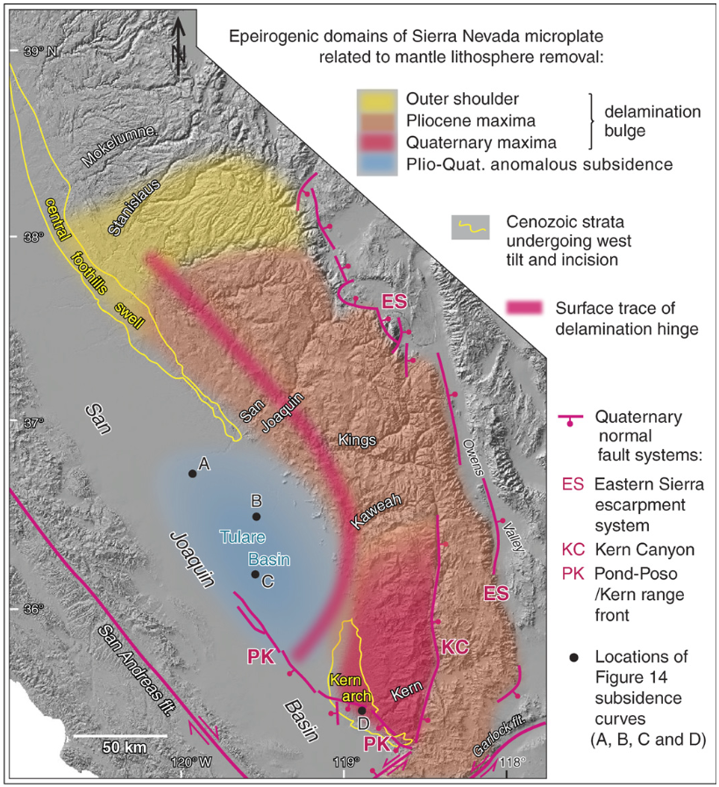
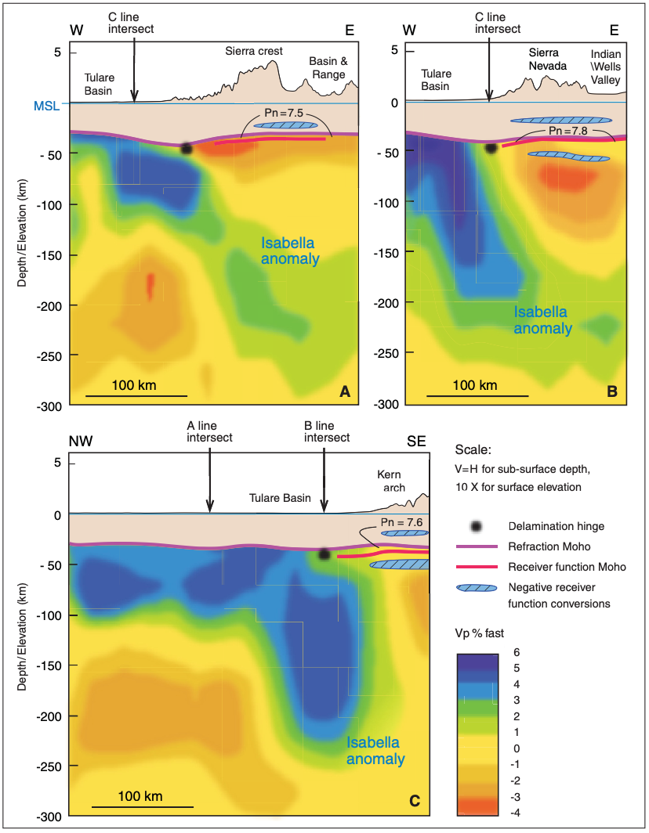
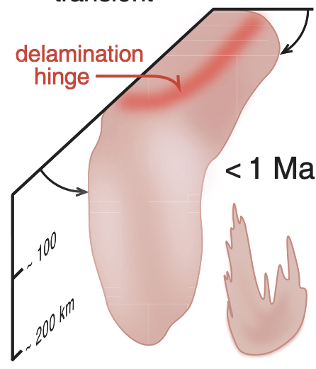
Evidences of root delamination: seismic profiles
Isabella anomaly (root):
High-wave speed anomaly beneath the crust
Dip downward to the east and south
Volume decreases to the north (the dark blue portion)
3c
3a
3b
❓
Options for high-wave speed anomaly
Cold lithospheric mantle
A structure composed of denser minerals (e.g. garnet-pyroxenites; eclogite)

Slide 3
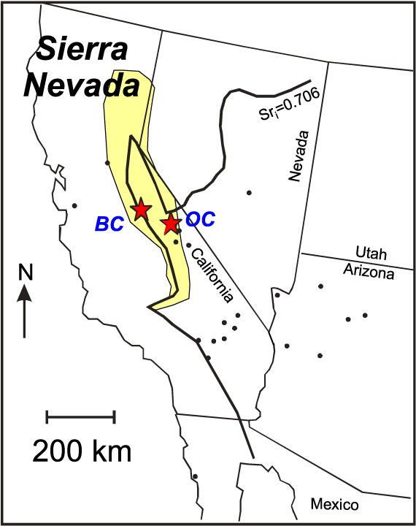
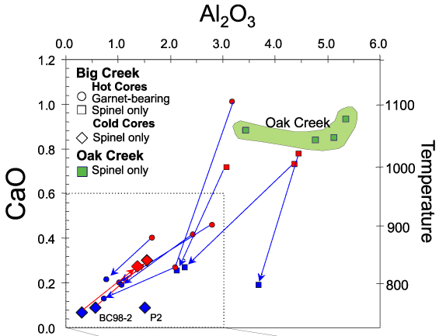
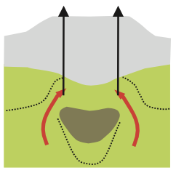
Evidences of root delamination: secular changes in xenolith and inferred thermal structure
Big Creek xenolith:
8.3 Ma
Garnet-pyroxenites + mantle xenolith
90 km
equilibrated at ~800 °C
Oak Creek xenolith:
0.115 Ma
Only mantle xenolith, no garnet-pyroxenites
equilibrated at >1000 °C
The composition of Isabella anomaly
Lee et al., 2003
Conclusion:
The cold, pyroxenite root of the Sierras was removed and replaced by asthenospheric mantle between the late Miocene and Pliocene

Slide 4
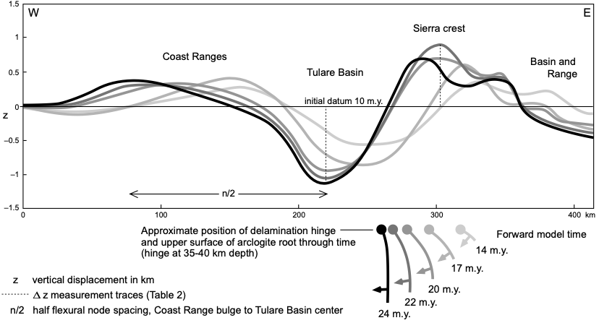
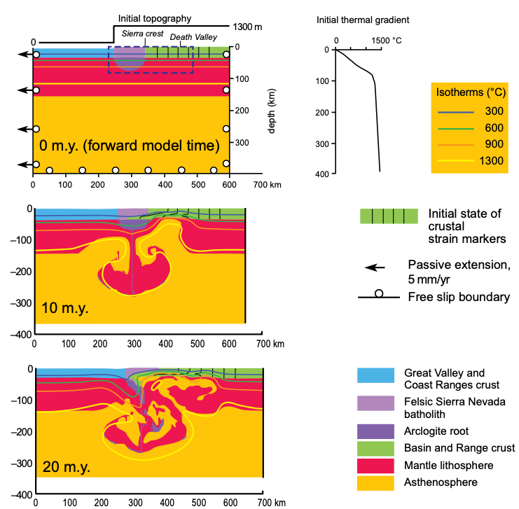
Modeling of root delamination
A sharp inflection in the geotherm is imposed near the base of the mantle lithosphere (the slab window made by mid-ocean ridge subduction ~20 Ma)
Higher density and rheology of the root
Felsic density and rheology of the crust (weaker and buoyant)

Slide 5
Modeling of root delamination: Comparison between modeling and seismic profiles
Relationship:
Foundering root ----- Isabella anomaly of higher wave speed
Foundered and separated root ----- Isabella anomaly of lower wave speed
Upwelled hot asthenosphere ----- low wave speed anomaly

Slide 6
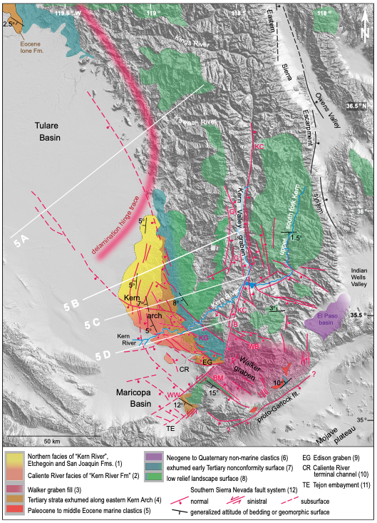
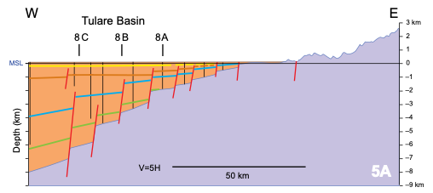
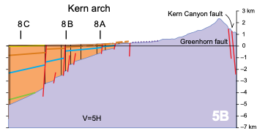
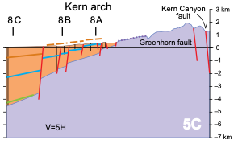
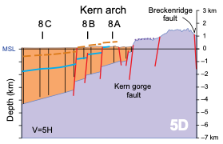
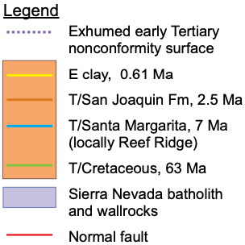
Surface expressions to the root delamination: Late Cenozoic Rock Uplift of the Southern Sierra Nevada
Kings River:
~400 m of incision between 3.0 and 1.5 Ma (constrained by cosmogenic dating of stratified cave sediments in a deeply incised vertical marble unit).
Sierra Crest:
Dense normal faulting cuts through strata that are older than E clay (0.61 Ma).

Slide 7
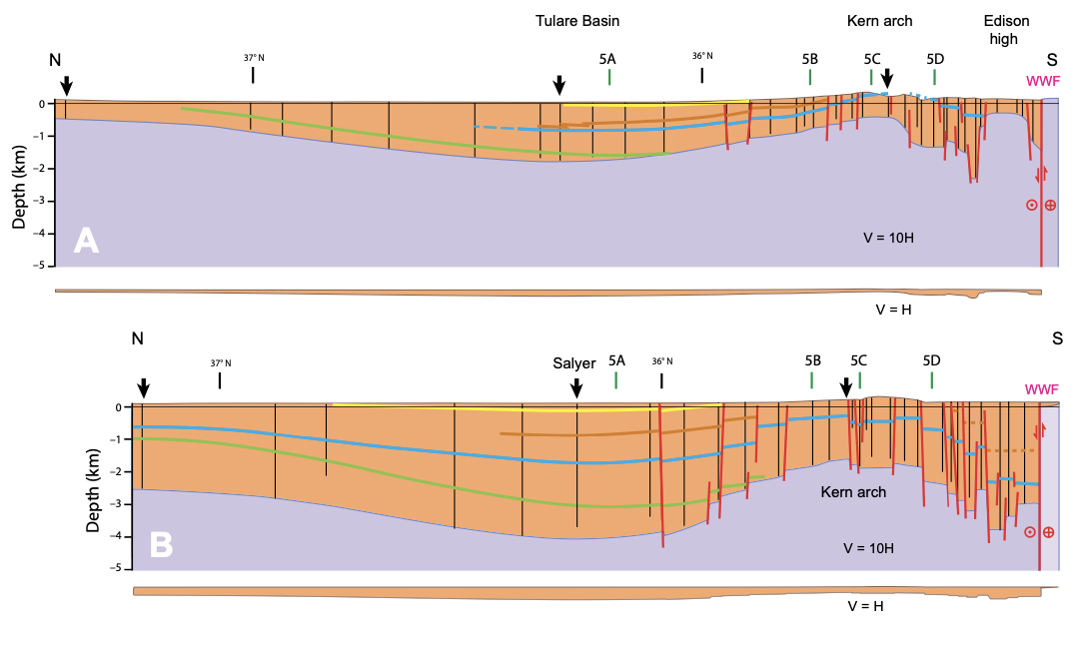
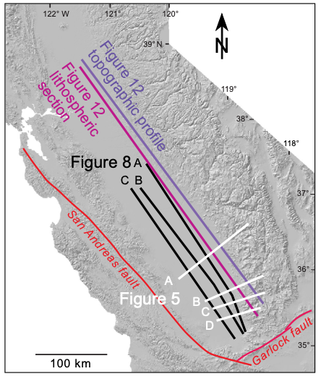
Surface expressions to the root delamination: subsidence of Tulare Basin
Maricopa supra- detachment basin
1260-1400 m vertical difference from Structural relief measurement

Slide 8
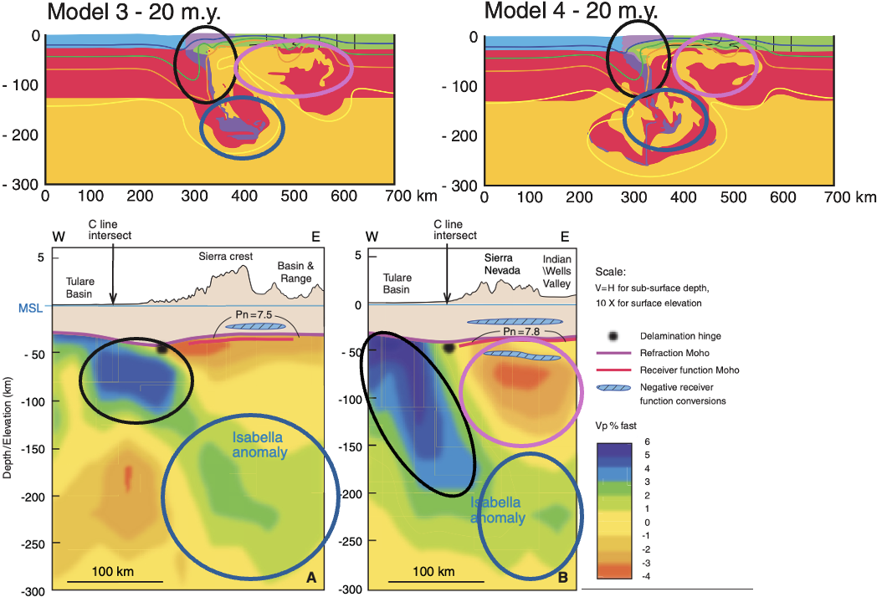
Summary
Evidences
Comparison between modeling and seismic profiles
Related surface expressions
Late Cenozoic Rock Uplift of the Southern Sierra Nevada
Subsidence of Tulare Basin

