Slide 1
Chronology of expansion and contraction of four Great Basin lake systems during the past 35,000 years
L. V. Benson, D. R. Currey, R. I. Dorn, K. R. Lajoie, C. G. Oviatt, S. W. Robinson, G. I. Smith, and S. Stine

Slide 2
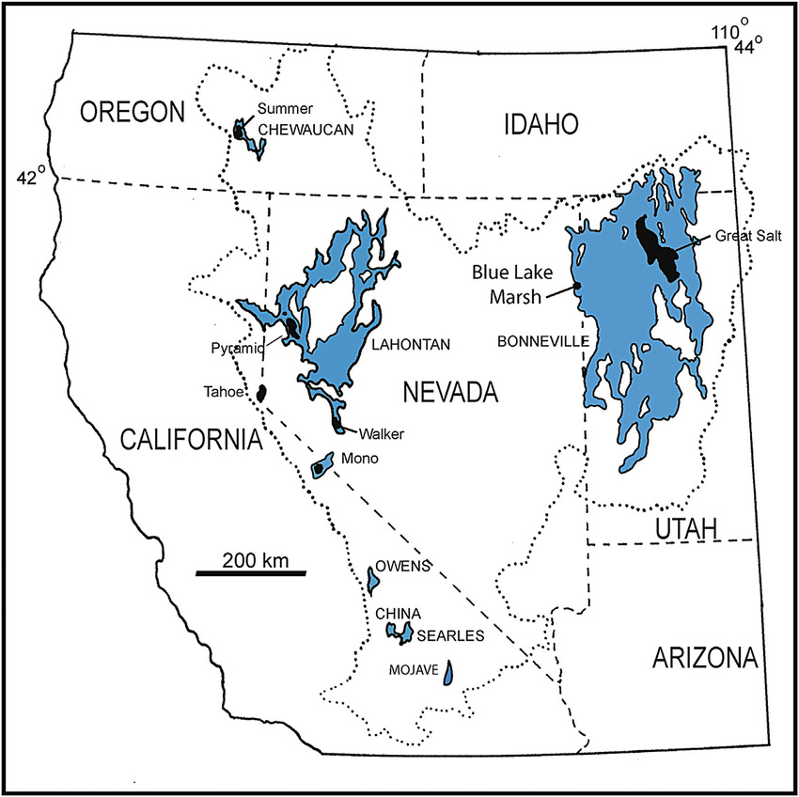
Introduction
When
35,000 years ago $→$ present.
Who
Lahontan, Bonneville, Russell, Searles
What
Identify patterns of lake-level and lake-surface area variation
Why
Generate and explore implications of the hypothesis that the lakes responded to large-scale changes in climate at the same time
RUSSELL
Modified from Benson et al., 2013

Slide 3
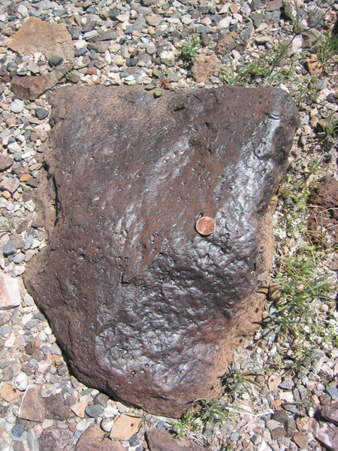
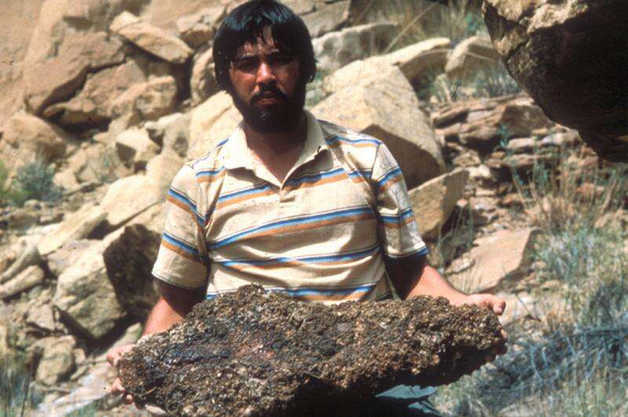
Methods
Ages from radiocarbon dating (of inorganic & organic material both above & below lake surface) from previous studies
Tufa
Rock varnish
Wood
Packrat pee-soaked dens (water soluble, duh)

Slide 4
Limitations
Materials only create upper and lower temporal bounds
Tufa – Form at wide range of depths
Rock varnish – Pretty good actually
Wood - Possibly exhumed and emplaced in lake
Packrat pee-soaked dens – Can form far above lake level

Slide 5
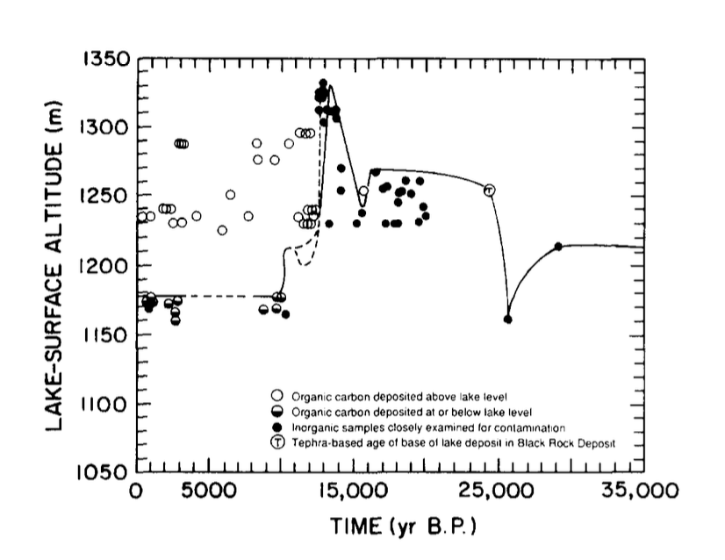
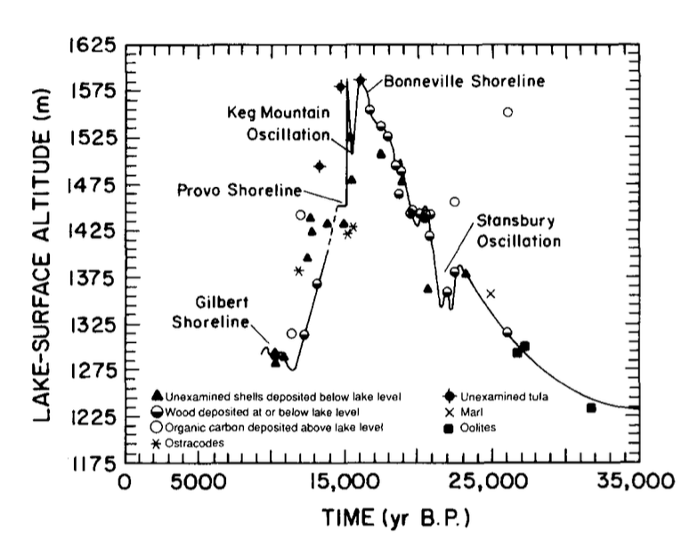
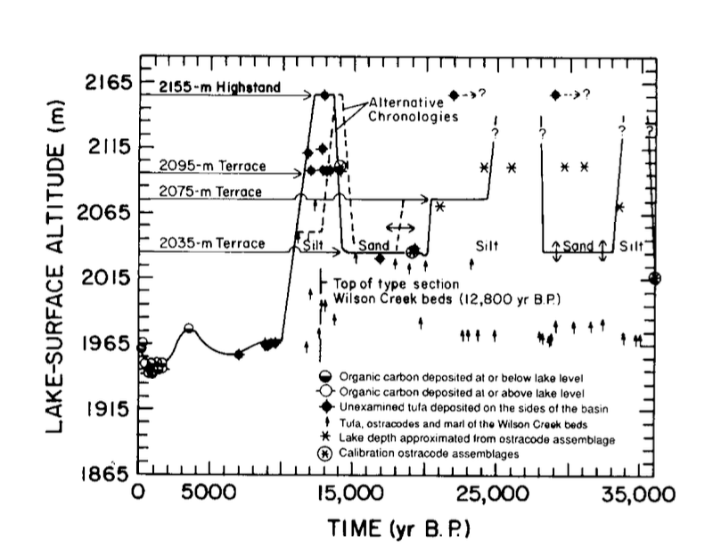
Models
(a)
(b)
- Lahontan
- Bonneville
- Searles
- Russell
(c)
(d)

Slide 6
Observations
Bonneville and Lahontan had one major oscillation (highstand).
Lake Russell and Lake Searles seem to have had several major oscillations.
Lakes went from dryer to achieving highstands between 15,000– 13,500 years B.P.
Recession from the last highstand may have occurred synchronously between 14,000 and 13,500 years B.P. in all four lakes.

Slide 7
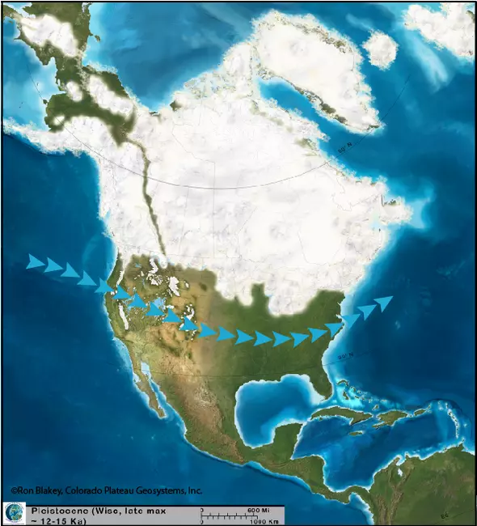
Interpretations
Jetstream passed over Lahontan and Bonneville but north of Russell and Searles
Lahontan and Bonneville continued to grow because of lake-atmosphere feedback loop (think large S.A.)
$$\sim × 10$$
$$\sim × 4−6$$

Slide 8
Interpretations (cont.)
Jetstream responded to continental ice sheet.
(semi) global climatic event, the Younger Drayas?
$$\sim × 2−3$$

Slide 9
Summary
Results based on radiocarbon are approximate and the reliability is reliant on type of carbon-bearing material.
Synchronous and asynchronous temporal changes in lake surface area and possible causes.
Relative position to jet stream
Jet stream ice sheet interactions
Lake-atmosphere feedback loop
Global climactic event

Slide 10
Citations
Benson, L. V., Currey, D. R., Dorn, R. I., Lajoie, K. R., Oviatt, C. G., Robinson, S. W., Smith, G. I., & Stine, S. (1990). Chronology of expansion and contraction of four great Basin lake systems during the past 35,000 years. Palaeogeography Palaeoclimatology Palaeoecology, 78(3-4), 241–286. https://doi.org/10.1016/0031-0182(90)90217-u
Benson, L. V., Smoot, J. P., Lund, S. P., Mensing, S. A., Foit, F. F., & Rye, R. O. (2013). Insights from a synthesis of old and new climate-proxy data from the Pyramid and Winnemucca lake basins for the period 48 to 11.5 cal ka. Quaternary International, 310, 62–82. https://doi.org/10.1016/j.quaint.2012.02.040
Extent of Pleistocene lakes in the western Great Basin. (2024). NBMG Publications. https://pubs.nbmg.unr.edu/Extent-Pleistocene-lakes-p/mf2323.htm
Swearingen, M. (2016). Packrats help dig up the past. The Journal. https://www.the-journal.com/articles/packrats-help-dig-up-the-past/
Tufa. (2024, January 9). Mono Lake. https://www.monolake.org/learn/aboutmonolake/naturalhistory/tufa/

Slide 11
Secondary Questions
What measure of lake-size variation (lake level, lake area, or lake volume) is the best indicator of change in the hydrologic balance?
Were lake-size variations synchronous across the Great Basin?
When comparing lake-size variations, what normalization procedure should be used?
Were synchronous changes in lake size of the same hydrologic magnitude?
What changes in global or local climate were associated with the rise and fall of the lakes?

Slide 12
