Slide 1
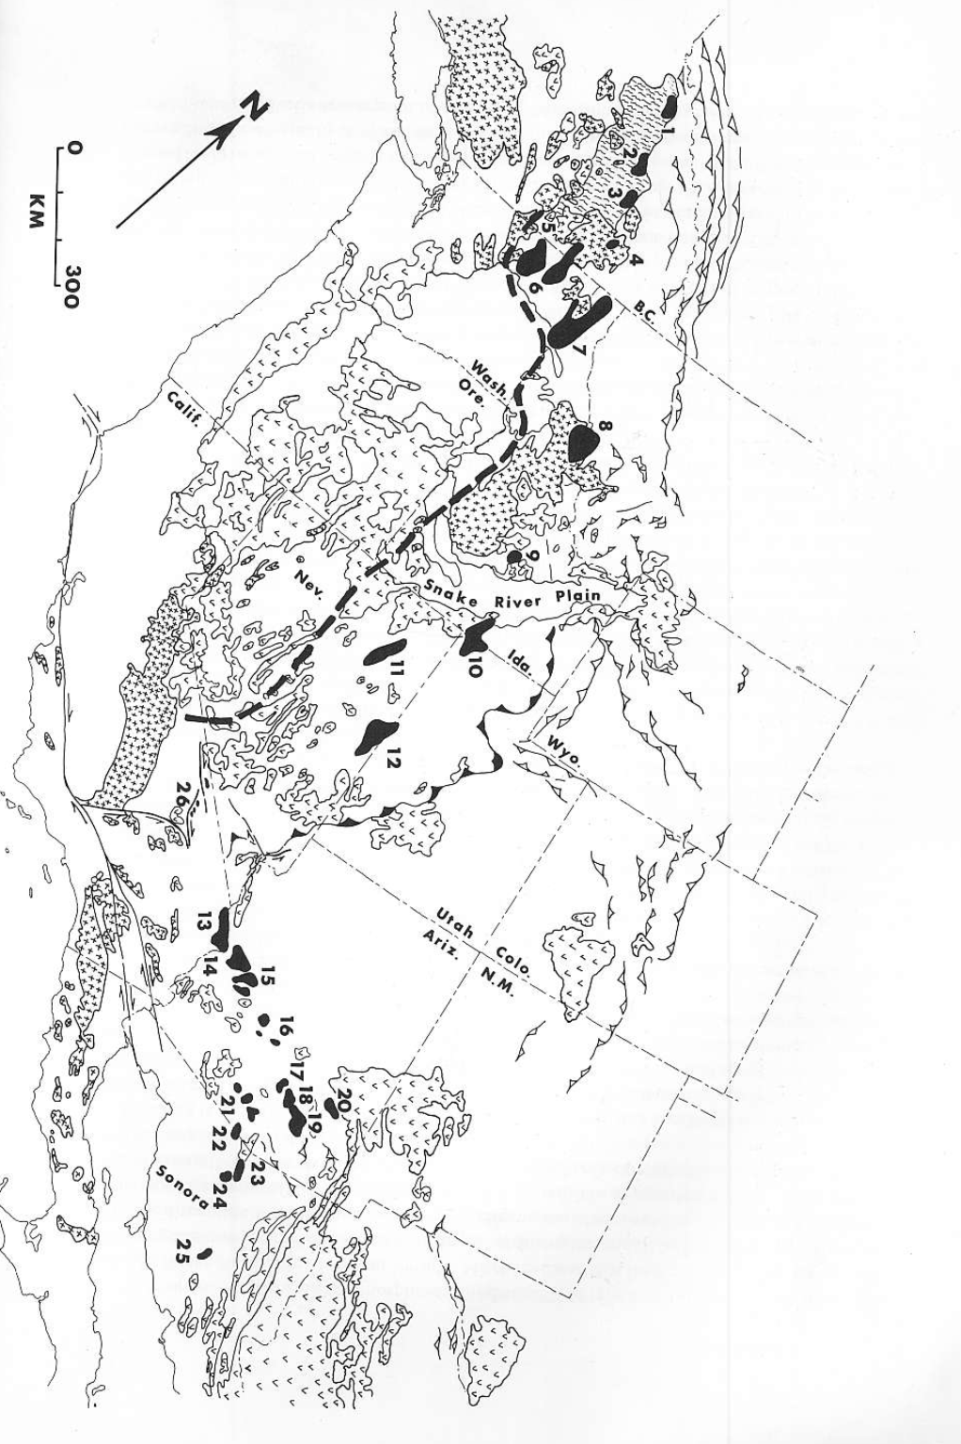
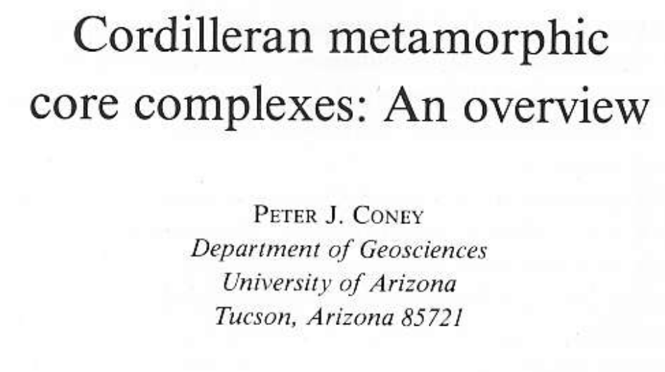
West of Sevier and laramide thrusts
East of 706 line
Compilation paper: Metamorphic Core Complexes (MCCs)
MCCs are regions of isolated metamorphic terranes.
Spanning from southern Canada to northern Mexico along the Cordillera.
Significance: MCCs offer insights into crustal extension and regional tectonics in North America.They are high-strain, highly deformed rocks that represent tectonic extension and crustal exhumation.

Slide 2
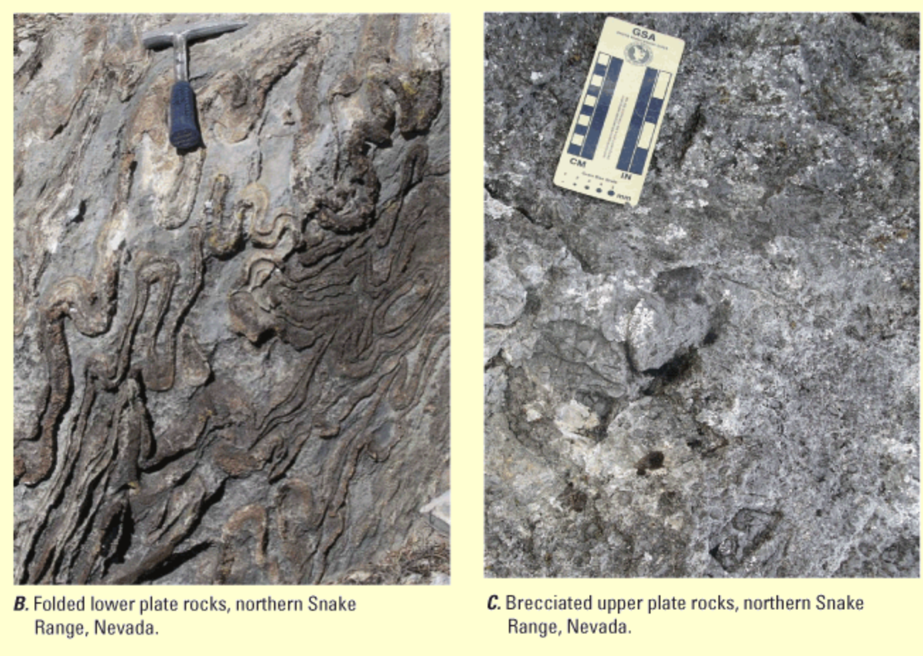
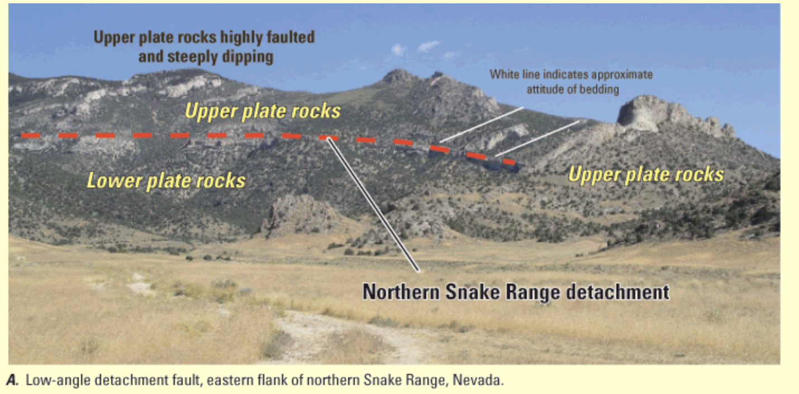
What is a Metamorphic Core Complex?
A: Basement terrane
B: Cover Terrane
C: Decollement Zone
A: Basement
B: Cover
A

Slide 3
What they look like…
Unmetamorphosed Cover Terrane
The overlying cover rocks are usually sedimentary and volcanic.
Structural Features: The detachment fault marks the boundary where ductile deformation in the basement transitions to brittle faulting in the cover rocks. This cover is often intensely thinned and fractured, especially along the fault zone.
Metamorphic-Plutonic Basement Terrane
This terrane includes highly deformed rocks, such as mylonitic gneisses, schists, and other high-grade metamorphic rocks. Intense ductile deformation.
Foliation and Lineation: show low-angle foliation and a prominent lineation (align with the direction of tectonic stretching). In some regions granites alternate with gneisses and schists

Slide 4
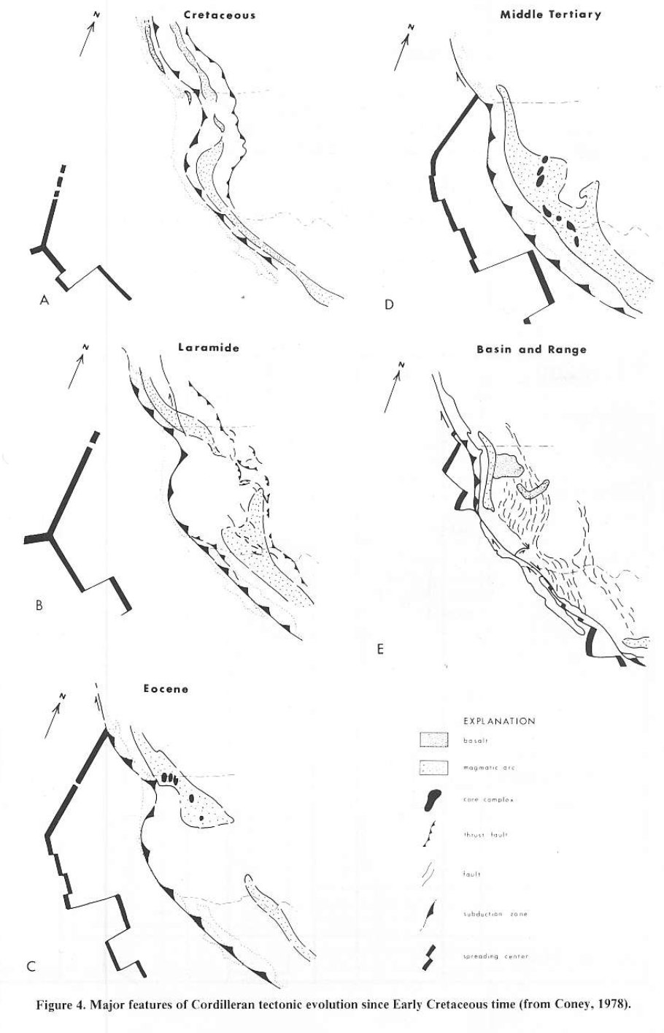
When
Formed from Eocene to mid-Tertiary, pre basin and range!
Cretaceous and Laramide: Sevier and Laramide thrust belts, subduction off the coast was forming the Sierras batholiths
Eocene: Some core complexes start forming, Laramide thrusting ends.
Middle Tertiary Thrusting along Sevier belt continued and the more core complexes form.
Miocene: Basin and Range faulting starts

Slide 5
As always…started off controversial
Interpreted to be thrust fault related—due to low angle faulting.
Armstrong, 1972 proposed a low angle detachment model
Subsequent observations have concluded rocks on top of decollement are younger (Tertiary) than below —normal faulting!
The core complexes show east trending crustal extension was occurring across the Basin and Range well before the Miocene B&R extension that we see in topography today.

