Slide 1
The Temporal and Spatial Association of Magmatism and Metamorphic Core Complexes in the North American Cordillera
Armstrong and Ward, 1991
MCC occur in close association with regional magmatism
MCC’s in the Northern American Cordillera decrease in age further south
Armstrong and Ward sought to explain formation of MCC’s by comparing them with the spatial and temporal patterns in magmatism
Literature review of previous studies to identify four successive periods of magmatism
MCC

Slide 2
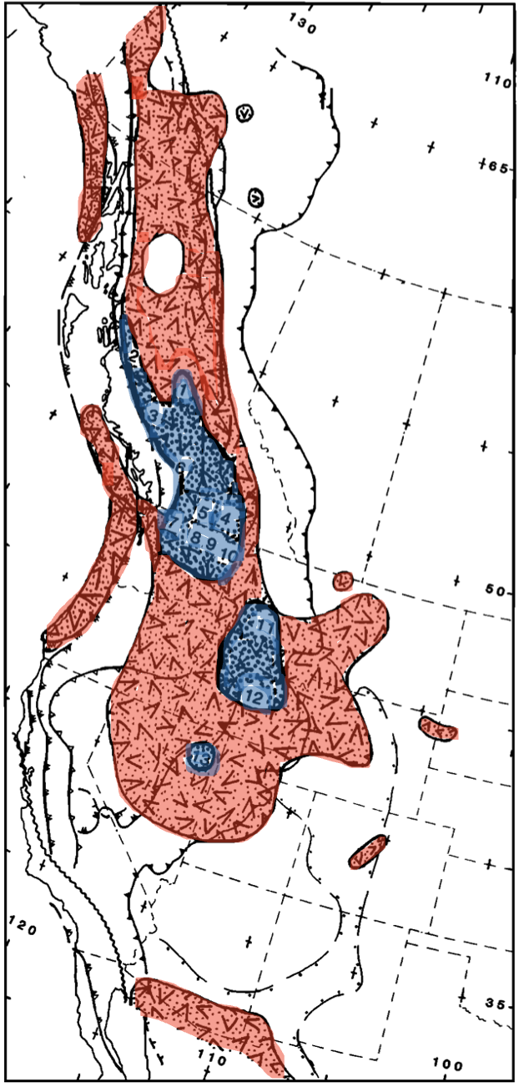
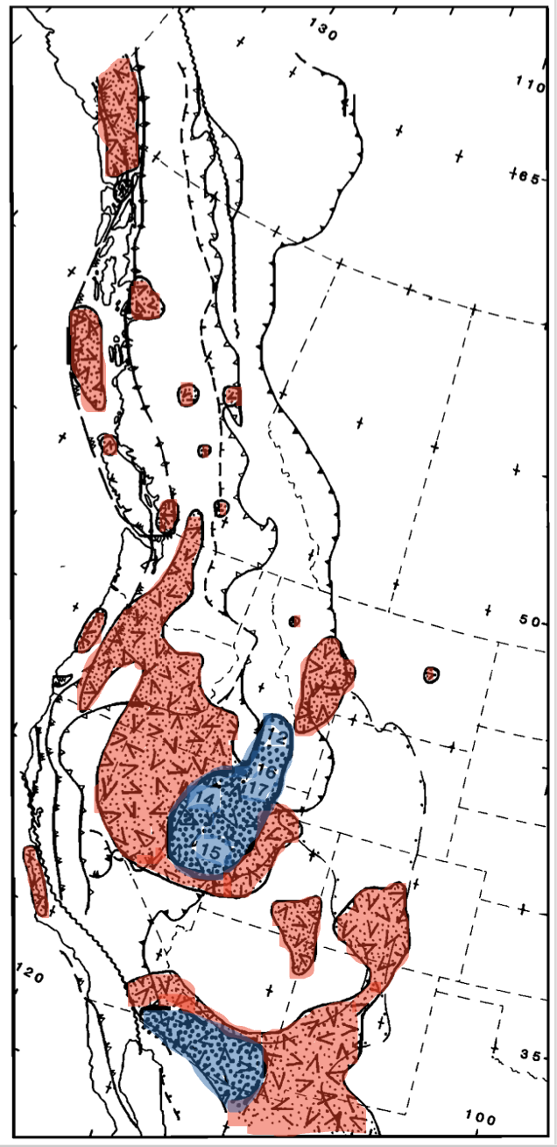
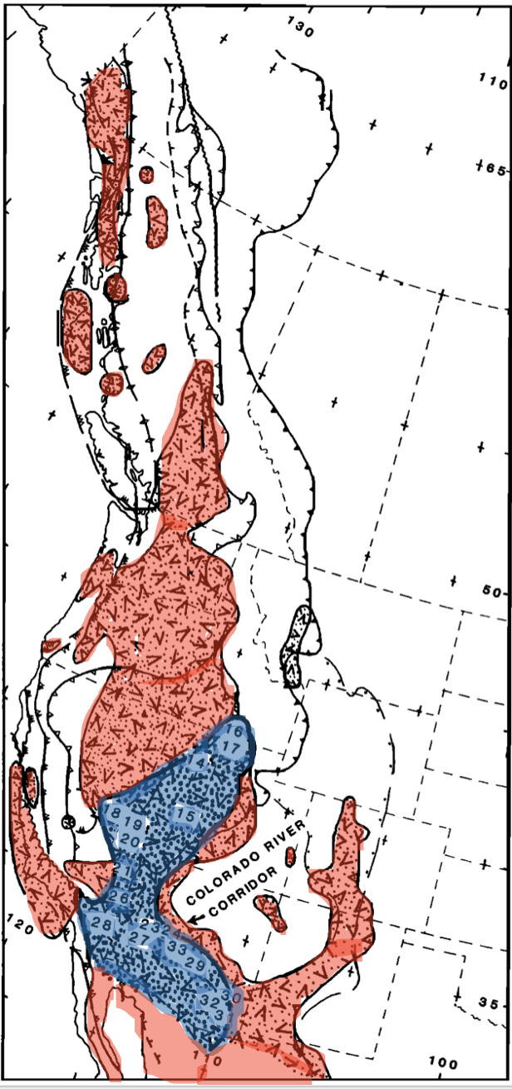
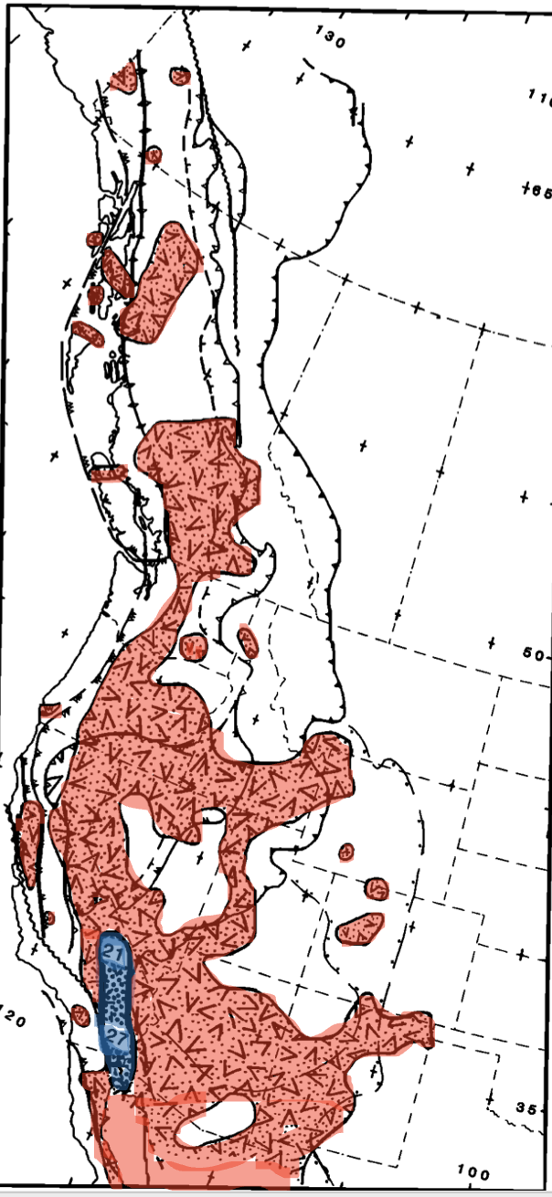
Temporal and Spatial Association of Magmatism and MCC’s
55-40 ma
40-25 ma
25-10 ma
10-0 ma

Slide 3
Temporal and Spatial Association of Magmatism and MCC’s
55-40 ma
40-25 ma
55-40 ma
Large magmatic field developed in Canada and northern states of US
Mainly from Kamloops-Challis-Absaroka Belt
Three MCC’s formed:
British Columbia
Northern Idaho
Nevada
25-10 ma
10-0 ma

Slide 4
Temporal and Spatial Association of Magmatism and MCC’s
55-40 ma
40-25 ma
40-25 ma
Northern magmatic belt subsided
New field developing in the south into the Cascade Arc and Great Basin fields
Ductile extension forming MCC’s occurred in Southern Idaho and Southern Arizona
25-10 ma
10-0 ma

Slide 5
Temporal and Spatial Association of Magmatism and MCC’s
55-40 ma
40-25 ma
25-10 ma
Northern magmatic field and southern magmatic field merged into one continuous and vigorous magmatic belt
Ductile strain continued in eastern Great Basin
Focus of ductile extension was in the Colorado River Corridor
Extension occurred over larger area and is viewed as main period of development of the Basin and Range Structure
Major reorientation of regional stress in Western US shown in MCC
25-10 ma
10-0 ma

Slide 6
Temporal and Spatial Association of Magmatism and MCC’s
55-40 ma
40-25 ma
10-0 ma
Magmatic activity continued throughout entire Cordillera although waning
Expanded east into Basin and Range
Little ductile strain between Death Valley and Salton Sea region of Southern California
Rates of extension over the entire basin and range are inferred to have declined
25-10 ma
10-0 ma

Slide 7
Temporal and Spatial Association of Magmatism and MCC’s
55-40 ma
40-25 ma
Since ~ 60 ma, development of MCC’s has followed the locus of large magma fields
As the magma fields moved southward so did the formation of the MCC’s
Suggest that the MCC’s only form within the largest magmatic belts and fields
Emplacement of magma into the crust raises crustal temperatures and lowers the strength of the crust allowing for existing stresses to deform the crust
Magmatism is a necessary precondition to the formation of MCC’s as it leads to elevated geotherms and consequent weakening of the entire lithosphere so extension and deformation may occur
25-10 ma
10-0 ma

Slide 8
Implications
55-40 ma
40-25 ma
25-10 ma
The Colorado River Corridor acted as “bridge” connecting California to Northern US
Cooler and stronger lithosphere constraining extension to either side
Merge destroyed the “bridge” resulting in reorientation of stress patterns
Rapid westward movement of California as an independent microplate
Coincided with development of San Andreas Transform System
25-10 ma
10-0 ma

