Slide 1
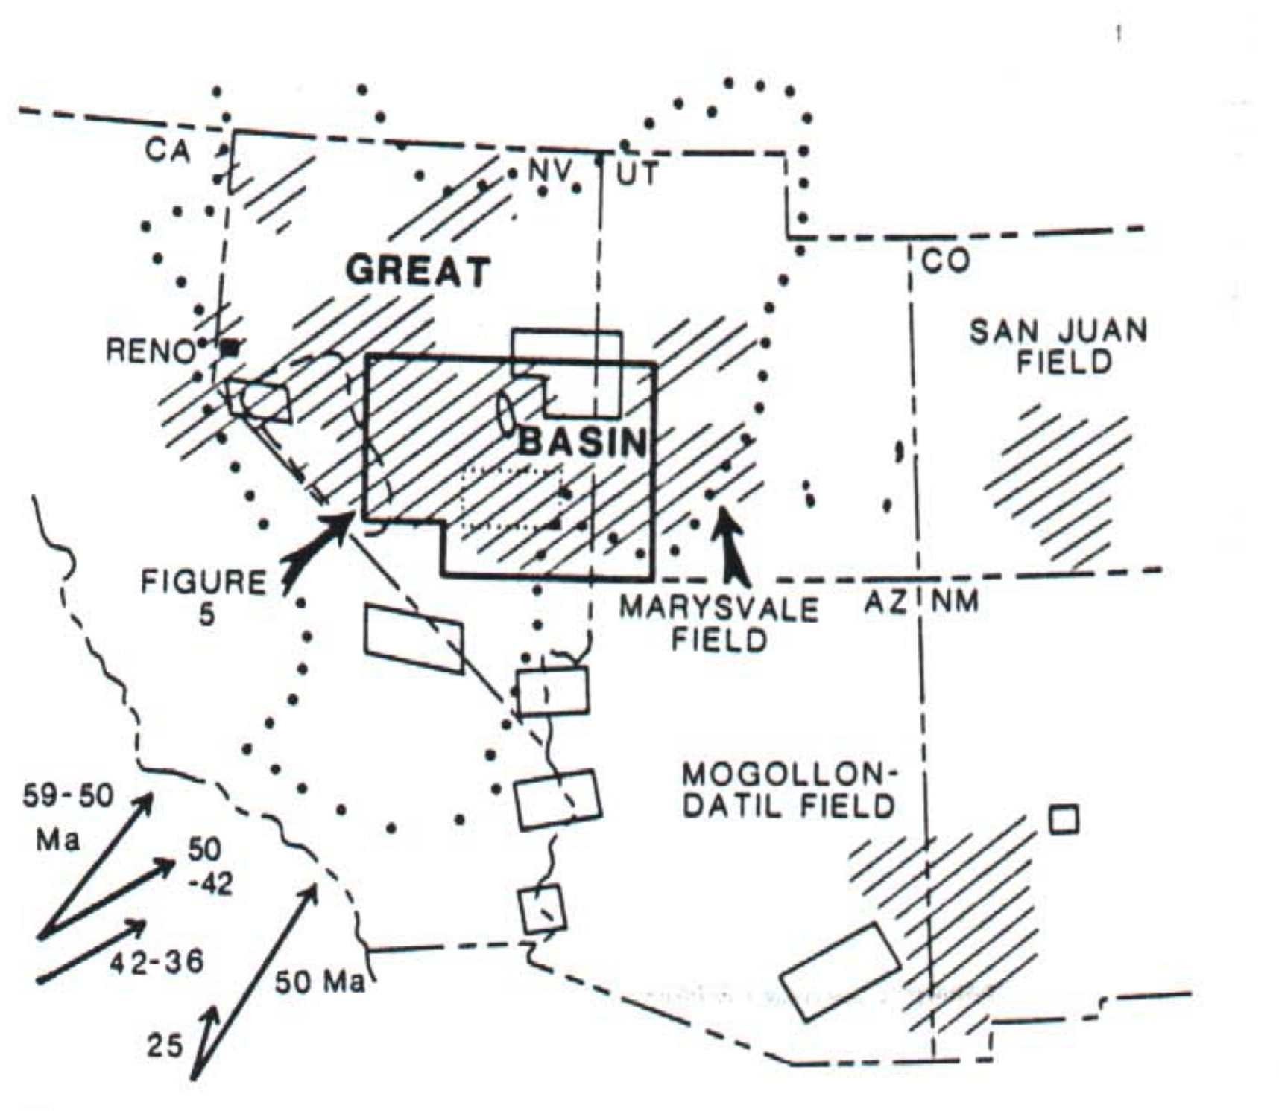
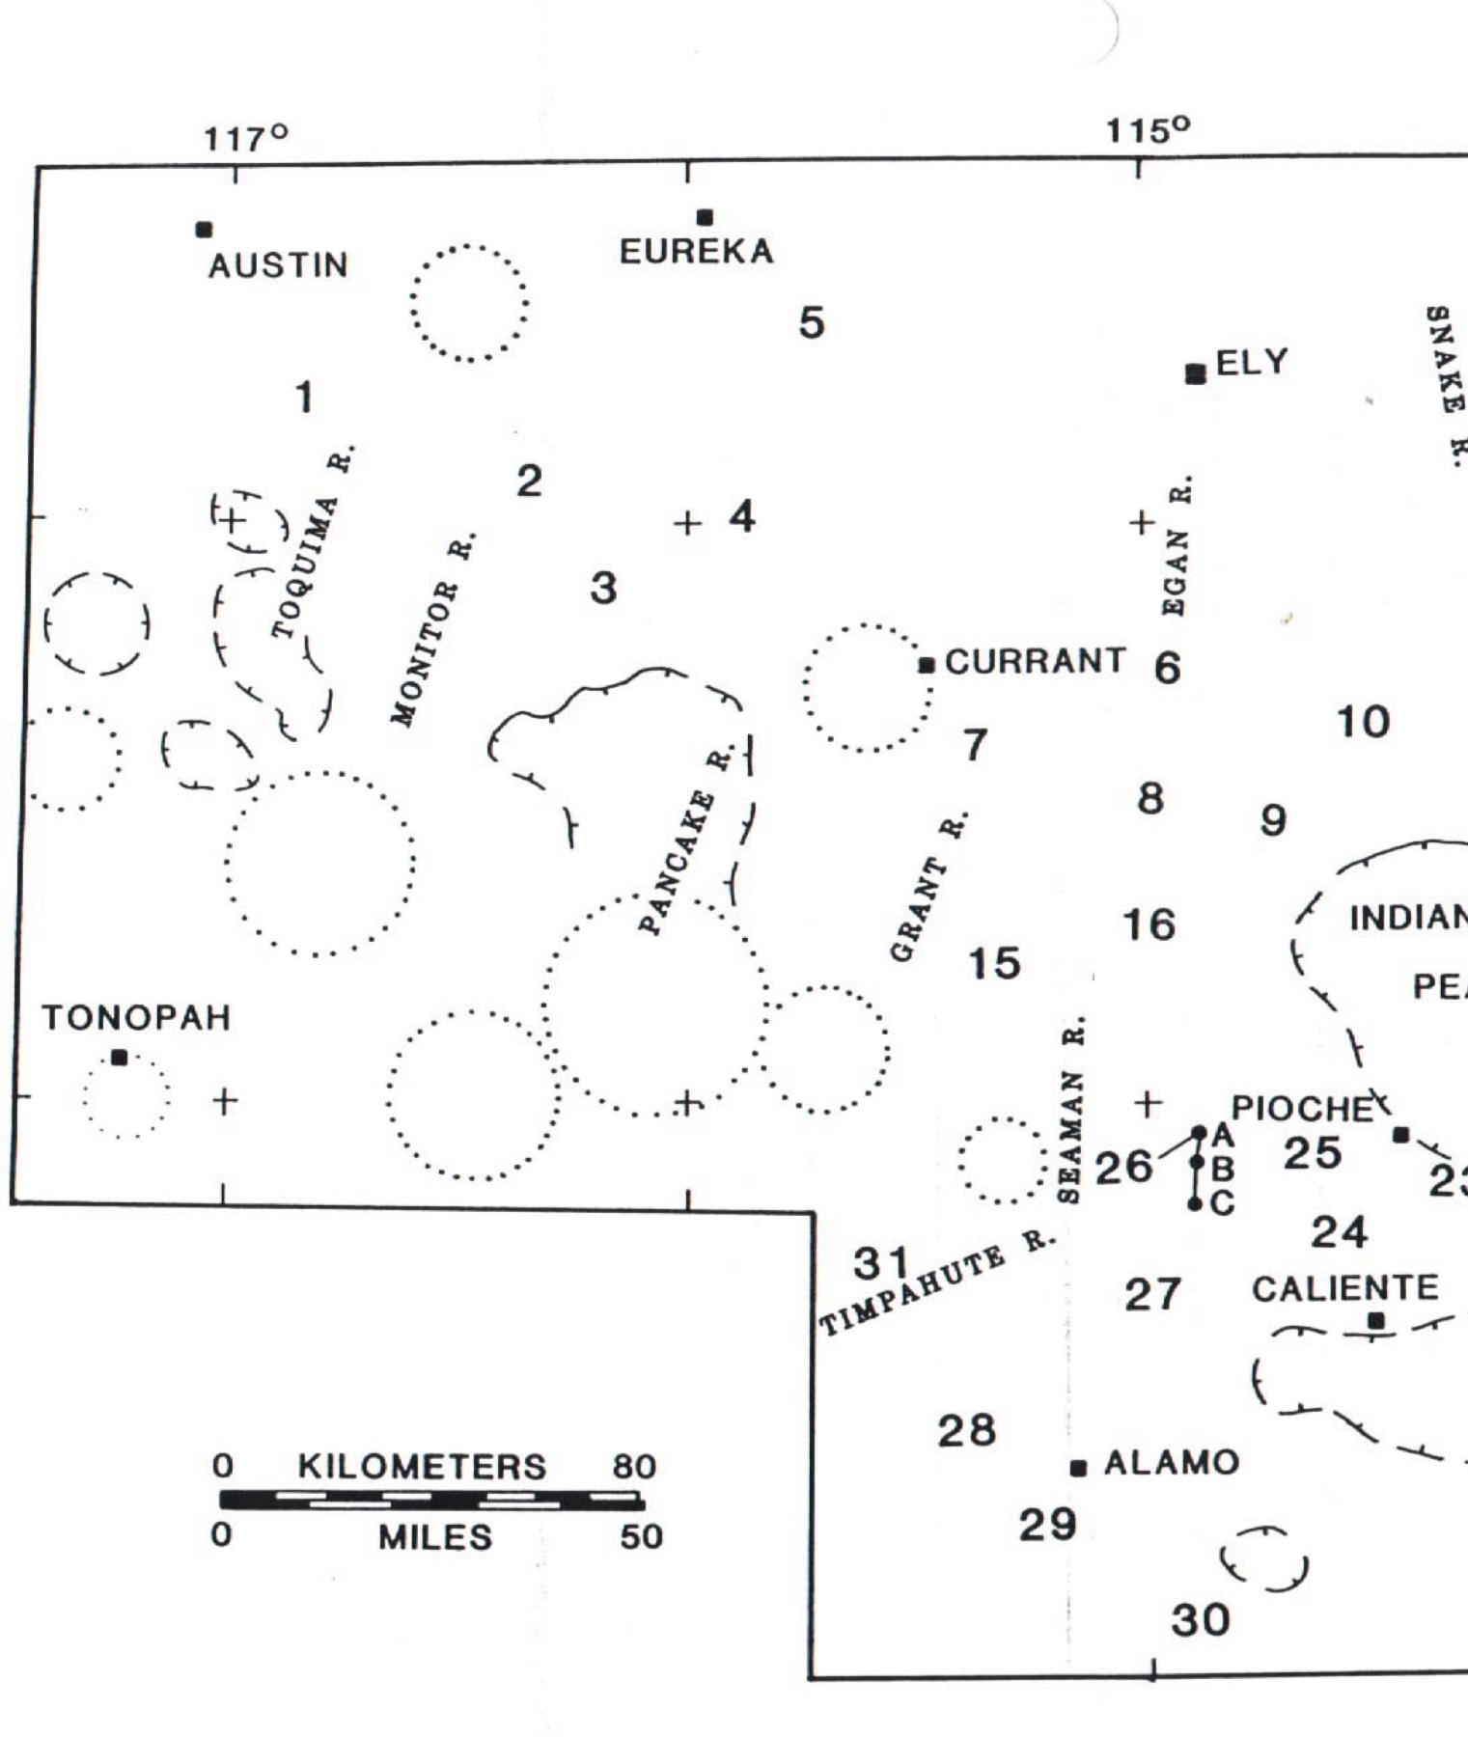
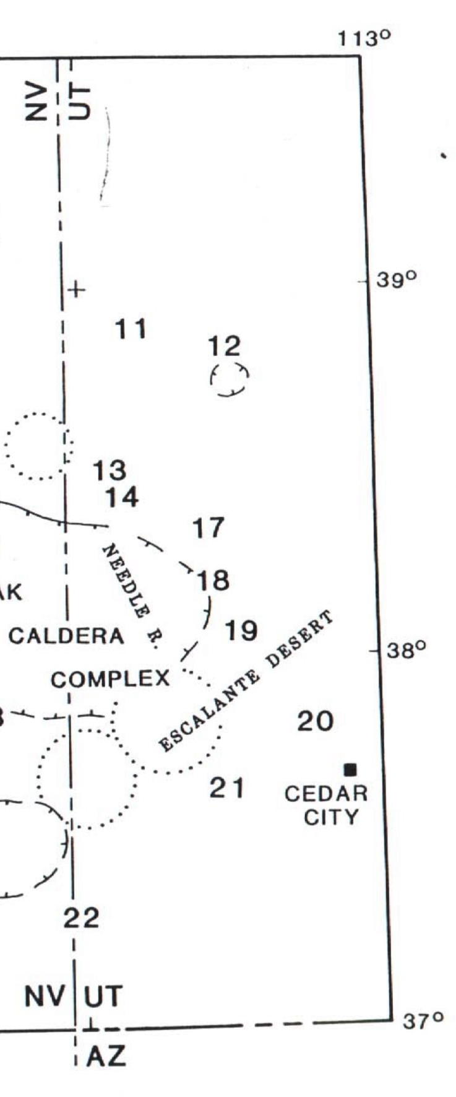
Limited extension during peak tertiary volcanism
Timing and magnitude of tertiary volcanism and extension is not well constrained
This paper uses 31 different stratigraphic columns to gain more insight on the region
Crustal extension was episodic not continuous in tertiary

Slide 2
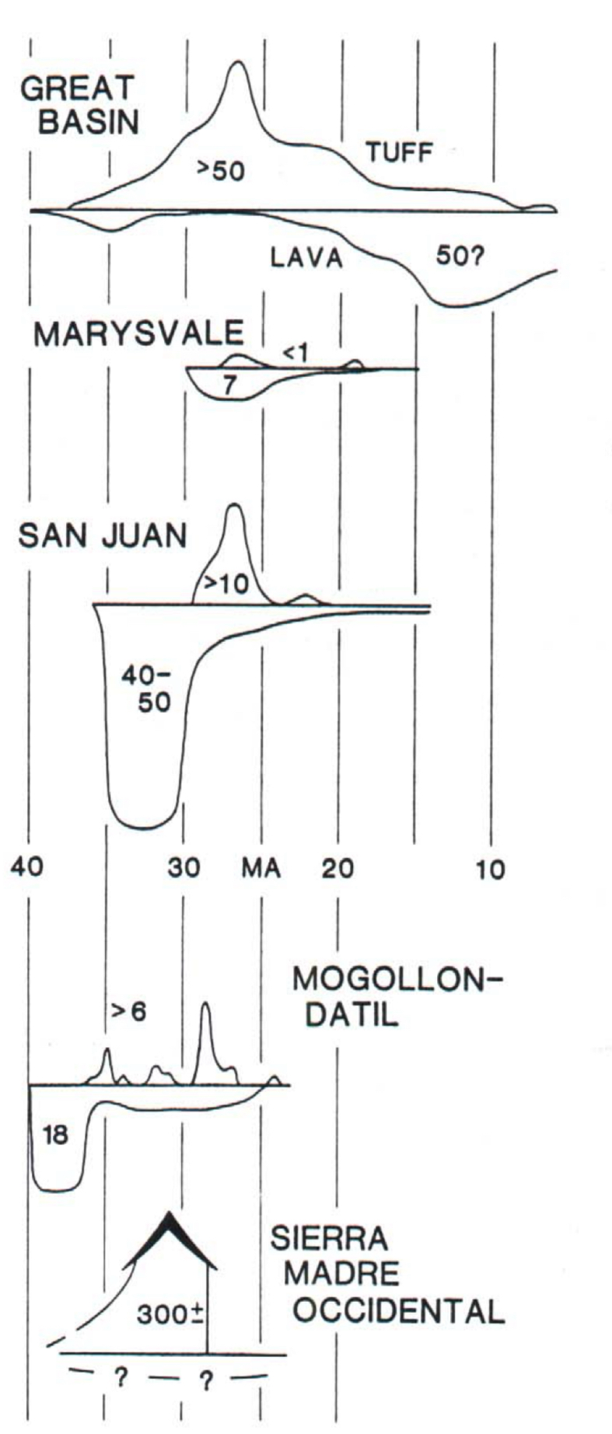
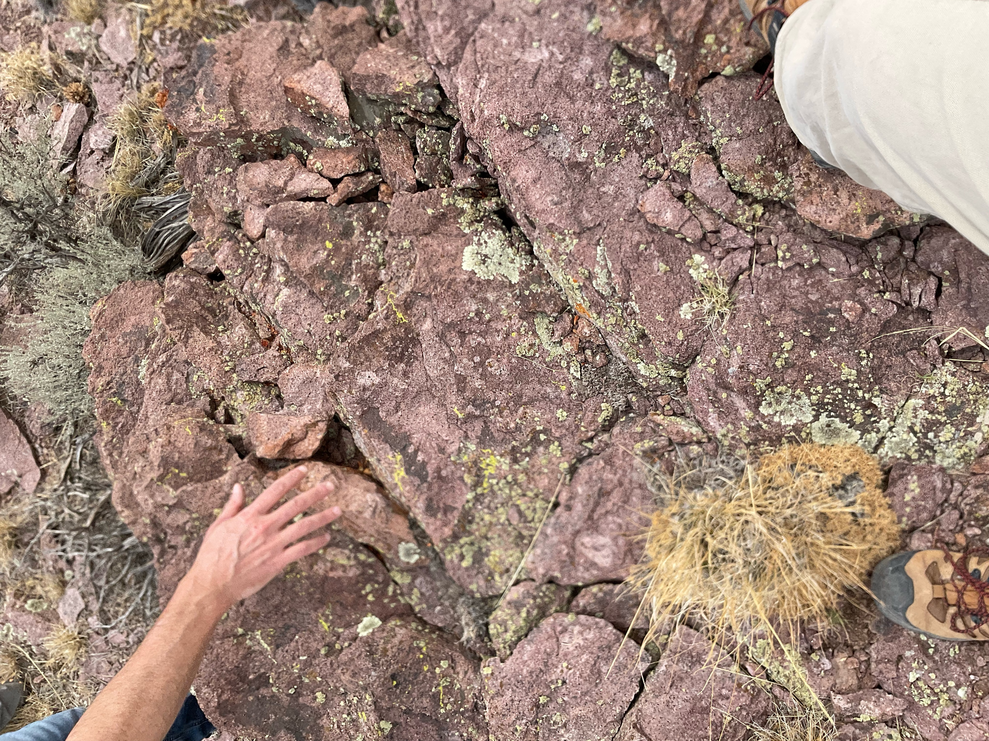
Tertiary Volcanism
Volcanism in Paleocene started north of Great Basin and swept southward around 43 ma
Moved into southern GB by Miocene
Until 31 am magma was high K andesite, dacite, and rhyolitic lava
31-20 ma similar lava was extruded but in higher volume this know as ignimbrite flare up
Following in 20 ma ash flow volcanism lowered and lava flourished

Slide 3
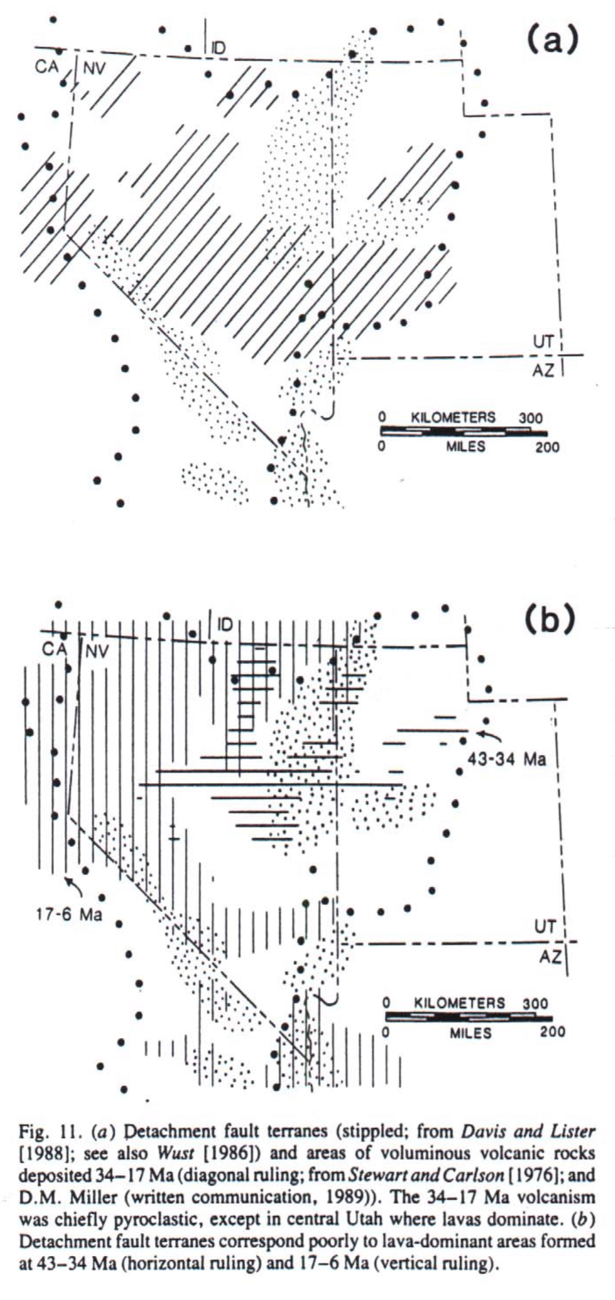
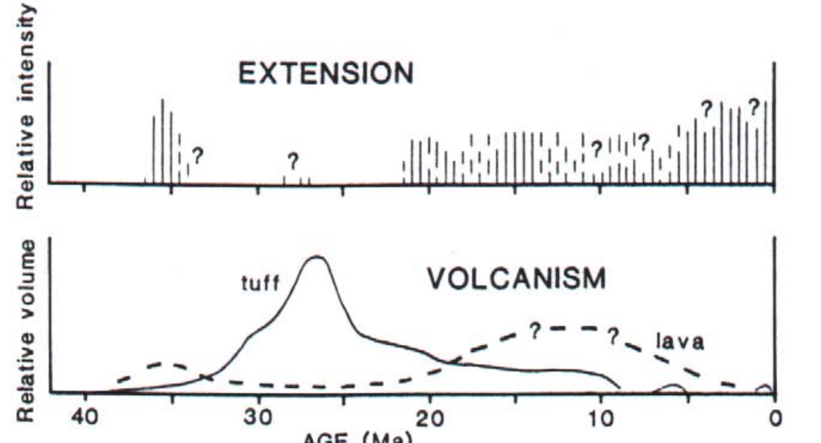
Episodic extension
In SE Nevada most significant extension was before 34-32 ma with more happening after 22-14 ma
Only local extension occurred between these time periods
Poor correlation of volcanic activity and extension over space and time in the Great Basin

Slide 4
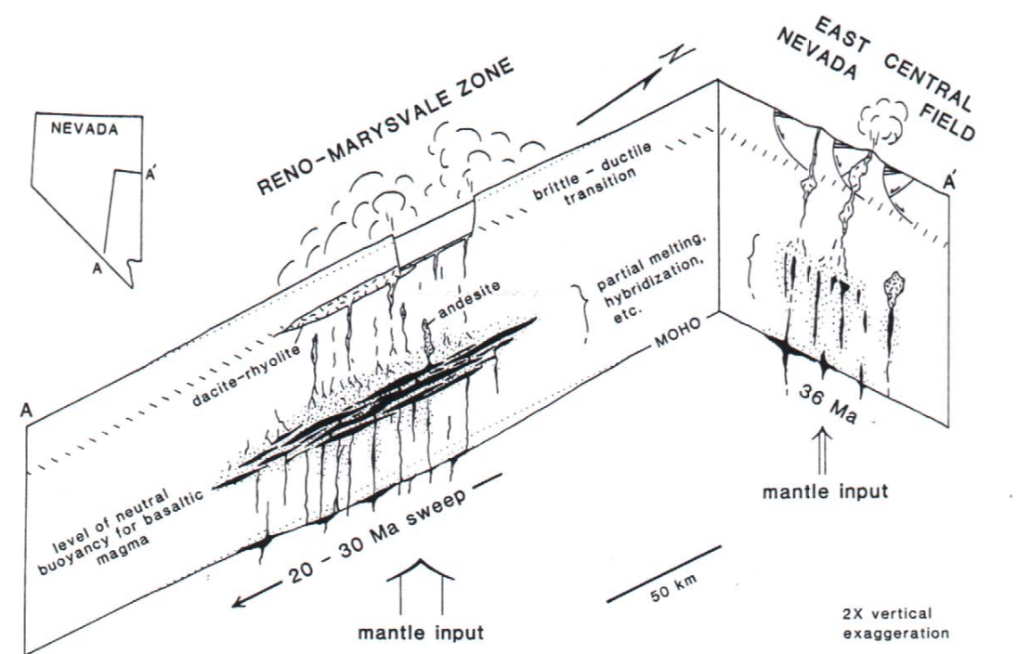
Tectomagnistm
Tectonomagnitsm in the tertiary were related to plate interactions
As subducting plate dip increased caused decelerating southward sweep of volcanic
It stagnated in south central Great Basin in the Reno marysvale corridor around the late oligocene early Miocene
Large silic magma sills were created and caused thousands of cubic km of pyroclastic material

Slide 5
Conclusion
Maximum extension and maximum volcanism in the Great Basin are mutually exclusive
Sills within oligocene early Miocene caused large pyroclastic eruptions
Peak extension was from 34-32 ma with more happening after 22-14 ma

