Slide 1
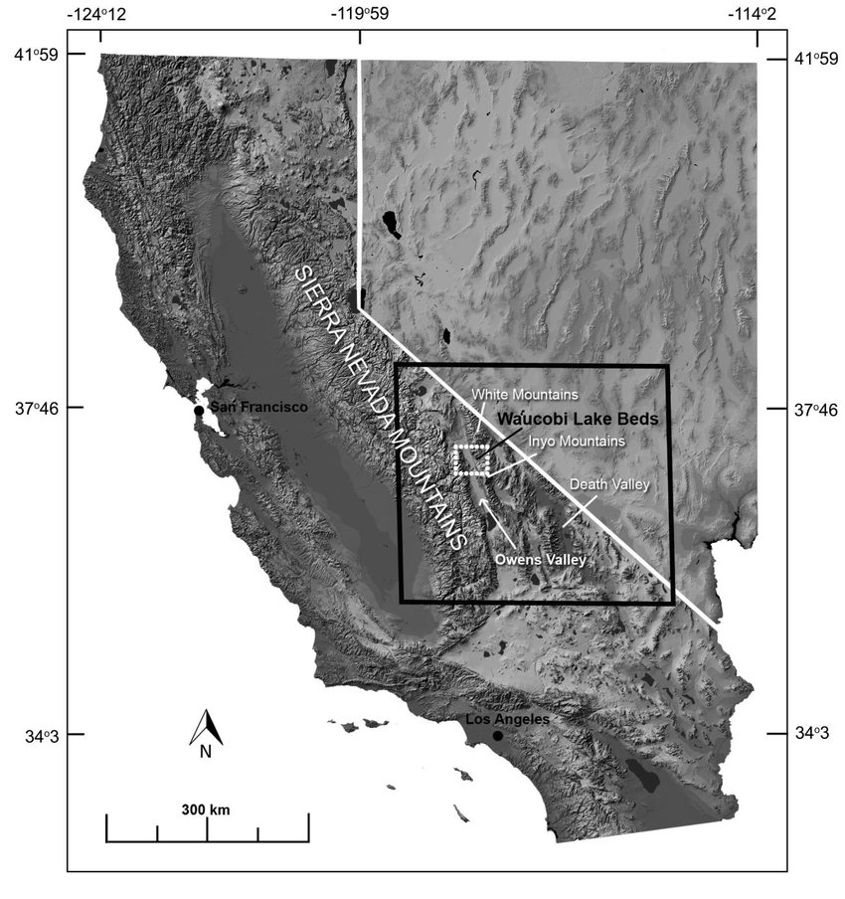
Pliocene-Pleistocene break-up of the Sierra Nevada-White-Inyo Mountains block and formation of Owens Valley
Research by Steven B. Bachman Presented by Ruben Underwood-Aguilar
Google photos: Owens valley

Slide 2
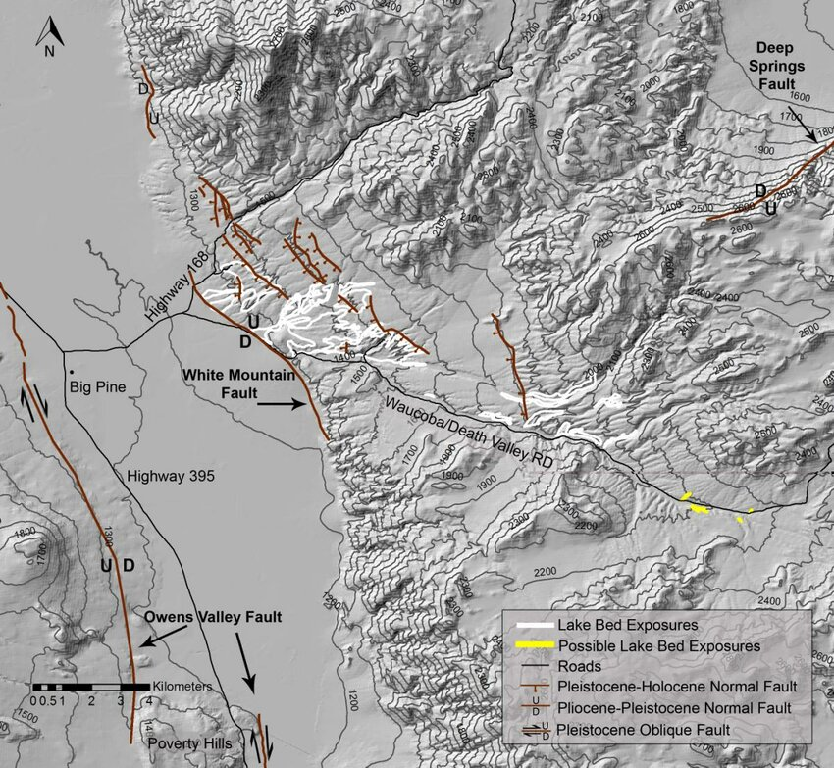
Introduction
Owens Valley is a fault bounded depression between the Sierra Nevada Mtns and the Basin and Range Province
Waucobi lake formed between the Sierra Nevada and White-Inyo Mountains block (SNWIB).
Plio-Pleistocene in age (2.3 Ma from K-Ar dating of gastropods and 2.43-.69 Myo by paleomagnetic work).
8 km long, 4km wide and 100 m thick
ResearchGate.com photos

Slide 3
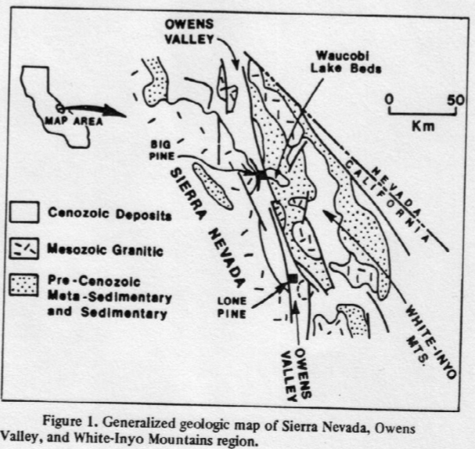
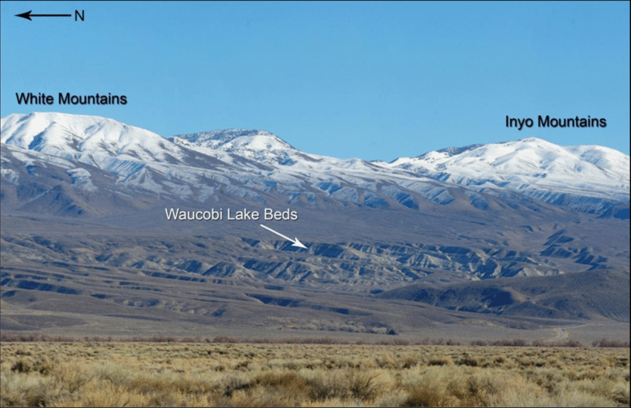
Waucobi Lake contains three sedimentary Facies/episodes
1) Saline-alkaline lacustrine→ depocenter shifted west
2) Fresh water Lacustrine→ depocenter shifted further west
3) Fluvial w/ minor lacustrine→ depocenter in modern day position
Depocenter of lake at any given time determined by:
1) Greatest sediment thickness
2) decrease in grain size basinward
3)shoreline facies around depocenter
Formed in a depression prior to break up of the SNWIB
Good for recording uplift, tilt (valley) and depocenter shift (lake).
Why Waucobi?
Google photos

Slide 4
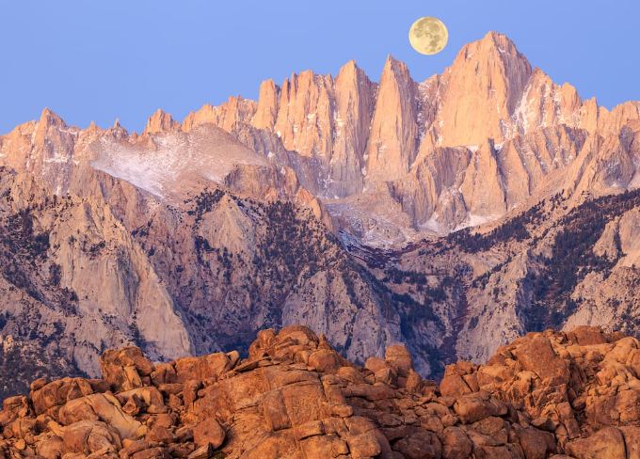
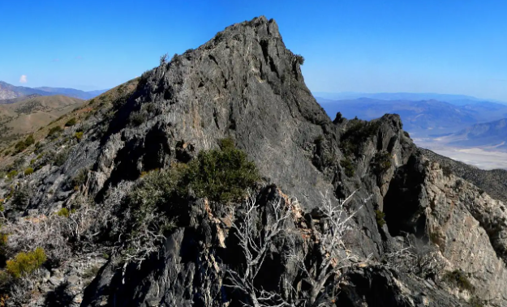
What’s in Waucobi?
Google photos: Sierra Nevada Mtns
Early deposits are primarily granitic material from the Sierra Nevada’s
Later metasedimentary material from the White-Inyo Mtns (WIM). deposited during the late stages of the lower fresh-water episode.
This transition marks the beginning of the basin shift and WIM uplift.
Google photos: Inyo Mtns

Slide 5
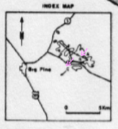
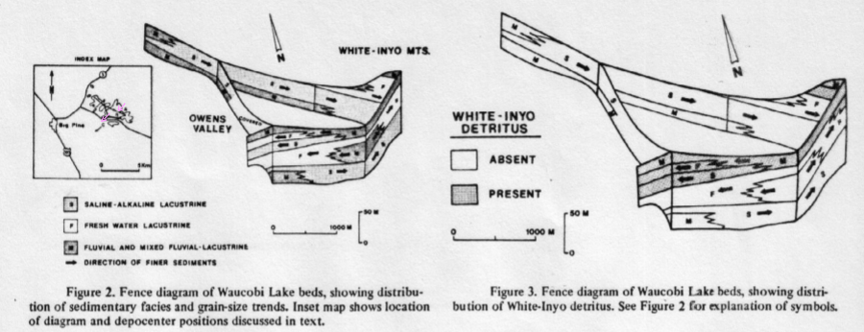
A
B
C

Slide 6
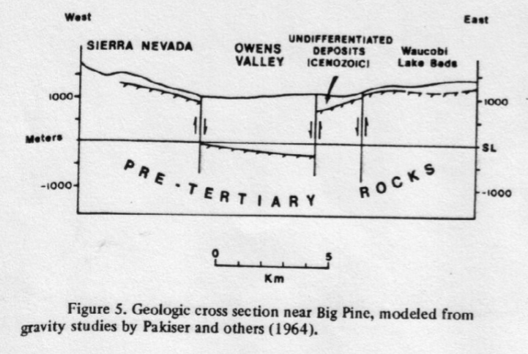
Tilting and Uplift of Waucobi Lake
Constant dip of beds & alluvium (6°), suggest bedrock and seds tilted as a unit
Uplift since deposition:
1100 m elev from lake base to Mtn base.
+100 m when restoring vertical throw on embayment faults
Total of 1200 m of relative uplift between Waucobi embayment and White-Inyo Mtns.
Uplift of WIM to basement:
Consider faulting
2100 m of downfaulting form gravity
modeling (Pakiser et al., 1964)
1100 m vertical displacement from WIM to basement surface under Owens Valley.
Total of 2300 m in relative movement in 2.3 My (1mm/yr)
Base of Lake

Slide 7
Cenozoic Uplift Rates in Eastern Sierra

Slide 8
Summary of late Cenozoic tectonic history
Early-middle Pliocene:
Eastern Sierra region (Sierra Nevada, Owens Valley, Long Valley, and WIM) was a topographic high, with the crest further east than present day w/ westward drainage across todays divide.
Late Pliocene (2.3-2.4 Ma)
Sierran escarpment forms from downward flexure followed by faulting and volcanism
Early Pleistocene (2.3-2.43 Ma)
Waucobi lake forms in a depression of the SNWIB, probably a result of the growing escarpment
Granitic detritus from the Sierra Nevada Mtns dominates early lake deposits.

Slide 9
Summary of late Cenozoic tectonic history cont…
Shortly after lake formation
WIM start to uplift
Waucobi Lake depocenter/basin shifts west
Metasedimentary detritus starts to fill into lake
Fault movement along escarpment continues
Westward tilting of the WIM shifts Waucobi Lake beds to their present-day location.
Present-day topography is carved over 2.3 My as Owens valley downfaulted.
Relative uplift between Owens Valley and WIM may be 2300 m over this period.

