Slide 1
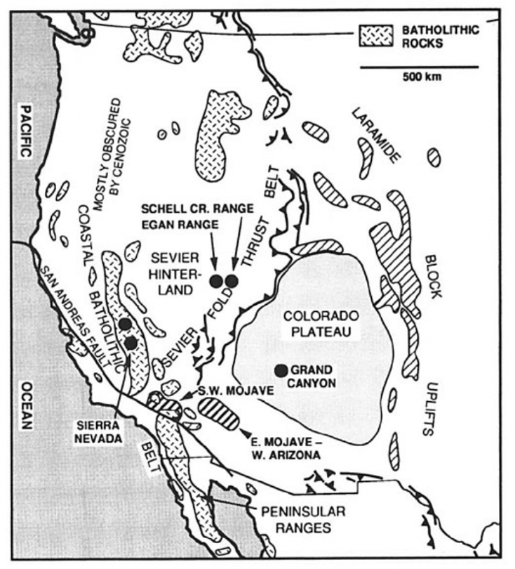
From normal angle subduction to shallow angle subduction…the Laramide Orogeny
1991
Normal angle subduction until ~80 Ma caused volcanism. The geothermal gradient was relatively hot.
At ~80 Ma, magmatism migrated east as much as 1000 km, attributed to shallowing of the slab.

Slide 2
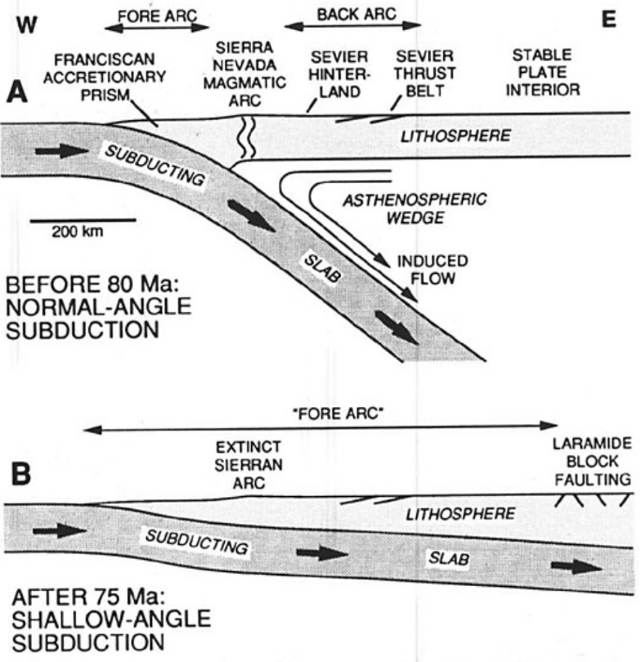
The Model
Hot asthenospheric mantle wedge, hot geothermal gradient. Modeling suggests slab was 120 km beneath the Sierras.
NO asthenospheric mantle wedge, cold geothermal gradient. Modeling suggests slab was 35-60 km below Sierras.

Slide 3
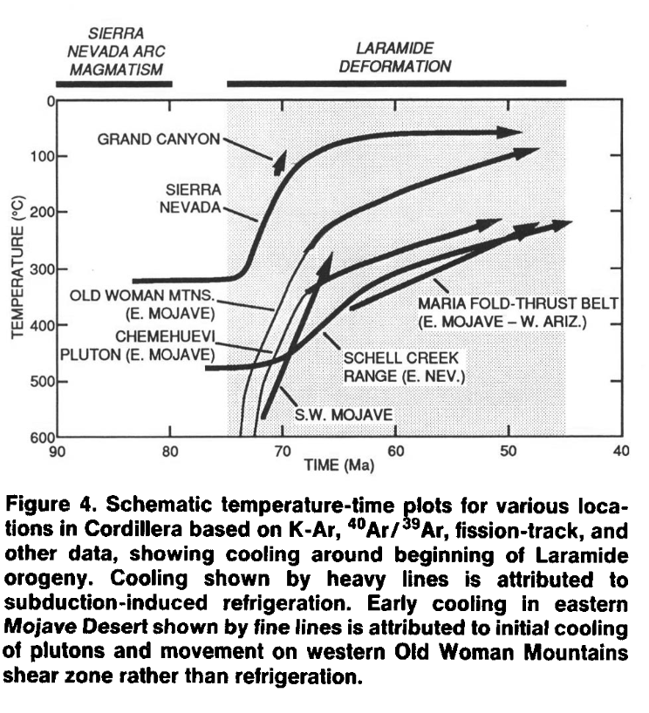
The Evidence: Biotite K-Ar, Ar/Ar, and fission track
SIERRAS
Biotite K-Ar ages suggest high geothermal gradient until 70-75 Ma, then decreased by 20% over the next 10 Ma.

Slide 4
The Evidence: Biotite K-Ar, Ar/Ar, and fission track
GREAT BASIN
Previous research by Gans and Miller indicate peak temps of B&R during the Cretaceous (90-75 Ma)
12km paleodepth:
Biotite and muscovite Ar/Ar age of 63-55 Ma
Zircon fission track age is 52 Ma
6-8 km paleodepth:
Ar/Ar ages indicate slow cooling form 80-40 Ma
<80Ma intrusions have strongly quenched margins indicating cooler crustal temperatures than >80Ma intrusions of the same paleodepth.

Slide 5
The Evidence: Biotite K-Ar, Ar/Ar, and fission track
MOJAVE & WEST ARIZONA
W. Mojave hornblende and biotite have K-Ar ages between 75 and 65 Ma.
Evidence of late Cretaceous cooling form 530-<330 C.
Ar/Ar ages of the Pelona schist are 75-48 Ma.
E. Mojave and W Arizona, Ar/Ar ages are between 65-50 Ma (later)
Upper Crustal (during the late Cretaceous) rocks indicate cooling between 66-62Ma form apatite fission track data.
Old Woman Mountains data is an exception b/c of local late Cretaceous unroofing

Slide 6
The Evidence: Biotite K-Ar, Ar/Ar, and apatite fission track
COLORADO PLATEAU
Apatite fission track dating at the Grand Canyon indicates cooling at 70 Ma
Only cooled from 130 to 90ish C
This cooling could be attributed to uplift and unroofing that created the Colorado Plateau monoclines, however cooling due to slab angle should also be considered as an alternative.

Slide 7
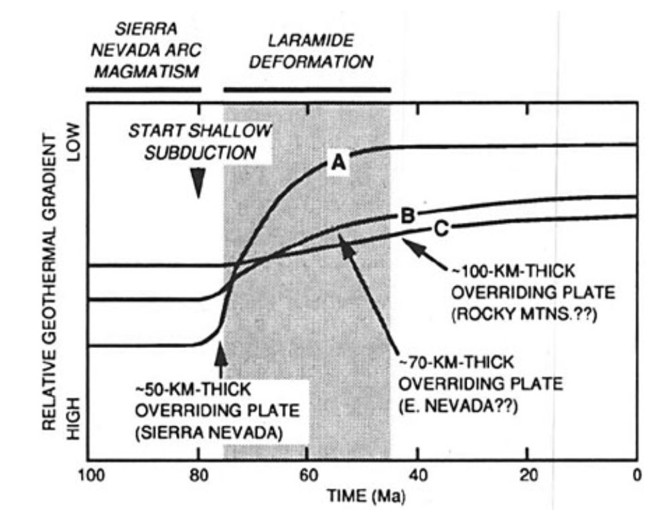
Conclusion
Modeling data and theory suggest flat slab subduction cooled the lithosphere in the western Cordillera.
Thermal history from the Sierra Nevada, Great Basin, Mojave and Colorado Plateau provide evidence of cooling.
The thicker the crust, the less the geotherm will affect crustal level rocks that we can measure.
Some of the cooling to the east could be attributed to unroofing so it is important to consider the options.
No large Laramide-age normal fault systems to accommodate unroofing in the study areas (except Old Woman Mountains).

