Slide 1
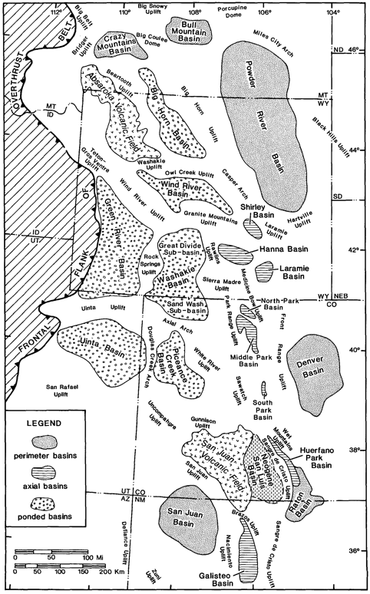
Paleographic and Paleotectonic Setting of Laramide Sedimentary Basins in the Central Rocky Mountain Region
Dickinson et al., 1988
Late Cretaceous and Early Tertiary Laramide deformation produced complex tectonic and paleogeographic patterns
Previously occupied by a broad foreland basin of laterally continuous marine facies
Laramide deformation broke up foreland province into local basins of non-marine deposits
Laramide uplifts and basins formed simultaneously
Sediments in the basins are principal records of Laramide orogeny

Slide 2
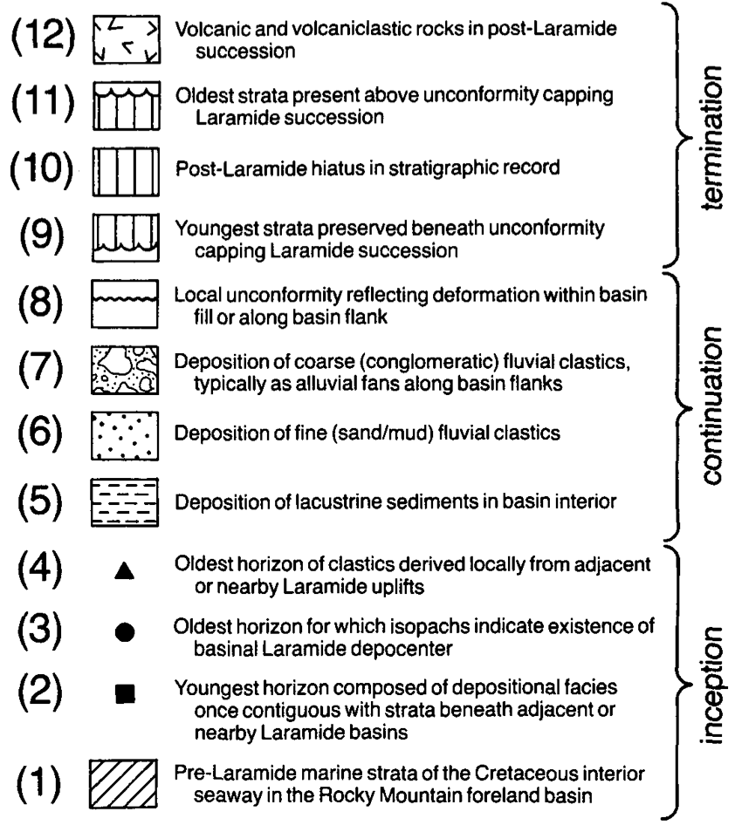
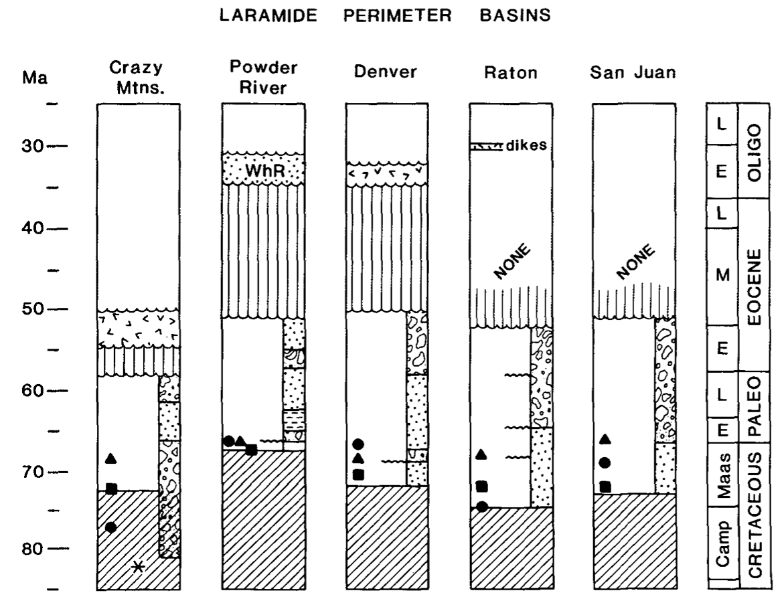
Perimeter Basins
Broad bowls with gentle relief along basin flanks
Mainly received stream deposits
Comprised of volcaniclastic detritus and stream deposits

Slide 3
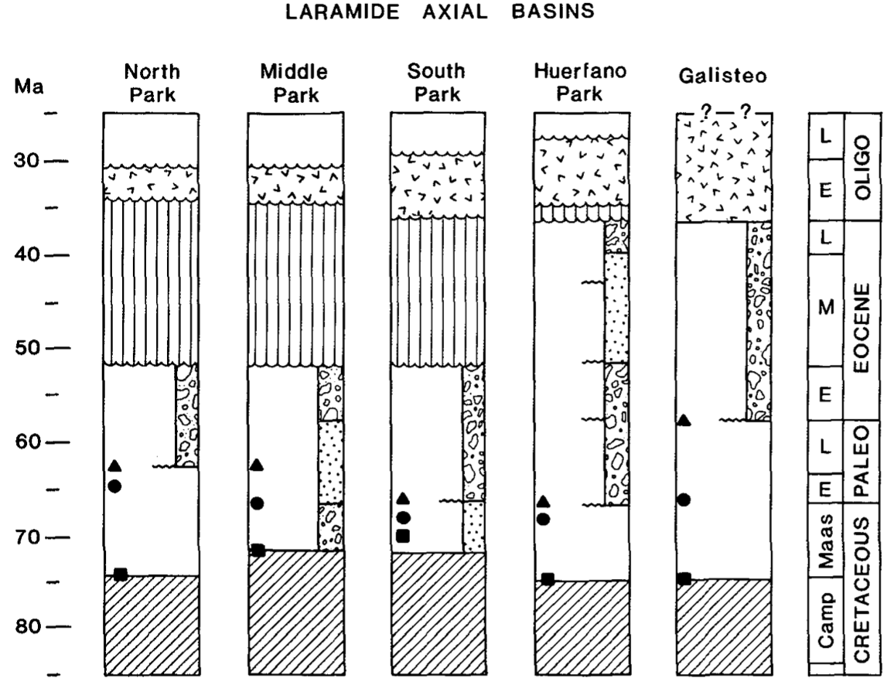
Axial Basins
Relatively small in size with high structural relief on basin flanks
Mainly comprised of conglomerate facies

Slide 4
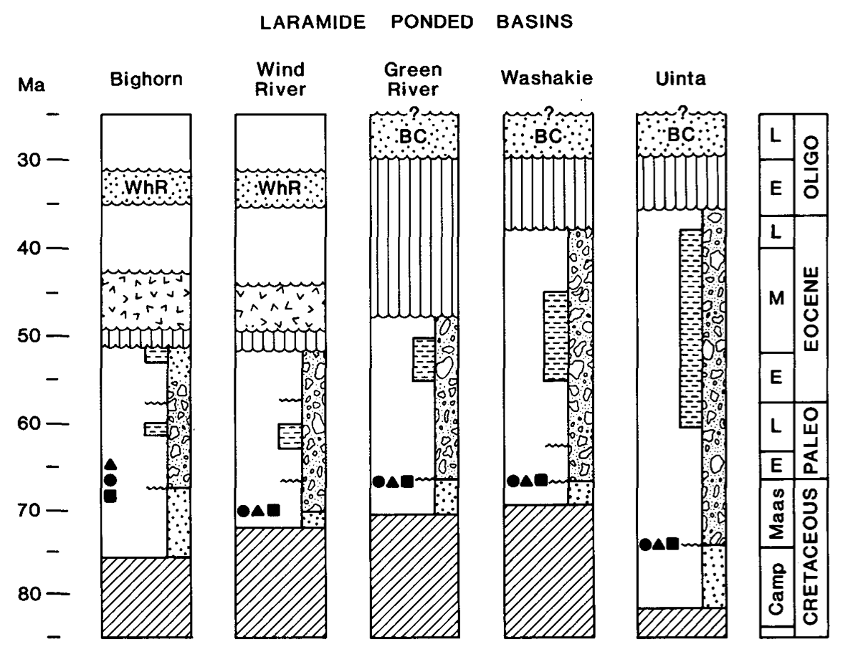
Ponded Basins
Regional sediment traps
Comprised of thick sequences of organic rich lacustrine shale and calcareous strata

Slide 5
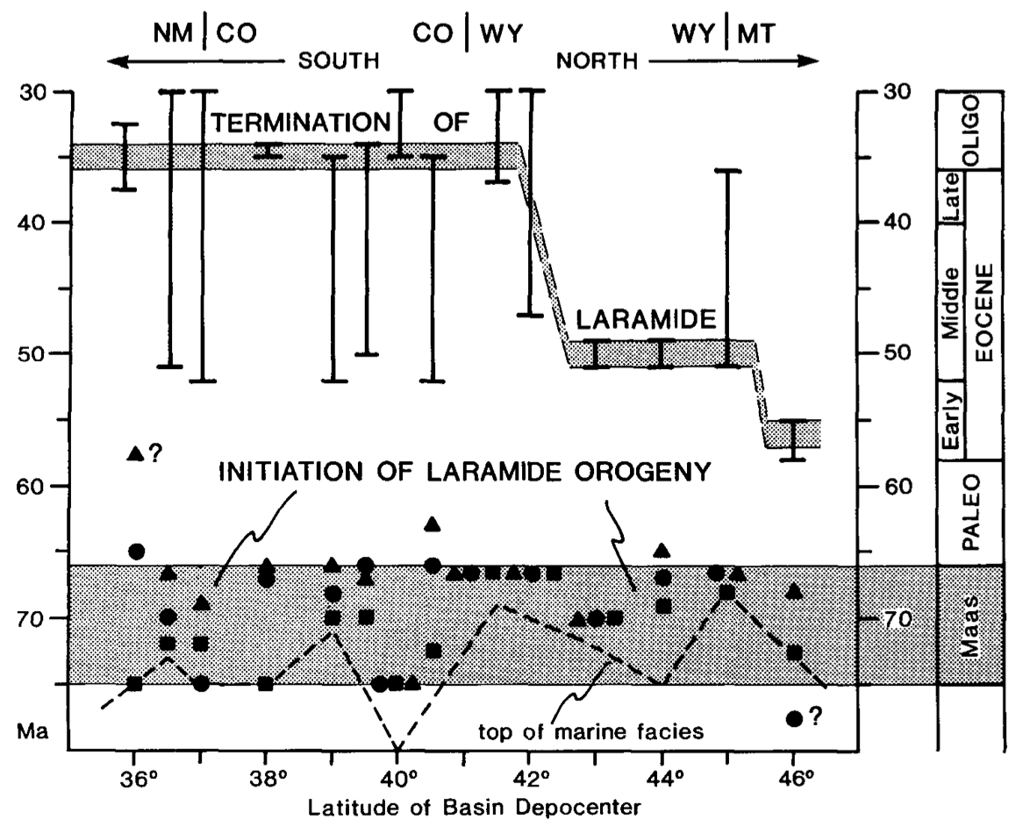
Laramide Orogeny Timing
Onset: 65 – 75 Ma
Termination in North: 32 - 40 Ma
Termination in South: 50 -55 Ma

Slide 6
Laramide Orogeny Causes
Result of shallow subduction under the Laramide province
Traction of underlying subhorizontal slab caused crustal thickening and therefore uplift within the Laramide Province

