Slide 1
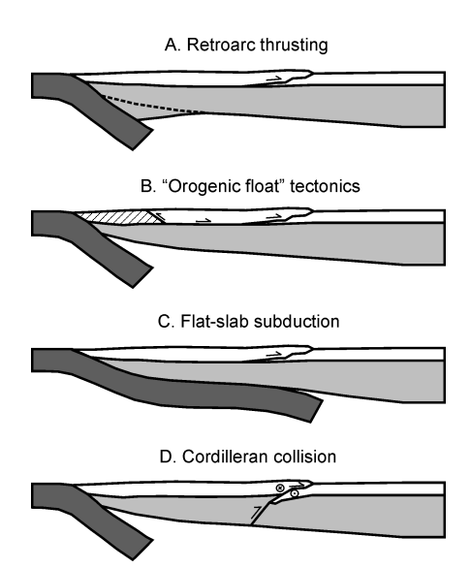
Laramide orogeny: Driving forces and post Laramide relief in Rocky Mountains
Laramide orogeny is the Late Cretaceous to Paleocene (80 to 55 Ma) orogenic event that gave rise to the Laramide block uplifts in the United States
Proposed mechanisms for the Laramide
Flat-Slab Subduction: shallow subduction caused deformation far inland
Retroarc Thrusting: involves the compression and thrusting of the continental crust due to the convergence of tectonic plates
Orogenic Float Tectonics: crustal blocks floated on a ductile lower crust.
Cordilleran Collision: proposes that oblique convergence and transgressional forces played a significant role in the orogeny

Slide 2
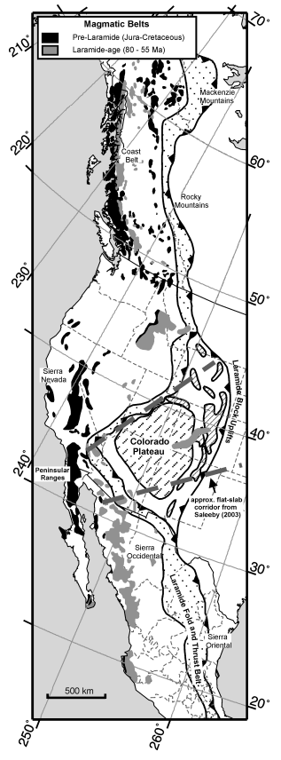
Driving Forces
convergence rate, slab age, average dip to 100 km, and absolute motion of the upper plate
None of the proposed mechanisms for driving Laramide orogenesis explain the geometry, timing, or extent of this inboard continental scale orogeny

Slide 3
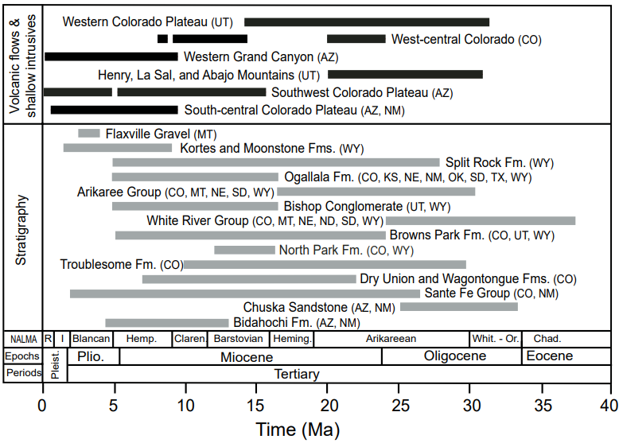
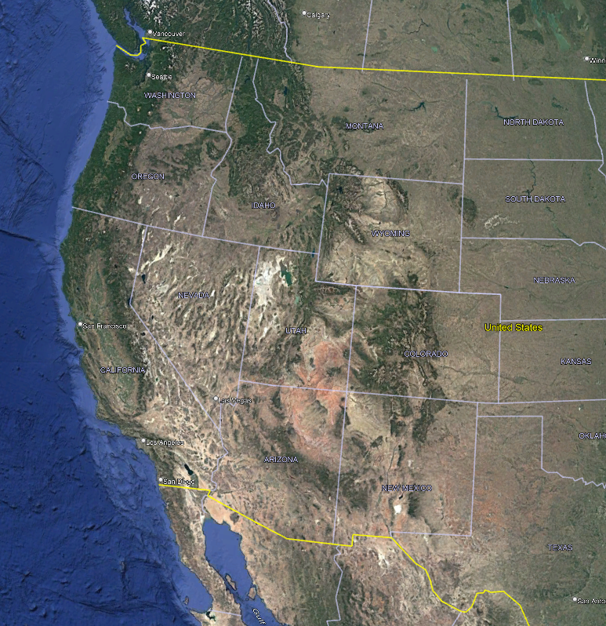
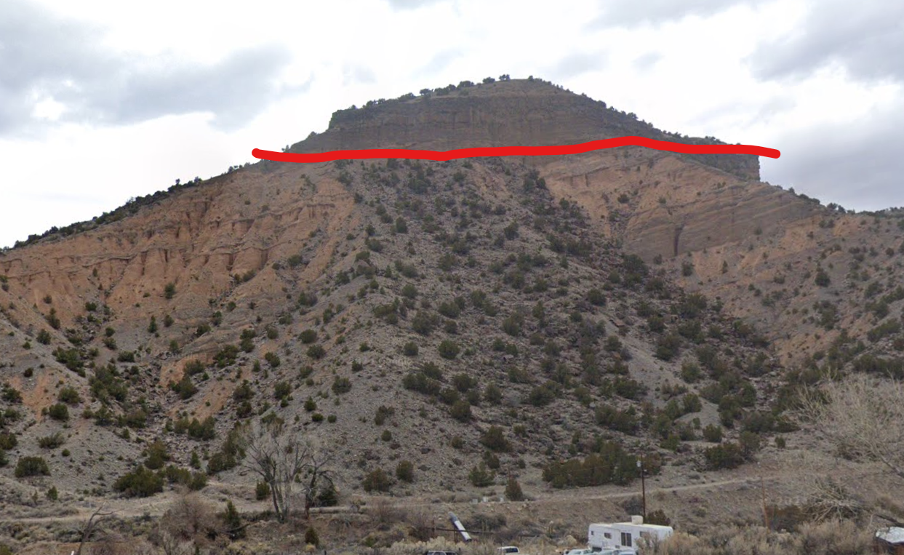
Post Laramide Relief
Rocky Mountain orogenic plateau has the highest mean elevation and topographic relief in the contiguous United States
mean altitude exceeds 2 km above sea level
Post-Laramide development of relief is thought to either result from tectonic activity or climatic change
Post-Laramide basin filling occurred due to slow subsidence during the Oligocene to Miocene periods. Incision into this basin fill began in the late Miocene and continues today
Notes:
(1) analyzing the magnitude of mid-to-late Cenozoic deposition in basins, which records the reduction of regional relief; (2) projecting the maximum elevation of preserved basin fi ll deposits to reconstruct a reference surface, or envelope map, that coincides with the transition from net accumulation to net degradation; and (3) calculating the difference between the reference surface and the modern topography in order to map the magnitude of late Cenozoic incision across the entire region

Slide 4
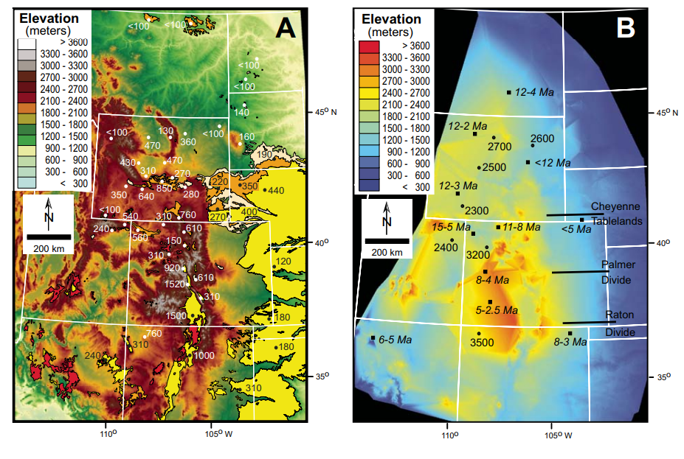
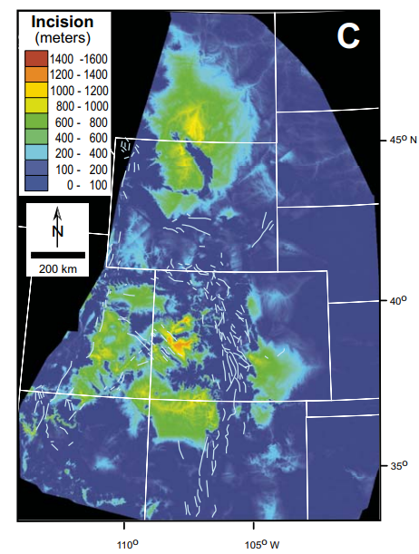
Reconstruction of Basin Fill
Used basin fill remnants to determine the minimum depositional thicknesses and original extent of the fill deposits across the Rockies and western Great Plains

Slide 5
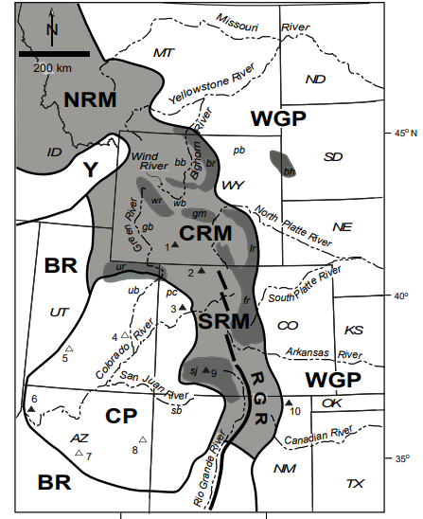
Overview
None of the mechanisms for the Laramide explain geometry, timing, or extent of this inboard continental scale orogeny
Laramide Orogeny ends 55 ma
Low amount of subsidence from end of Laramide to 8 ma
Incision develop 8 ma to the present
there is no fundamental disparity between estimates of paleo elevation at the end of the Laramide orogeny and the cumulative late Cenozoic tectonic history of the Rocky Mountain region
Notes:
the combination of post-Laramide subsidence followed by regional surface uplift reduces the net magnitude of surface elevation change since Laramide time

