Slide 1
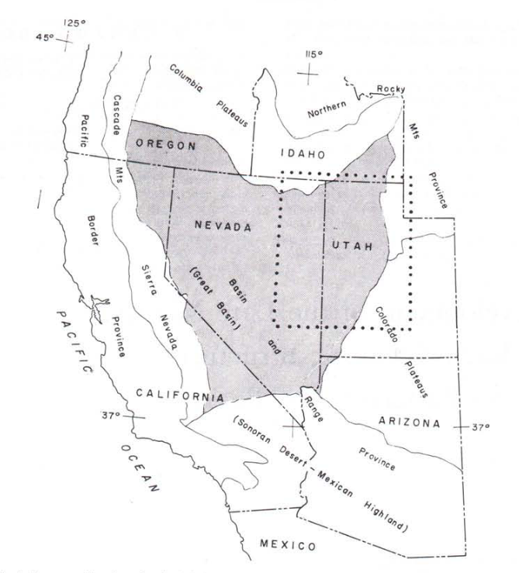
Development of the late Mesozoic to Early Cenozoic Structures of the Eastern Great Basin Hose and Danes 1973

Slide 2
Introduciton
Western zone
Low-angle faults with large displacements developed during the late Mesozoic and early Cenozoic
The great basin divided into an E and W structural zone
Eastern portion developed in literature as: Rocky Mountain–Great Basin Thrust arc→ Zone of Laramide thrusting→ Sevier Orogenic Belt
Eastern Zone

Slide 3
Allocthon Vs Autochton

Slide 4
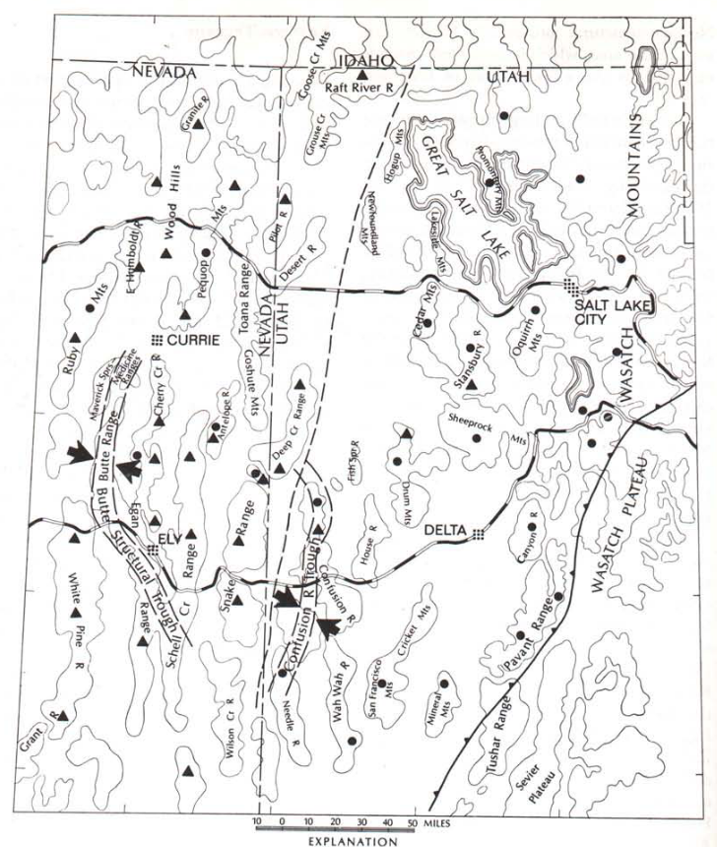
Eastern vs Western Deformational zones
West
Younger rocks placed on older (Normal faults Thin crust))
Allochthon:
Normal Faults→ Horst and Grabens
Lacks Faults
Autochthon:
Metamorphosed
East
Older rocks placed on younger (thrust faults thicken crust)
Allochthon:
Steep Frontal Faults
Broadly folded
Autochthon:
Overturned Recumbent fold (Near Wasatch Range)
Thrust Fault that underlays Paleocene Seds in Allochthon and other thrusts cut Cretaceous rocks → Orogeny Occurring in Cretaceous to early Paleocene.

Slide 5
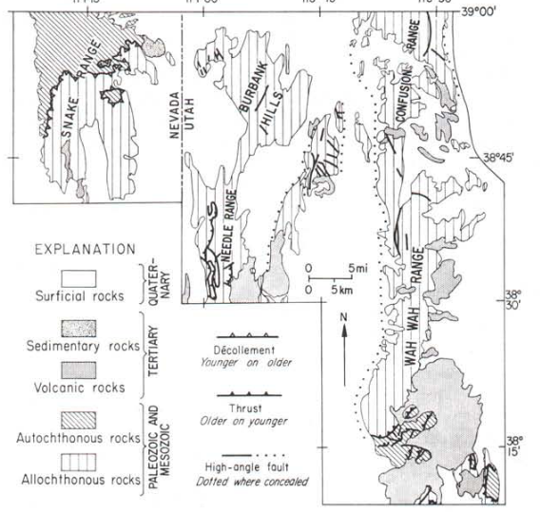
Misch (1960) suggests the allochthon in the east is coextensive with those in the W
Snake Range detachment goes under Confusion Range to E
Bases for this studies resolution for the differences in W and E zones.

Slide 6
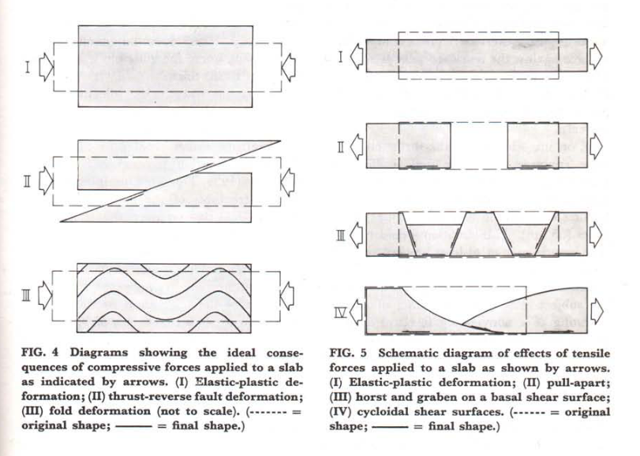
Trouble explaining the nature of the relative movement of the Autochthon and Allochthon
Gravity's role was previously rejected but Hose brings it back! assumed erosion of basement must occur.
Fig 4) II an III would require brittle deformation of autochthon. Also, compressional features lack in the W.

Slide 7
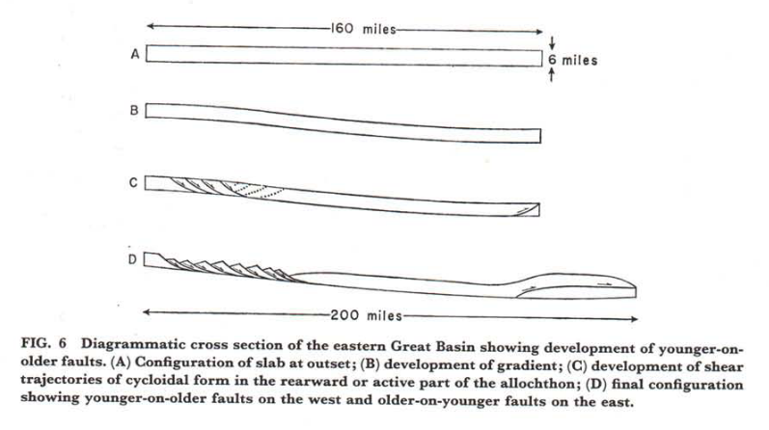
Model and sequence of events
Hose proposes structures in the east and west zones, initiated from horizontal tension and vertical compression.
B) Indeterminate tectonic process puts W relatively higher than E.
High Fluid pressure near bas of slab allows slip on a low-angle fault
Compression vert. in W and horiz. in E.
C) High angle faults developed and shear trajectories form
D)Movement of block, down trajectory, due to gravity.

Slide 8
Conclusion
40 mi of movement on Low-angle fault
Gravity + gradient+ Fluids allows for the development of rigid blocks (Allochthons) to slide along basement rock, creating the characteristic extensional faulting in easter Nevada and thrusting in SE Utah. (i.e. the Great Basin)
But…what the heck causes the gradient?

