Slide 1
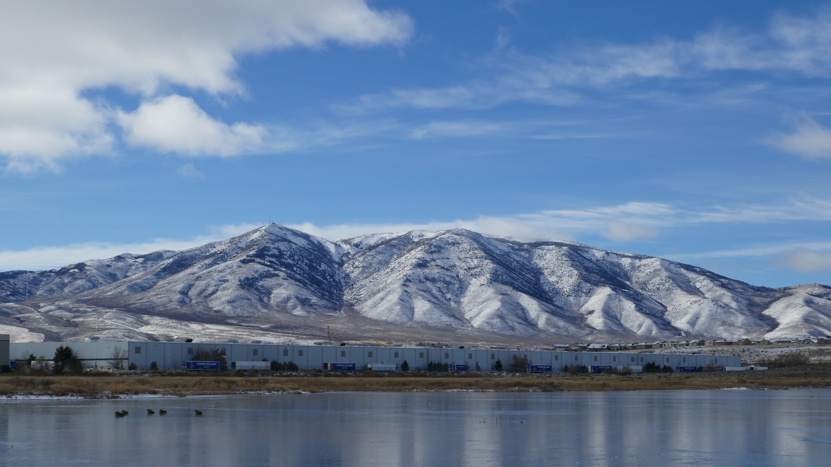
Evolution of a Late Mesozoic Back-Arc Fold & Thrust Belt, Northwestern Great Basin, USA
Paper by Oldow (1984)
Presentation by Solomon Feinstein

Slide 2
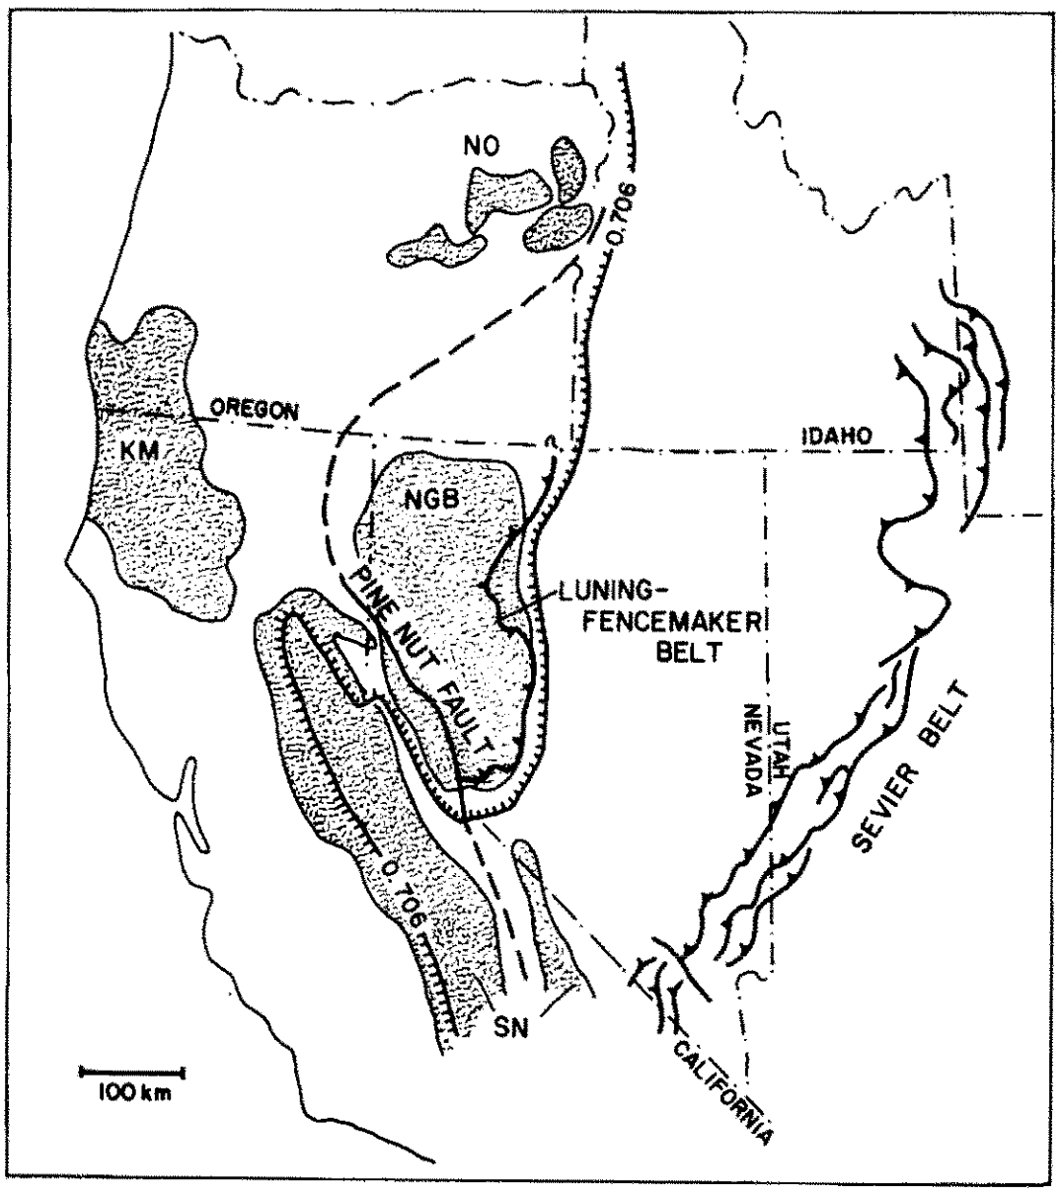
Introduction
The Luning-Fencemaker Fold & Thrust Belt was active from the Mid-to-Late Jurassic to the Early Cretaceous in Northwestern Nevada
It occurred in a back-arc basin east of the Sierra Nevada, immediately west of the 0.706 Strontium Line- the line that demarcates Continental Basement in western North America
Did the crust form in a marginal basin associated with North America, or was it an exotic oceanic-arc terrane accreted in the Permo-Triassic?
So what specifically happened during the LFFTB? Let’s find out…

Slide 3
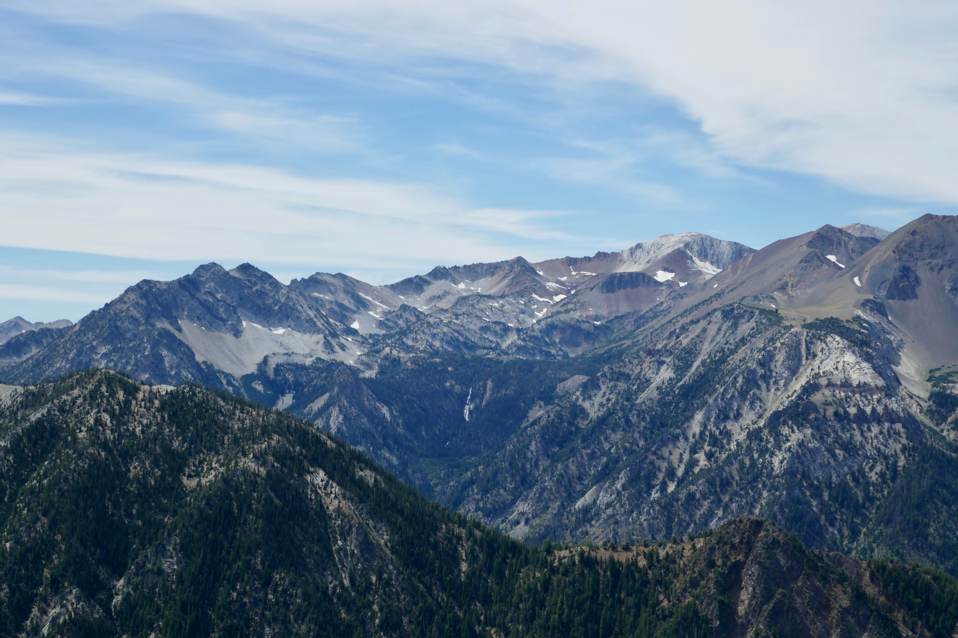
Detour to Wallowa Mountains, Oregon

Slide 4
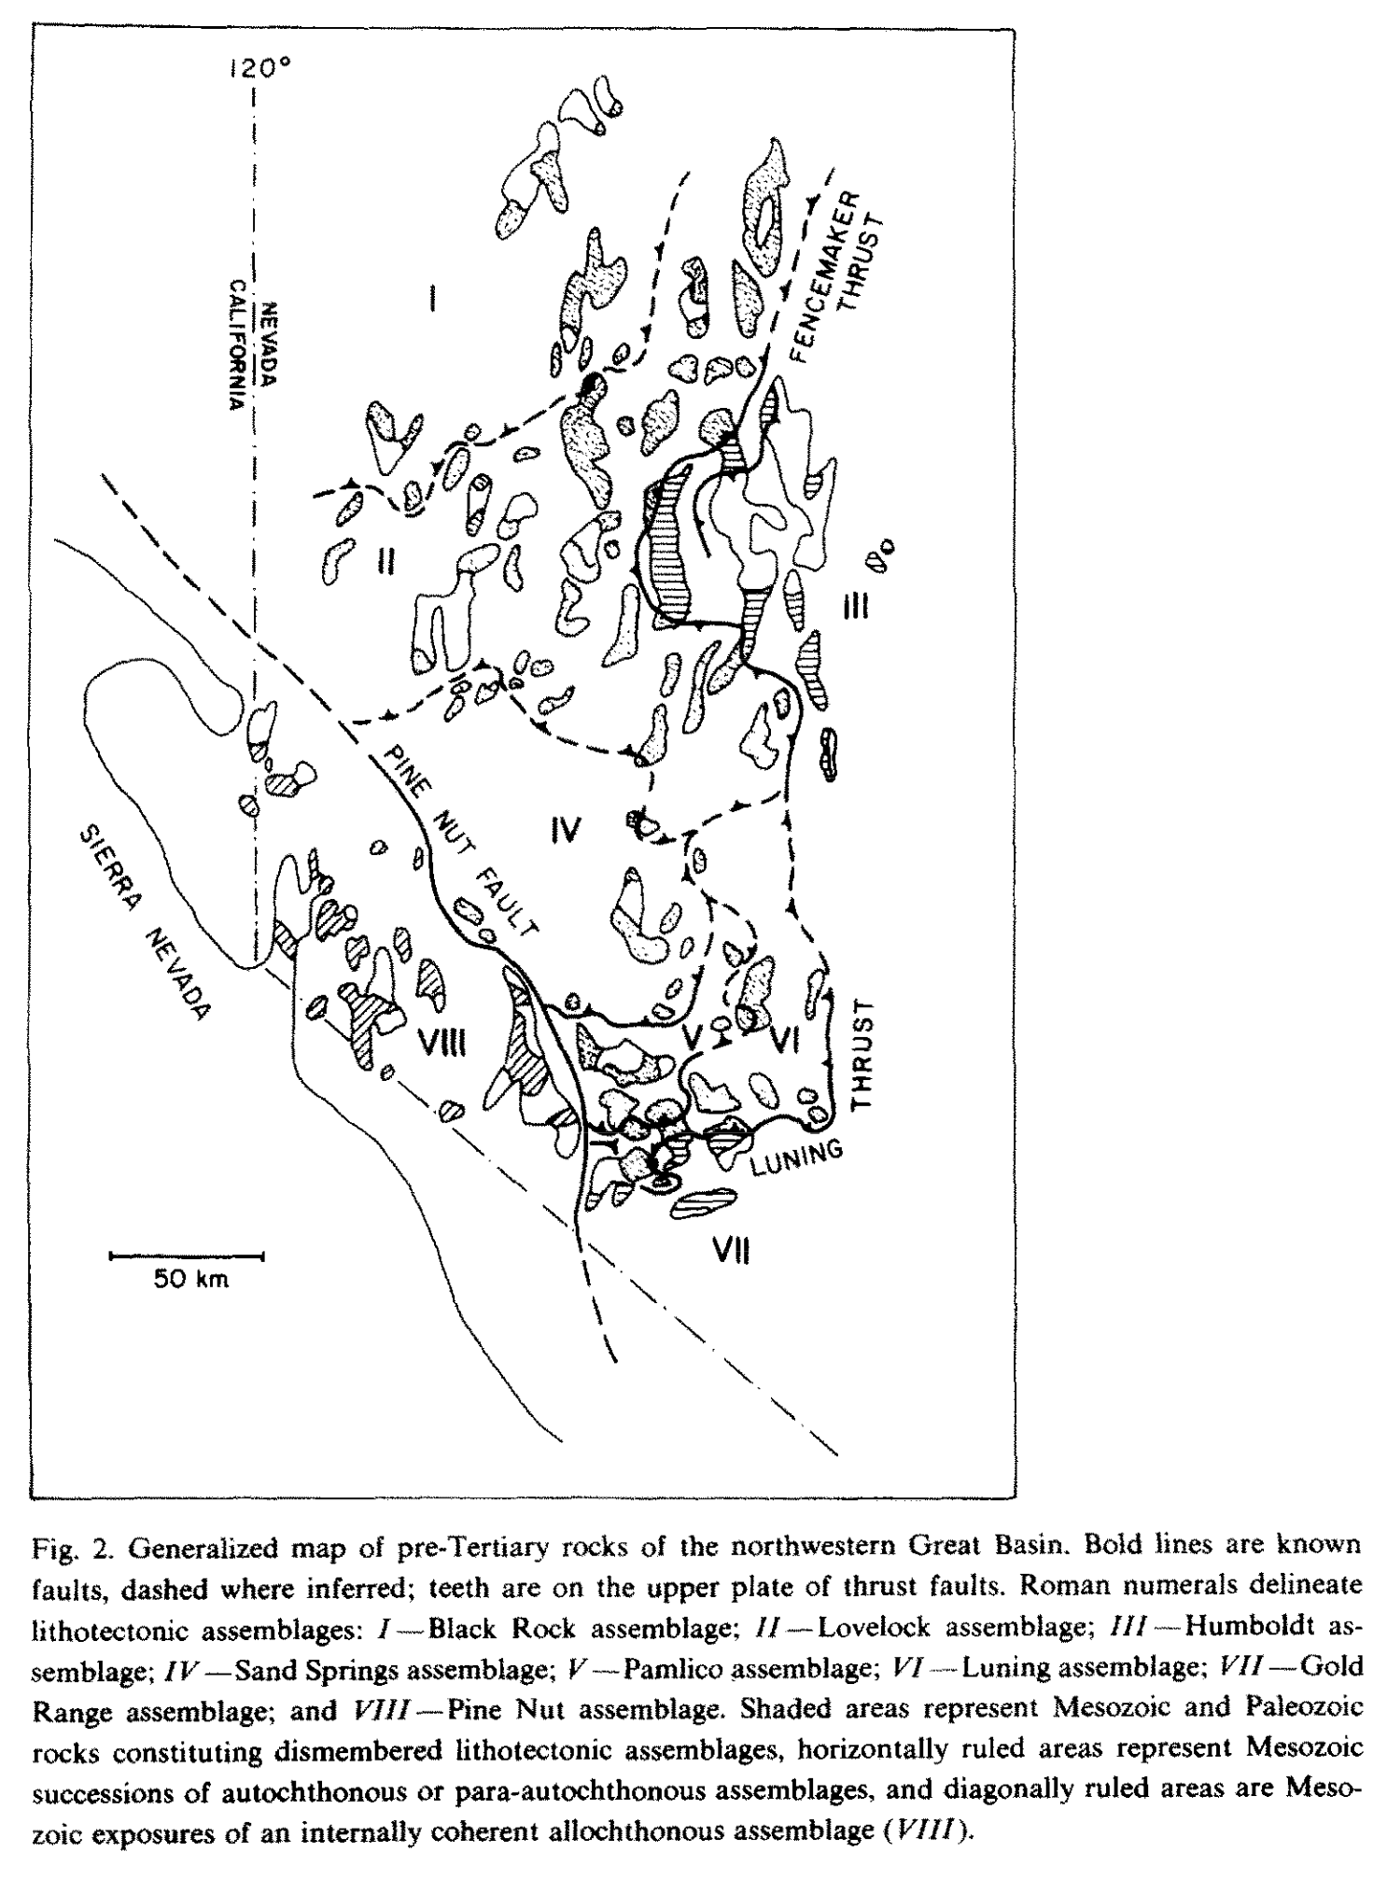
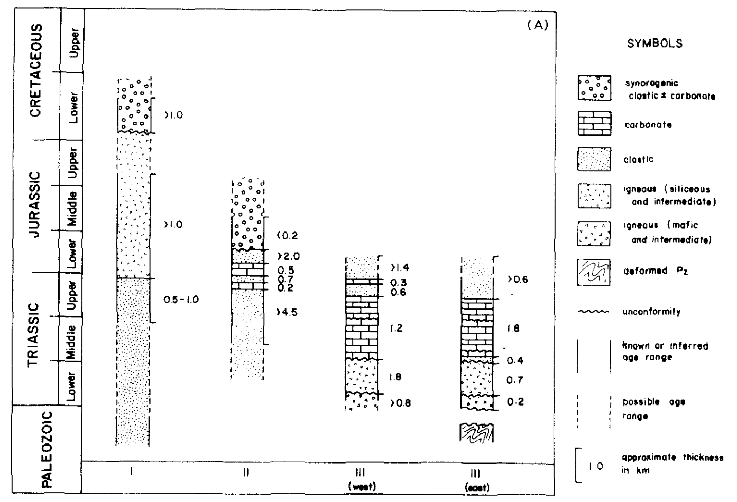
The Rocks
Composed of 8 main assemblages in NW NV

Slide 5
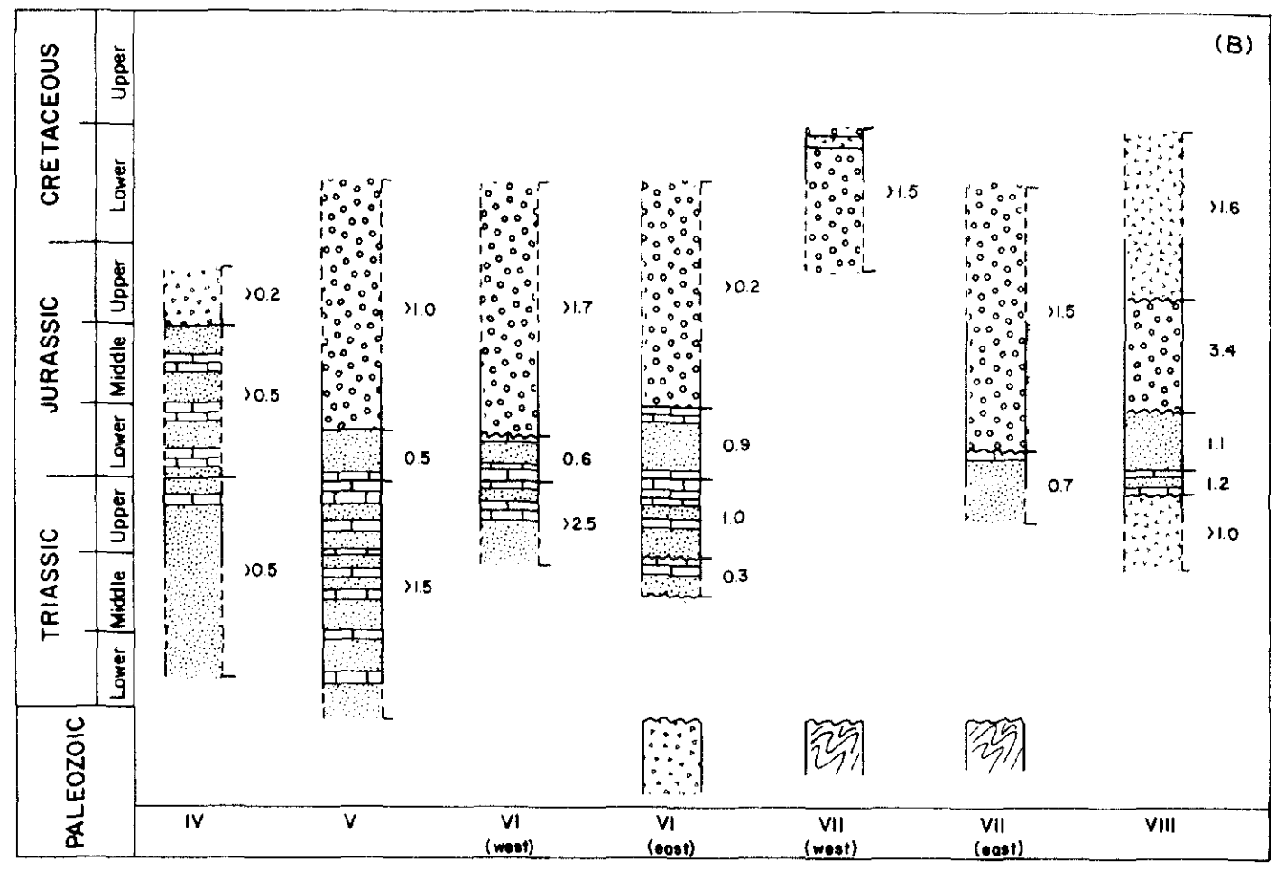
The Rocks, cont.
Composed of 8 main assemblages in NW NV

Slide 6
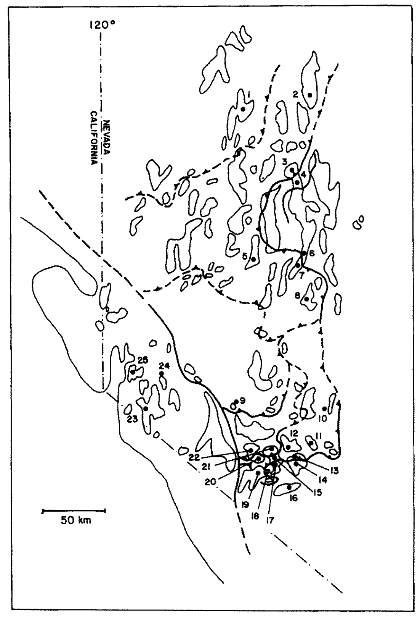
The Folds

Slide 7
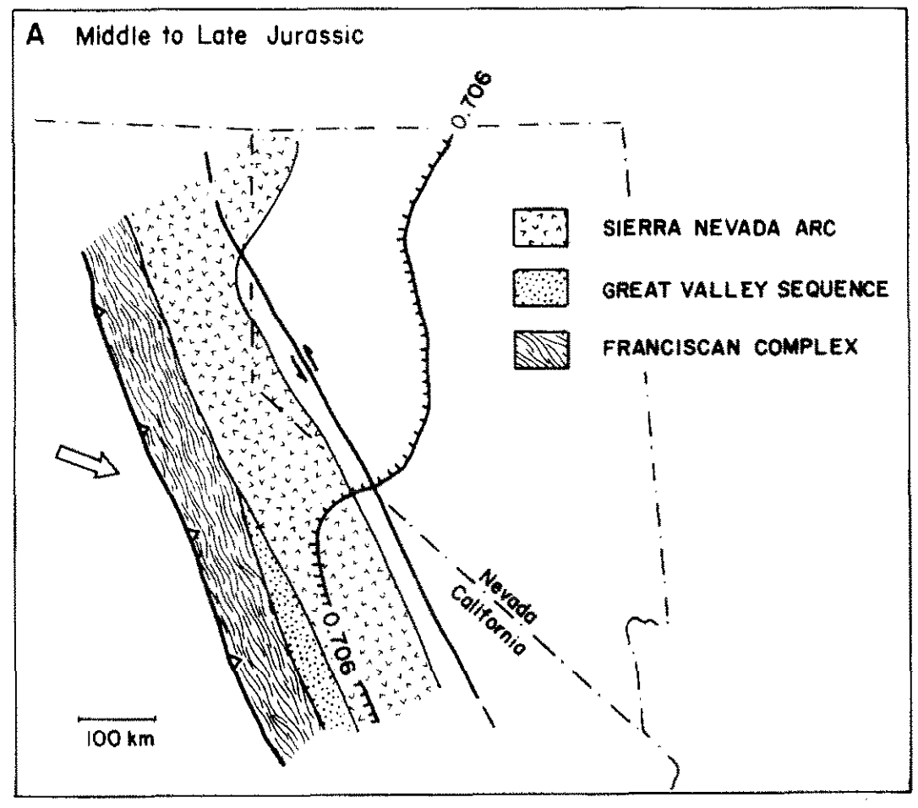
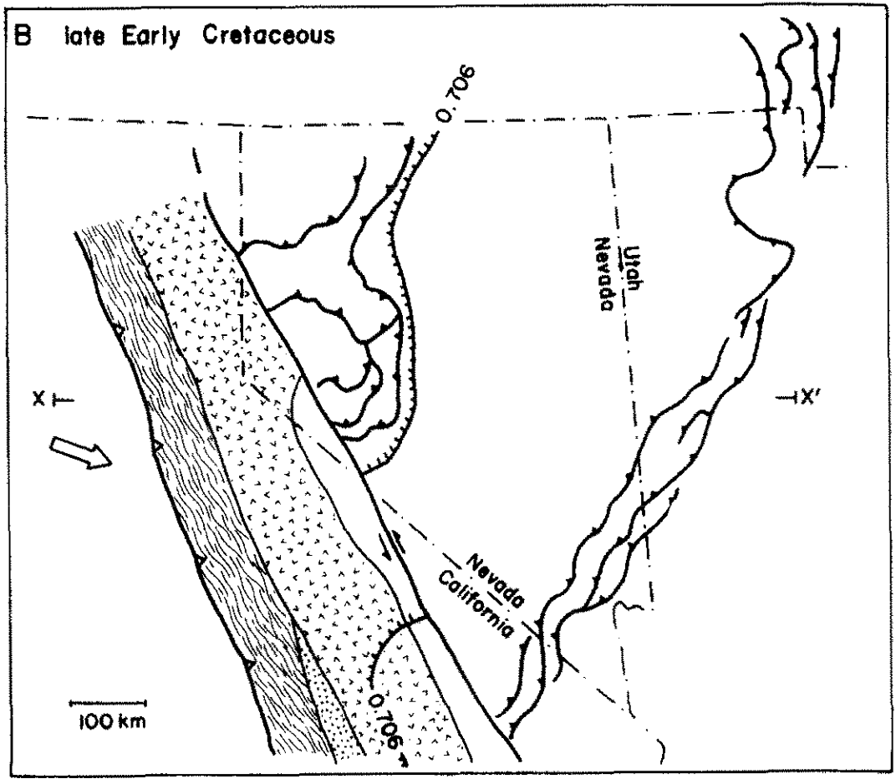
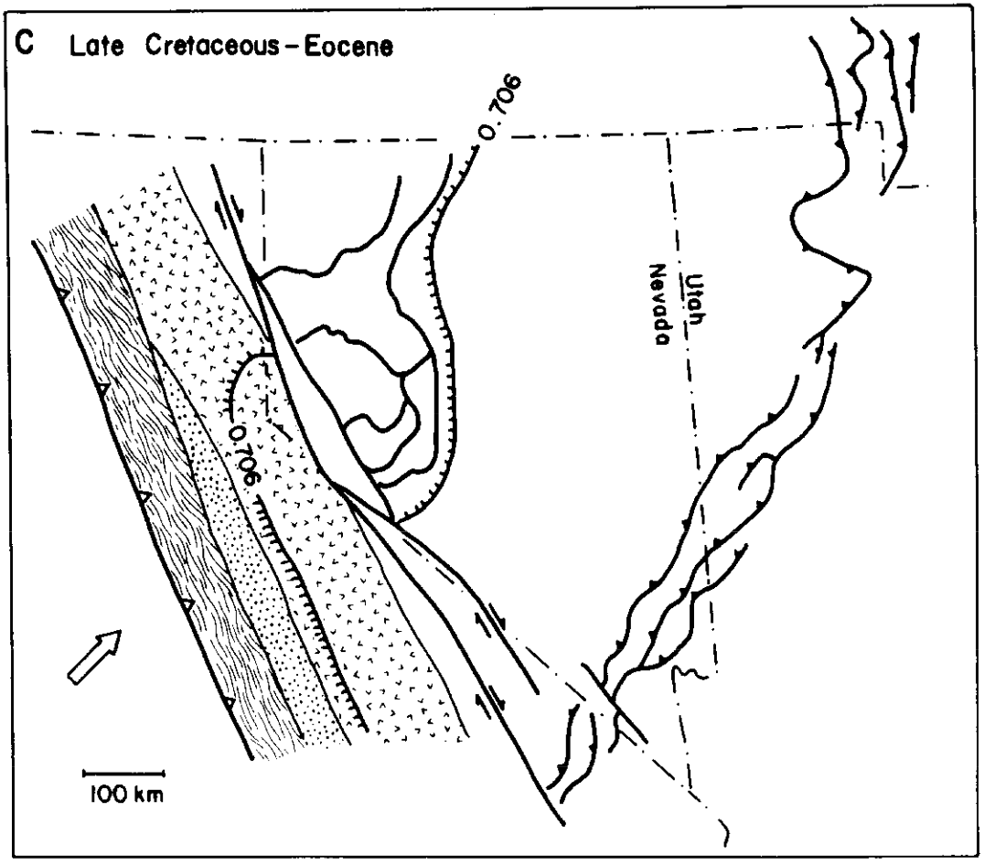
Big Picture
Notes:
1) A regionally extensive back-arc fold and thrust belt developed in a marginal basin associated with the Mesozoic Sierran arc and resulted in major NW-SE shortening and imbrication of lithotectonic assemblages during the Middle or Late Jurassic and Early Cretaceous.
2) Simatic crust (mafic) underlying the northwestern Great Basin profoundly affected Mesozoic deposition and localized development of the Luning-Fencemaker fold and thrust belt.
3) For much of their histories during the late Mesozoic, the Sierran arc and the back-arc region were at least partially decoupled and separated by a regionally extensive strike-slip fault with left-lateral displacement.
4) The partial synchroneity in development of the Luning-Fencemaker and Sevier fold and thrust belts suggests that they are related and may have shared a decollement during part of the late Mesozoic.
5) The shortening axis of the Luning-Fencemaker fold and thrust belt is apparently incompatible with right-oblique plate convergence for the western margin of North America and suggests an interval of left-oblique subduction from the Middle or Late Jurassic through the Early Cretaceous.

