Slide 1
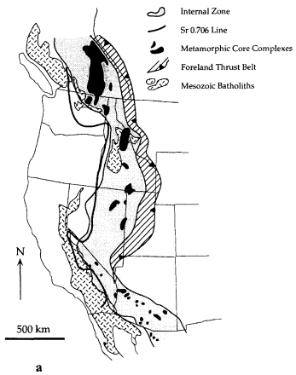
Extension in the Cretaceous Sevier orogen, North American Cordillera
KV Hodges, JD Walker
By Henry
Fold and thrust belt
Coeval extension and compression in the internal zone of Sevier orogen
A model that supports synchronous extension and compression
Foreland
Hinterland
Internal zone:
Bounded by ⁸⁷Sr/⁸⁶Sr 0.706 line on the west and Fold and thrust belt on the east
Internal Zone

Slide 2
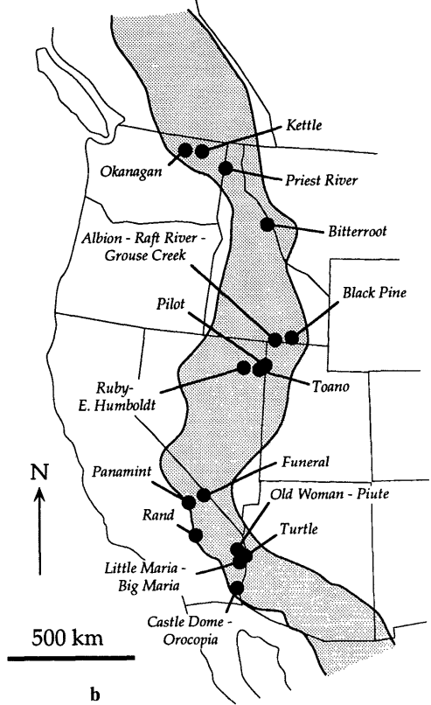
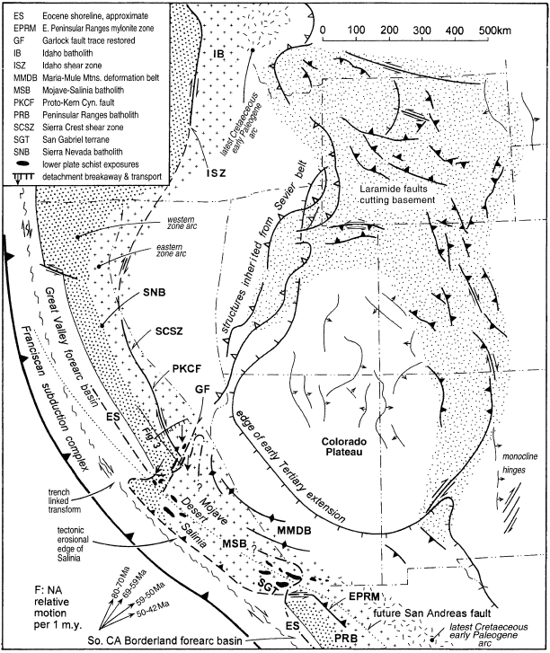
Evidence of extension in the internal zone
Types of evidence:
A fault that places younger rocks on older rocks, omitting stratigraphy.
A fault places low-grade metamorphic rocks on high-grade rocks
Nearly isothermal decompression
Rapid cooling from thermochronology
This provided a good temporal constraint for extension. However, it was considered part of the Laramide orogeny later.
✅
Albion- Raft River- Grouse creek:
Normal faults
⁴⁰Ar/³⁹Ar apparent age, 82-90 Ma
Hypothesis: Extension in the Internal Zone was coeval with shortening in the fold-and-thrust belt.
Is there an existing model to support the coeval extension and compression?
Saleeby, 2003

Slide 3
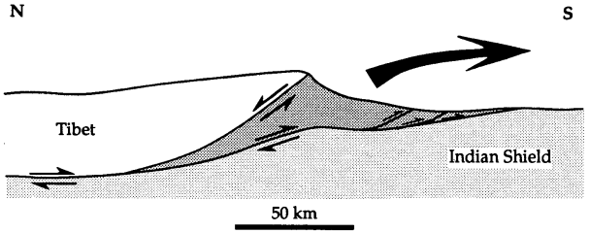
Coeval contraction and extension in the Himalayas
Gravitational collapse
Gravitational collapse should also drive the extension in the internal zone:
Thermobarometric data from several metamorphic core complexes :
>35 km Internal Zone crustal thicknesses.
South Tibet detachment system
Main central thrust
But the Himalayan model can not be directly applied to the internal zone:
For internal zone:
Extension mainly occurs in the middle to lower crust and didn’t penetrate the surface.
The low-angle, regional unconformity beneath mid-Cenozoic strata in the eastern Great Basin indicate no large topographic gradient in many parts of the Internal Zone in Cretaceous time (Armstrong, 1968).

Slide 4
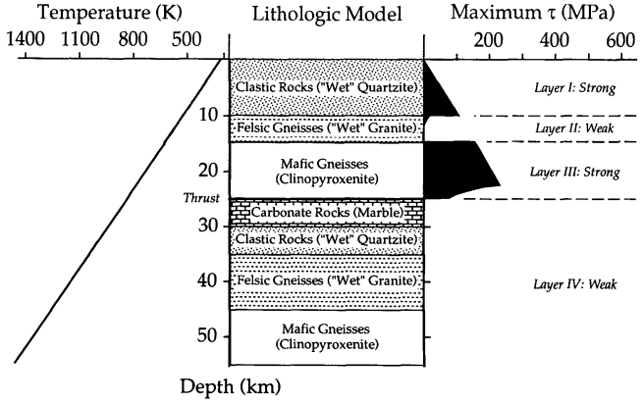
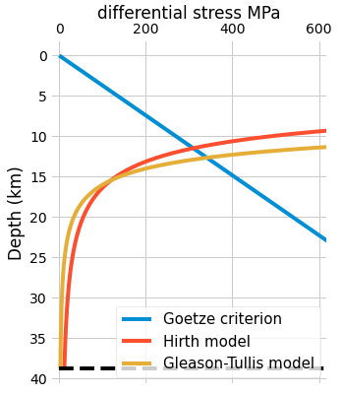
Proposed model: Crustal strength structure
Differential stress; Strength
Potential thrust
Thrust
Potential thrust
Brittle: Differential stress at failure (break the rock)
Ductile/Dislocation creep (strength applied to make the rock deform at a constant strain rate, (define by yourself))
https://github.com/marcoalopez/strength_envelopes/blob/master/notebooks/brittle_faults.ipynb

Slide 5
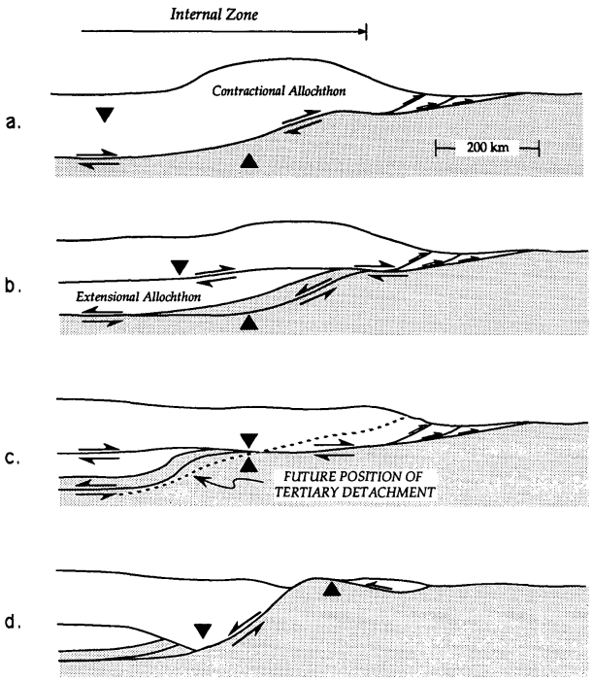
Proposed Model
Generation of thickened crust
Gravitational collapse started
Generation of thickened crust and topographic gradients in Jurassic-Cretaceous time.
Initiation of mid-crustal extensional allochthon in Cretaceous time.
Cretaceous movement of extensional allochthon causes unroofing of parts of the lower crust
Tertiary extension leads to the final exhumation of lower-crustal rocks.
Generation of extensional Allochthon

Slide 6
Summary
Gravitational collapse
Fold and thrust belt
Foreland
Generation of thickened crust
Hinterland
Gravitational collapse
Internal Zone
Sevier
Himalaya
Gravitational collapse start
Conclusions:
The extension signifies gravitational collapse of the Sevier orogen while the overall tectonic setting was still basically convergent.
Extension in a convergent setting requires decoupling within the lithosphere

