Slide 1
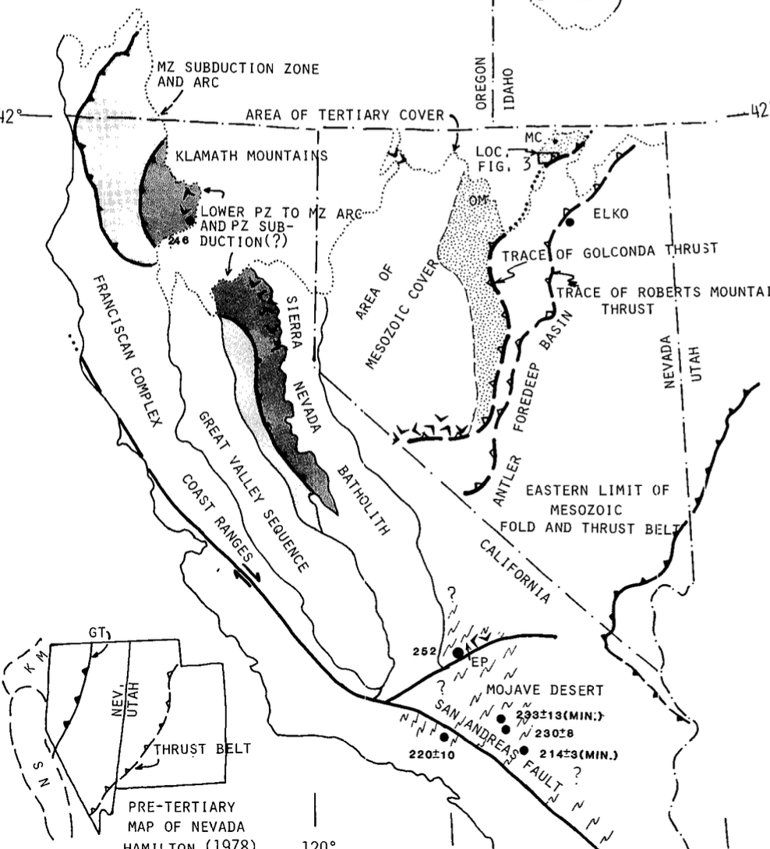
Insight into the continental margin during the Antler and Sonoma orogenies
1991
Did the margin grow successively oceanward by the collision of island arcs?
Was western North America an active margin throughout the Paleozoic (541-251)?
with a system of southwest Pacific-style island arcs and small oceanic basins accreting during episodes of increased plate convergence?

Slide 2
Insight into the continental margin during the Antler and Sonoma orogenies
Detailed radiolarian biostratigraphy in the Independence Mountains.
Determined that were short-lived, episodic crustal shortening along the continental margin and longer periods of extension or transcurrent tectonics.

Slide 3
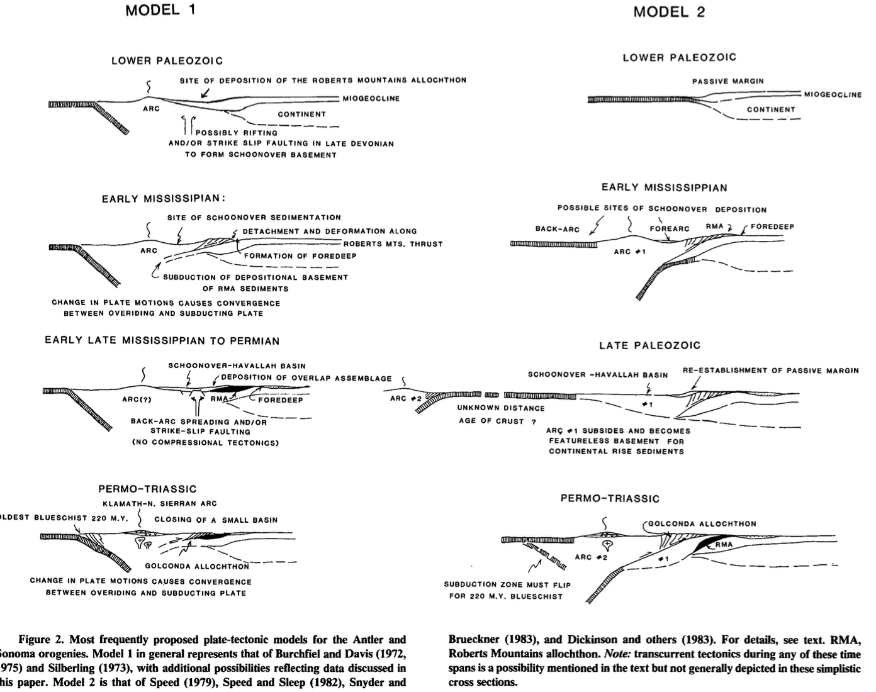
The Model
Model 1: BACK ARC BASIN Allochthons represent strata deposited between the North American continent and a west-facing island-arc system and were emplaced by thrusting during back-arc basin closure. Represent deposition in a smaller basin
In order to discriminate between these or other models, we need to know the exact ages, paleogeography, depositional history, and structure
Model 2: ACCRETIONARY PRISM
Allochthons represent the continentward toes of large accretionary prisms developed in front of further-traveled, east-facing arcs that collided with the continent. We would expect to see seafloor seds + north american continent seds +

Slide 4
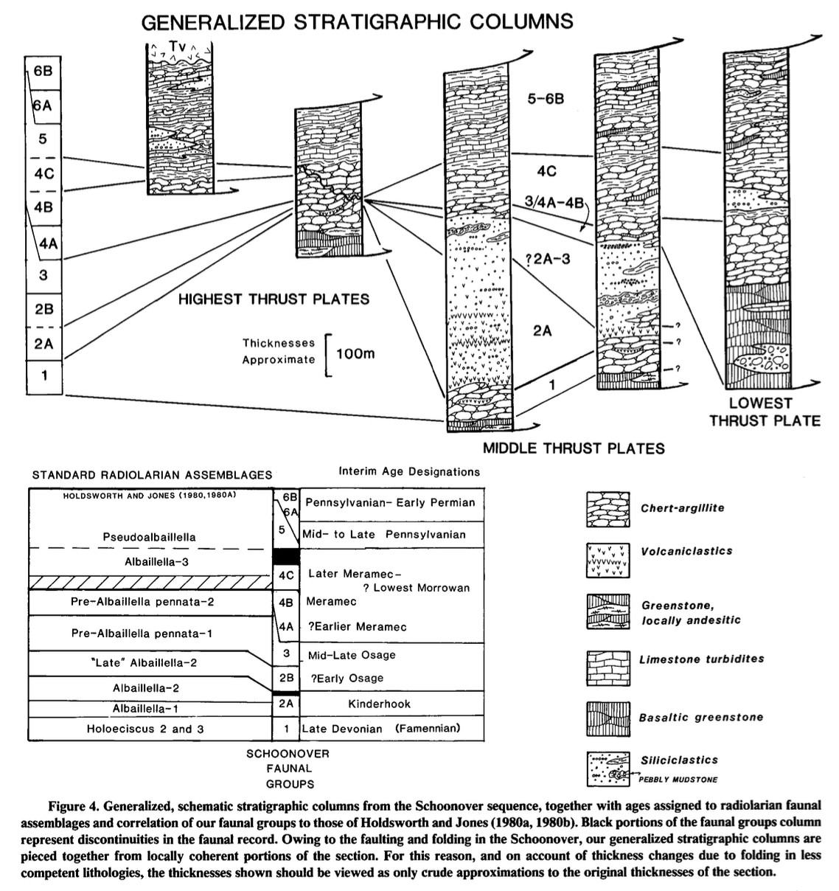
Stratigraphy

Slide 5
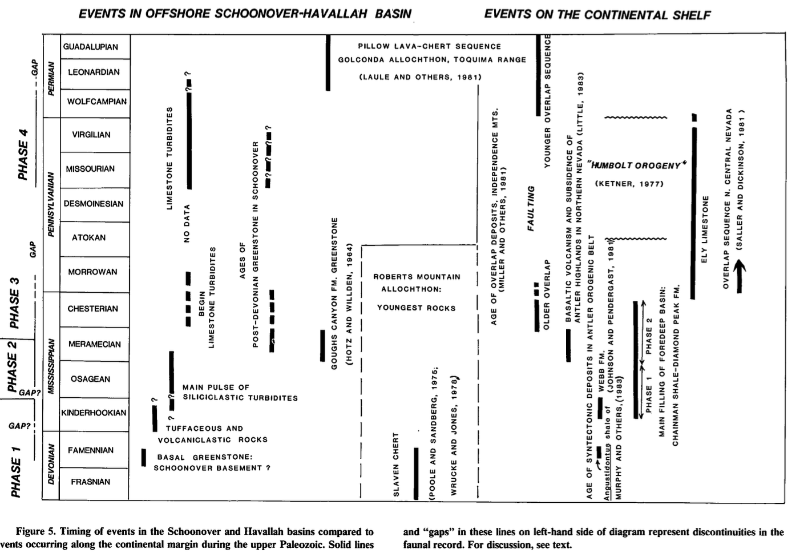
Phases
259
Phase 1: Late Devonian rifting and volcanic activity
Basalt and andesite
Indicative of rift origin of the basin
Manganiferous Chert with minimal volcanic detritus
Kinderhookian volcaniclastic detritus
Interpreted to be proximal to an island arc
Phase 2: Turbidite sedimentation
Coarse clastic turbidite w/ reduction in volcaniclastic input
Some thrust sheets do not have Mississippian seds
298
323
358
382

Slide 6
Phases
Phase 3: Meramecian basalt and limestone
Basalt volcanism
Abrupt waning in turbidite deposition
Mature sandstones
Significant detrital carbonate
Phase 4: Early Pennsylvanian limestone carbonate shelf environment
Increased carbonate detritus
thin Devonian-Early Mississippian pelagic section is overlain by a thick sequence of Pennsylvanian-Permian limestone turbidites
Interpreted as from a continental slope-rise environment
259
298
323
358
382

Slide 7
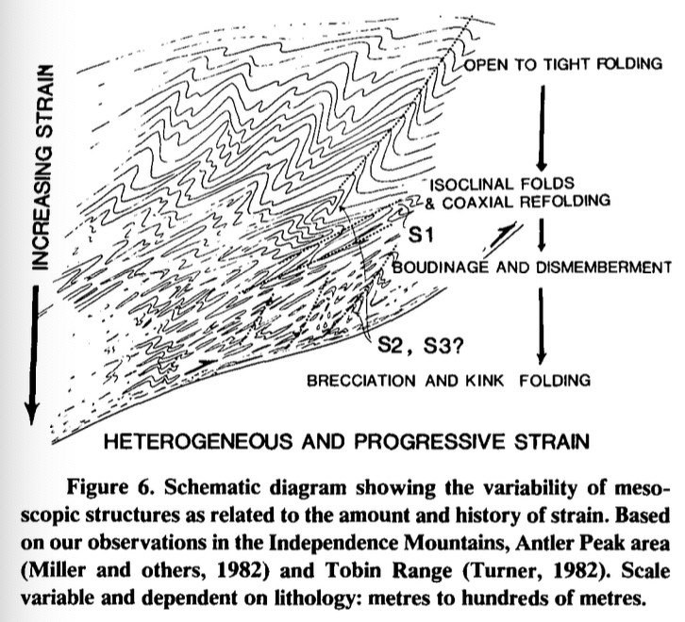
Structure
Structurally simple indicating back-arc basin NOT accretionary prism.
Shoovner sequence consists of thin, repeated thrust plates
Tight isoclinal folds due to NW-SE shortening
Asymmetrical folds evidence of SE-directed thrusting
Low temp and pressure
Aligned with larger-scale observation from the Golconda allochthon

Slide 8
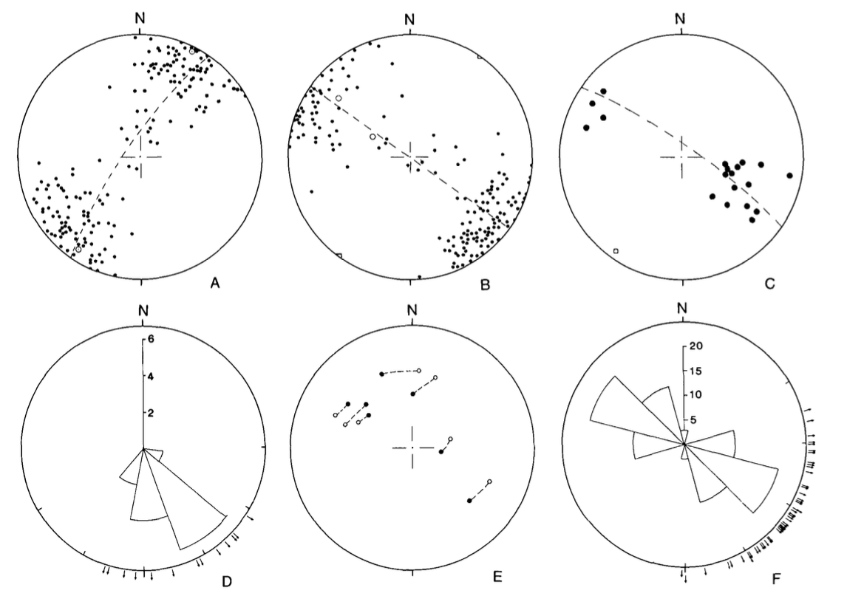
Structure
A: Fold Axes Trend: The majority of fold axes in the Schoonover sequence trend NE-SW, plunging shallowly to the NE and SW.
B: Axial Plane Orientation: Axial planes dip steeply (60°–90°) to the NW or SE, forming a weak girdle distribution parallel to fold axes.
C/D: Fault Planes: Most fault planes also trend NE-SW, aligning with fold axes. This configuration supports the NW-SE shortening inferred for the region.
E: Slip Directions: Calculated slip vectors show a consistent SE thrusting direction indicating uniform tectonic movement across thrust faults and folds.
Notes:
Most of these folds trend northeast-southwest, and they plunge gently in both directions. This means they’re oriented in line with the main direction of tectonic compression in the area
The fault planes here also trend NE-SW, similar to the folds, which shows that the thrusting direction is closely related to the folding. the calculated slip directions on these faults show movement to the southeast
So, what does all this mean?
These orientations of folds and faults, plus the consistent SE-directed slip, support the idea that this area experienced NW-SE-directed compression.
This pattern of structural deformation aligns well with the back-arc basin model. Instead of a chaotic, mixed-up accretionary prism, we’re looking at a more straightforward thrust and fold setup

Slide 9
Conclusion
The Schoonover sequence from the Late Devonian (382 - 358 Ma) to Early Permian (298Ma) in Northern Nevada.
Its formation is associated with a back-arc basin setting near a west-facing island arc.
Compressional regime NE-SW
Structural simplicity supports the back-arc basin model.

